Slide 1



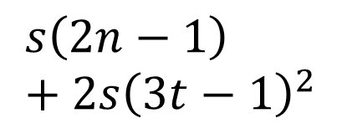


$$2n−1$$
$$3t−1$$
$$s$$
$$s\left(2n−1\right)+2s{\left(3t−1\right)}^{2}$$
$$2s(3t−1)$$
$$3t−1$$

Slide 2
$$2n−1$$
$$3t−1$$
$$s$$
$$s\left(2n−1\right)+2s{\left(3t−1\right)}^{2}$$
$$2s(3t−1)$$
$$3t−1$$

