Slide 1

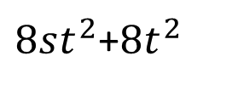






$$2t$$
$8st^{2}$+$8t^{2}$
$$2t$$
$$2t$$
$$4nt−2t$$
$$4st^{2}+4t^{2}−4nt$$
$$4t^{2}−2t$$
$$4st^{2}$$

Slide 2
$$2t$$
$8st^{2}$+$8t^{2}$
$$2t$$
$$2t$$
$$4nt−2t$$
$$4st^{2}+4t^{2}−4nt$$
$$4t^{2}−2t$$
$$4st^{2}$$

Slide 3
$$2t$$
$8st^{2}$+$8t^{2}$
$$2t$$
$$2t$$
$$4nt−2t$$
$$4st^{2}+4t^{2}−4nt$$
$$4t^{2}−2t$$
$$4st^{2}$$

