Slide 1
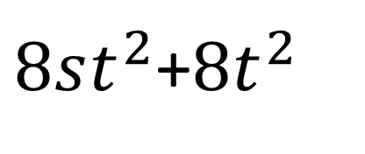
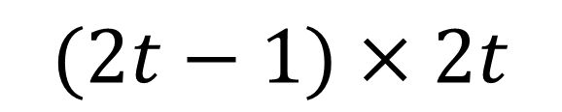
$8st^{2}$+$8t^{2}$
$$(2t−1)×2t$$

Slide 2
$8st^{2}$+$8t^{2}$
$$(2t−1)×2t$$

