Slide 1
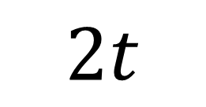
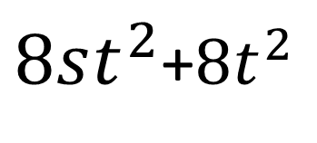
$$2t$$
$8st^{2}$+$8t^{2}$

