Slide 1

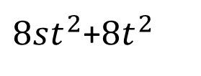






$$2t$$
$8st^{2}$+$8t^{2}$
$$2t$$
$$1$$
$$2n−1$$
$$2st+2t−2n$$
$$2t−1$$
$$2st$$

