Slide 1


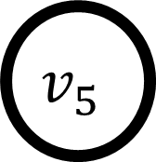
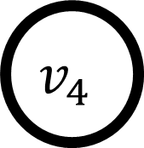

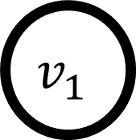
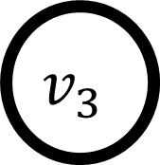

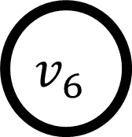

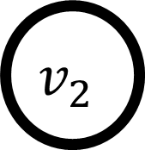

$$v_{1}$$
$$v_{5}$$
$$e_{2}$$
$$e_{4}$$
$$e_{1}$$
$$e_{6}$$
$$v_{2}$$
$$v_{3}$$
$$v_{6}$$
$$e_{3}$$
$$e_{5}$$
$$v_{4}$$

