Slide 1
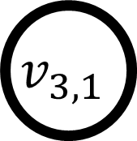
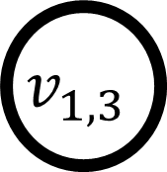
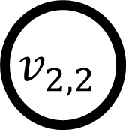
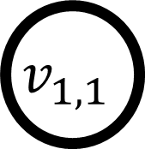
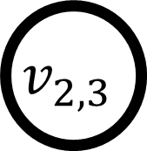
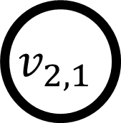
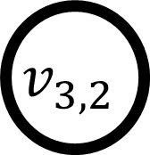
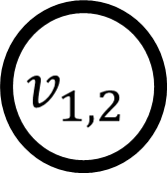

$$v_{1,1}$$
$$v_{1,2}$$
$$v_{1,3}$$
$$v_{2,1}$$
$$v_{2,2}$$
$$v_{2,3}$$
$$v_{3,1}$$
$$v_{3,2}$$
$$v_{3,3}$$
(a)
(b)

