Slide 1
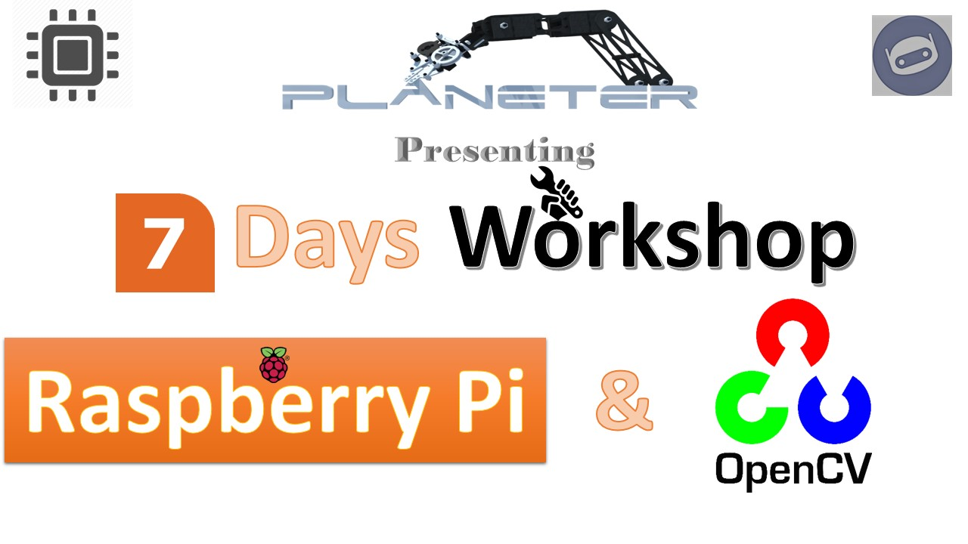
Internet of Things (IoT)

Slide 2
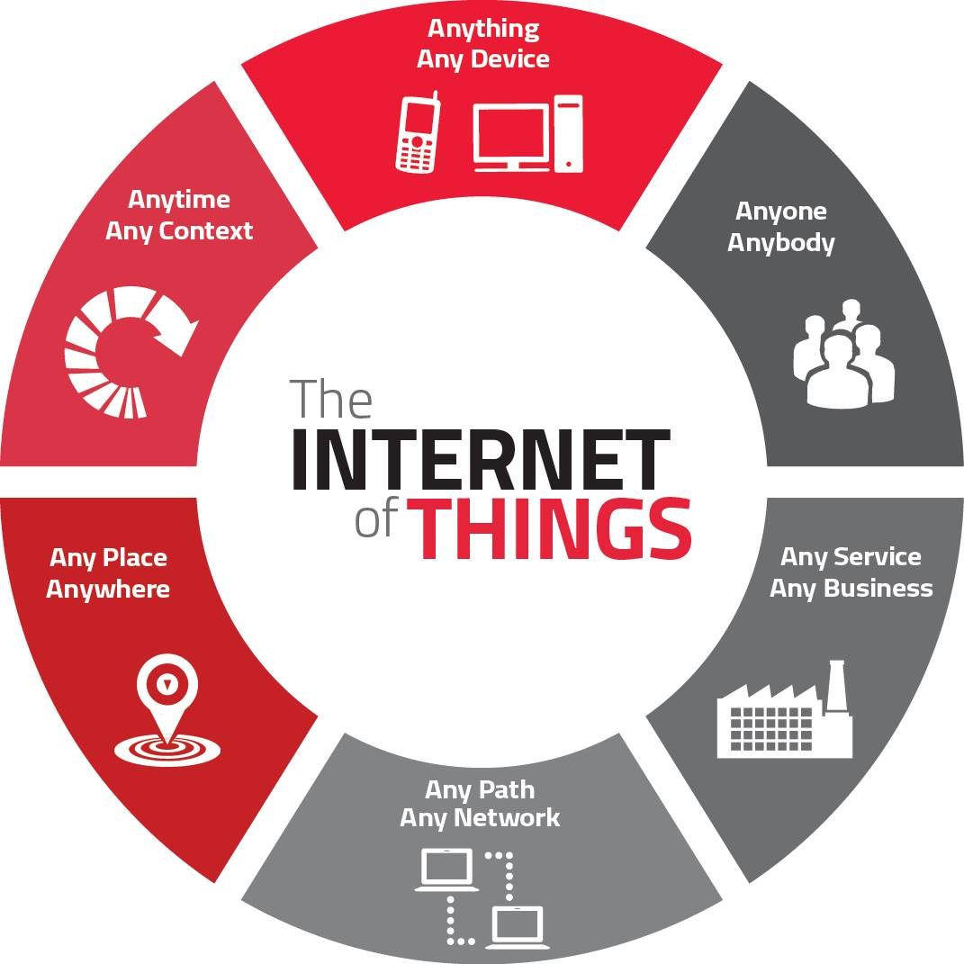
What is IoT?
Internet of Things (IoT) describes an emerging trend where a large number of embedded devices (things) are connected to the Internet.

Slide 3
Raspberry Pi Communications
Ethernet
WiFi
Blutooth

Slide 4
Cloud Server ThingSpeak
The open IoT platform with MATLAB analytics.
ThingSpeak is an IoT analytics platform service that allows you to aggregate, visualize and analyze live data streams in the cloud.

Slide 5
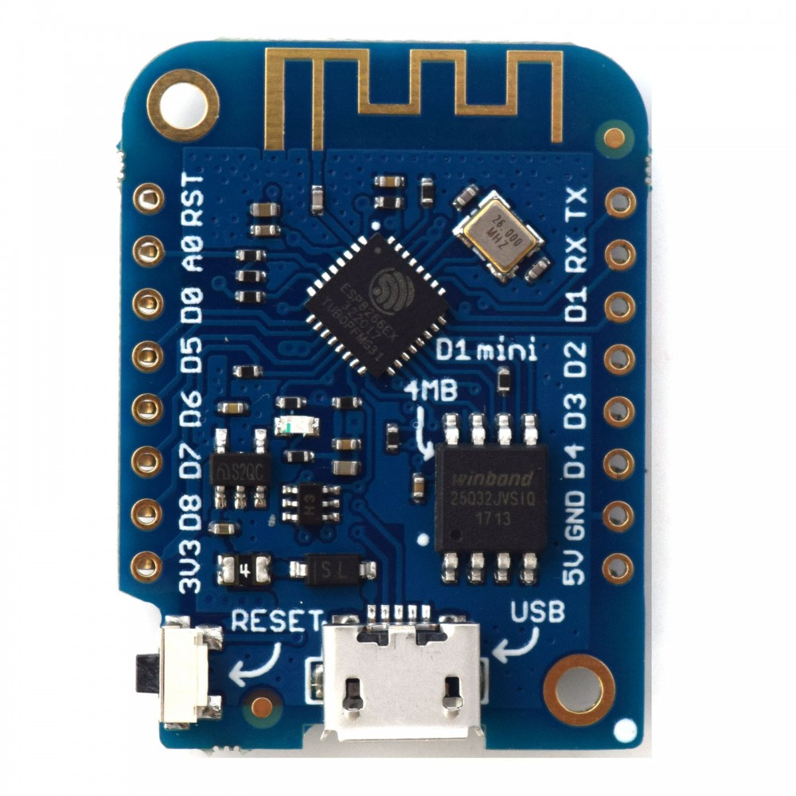
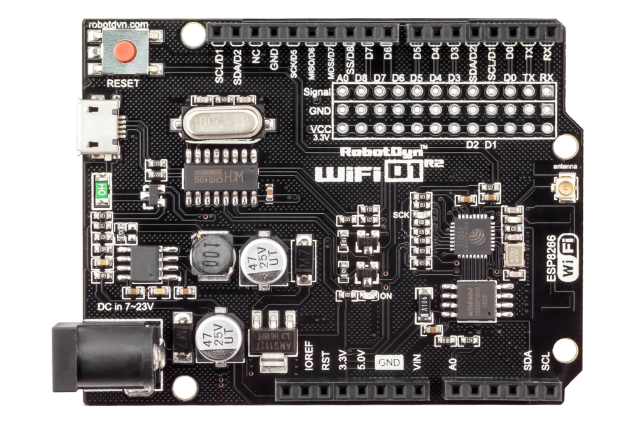
WeMos D1

