Slide 1
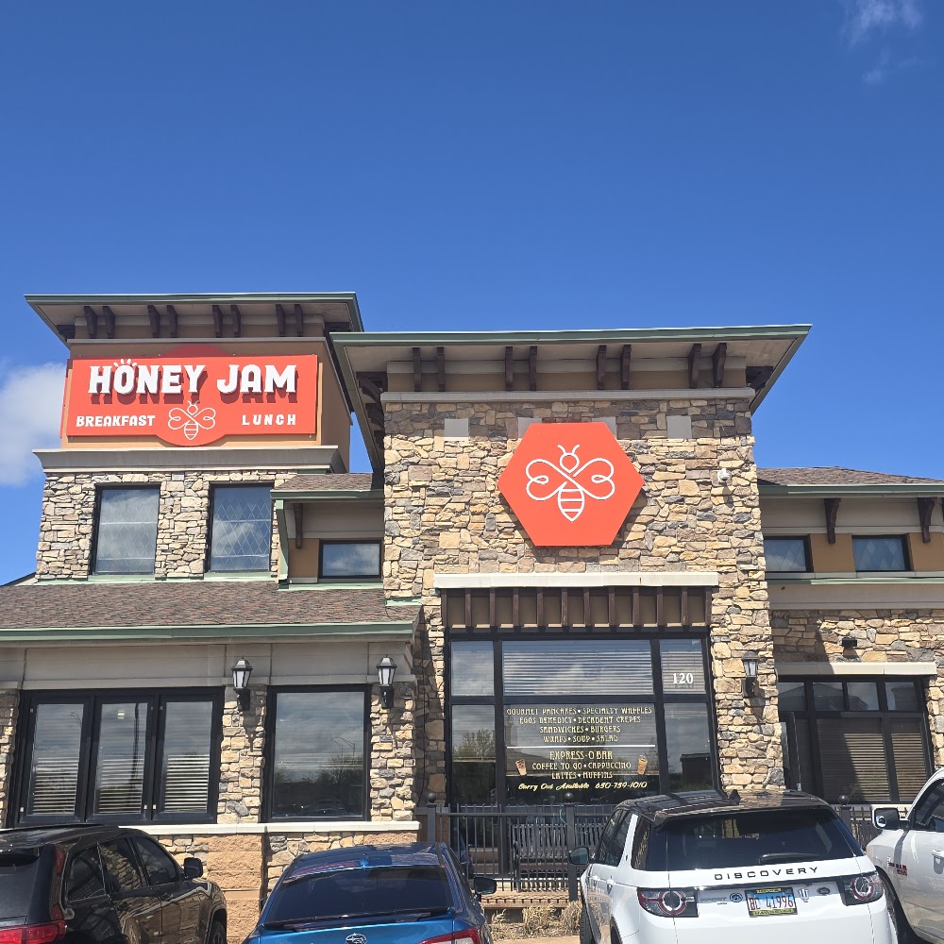
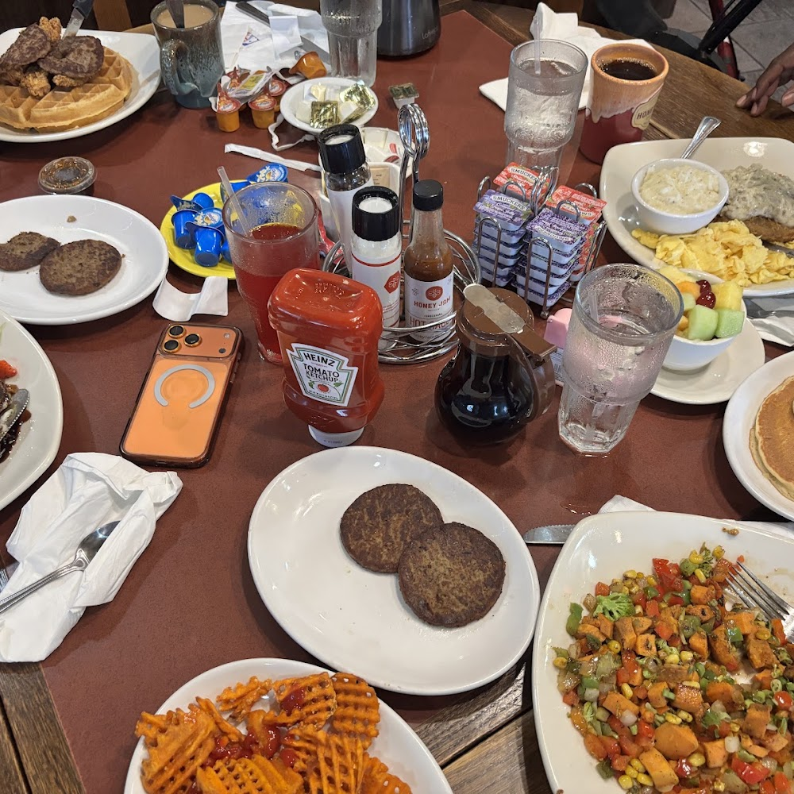
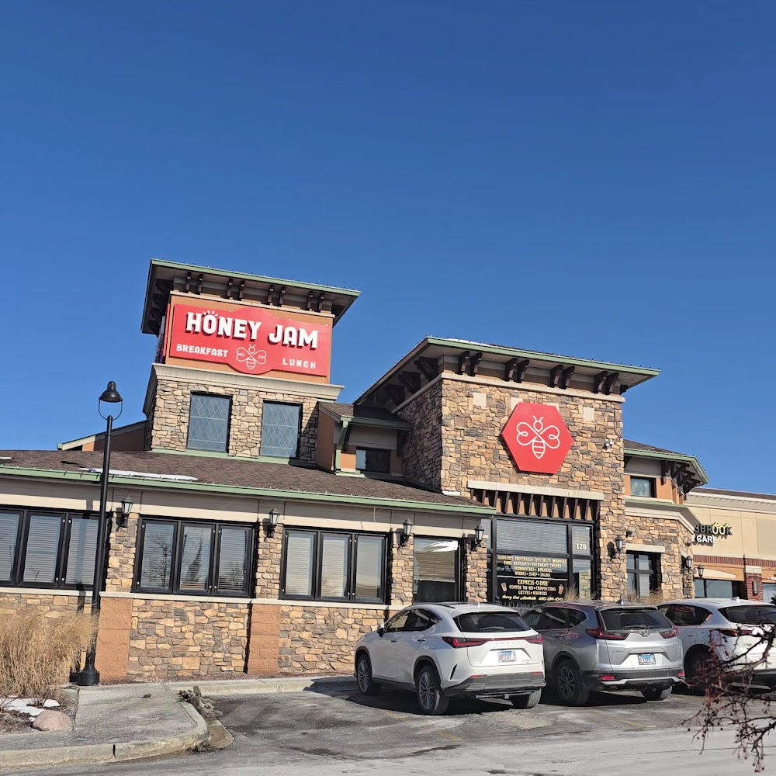
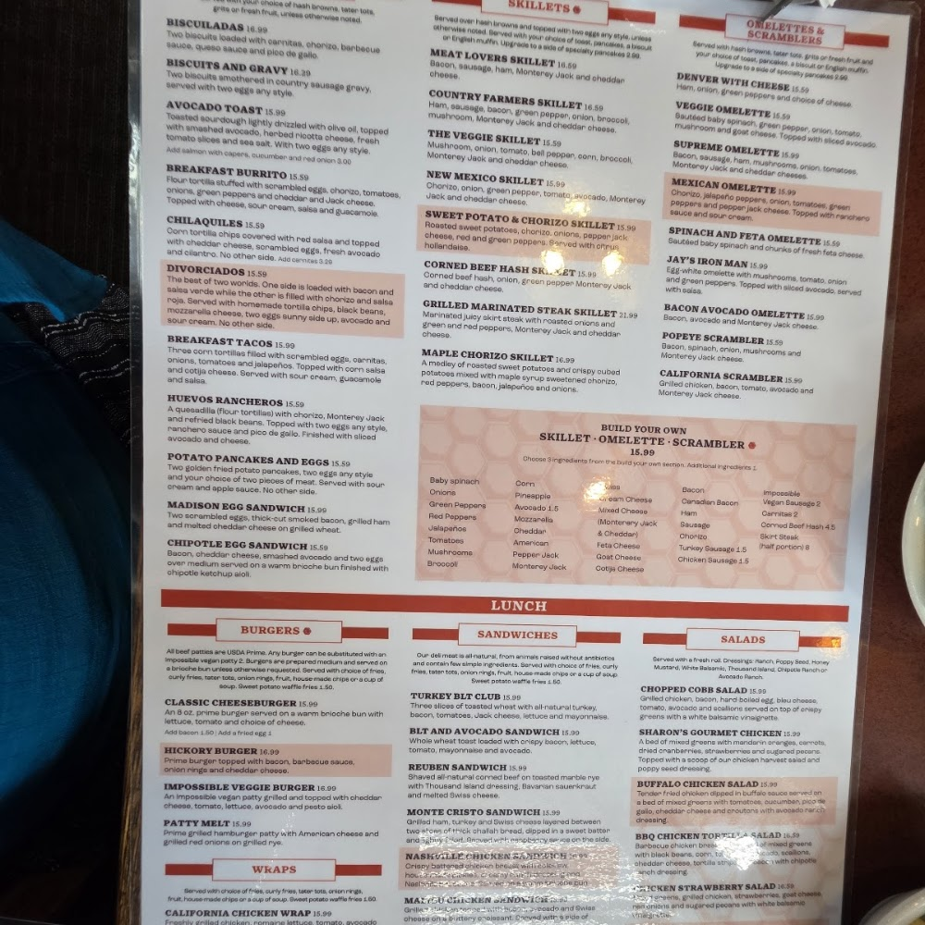
Honey-Jam Cafe Bolingbrook
120 E Boughton Rd, Bolingbrook, IL 60440 · Breakfast restaurant, Brunch restaurant · ★ 4.2 (1,517 reviews)
AMW - ILLINOIS · 4 concepts
Goal
Create a signature dish program
In this deck
1. Sweet & Savory Croissant Stack
2. The Morning Harvest Lobster Skillet
3. Golden Hour Lobster Melt
4. The Coastal Benedict Square
Prepared by Bob Janz
Bob.Janz@affinitysales.com · 224-410-2030
August 21, 2026
Powered by Affinity NXT

Slide 2
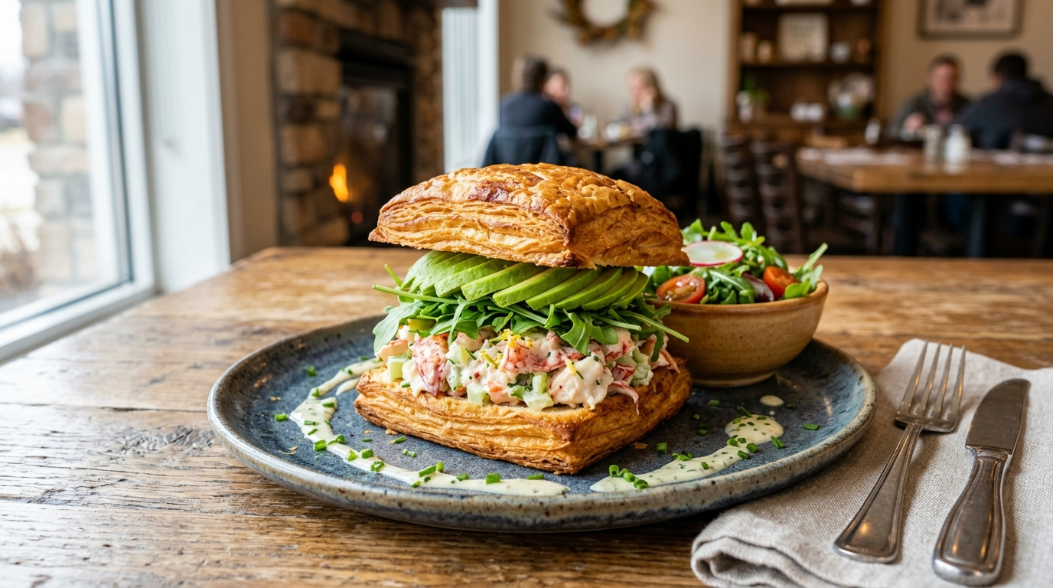
Concept 1 of 4
Sweet & Savory Croissant Stack
This concept plays with the versatility of the square croissant, offering a unique texture profile that bridges the gap between breakfast and lunch. It is a visually stunning dish that showcases our commitment to creative, elevated comfort food.
Featured products
• SQUARE SANDWICH CROISSANT, SLICED — BAKER BOY® · SKU 32650
• LOBSTER SENSATIONS — KING & PRINCE · SKU 004610
Powered by Affinity NXT

Slide 3
Concept 1 of 4 · Execution
Sweet & Savory Croissant Stack — Execution
Menu description
Our signature square croissant, lightly toasted to golden perfection and stacked high with a generous portion of premium chilled Lobster Sensations. We layer in fresh, creamy avocado, crisp peppery arugula, and a touch of house-made lemon-zest mayo for a sophisticated twist on the classic lobster roll. It’s the ultimate elevated comfort lunch, perfectly bridging the gap between brunch and afternoon cravings.
Pricing
Position at $16.50–$18.50. This price point maintains the Honey-Jam value proposition while reflecting the premium perception of lobster, ensuring a healthy margin given the efficiency of the ready-to-use ingredients.
Plating
Serve on a rectangular ceramic plate to mirror the square shape of the croissant. Place the stack slightly off-center, with a small handful of dressed arugula tossed in lemon vinaigrette tucked beside it to add height and color. Dust the plate with a light crack of fresh black pepper for a professional finish.
Prep
Thaw square croissants in a cool, dry place. Slice horizontally if needed. In a mixing bowl, fold Lobster Sensations with lemon-infused mayonnaise and cracked black pepper. To assemble: lightly toast the croissant halves on a flat-top grill, spread a thin layer of avocado on the base, top with a generous scoop of the lobster mixture, add a nest of arugula, and crown with the croissant top.
Portion
One square croissant (approx. 3.5oz) filled with 4oz of prepared lobster salad, 1/4 sliced avocado, and a 0.5oz garnish of arugula.
Powered by Affinity NXT

Slide 4
Concept 1 of 4 · Execution (continued)
Sweet & Savory Croissant Stack — Execution (cont.)
Prep time
5 minutes per order; 15 minutes of bulk prep time for the lobster salad mix.
Equipment
Flat-top grill or toaster for the croissant, mixing bowls, portion scoops for consistency, serrated bread knife, and chilled storage containers.
Pairings
Pairs excellently with a side of house-made kettle chips or a light cucumber salad. For beverages, suggest a crisp glass of Sauvignon Blanc or a sparkling lemon-basil iced tea.
Menu position
entree
Powered by Affinity NXT

Slide 5
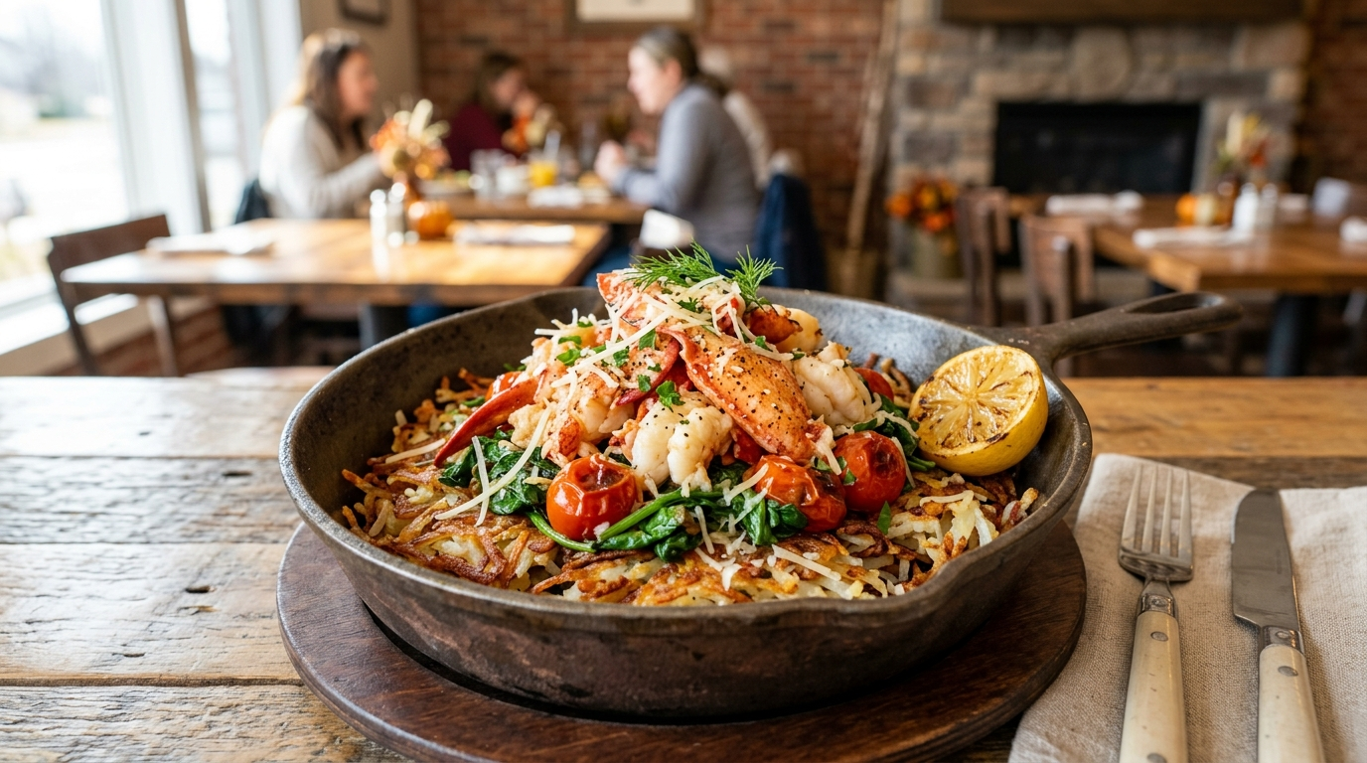
Concept 2 of 4
The Morning Harvest Lobster Skillet
We’ve taken our famous cast-iron skillet concept and infused it with the elegance of fresh lobster. This dish is designed to be a centerpiece, offering a hearty and abundant portion that satisfies the most discerning brunch enthusiasts.
Featured products
• SQUARE SANDWICH CROISSANT, SLICED — BAKER BOY® · SKU 32650
• LOBSTER SENSATIONS — KING & PRINCE · SKU 004610
Powered by Affinity NXT

Slide 6
Concept 2 of 4 · Execution
The Morning Harvest Lobster Skillet — Execution
Menu description
Elevate your brunch with the Morning Harvest Lobster Skillet—a decadent, cast-iron masterpiece featuring tender North Atlantic Lobster Sensations, crispy golden hash browns, fresh baby spinach, and vine-ripened tomatoes. Sautéed in aromatic garlic butter and finished with a generous dusting of melted parmesan, this hearty skillet is served with a side of our signature buttery, flaky square croissant for the ultimate comfort food experience.
Pricing
Position as a premium 'Chef's Special' item. Given the $10–20 average menu price, this should be priced at the top end of the spectrum, approximately $18.99–$19.99, to account for lobster food costs while maintaining perceived value.
Plating
Serve in a pre-heated 8-inch cast-iron skillet set atop a branded wooden underliner or a folded linen napkin to protect the tabletop. Garnish with a fresh sprig of parsley or chives for color contrast. Serve the square croissant on a small side plate or tucked alongside the skillet handle.
Prep
Pre-cook hash browns to a golden crisp. In a hot skillet, melt garlic butter and sauté spinach and tomatoes until just wilted. Fold in Lobster Sensations and hash browns, tossing gently to incorporate flavors without breaking up the lobster chunks. Top with parmesan and place under a broiler for 60 seconds to melt the cheese. Thaw croissant and lightly toast before serving.
Portion
Standard 8-inch cast-iron skillet serving;
Powered by Affinity NXT

Slide 7
Concept 2 of 4 · Execution (continued)
The Morning Harvest Lobster Skillet — Execution (cont.)
Portion (cont.)
4 oz Lobster Sensations blend, 6 oz seasoned hash browns, 1 cup fresh spinach, 2 oz cherry tomatoes, 1 square croissant.
Prep time
Total prep and cook time: 8–10 minutes per order.
Equipment
8-inch cast-iron skillets, flat-top griddle (for hash browns), salamander or broiler (for finishing), wooden underliners, standard kitchen prep tools.
Pairings
Pairs excellently with a chilled glass of Prosecco, a crisp Mimosa, or a bright, acidic house-made lemonade to balance the richness of the garlic butter.
Menu position
entree
Powered by Affinity NXT

Slide 8
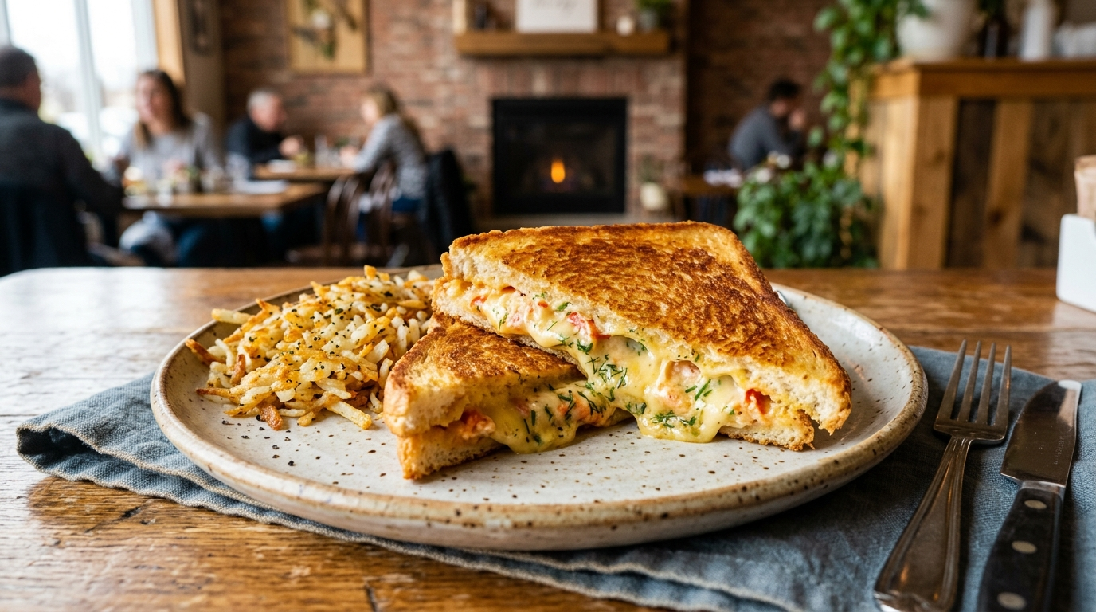
Concept 3 of 4
Golden Hour Lobster Melt
This sophisticated take on a grilled cheese transforms lunch into a gourmet affair using our signature square croissant. It highlights the premium quality of our seafood blend while maintaining the comforting, high-value appeal that our Bolingbrook regulars love.
Featured products
• SQUARE SANDWICH CROISSANT, SLICED — BAKER BOY® · SKU 32650
• LOBSTER SENSATIONS — KING & PRINCE · SKU 004610
Powered by Affinity NXT

Slide 9
Concept 3 of 4 · Execution
Golden Hour Lobster Melt — Execution
Menu description
Elevate your lunch with the Golden Hour Lobster Melt. We take our signature buttery, flaky square croissant and griddle it to golden perfection, stuffing it with a decadent blend of North Atlantic lobster and premium surimi, melted havarti cheese, and a hint of fresh herbs. Served alongside our signature crispy hash browns, it’s the ultimate gourmet comfort classic.
Pricing
Recommended price point of $17.95–$18.95 to maintain a strong perceived value while protecting margins on premium lobster ingredients.
Plating
Serve on a rectangular ceramic platter or a rustic wooden board. Place the lobster melt on one side, cut diagonally to show the cheese pull and lobster texture. Arrange a generous portion of crispy hash browns in a small cast-iron ramekin or neatly piled alongside to maintain the Honey-Jam Cafe aesthetic.
Prep
1. Thaw square croissants. 2. Prepare lobster sensation mix with fresh herbs (chives/dill) and a light touch of aioli. 3. Butter the cut sides of the croissant. 4. Build the sandwich with a generous scoop of lobster blend and two slices of havarti. 5. Grill on a flat-top or buttered cast-iron skillet until the croissant is golden brown and cheese is fully melted.
Portion
1 square croissant (approx. 4x4 inches), 4 oz lobster blend, 2 slices havarti, 5 oz hash browns.
Powered by Affinity NXT

Slide 10
Concept 3 of 4 · Execution (continued)
Golden Hour Lobster Melt — Execution (cont.)
Prep time
8-10 minutes from order to plate.
Equipment
Flat-top griddle or cast-iron skillet, serrated knife, portion scoop (4 oz), heat-resistant spatula, serving platter.
Pairings
Pairs excellently with a crisp Sauvignon Blanc, a chilled cucumber-infused sparkling water, or a side of creamy tomato basil soup to lean into the 'elevated comfort' theme.
Menu position
entree
Powered by Affinity NXT

Slide 11
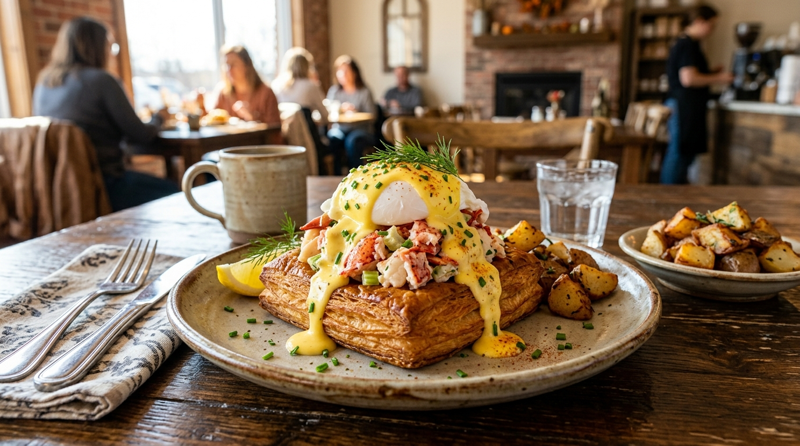
Concept 4 of 4
The Coastal Benedict Square
A decadent brunch twist that elevates the classic benedict by swapping the English muffin for a buttery, flaky square croissant. This dish brings a touch of luxury to the neighborhood cafe experience, perfect for guests seeking a substantial and indulgent start to their weekend.
Featured products
• SQUARE SANDWICH CROISSANT, SLICED — BAKER BOY® · SKU 32650
• LOBSTER SENSATIONS — KING & PRINCE · SKU 004610
Powered by Affinity NXT

Slide 12
Concept 4 of 4 · Execution
The Coastal Benedict Square — Execution
Menu description
Our signature Coastal Benedict Square takes indulgence to the next level. We start with a buttery, flaky square croissant, toasted to perfection and topped with a generous portion of premium Lobster Sensations and two perfectly poached eggs. Finished with a velvety lemon-chive hollandaise, this elevated brunch classic brings a touch of coastal luxury to your neighborhood table.
Pricing
Recommended price point of $17.95–$19.95. This maintains the 'sweet spot' value perception while accounting for the high-cost protein (lobster blend) and the premium nature of the square croissant, ensuring a healthy contribution margin.
Plating
Serve on a warm, rectangular stoneware plate to complement the square croissant shape. Place the croissant halves slightly offset. Drizzle the hollandaise generously over the poached eggs, allowing it to pool slightly on the plate. Garnish with a vibrant sprinkle of fresh-cut chives and a light dusting of paprika or lemon zest for visual pop.
Prep
Thaw square croissants under refrigeration. Slice horizontally and toast lightly on a flat-top or in a convection oven to ensure the center stays soft while the exterior is crisp. Warm Lobster Sensations gently in a butter-lemon emulsion. Poach eggs to order. Assemble by layering the lobster on the bottom croissant half, adding the eggs, and ladling the warm hollandaise over the top before closing with the top half of the croissant.
Powered by Affinity NXT

Slide 13
Concept 4 of 4 · Execution (continued)
The Coastal Benedict Square — Execution (cont.)
Portion
1 square croissant (split), 3.5 oz Lobster Sensations, 2 large poached eggs, 2 oz hollandaise sauce.
Prep time
8–10 minutes per order; 15 minutes total prep for mise en place (hollandaise holding and lobster portioning).
Equipment
Flat-top grill or convection oven, poaching station/pan, small saucepan for hollandaise, squeeze bottle for hollandaise, serving tongs, and rectangular plateware.
Pairings
Pairs excellently with a side of crispy breakfast potatoes or a light arugula and shaved fennel salad to cut through the richness. Best served with a chilled glass of fresh-squeezed orange juice or a crisp Mimosa.
Menu position
entree
Powered by Affinity NXT

