Slide 1
Generating Multivariate Gaussian

Slide 2

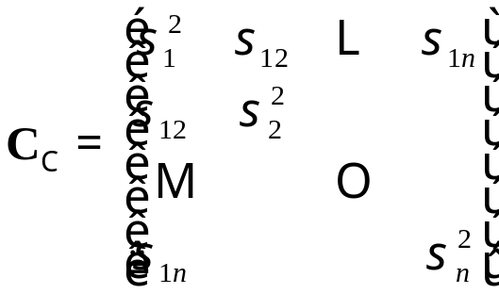

Generating Multivariate Gaussian
We require n normal random numbers
drawn from a multivariate normal distribution with

Slide 3
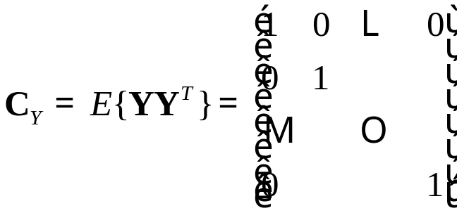




Generating Multivariate Gaussian
Generate n independent, zero-mean, unit variance normal random variables
Take where (Cholesky factorization)

Slide 4
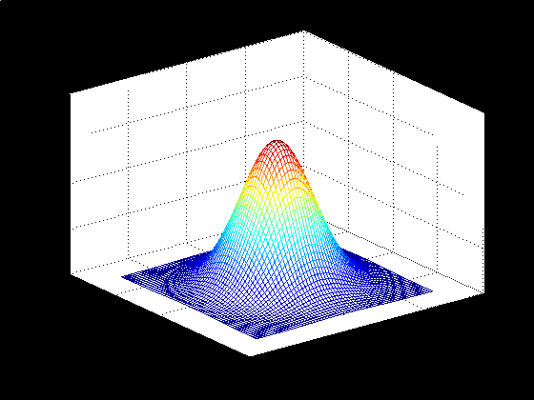
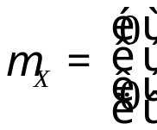
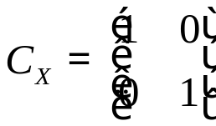

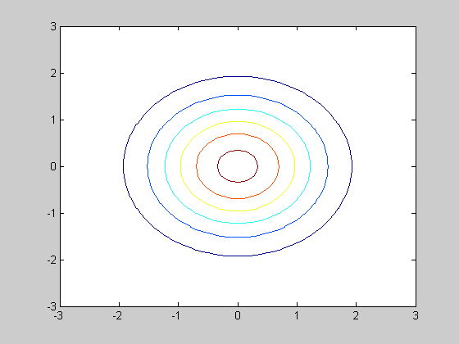
Generating Multivariate Gaussian
mx=[0 0]';
Cx=[1 0; 0 1];
x1=-3:0.1:3;
x2=-3:0.1:3;
for i=1:length(x1),
for j=1:length(x2),
f(i,j)=(1/(2*pi*det(Cx)^1/2))*exp((-1/2)*([x1(i) x2(j)]-mx')*inv(Cx)*([x1(i);x2(j)]-mx));
end
end
mesh(x1,x2,f)
pause;
contour(x1,x2,f)
pause

Slide 5
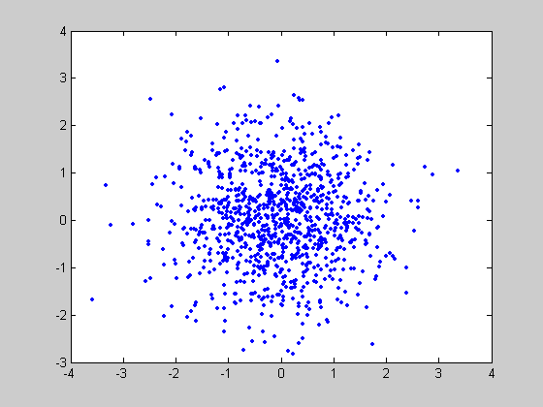
Generating Multivariate Gaussian
N=1000;
[y1,y2]=gennormal(N,0,1);
plot(y1,y2,'.')

Slide 6
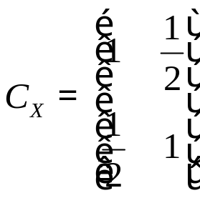
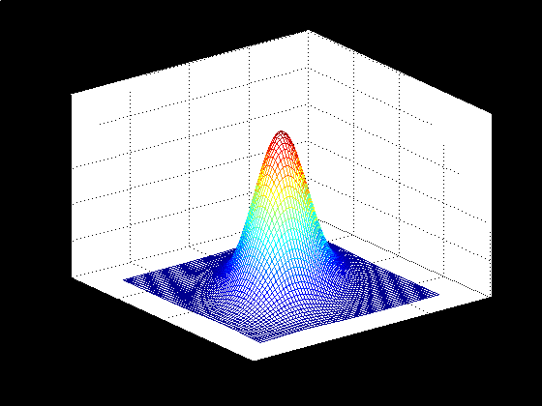
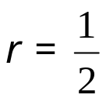
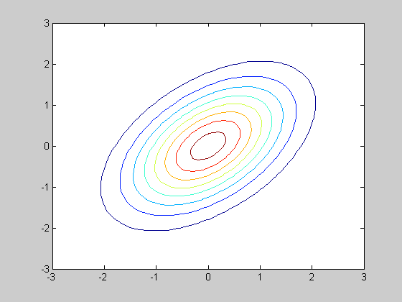
Generating Multivariate Gaussian
mx=[0 0]';
Cx=[1 1/2; 1/2 1];

Slide 7
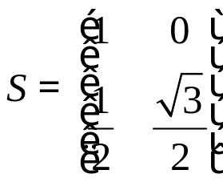
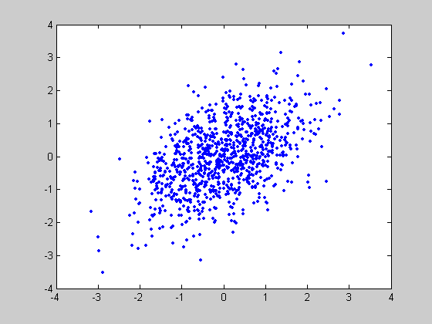
Generating Multivariate Gaussian
N=1000;
mx=zeros(2,N);
[y1,y2]=gennormal(N,0,1);
y=[y1;y2];
S=[1, 0; 1/2, sqrt(3)/2];
x=S*y+mx;
x1=x(1,:);
x2=x(2,:);
plot(x1,x2,'.')
r=corrcoef(x1',x2')
r =
1.0000 0.5056
0.5056 1.0000

Slide 8
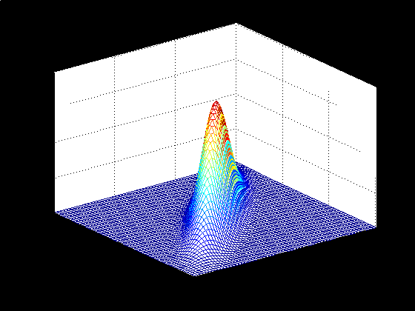
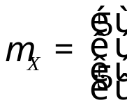
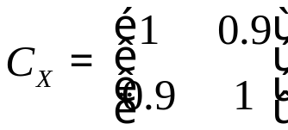

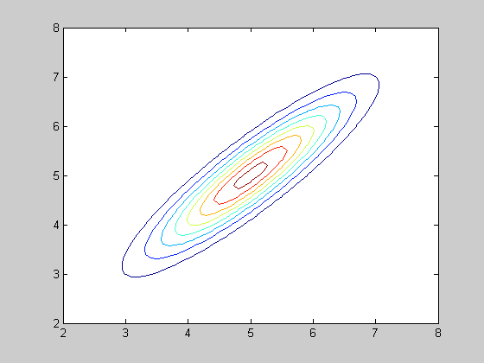
Generating Multivariate Gaussian
mx=[5 5]';
Cx=[1 9/10; 9/10 1];

Slide 9
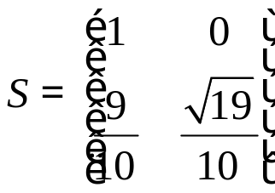
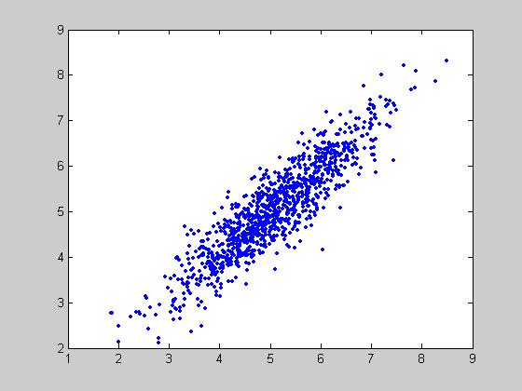
Generating Multivariate Gaussian
N=1000;
mx=5*ones(2,N);
[y1,y2]=gennormal(N,0,1);
y=[y1;y2];
S=[1, 0; 9/10, sqrt(19)/10];
x=S*y+mx;
x1=x(1,:);
x2=x(2,:);
plot(x1,x2,'.')
r=corrcoef(x1',x2')
r =
1.0000 0.9041
0.9041 1.0000

