Slide 1









Idea submission

Slide 2


Team details
Team Lead:
Name: Pragathi Vaikar
Contact: 9902445109
Email:pragathinagesh.ad24@bmsce.ac.in
Team Member 2:
Name: Maseera Arafath
Contact: 8220076167
Email: maseera.ad24@bmsce.ac.in
Team Member 3:
Name: Harika Anil
Contact: 9148767671
Email: harika.ad24@bmsce.ac.in

Slide 3


Our solution
An AI-powered smart calendar optimizes scheduling and enhances productivity. It provides personalized time management insights based on user behavior. Seamlessly integrates with apps to streamline daily tasks.

Slide 4

TECHNICAL APPROACH
Frontend (React + Tailwind CSS): React builds dynamic UIs, while Tailwind CSS ensures responsive, clean designs.
Backend (Node.js + MongoDB): Node.js handles API requests and business logic, with MongoDB managing flexible data like schedules and user profiles.
Main Component (JavaScript): JavaScript powers both frontend and backend, enabling real-time updates, AI integration (e.g., TensorFlow.js), and seamless data flow.

Slide 5
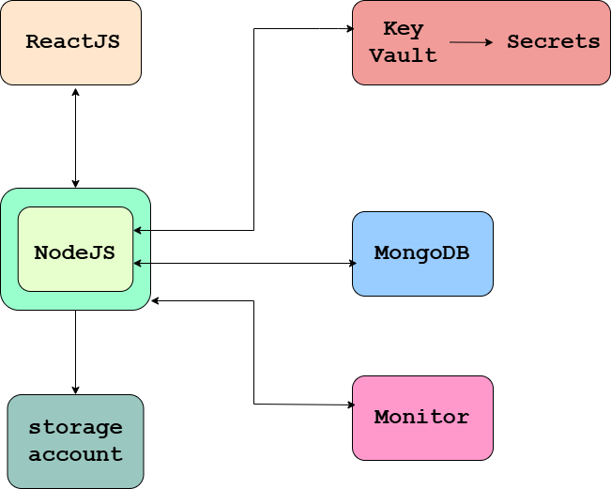
Workflow/pipeline

Slide 6
Feasibility & FUTURE SCOPE
🚀 Boost Productivity with a Free, Open-Source Time Management Dashboard! ⏳
Tired of losing track of time? A powerful, customizable, and cost-free time management dashboard can help you optimize how you and your team work!
🔥 Key Benefits:
✅ Save Money – No licensing fees, just pure efficiency! 🔧 Customize & Adapt – Tailor it to fit your exact workflow needs. 📊 Track & Improve – Gain insights into time spent on tasks & projects.
💡 Start managing time smarter, not harder – because every second counts! ⏰
​

