Slide 1

MNIST Predictions
Masego Modibane

Slide 2
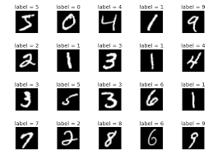
Purpose of project
Build a machine learning model to accurately classify handwritten digits from the MNIST dataset
Description of MNIST dataset
Most famous datasets often used for training and testing image processing systems, especially for the task of handwritten digit recognition.
The MNIST dataset contains 70,000 images of handwritten digits.
Each image represents a digit from 0 to 9.
Each image is a grayscale image with a resolution of 28x28 pixels.
The pixel values range from 0 (black) to 255 (white).

Slide 3
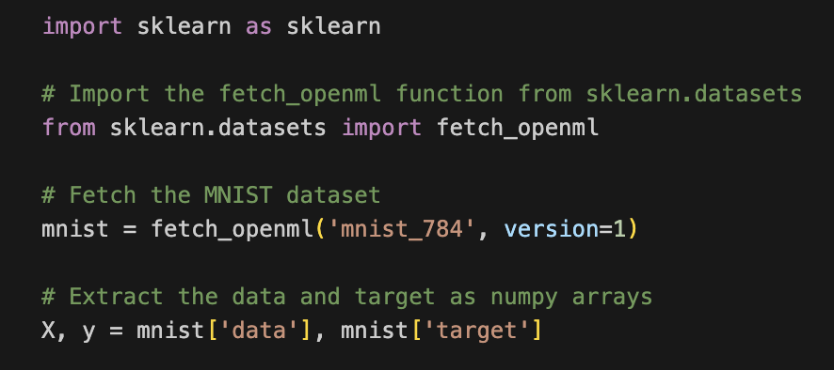
Data Preprocessing
Imported data
Used fetch_openml

Slide 4
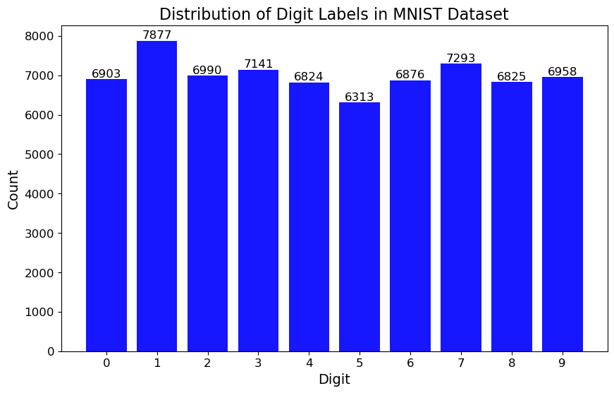
Data Preprocessing
Imported data
Used fetch_openml
Exploratory Data Analysis
Shape of data
Data types of features
Summary statistics of feature
Distribution of labels
Checking for missing values

Slide 5
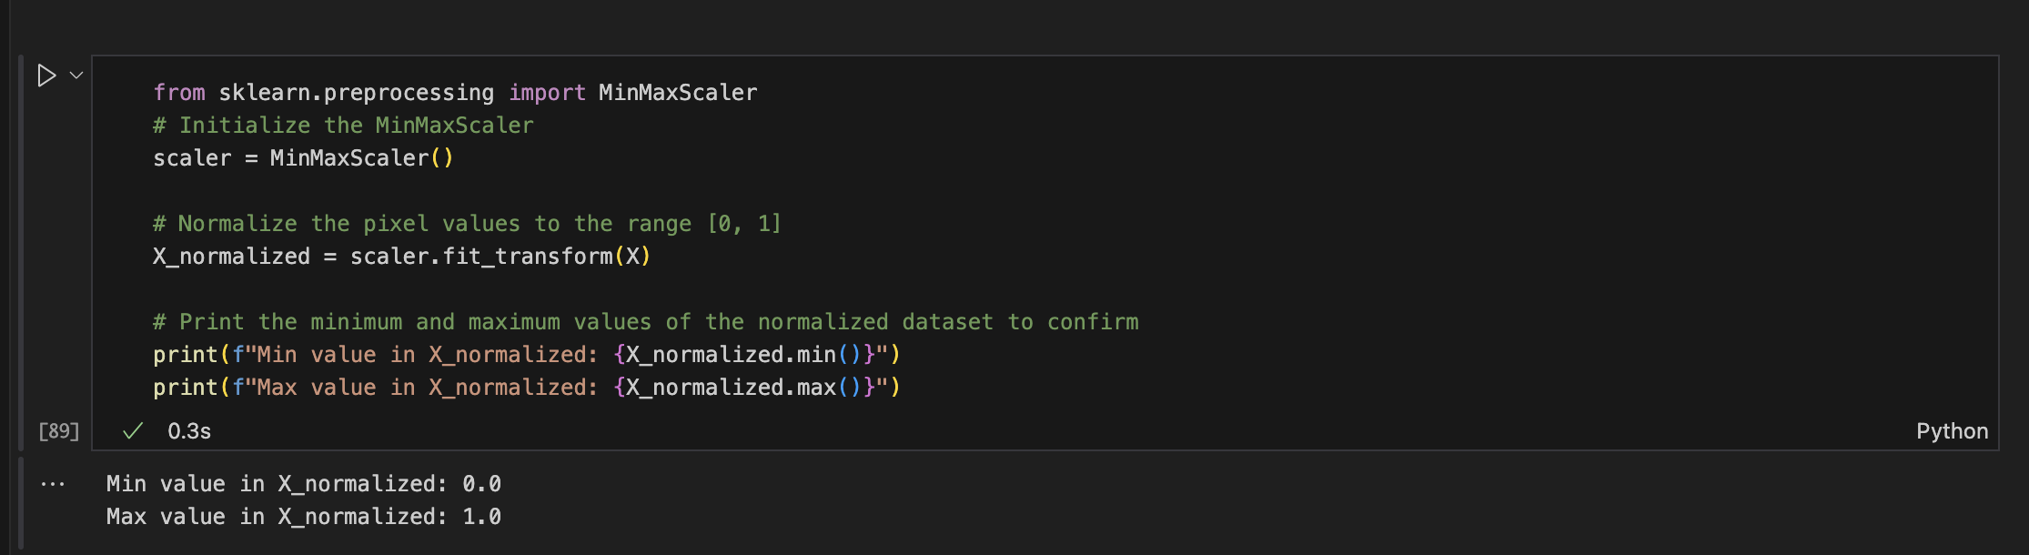
Data Preprocessing
Imported data
Used fetch_openml
Shape of data
Data types of features
Summary statistics of feature
Distribution of labels
Checking for missing values
Data Normalisation
Exploratory Data Analysis
Normalise features (pixel values) to a value between 0 and 1

Slide 6
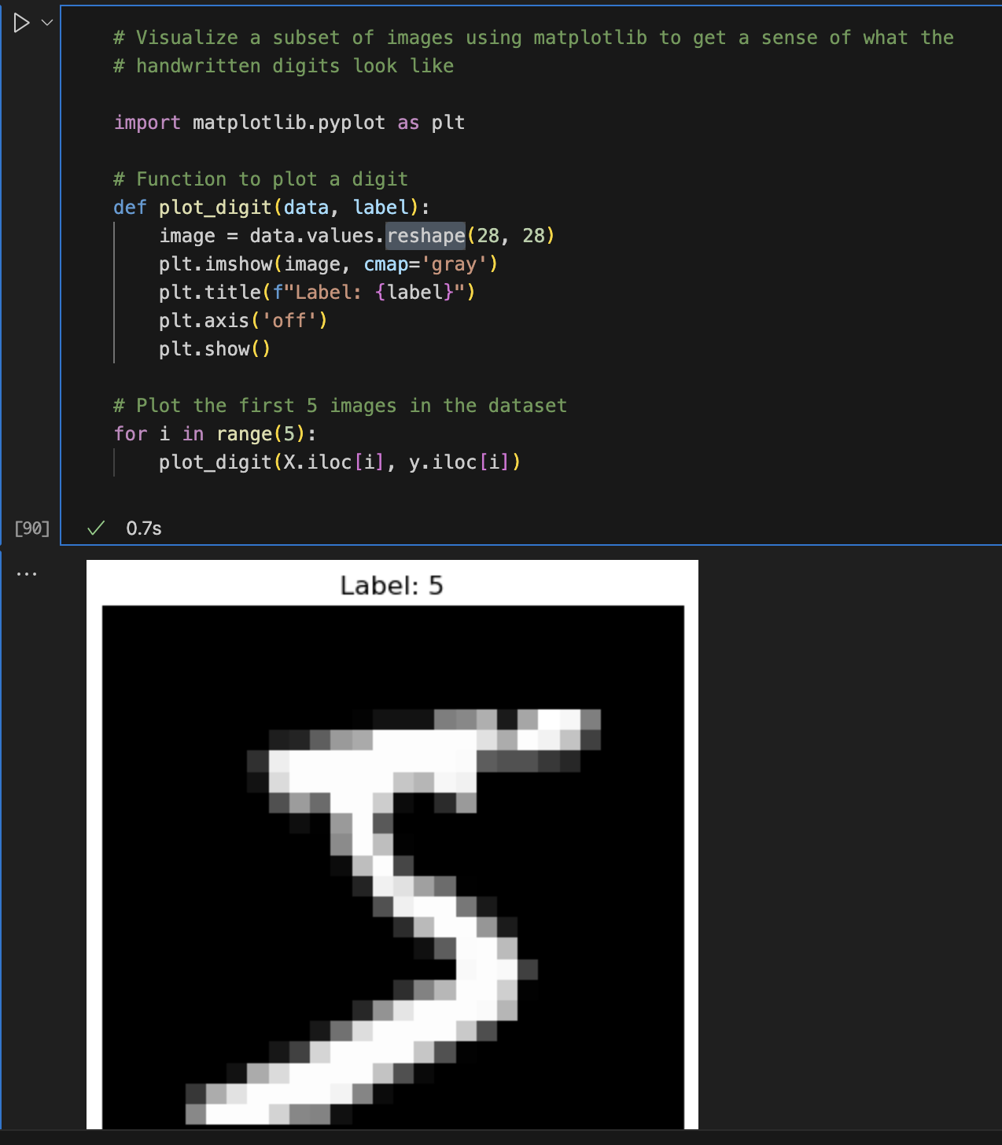
Label Visualisation
Each handwritten digit image is originally a 28x28 pixel grid and loaded data -> 784 columns (28X28)
Reshaping the data back into a 28x28 grid
Using matplotlib library and reshape to visualise images

Slide 7
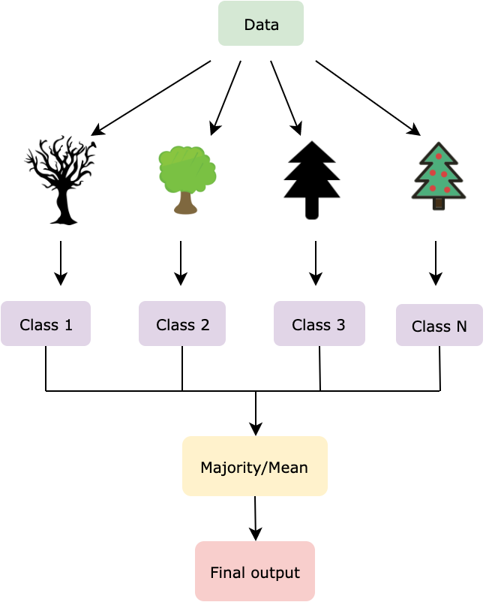
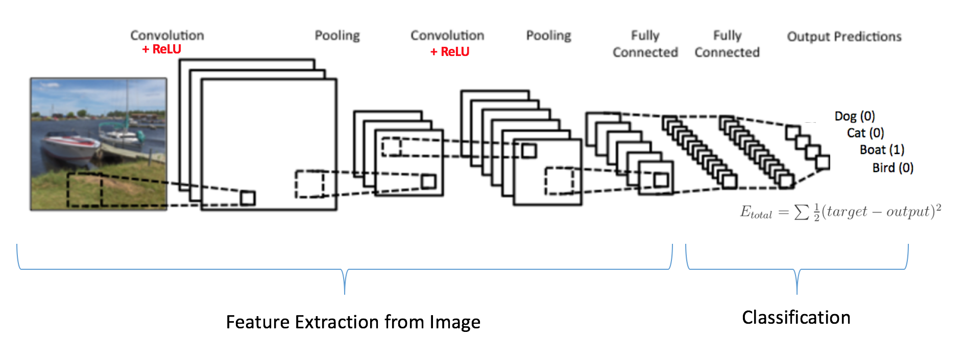
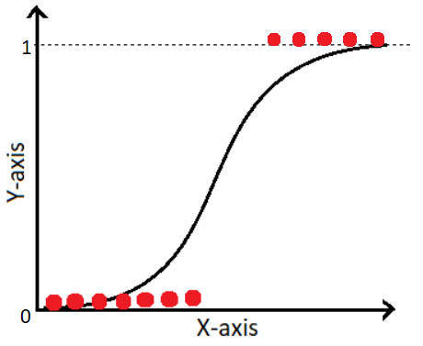
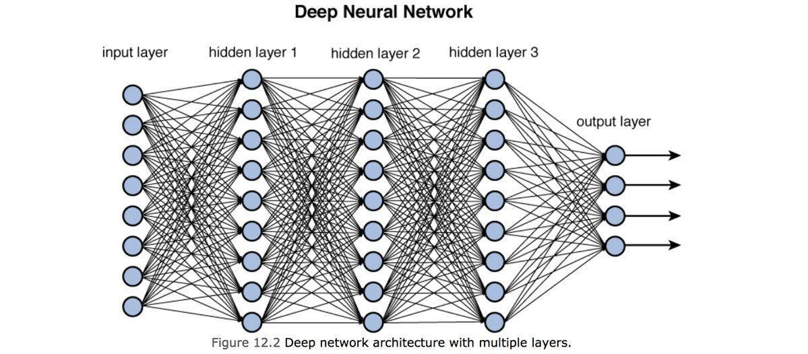
Model Selection
Machine Learning Models
Neural Network Models
Logistic Regression
Simple and interpretable model
Random Forest
Ensemble Learning
Deep Neural Network
Flexibility
Learning Nonlinearities
Convolutional Neural Network
Specialisation for Image Data

Slide 8
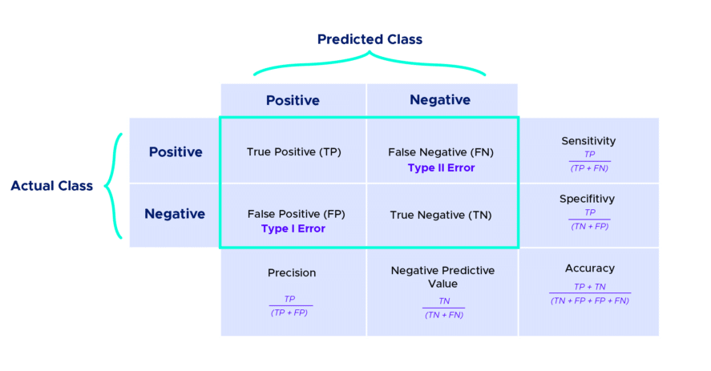
Evaluation metrics used
Accuracy
Recall
Precision
F1 Score
percentage of accurate predictions
proportion of images correctly identified as a specific digit out all the actual images of that digit
how often the model’s positive predictions are correct
balances the concerns of precision and recall

Slide 9

Model Training - Machine Learning Models
Steps taken:
Logistic
Regression
Grid search
C -> $\frac{1}{regularisation rate}$
Solvers
Random
Forest
Grid search
Number of estimators
Maximum depth
Minimum sample split
Split data into train and test set
Removed columns that only had zeros
Evaluated each model
Performed Grid Search
Choose the best model for each model type
C |  | Solvers
0.1 |  | lbfgs
1 |  | newton-cg
10 |  | sag
 |  | saga
n_estimators |  | max_depth |  | min_samples_split
100 |  | 10 |  | 10
200 |  | 20 |  | 20
300 |  | 30

Slide 10
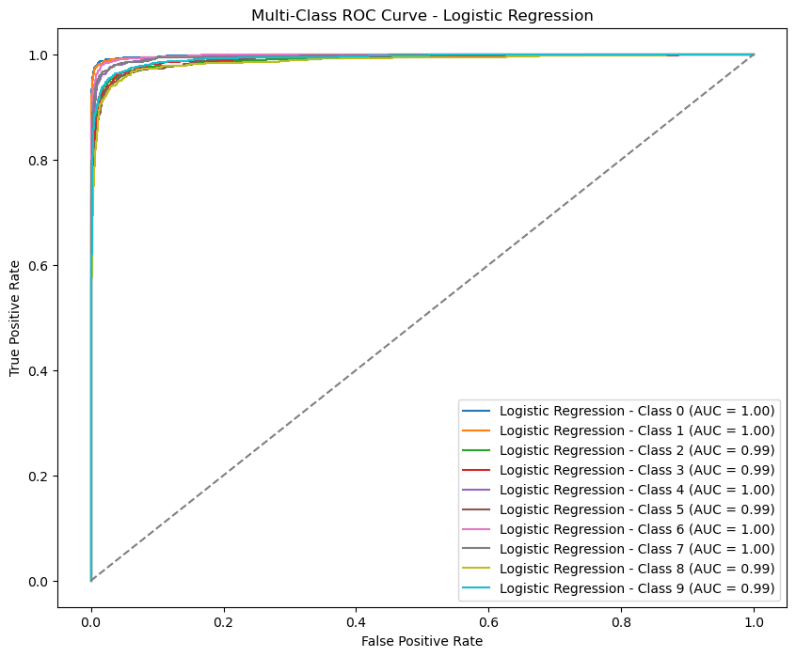
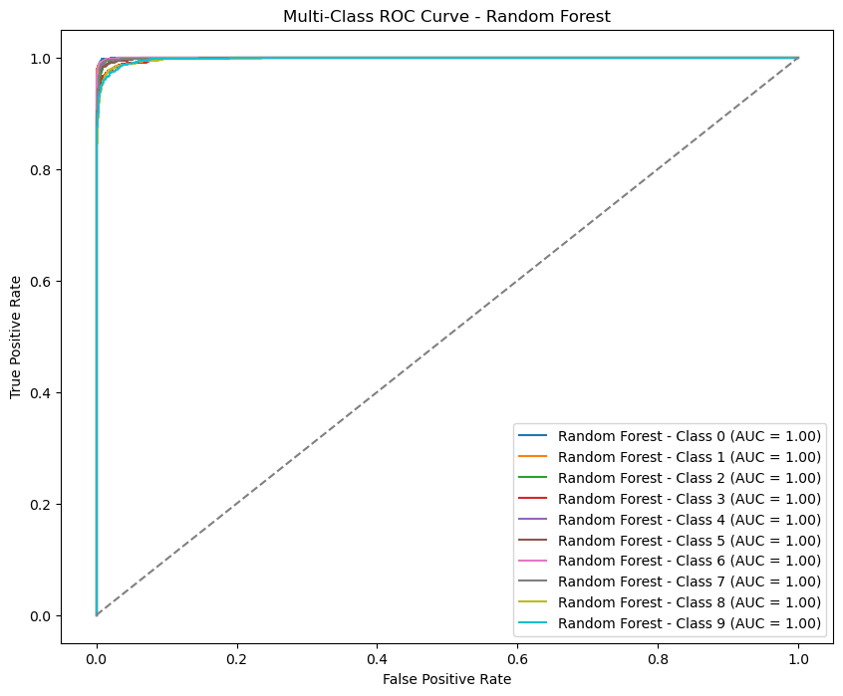
Evaluation - Machine Learning Models
ROC Curve

Slide 11
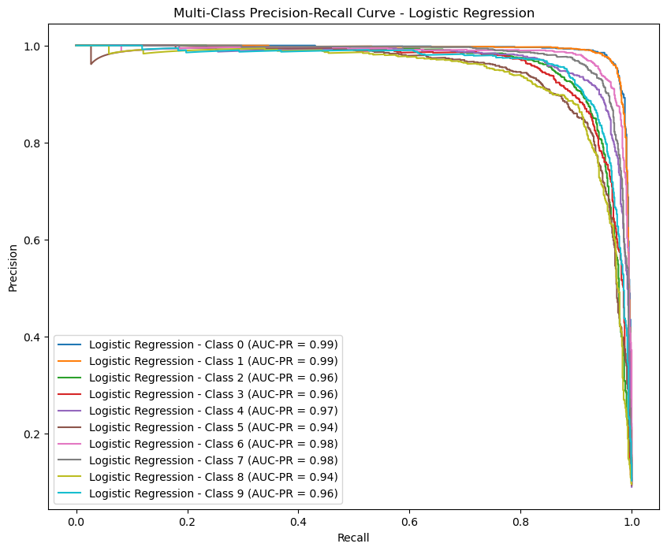
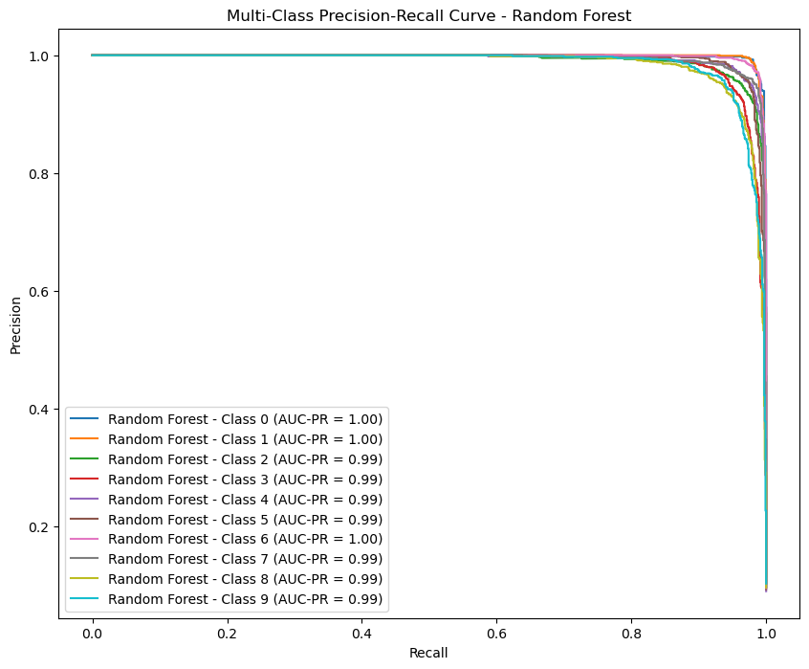
Evaluation - Machine Learning Models
Precision Recall Curve

Slide 12
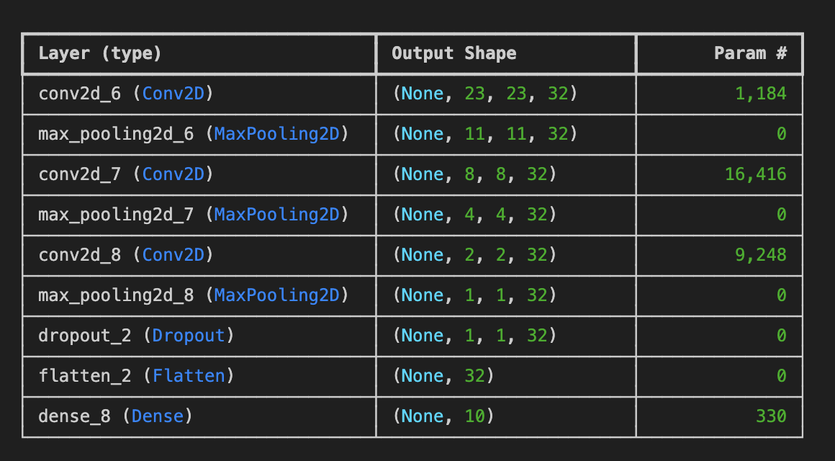
Model Training - Neural Networks
Steps taken:
Deep
Neural Network
3 layers
Input layer (RELU)
Hidden layer (RELU)
Output layer (Softmax )
adam optimizer
10 epochs
Convolutional
Neural Network
adam optimizer
10 epochs
Split data into train, validation and test set
Used all columns
Trained model
Evaluated model
CNN -> reshaped data

Slide 13
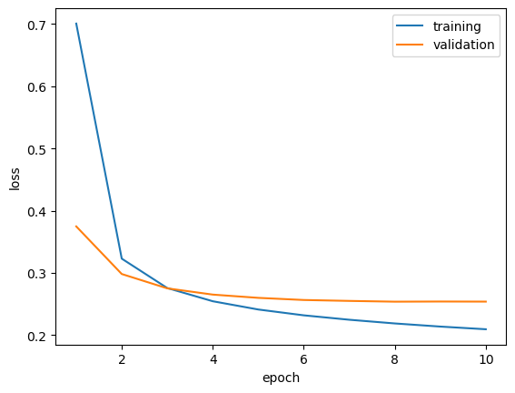
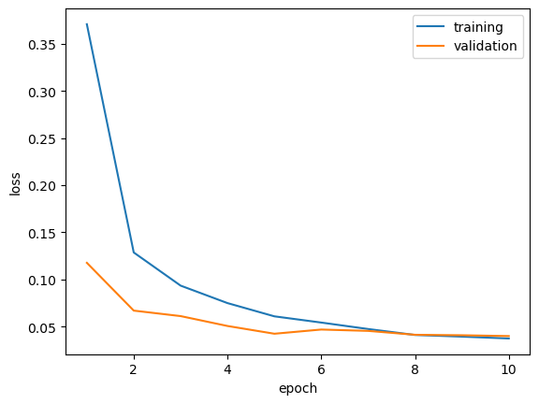
Evaluation – Neural Network Models
Deep Neural Network
Convolutional Neural Network

Slide 14
Recap - Training and Evaluation
Training
Evaluation metrics
Trained each model
12 Logistic Regression Models
18 Random Forests
1 Deep Neural Network
1 Convolutional Neural Network
Chose the best model for each type of model
Compared results to choose best model overall
Accuracy
Recall
Precision
F1 Score

Slide 15
Results
 | LOGISTIC REGRESSION C = 0.1 -> Regularisation rate = 10 Solver = lbfgs | RANDOM FOREST Maximum depth : 30 Minimum samples of split: 10 Number of estimators : 300 | DEEP NEURAL NETWORK | CONVOLUTIONAL NEURAL NETWORK
ACCURACY | 0.920800 | 0.965500 | 0.925800 | 0.988000
PRECISION | 0.920617 | 0.965572 | 0.926027 | 0.988065
RECALL | 0.920800 | 0.965500 | 0.925800 | 0.988000
F1 SCORE | 0.920641 | 0.965505 | 0.925755 | 0.988006

Slide 16
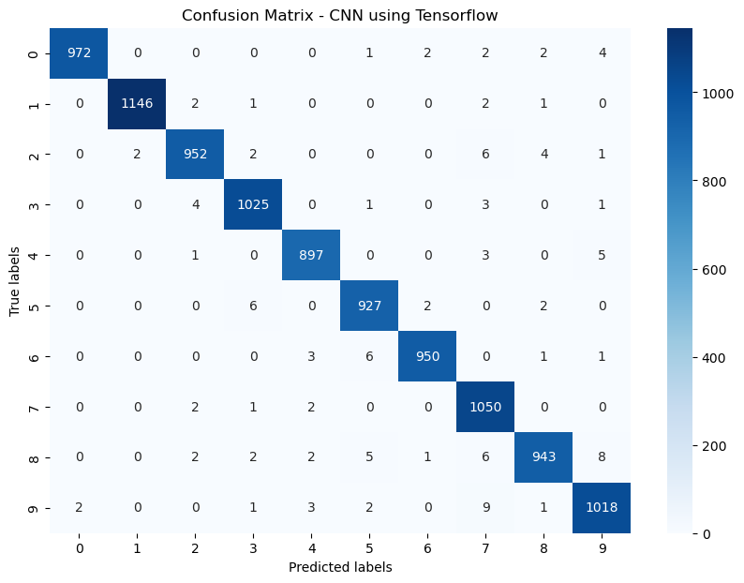
Best Model Results – Convolutional Neural Network
 | CONVOLUTIONAL NEURAL NETWORK
ACCURACY | 0.988000
PRECISION | 0.988065
RECALL | 0.988000
F1 SCORE | 0.988006

Slide 17
Conclusion and Future work
Best model was Convolutional Neural Network
Try some more combinations for the neural networks
Look at more easily interpretable models
Add own handwritten images and check model performance

