Slide 1
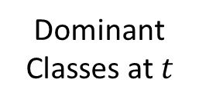
(a)
Dominant Classes at $t$
Log of Abundances
Fitness

Slide 2
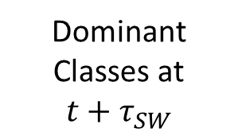
Dominant Classes at
$$t+τ_{SW}$$
Log of Abundances
Fitness

