Slide 1

I-dOne
Next generation bacterial identification

Slide 2
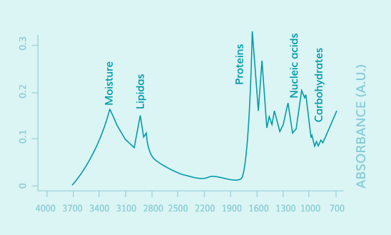
What does I-dOne do?
I-dOne analyses the spectrum produced by the interaction between intact microbial cells and IR light through the vibrational state of their chemical bonds. Each species produces a unique fingerprint-like FTIR spectrum
Results are reported as Microorganism ID along with relative score that represents the reliability of the identification to known vibrational profiles of species present in the reference database

Slide 3
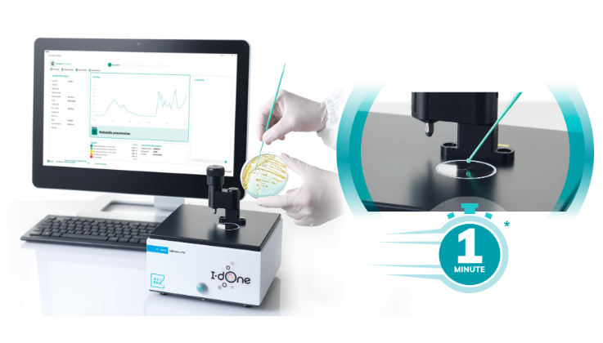
How does I-dOne work?
A sample of the bacteria is deployed on the FTIR device’s crystal. I-dOne will collect the bacteria spectrum, analyze it and identify the bacteria’s species based on its own reference spectra database.

Slide 4





Tech stack
Main application
Desktop application developed in C# + WPF + SQLite
Identification engine
Python + Pandas + Scikit Learn

