Slide 1

MES
Industry manufacturing execution system

Slide 2
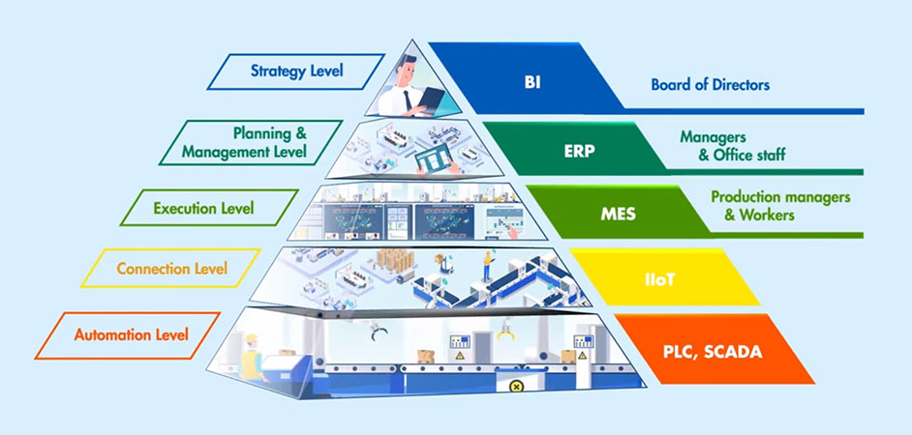
What is a MES software?
A Manufacturing Execution System (MES) software is a computer-based system used in manufacturing industries to monitor, control, and optimize production processes on the shop floor.
Main functions:
Process Monitoring
Production Scheduling
Quality Control
Traceability
Performance analysis
Systems Integration

Slide 3
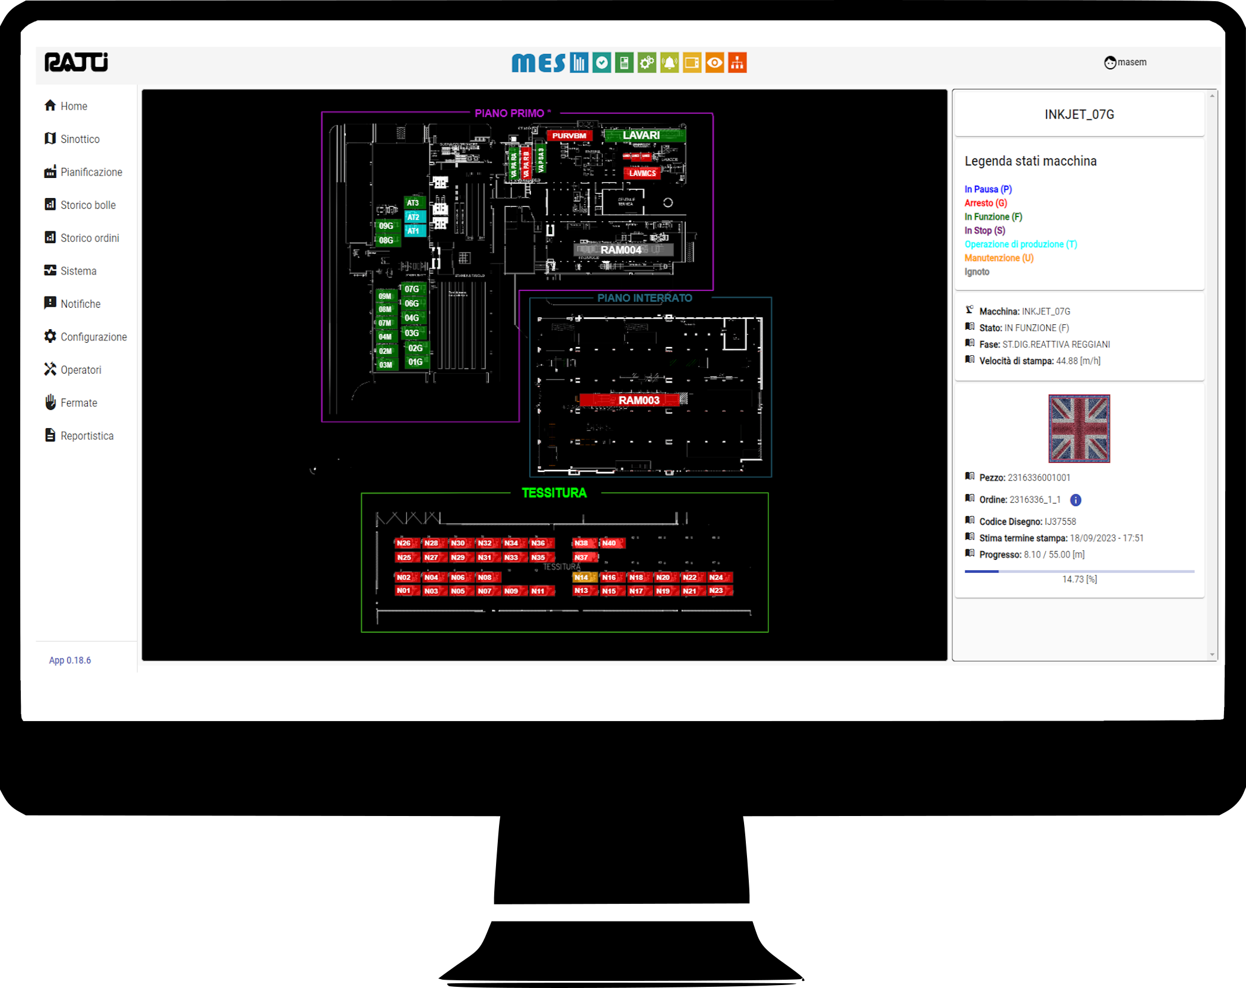
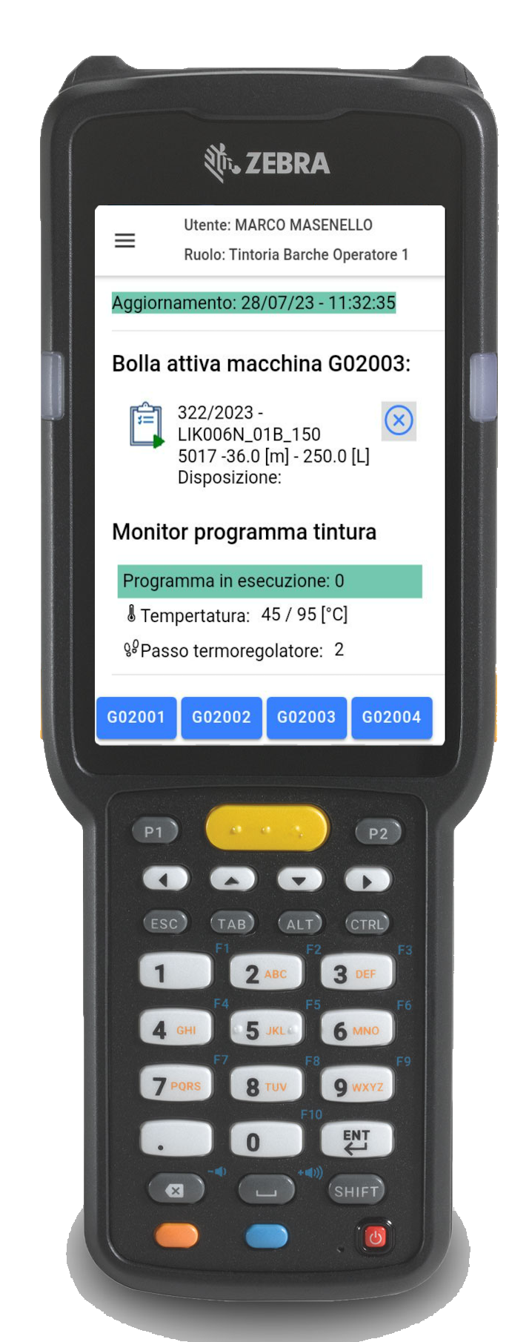
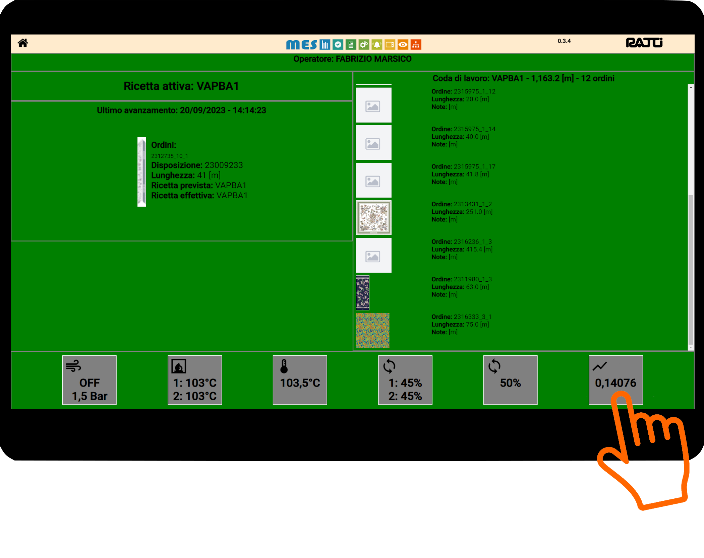
One system, many interfaces
Web client
Mobile field device
Touch screen field device

Slide 4

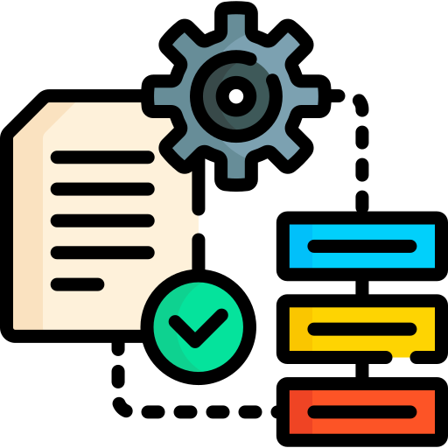

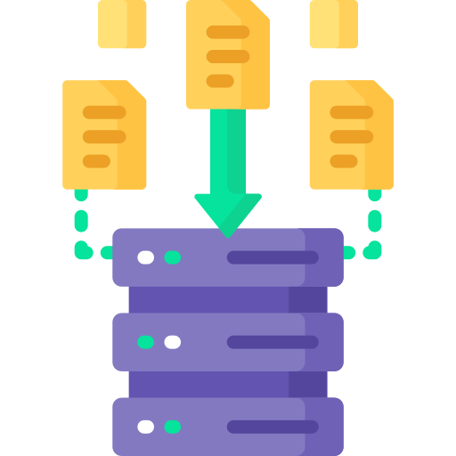



What does MES do?
Process control
Data collection
Production delays tracking
Production scheduling
Plant status monitoring
Alarms and notifications
Reporting

Slide 5



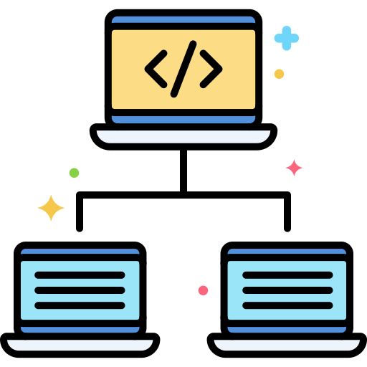

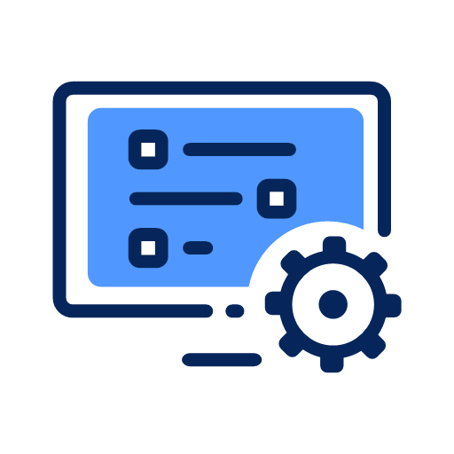
System features
Advanced system logging
Admin dashboard
Client connections monitoring
Simplified updates deployment
Advanced users and roles management
Advanced system configuration

Slide 6







Tech stack
Back end
.NetCore + Python + RabbitMq + MongoDb
Web Front end
Angular
Mobile App (Android)
Angular + Ionic + Capacitor

