Slide 1

Molecular Mouse
Qualitative and fast analysis of DNA targets through real-time PCR

Slide 2
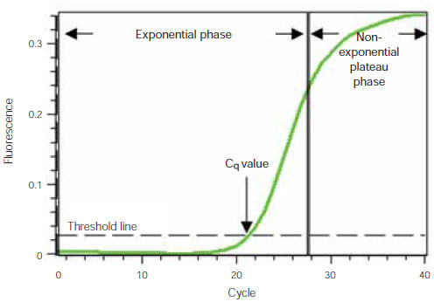
What does Molecular Mouse do?
Molecular Mouse performs real time PCR (Polymerase Chain Reaction), a molecular biology method that amplifies and quantifies DNA or RNA in real time, providing precise and immediate results.
Real-time PCR is widely used in various applications, including gene expression analysis, pathogen detection, and genetic research.

Slide 3
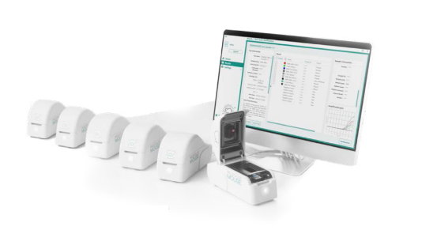
How does Molecular Mouse work?
Molecular Mouse uses ready-to-use lab-on-chip cartridges containing lyophilized reagents in micro-wells. Users place their samples for analysis in each well and initiate the PCR reaction. In approximately one hour, the reaction is completed, and the results are presented within the application.

Slide 4


Tech stack
Main application
Desktop application developed in C# + WPF + SQLite

