Slide 1

MES
Industry manufacturing execution system

Slide 2
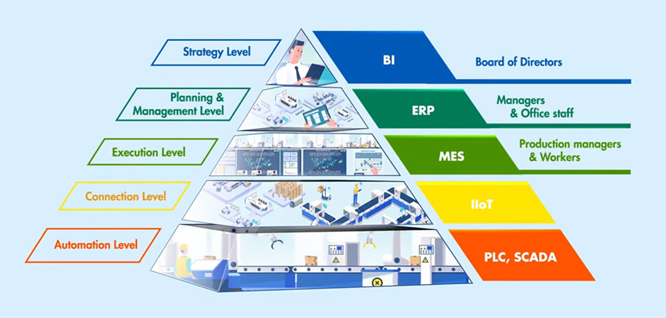
What is a MES software?
A Manufacturing Execution System (MES) software is a computer-based system used in manufacturing industries to monitor, control, and optimize production processes on the shop floor.
Main functions:
Process Monitoring
Production Scheduling
Quality Control
Traceability
Performance analysis
Systems Integration

Slide 3
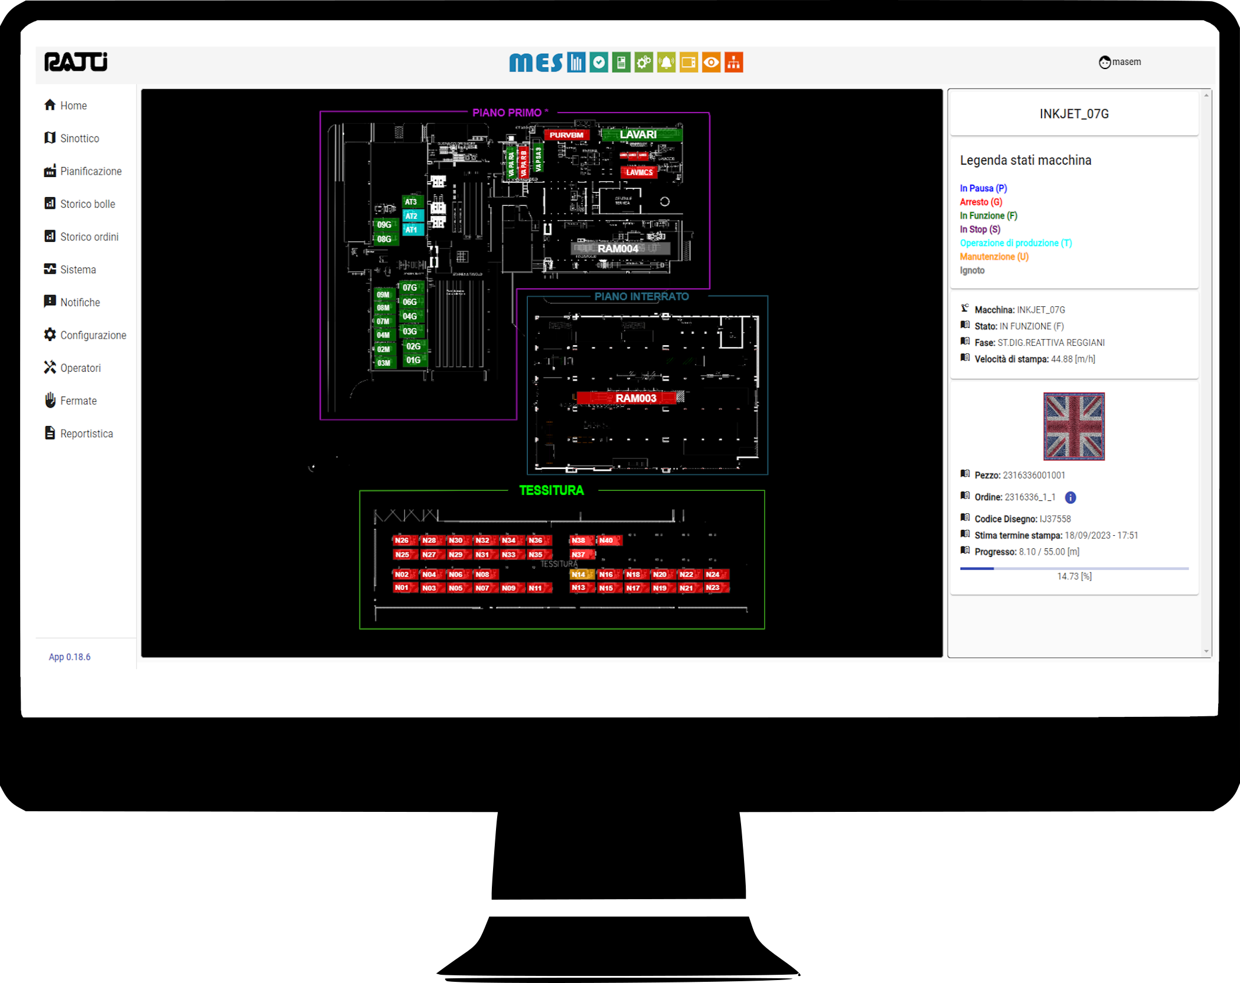
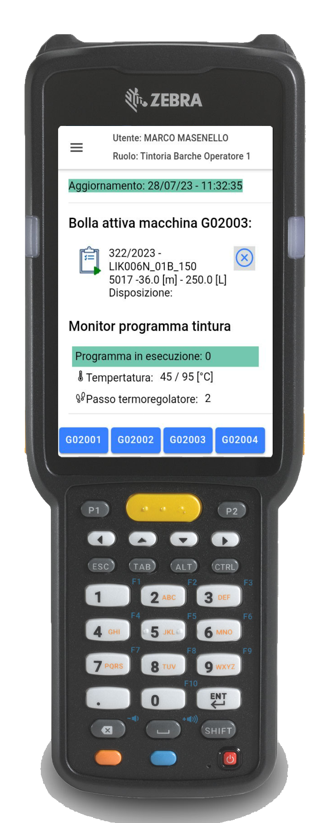
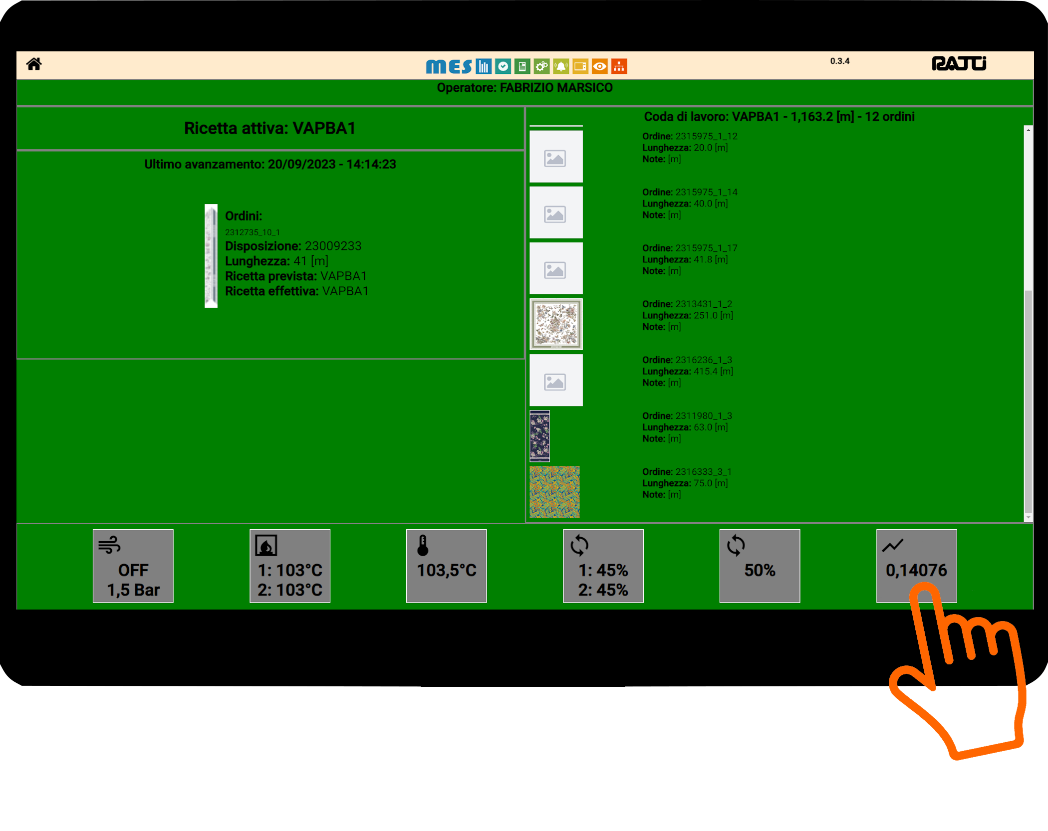
Different interfaces for different users
Web client
Mobile field device
Touch screen field device

Slide 4







Tech stack
Back end
.NetCore + Python + RabbitMq + MongoDb
Web Front end
Angular
Mobile App (Android)
Angular + Ionic + Capacitor

