Slide 1
Probing the AGN Nature of Maser Galaxy Hosts
Gaudeor Rudmin
Dr. Anca Constantin
James Madison University
Summer 2023

Slide 2
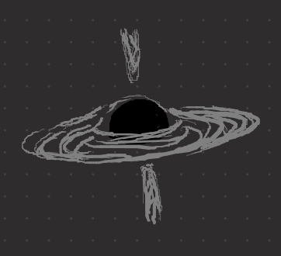
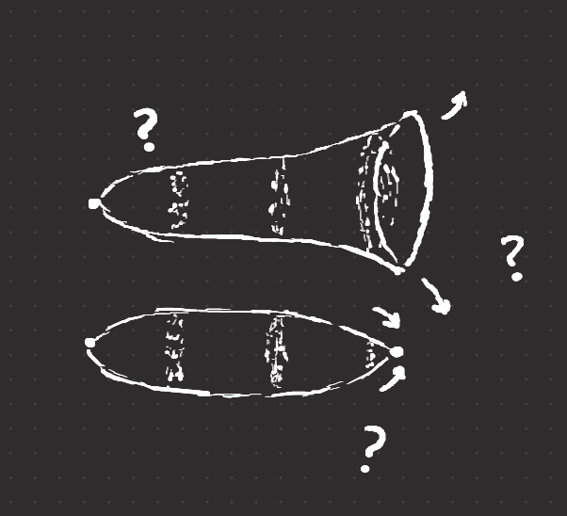

Universal Questions
How do we refine cosmological models?
How massive are supermassive black holes?
How far away are other galaxies?
What is the fate of the universe?

Slide 3
How do we answer these questions?
Maser Disks provide direct geometric measurement of distance and mass

Slide 4
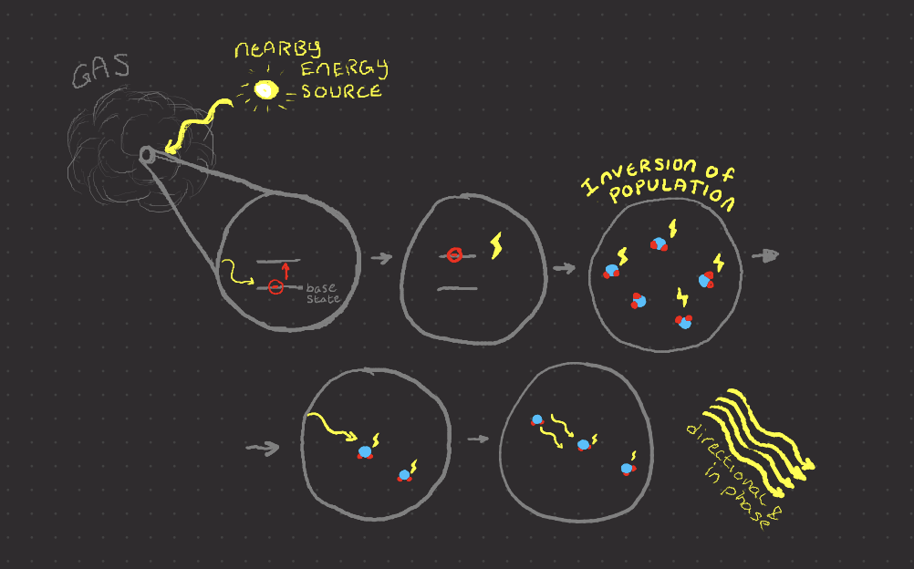
What are Masers?
Laser in Microwave
Emitted by hot gas with a nearby energy source

Slide 5
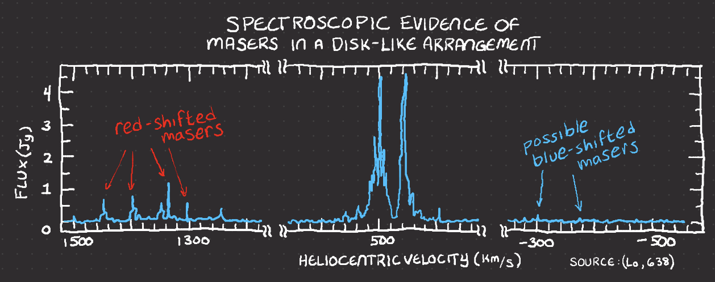
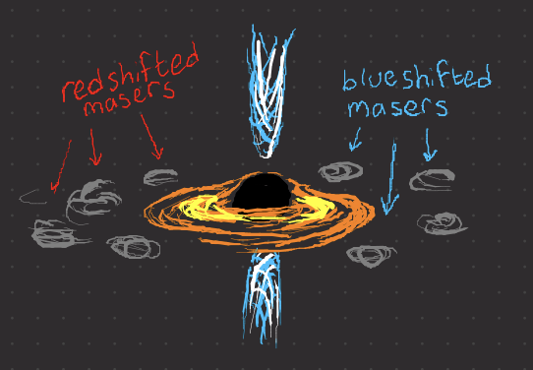
Types of Masers
Star-forming
MegaMasers (1 M x more luminous)
From Galaxy Centers
Maser Disks

Slide 6
The Problem
Masers, and especially Maser Disks, are hard to find.
The Megamaser Cosmology Project (MCP) found only 3% of surveyed sky objects were masers. (180 total)
Only 19% of Masers are Maser Disks (34 total)
To answer the Universal Questions, we need to find more maser disks.

Slide 7
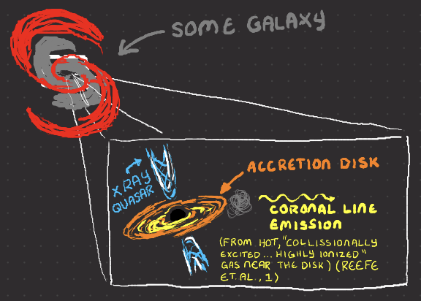
How to find more Masers: AGN?
Active Galactic Nuclei (AGN)
Hungry Black Hole at the center of a Galaxy
Accretion disk of gas and dust
We investigate using AGN
Identifiers to find masers

Slide 8
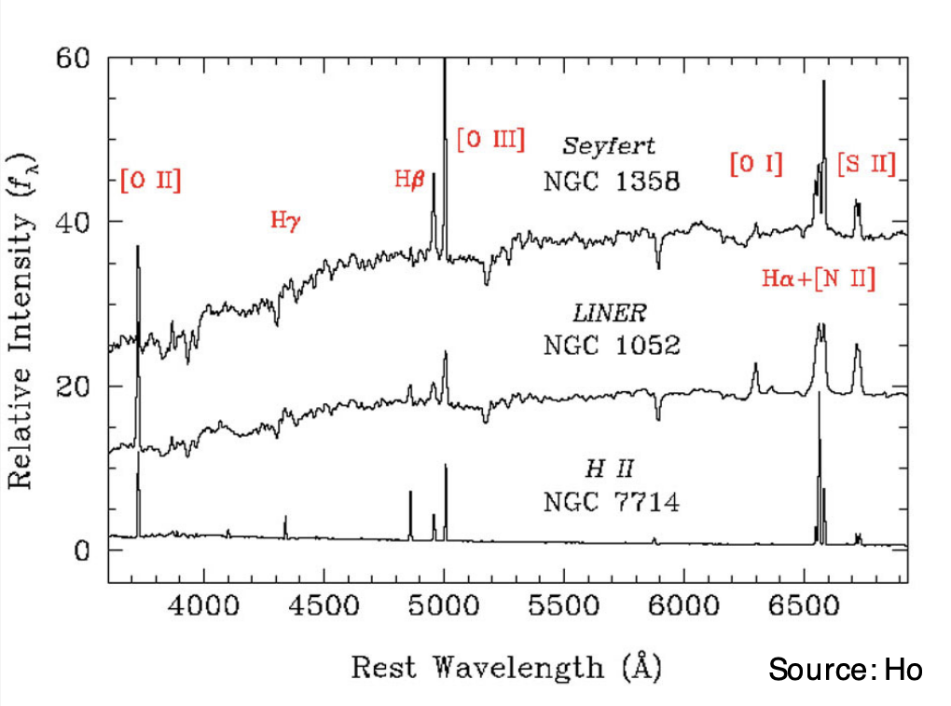
Identifying AGN
X-Ray
Optical Lines
Mid-infrared & Variability
Covered by Emily McPike
Coronal Lines
We Used Optical and Coronal lines

Slide 9
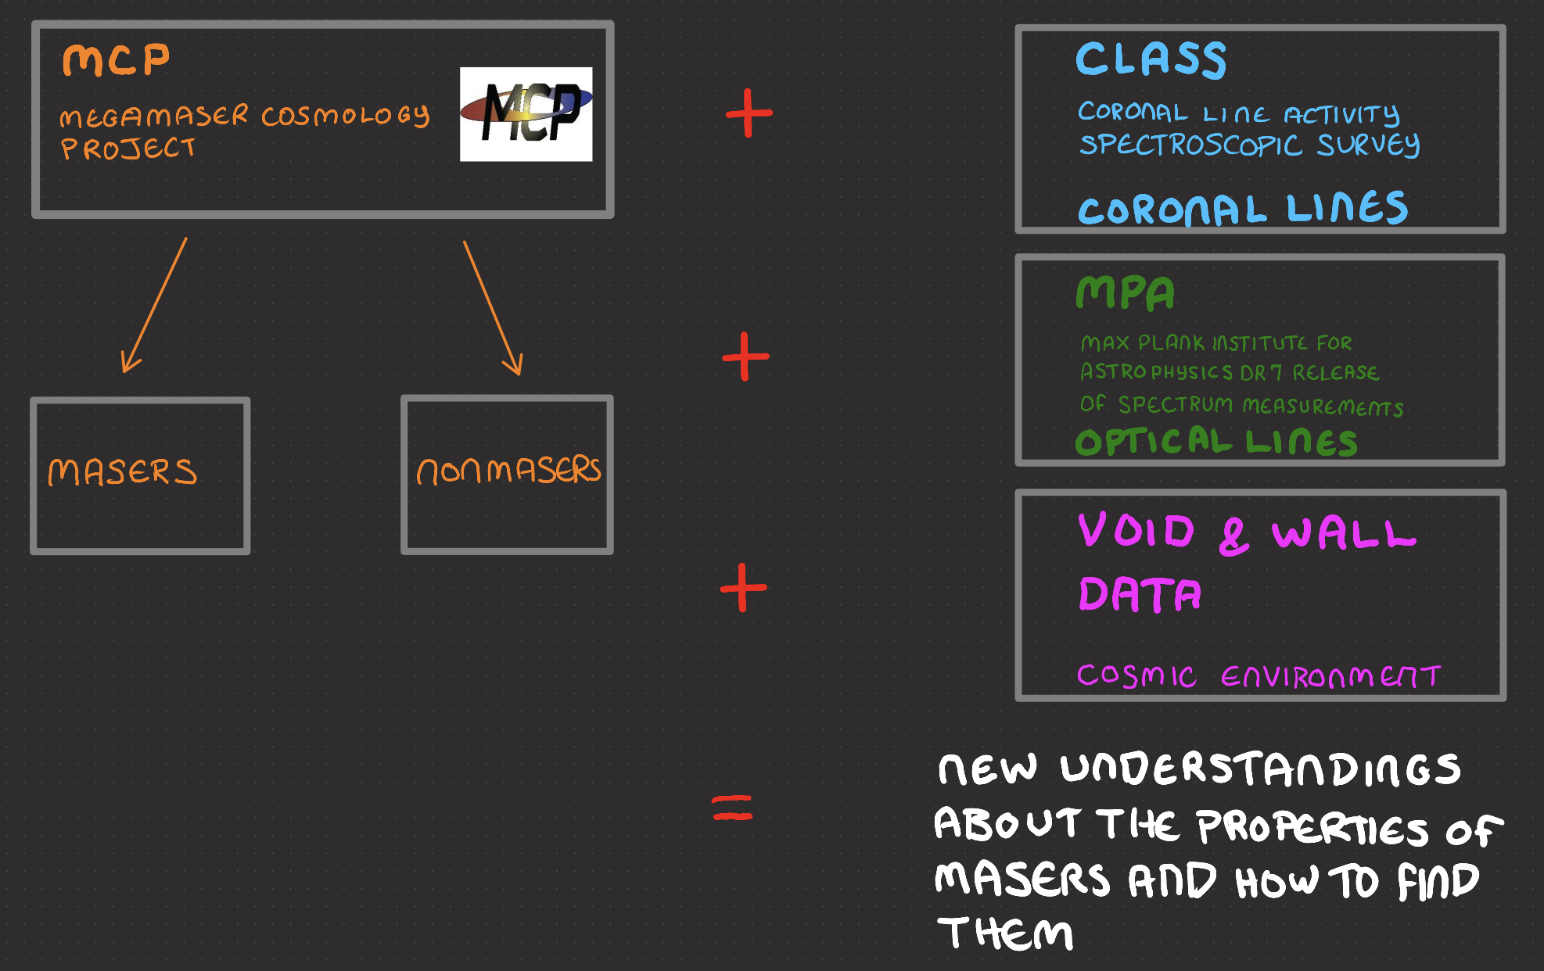
The Data

Slide 10
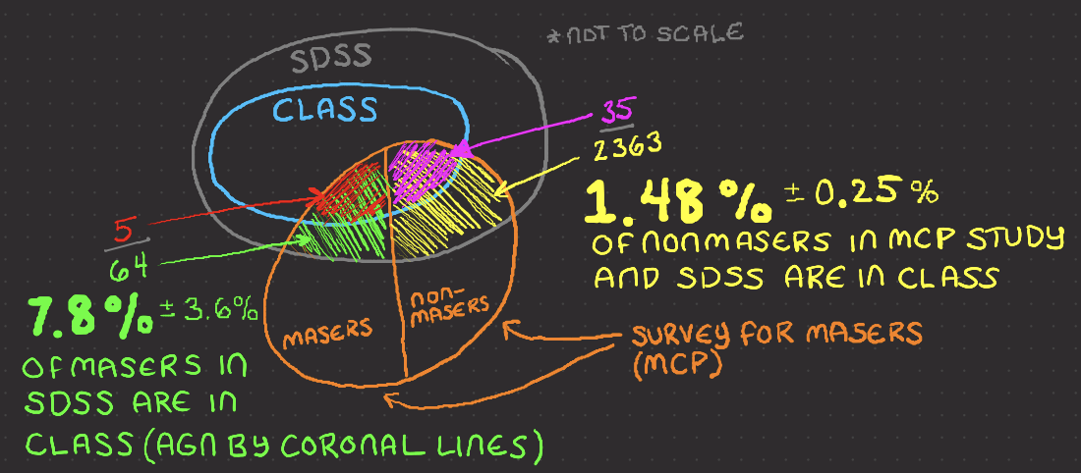
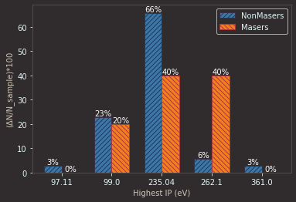
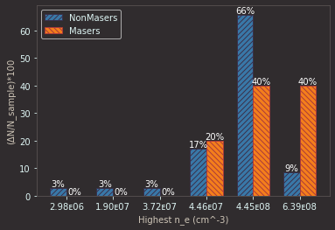
Masers VS Coronal Line AGN
A higher percentage of
Masers have coronal
Lines (so are AGN) than
Nonmasers.
Physical Properties
Associated with
Coronal Lines

Slide 11
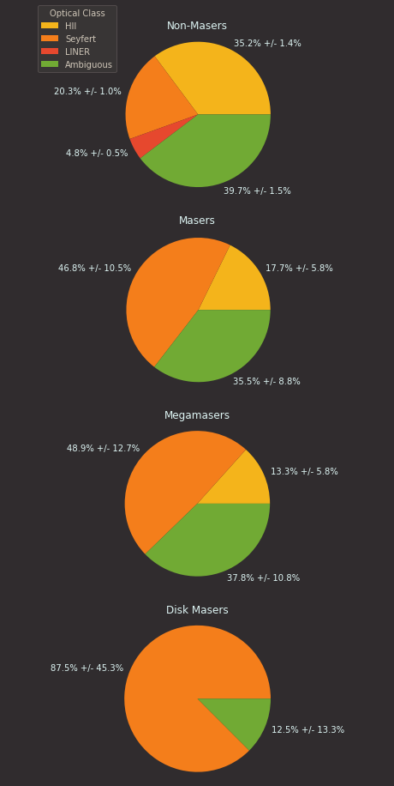
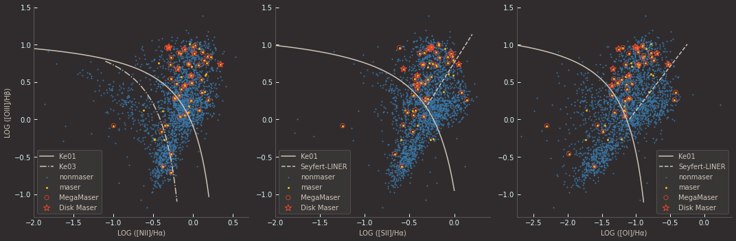
Masers VS Optical Line AGN
Masers are concentrated in the Seyfert AGN area.
Disk Masers are almost exclusively Seyfert AGNs

Slide 12
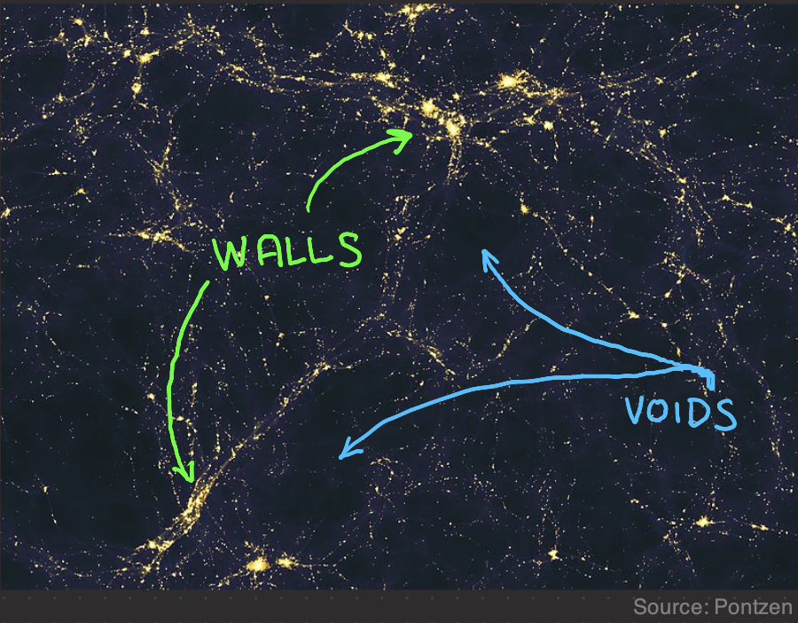
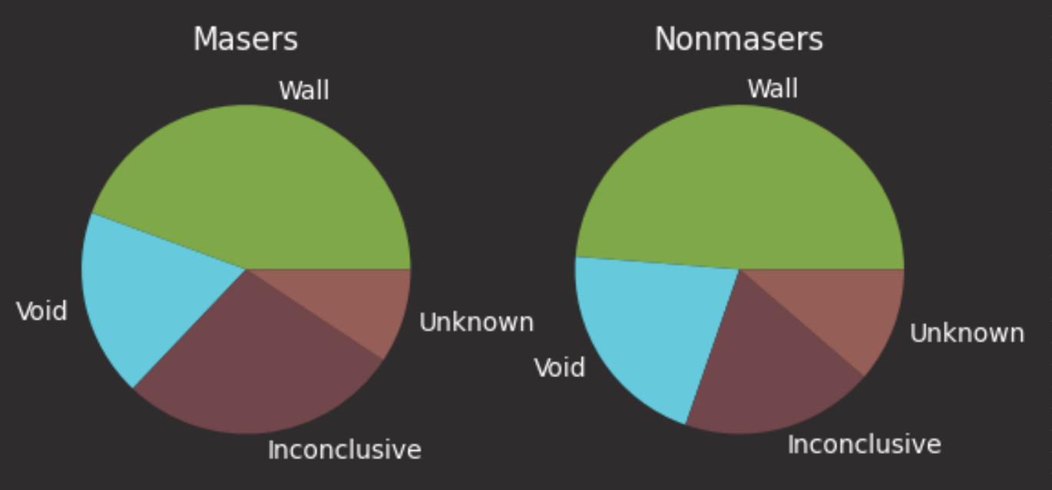
Masers VS Cosmic Environment
Location | Masers | Nonmasers
Wall | 44.4% +/- 10.9% | 48.7% +/- 1.8%
Void | 18.5% +/- 6.4% | 20.9% +/- 1.1%
Inconclusive | 27.8% +/- 8.1% | 19.0% +/- 1.0%
Unknown | 9.3% +/- 4.3% | 11.3% +/- 0.8%

Slide 13
Conclusions
There were statistically significant differences between Masers and Nonmasers using:
Coronal Line AGN Detection
Optical Line AGN Detection
They may be useful tools in narrowing the search for usable Maser Disks
Galaxy’s location in the cosmic environment does not seem to be a useful tool.

Slide 14
References
Ho, L. C. (2008). Nuclear Activity in Nearby Galaxies. Annual Review of Astronomy and Astrophysics, 46(1), 475–539. https://doi.org/10.1146/annurev.astro.45.051806.110546
Keel, B. (2002, November). Optical Spectra of Various Kinds of Active Galactic Nuclei. Active Galaxies and Quasars - Spectrum Comparison. https://pages.astronomy.ua.edu/keel/agn/spectra.html
Lo, K. Y. (2005). Mega-masers and Galaxies. Annual Review of Astronomy and Astrophysics, 43(1), 625–676. https://doi.org/10.1146/annurev.astro.41.011802.094927
Pontzen, A., &amp; Governato, F. (2014). Large-scale Structure of Light Distribution in the Universe. Wikimedia Commons. Retrieved July 25, 2023, from https://commons.wikimedia.org/wiki/File:Large- scale_structure_of_light_distribution_in_the_universe.jpg.
Reefe, M., Satyapal, S., Sexton, R. O., Doan, S. M., Secrest, N. J., &amp; Cann, J. M. (2022).
Class: Coronal line activity spectroscopic survey. The Astrophysical Journal, 936(2), 140.
https://doi.org/10.3847/1538-4357/ac8981

Slide 15
Thanks To:
Dr.

