Slide 1
Probing the AGN nature of Maser Galaxy Hosts Via Coronal Line Emission
Working towards a Method of Discovery of Maser-Emitting Galaxies

Slide 2
Terms
Microwave Amplification by Stimulated Emission of Radiation (Maser):
A Maser is like a Laser emission but in Microwave Wavelength. The emission is directional and in phase with itself.
Masers were first developed artificially, but similar spectroscopic signals were discovered in nature, emitted by various objects such as stars and galaxies.
Masers are in general rare, and are emitted at varying strengths. Some of the strongest emissions come from distant galaxies, and have strengths brighter than 10 solar luminosities and are called “Megamasers”
Masers offer a rare chance to accurately measure the distance to the source which does not rely on error-prone predictive models of the universe.
Coronal Lines:
A spectroscopic signature produced by extremely hot gas. It was first observed coming from the Sun’s corona, and is only detectable when the rest of the sun’s light is filtered out. It is only emitted by gas at extreme temperatures. Seeing coronal lines from an extragalactic source indicates that there is an enormous amount of high-energy gas in the emitting galaxy.
Active Galactic Nucleus (AGN):
An AGN is a fairly rare type of galaxy center in which a supermassive black hole is actively consuming matter and is creating an accretion disk. AGNs are characterized by several unique spectroscopic emission signatures, including coronal lines and <INSERT OTHER SIGNALS>. AGNs are only found in mid-universe-age galaxies; in other words, there were no AGNs in the Early Universe and there do not seem to be AGNs in the modern universe.

Slide 3
Motivation
Maser Emissions provide an accurate method of determining the distance to the Maser-emitting galaxy; but only about 180 masers have been discovered. For Masers to be useful as accurate universal measuring sticks, new methods of efficiently detecting them must be developed.
The way in which Masers are formed in Nature is mysterious, and is one area of ongoing research. One established fact is that Masers require a powerful energy source. We hypothesized that the high energy of AGNs would make an ideal energy source for Maser emission. AGNs are detectable by various methods; if Masers are common enough among AGN galaxies then a practical method of finding them may be to search among AGN galaxies for maser emissions.

Slide 4
Methodology
The first way we approached determining a correlation between masers and AGNs is using coronal lines. Coronal lines are an established AGN detection method. The CLASS database is a subset of SDSS galaxies which have coronal line emissions. <THE FIRST STAGE OF> our project involved cross-matching all known masers with Class database objects.

Slide 5
Procedures
The goal was to establish a correlation between AGN activity and maser emission.
We had a subset of the SDSS object database which contained AGNs detected by coronal lines in the CLASS database. The CLASS study found that about .027% of SDSS objects were CLASS objects. Given a random sampling of SDSS objects, the percent which are CLASS objects should mimic the same fraction.
We had a survey for masers, and a list of masers found by the survey. Some of the survey objects were in SDSS; others were not. We cross-matched the maser survey objects with SDSS to obtain a database of masers and nonmasers which were a subset of SDSS.
We compared the survey subset of SDSS (including masers and nonmasers) with the CLASS subset of SDSS and found how many objects were in each subset.

Slide 6
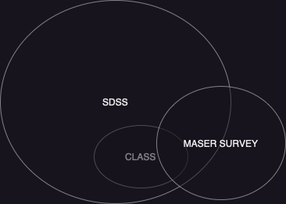
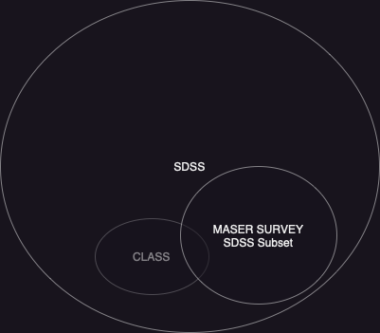
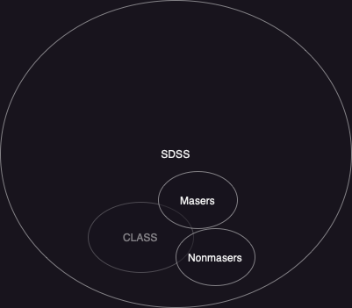
Procedures

Slide 7
Results
There were 2427 objects in the Survey SDSS subset; 2363 were nonmasers, and 64 were masers.
5 masers and 35 nonmasers were in the CLASS SDSS subset
40/2427 (1.65%) objects in the SDSS subset of the survey were CLASS objects. That is much higher than the .027% of SDSS objects found by the CLASS study to be CLASS objects.
Of masers in the Surveyed SDSS objects, 5/64 were CLASS objects, or 7.81% of Surveyed SDSS masers were CLASS objects.
Of nonmasers in the Surveyed SDSS objects, 35/2363 were CLASS objects, or 1.48%

Slide 8
Conclusions
Masers had a much higher chance to be emitted by AGNs than did nonmasers. <What does that indicate, and how statistically significant is it given the low number of masers we have?>

Slide 9
Data Analysis/Processing
The data used in this study was not ready to use as-is. Researchers completing the survey had entered object names in a variety of formats and the data contained duplicate objects named by various standards. I used a python script to detect potential duplicate objects by angular separation: if two objects in the Survey table were less than 1 arcsecond from each other, the script would present me with relevant data from NED and a choice of which object to keep, or to keep both (if they were not duplicates). The dataset had been pre-processed to remove obvious duplicates using name-string matching.
I then used a similar distance-matching algorithm in SQL to match the objects in the survey with their counterparts in SDSS, developing a subset of the survey which was in SDSS. I used a search radius of 5 arcsec, and collected the spectroscopic observation data from SDSS, for both masers and nonmaser survey subsets.
Finally, I matched Spectroscopic observation IDs with the CLASS database to get the subset of masers and nonmasers which were in CLASS.

