Slide 1

Towards Devising a Vibration Based Machinery Health Monitoring System
Md. Harunur Rashid Bhuiyan, Iftekhar Morshed Arafat, Masfiqur Rahaman,
Tarik Reza Toha, and Shaikh Md. Mominul Alam
Paper ID: MATPR-D-21-07129
Department of Textile Machinery Design and Maintenance
Bangladesh University of Textiles, Dhaka, Bangladesh
ICCAME 2021

Slide 2
Outline
Textile industry
Background and motivation
Our proposed system
System design
System implementation
Experimental evaluation
Industrial data collection
Findings
Conclusion and future work

Slide 3

Textile Industry

Slide 4
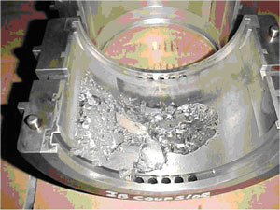
Background
Excess vibration for a long period of time can cause deterioration of machine parts [1].
Too much vibration thus can reduce machine lifetime in the long run
These deteriorations in long term can cause breakage in machine parts
An inboard bearing nearly destroyed due to excessive vibration

Slide 5
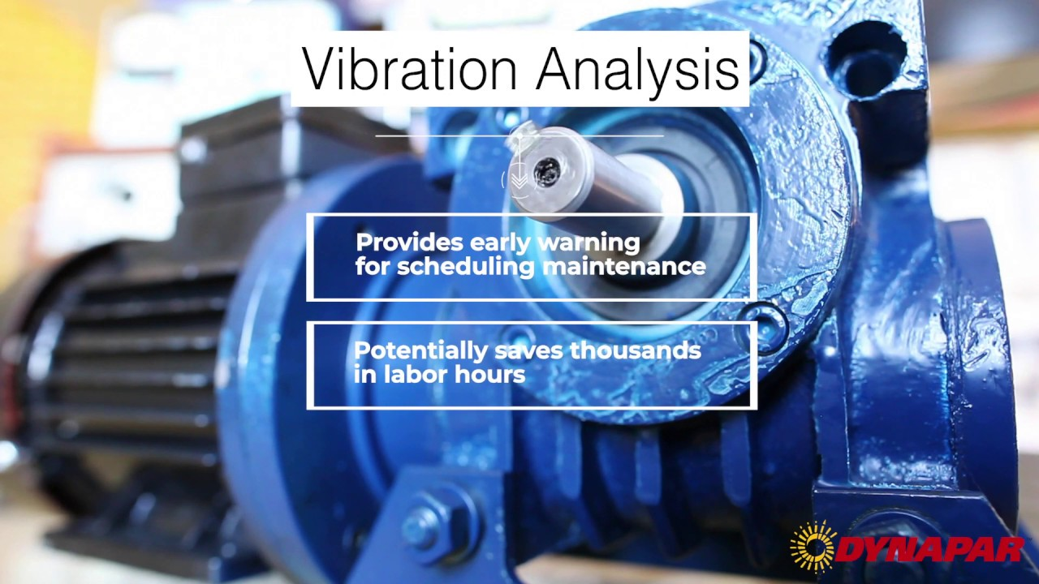
Motivation of our research
Monitoring the machine vibration to get an early warning about scheduled maintenance
Finding a standard vibration amount for each machine to detect any change in machine’s structural integrity
Making the system wireless so that it is suitable for industry
Vibration analysis for scheduled maintenance

Slide 6
Related Work
A machine maintenance system based on machine tool condition [3]
Rastegari et al., RAMS, 2017
Monitor the vibration of spindle units of machine.
Uses Ethernet for data transmission that is expensive and not suitable for industrial application.
A Wi-Fi based periodic vibration monitoring of pump [4]
Lewis et al., Proceedings of the 33rd International Pump Users Symposium. Turbo-machinery Laboratory, 2017
It does the periodic vibration monitoring in the pump
There is no Wi-Fi in the production areas
FEM-based damage assessment through vibration monitoring [5]
A Cabboi et al., Journal of Construction and Building Materials, Elsevier, 2017
Uses fiber optic cable for data transmission.
Impracticable solution for textile industry

Slide 7
Our Contribution
We propose a low-cost and wireless vibration monitoring system comprising off-the-shelf hardware resources and Bluetooth modules, which is applicable to the textile industry

Slide 8
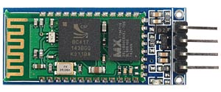
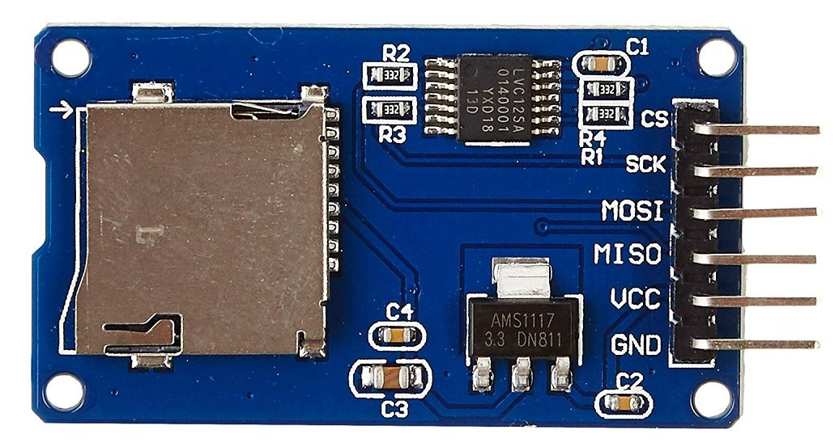

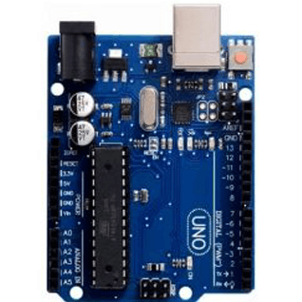
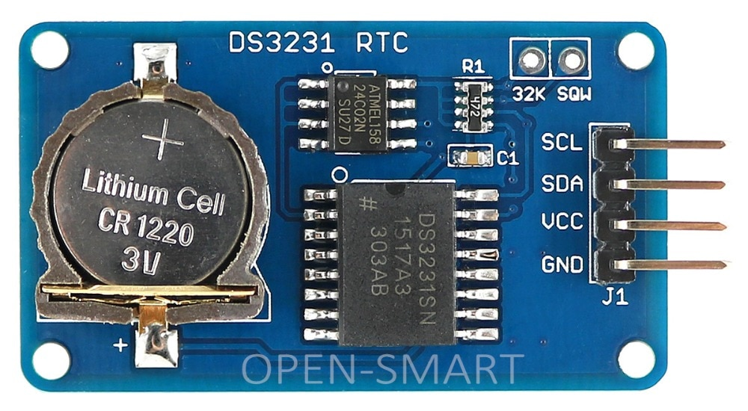

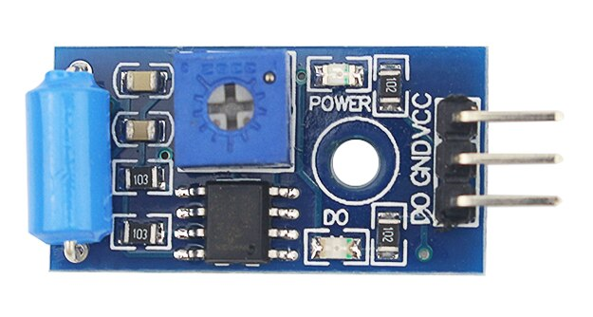

Operational Block Diagram
Bluetooth module
Bluetooth module
Storage module
Power module
Controller module (Arduino UNO) [Sender]
Controller module (Arduino UNO) [Receiver]
Power module
Real time clock
Bluetooth module
Sensor module (Vibration sensor SW-420)
Smart phone

Slide 9
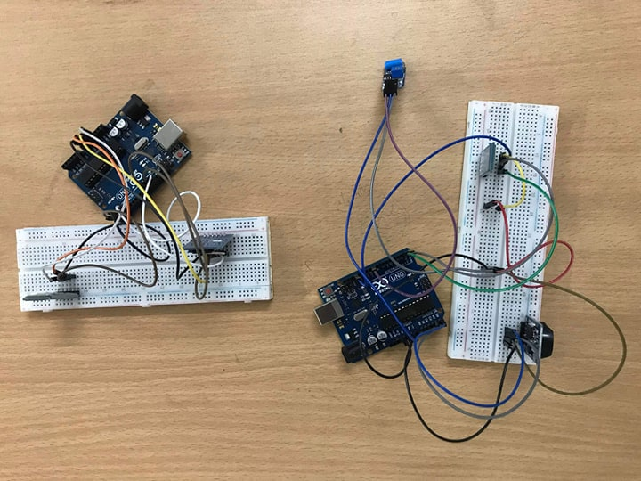
System Implementation
SW-420 Vibration sensor
Arduino Uno R3
SD card module
HC-05 Bluetooth module
Breadboard
Breadboard
Jumper wire
DS-3231 clock module
HC-05 Bluetooth module
Arduino Uno R3
Sender Unit
Receiver Unit

Slide 10
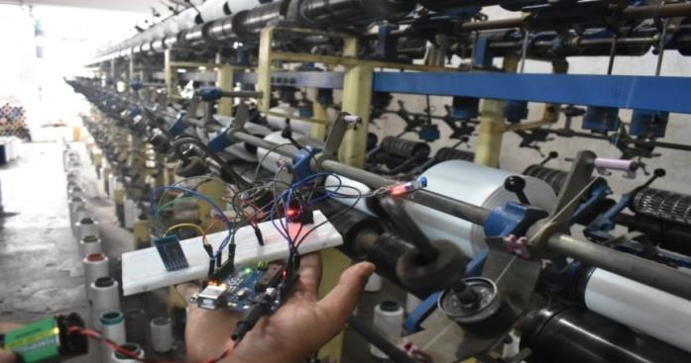
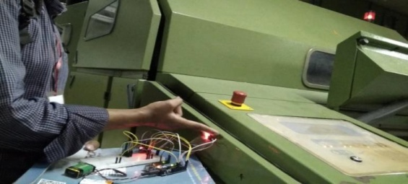
Industrial Data Collection
Soft winding section
(Gangeetal Thread Factory)
Spinning section (R.K. Textiles)

Slide 11
Industrial Data Collection (contd.)

Slide 12
Industrial Data Collection (contd.)

Slide 13
Industrial Data Collection (contd.)

Slide 14
Industrial Data Collection (contd.)
The soft winding machine (used for 2 years, good structural integrity) has the least amount of vibration.
Machine’s structural integrity has higher impact on the vibration level than the age of the machine.
So, by looking at the vibration amount of a machine and comparing it with its general vibration amount we can determine its health condition and quality

Slide 15
Industrial Data Collection (contd.)
The generators in utility and the ring spinning machine has most vibration. And they need the most maintenance

Slide 16
Conclusion and Future Work
Existing vibration monitoring systems are generally costly and less suitable for textile industry
We propose a low-cost, wireless and easy-to-implement vibration monitoring device for textile industry
In the future, we plan to scale-up our system and evaluate it in a realistic setting

Slide 17
References
S. Ahilan, M. Hemkumar, N. Mishra, Vibration analysis of vertical pumps, Indian Journal of Scientific Research (2018) 251–257.
Vibration study and root cause analysis, hydro inc., https:// hydroinc.com/ blog/ 2009/ 12/01/vibration-study-root-cause-analysis/
A. Rastegari, A. Archenti, M. Mobin, Condition based maintenance of machine tools: Vibration monitoring of spindle units, in: 2017 Annual Reliability and Maintainability Symposium (RAMS), IEEE, 2017, pp. 1–6.
B. Lewis, M. Miller, et al., Predictive diagnostics for pump seals: Field trial learnings, in: Proceedings of the 33rd International Pump Users Symposium, Turbomachinery Laboratory, Texas A&M Engineering Experiment Station, 2017.
A. Cabboi, C. Gentile, A. Saisi, From continuous vibration monitoring to fem-based damage assessment: application on a stone-masonry tower, Construction and Building Materials 156 (2017) 252–265.

Slide 18
Thank You!
Questions are welcome!
Email: harunurrashidmoon@gmail.com

