Slide 1
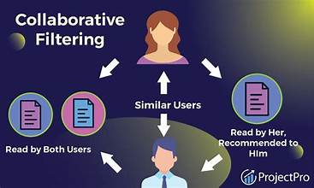
Movie Recommender System
Collaborative filtering

Slide 2
Description
The movie recommender system aims to provide personalized movie recommendations to users based on ratings. By using data on movie genres and ratings, the system will predict and suggest movies that users are likely to enjoy.
The system will use collaborative filtering (user - based) to make suggestions for each user.

Slide 3
Business Problem
Users finds it difficult to choose content that matches their preferences. Lack of personalized recommendations leads to users dissatisfaction.
The recommender system will:
Help users to discover new content that they may enjoy based on their unique preferences.
Enhance user experience by providing personalized movie recommendations.
Ensure viewers are exposed to a variety of relevant movies

Slide 4
Objectives
Performance evaluation of the models
Personalization
User engagement

Slide 5
Shareholders
End users - these are the people who consume the content and are relying on recommendations.
Content creators - these are people who are producing the content
marketing team - these team will rely on the system to come up with a marketing strategy
product team`- these are for integrating the system into the platforms

Slide 6
Data Understanding
Data used was the grouplens.org/datasets/movielens/latest/ sourced from the Group Lens research lab at the University of Minnesota.
The small dataset containing 100,000 user ratings and a subset of the data i.e. movies and ratings was used.
The data contains columns:
movie ID - uniquely identifies a movie
Title - name of a movie

Slide 7
Data Understanding
Genres - genre to which a movie belongs
user ID - uniquely identifying each user
rating - a rating given to movies by users
timestamp - time the movies were released

Slide 8
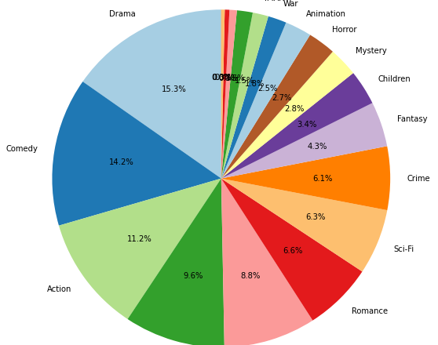
Genre popularity visualizations
Genres Drama, Comedy and Action are the most popular ones

Slide 9
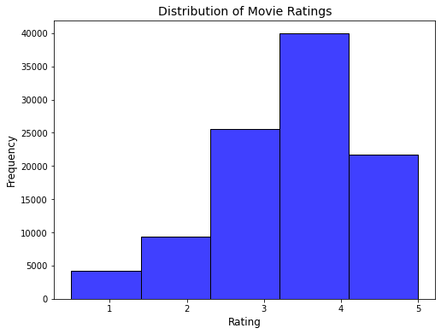
Ratings Distribution
Rating 4 has the highest frequency followed by 3,5,2 and 1

Slide 10
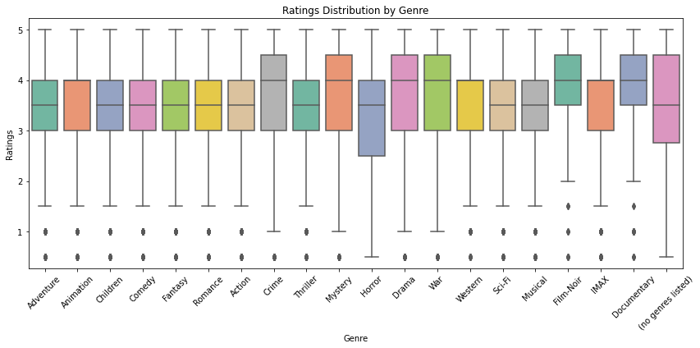
Rating Distribution by Genre

Slide 11
Using different Models
Modeling with SVD using gridsearch – Test RMSE = 86.93%
Cross validation with KNNBasic – Test RMSE = 97.36%
Cross validation with KNNBaseline – Test RMSE = 87.67%
Cross validation with KNNWithMeans – Test RMSE = 89.74%

Slide 12
Using SVD for modeling
SVD has the lowest RMSE at 86.93 and therefore used for creating a recommender system.

Slide 13
Making Recommendations
Recommendation 1: "The Godfather, The (1972)".
Recommendation 2: "The Shawshank Redemption (1994)".
Recommendation 3: "Fight Club (1999)".
Recommendation 4: "The Boondock Saints (2000)".
Recommendation 5: "Lawrence of Arabia (1962)".

Slide 14
THANK YOU!

