Slide 1
Class Talk
2017011466 李晨昊

Slide 2
Content
Qt pronunciation
Qt container
Python int multiplication algorithm

Slide 3
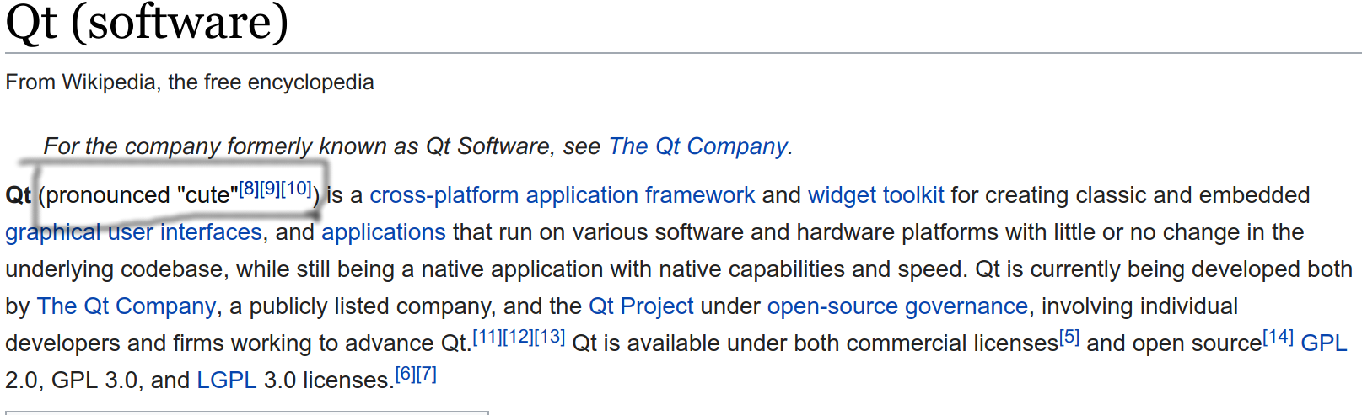
Qt pronunciation
cute!

Slide 4
Qt container
  QLinkedList vs std::list
  QList: no stl counterpart
  QVector vs std::vector
  QMap vs std::map
  QHash vs std::unordered_map
  QSet vs std::unordered_set
  QByteArray vs std::string

Slide 5
Qt container
QList<T> implementation
  store data in a void*
  for sizeof(T) <= sizeof(void *), use the space of void * to store data
  otherwise allocate memory elsewhere in the heap, the void * points to it
  allocate memory on both end for fast prepend(this is NOT std::deque)
  the main part is implemented in a cpp file
  cooperate well with other qt components (xxxPrivate *)

Slide 6
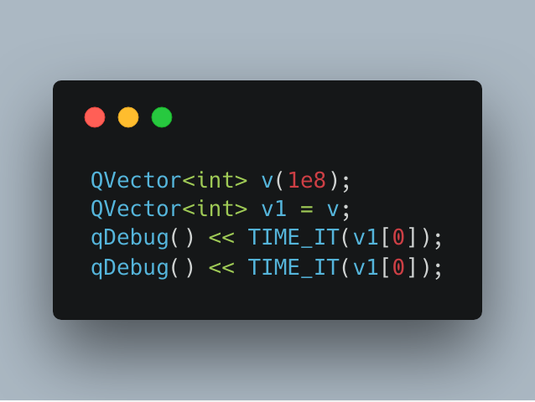
Qt container
Cow: Copy On Write
All qt container offer the same COW implementation as in QString
example:
  possible output:
    0.186924
    3.92e-07

Slide 7
Qt Container
"Whereas STL's containers are optimized for raw speed, Qt's container classes have been carefully designed to provide convenience, minimal memory usage, and minimal code expansion." -- J. Blanchette

Slide 8
Qt container
Pros
  cow helps save unnecessary copy
  better type information(via QTypeInfo and Q_DECLARE_TYPEINFO), which enables QVector's expanding to utilize realloc
  convenience(e.g. QString::count, QVector::prepend)
  less code expansion
  cooperate well with other qt components

Slide 9
Qt container
Cons
  cow overhead(and normally we don't follow the best practice, so that unnecessary copy happens anyway)
  providing unnecessary method causes redundancy and misleading
  some functions cann't be inlined, which introduces function call overhead and prevent compiler from further optimizing
  stl containers cooperate well with stl algorithm

Slide 10
Qt container
  Note:
    if you care performance, use the constant version of qt container's method whenever possible
    you CAN store objects like QDialog directly in both QVector and std::vector(thanks to c++ 11 move semantics), e.g., QVector<MyDialog> / std::vector<MyDialog>
    qt's associative container's `insert` works differently from stl's(same as `insert_or_assign` introduced in c++17 )

Slide 11
Qt container
“We should forget about small efficiencies, say about 97% of the time: premature optimization is the root of all evil.” -- Donald Knuth

Slide 12
Python int multiplication
Python's builtin int provides arbitrary precision integer
For large integer multiplication, python adapts Karatsuba algorithm for efficiency

Slide 13
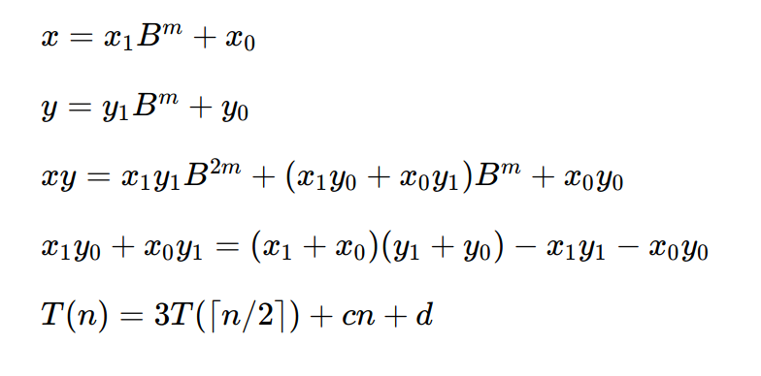
Python int multiplication
Time complexity: O(n^1.585)
Extra memory: O(n)

Slide 14
Python int multiplication
Example:
  12345 = 12 · 1000 + 345; 6789 = 6 · 1000 + 789
  12345 * 6789 = (12 · 1000 + 345) * (6 · 1000 + 789)
  = (12 * 6) * 1000000 + (12 * 789 + 345 * 6) * 1000 + 345 * 789
  12 * 789 + 345 * 6 = (12 + 345) * (6 + 789) - (12 * 6) - (345 * 789)
  recursively calculate (12 + 345) * (6 + 789), (12 * 6),
  (345 * 789)

Slide 15
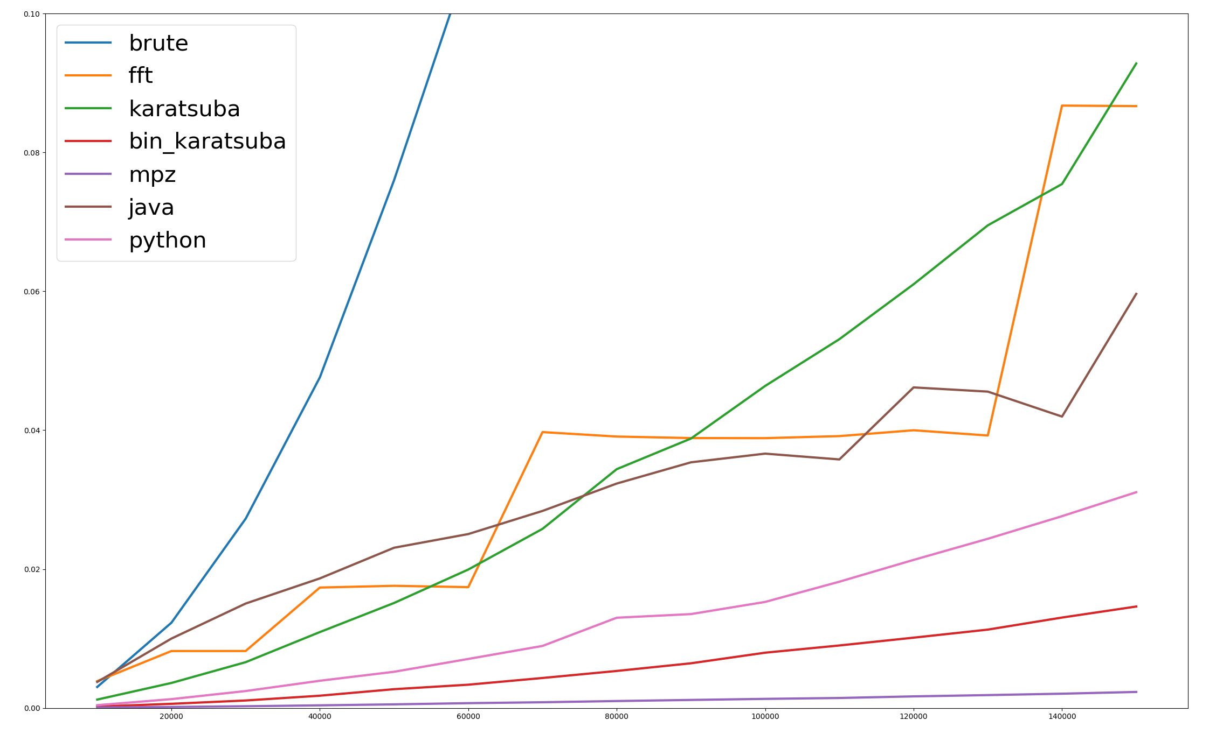
Python int multiplication
Performance(only the time of multiplication, rather than the whole program)

Slide 16
Thank you

