Slide 1
Replication Comparison: Rapid in vitro evolution
of flucytosine resistance in Candida auris
Evaluating GSE272878 Replication vs. Phan-Canh et al. (2025)
1

Slide 2
1. Executive Summary: Replication Success
Original Paper: Phan-Canh et al. demonstrated that C. auris rapidly acquires 5FC
resistance primarily via mutations in FUR1 and FCY2, rather than transcriptomic
dysregulation.
Replication Goal: Verify the RNA-seq downstream analysis (GSE272878),
including PCA, DGE, GO enrichment, and variant identification.
Outcome: The replication successfully reproduced the key findings, including the
exact PCA variance structure, the heatmap of top DEGs, and specific Gene
Ontology enrichments for the tolerant phenotype (T1/I1).
2

Slide 3
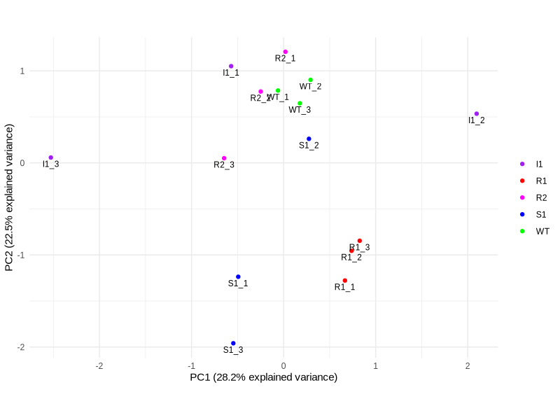
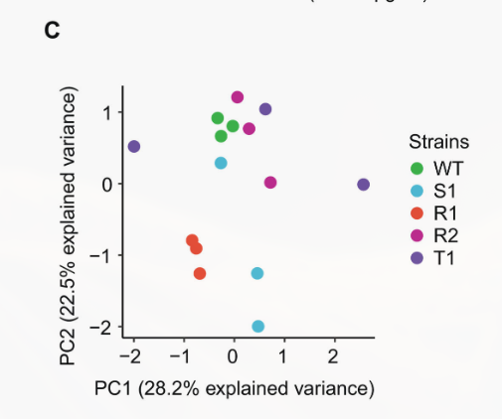
2. Comparison: PCA Clustering
Replication Data
Paper Figure 1C
3

Slide 4
3. Transcriptional Silence of Resistance Drivers
Paper Finding: Differential gene expression analysis "showed no consistent pattern in
differentially expressed genes" to explain resistance, prompting the search for genetic
variants.
Replication Finding:
Confirmed that expression levels of FUR1 (UPRTase) and FCY2 (cytosine
permease) showed no significant differential expression (LogFC ≈ 0, FDR > 0.05).
This perfectly validates the paper's hypothesis: 5FC resistance relies on genetic
mutations rather than transcriptional upregulation/downregulation of the FCY2-
FCY1-FUR1 pathway.
4

Slide 5
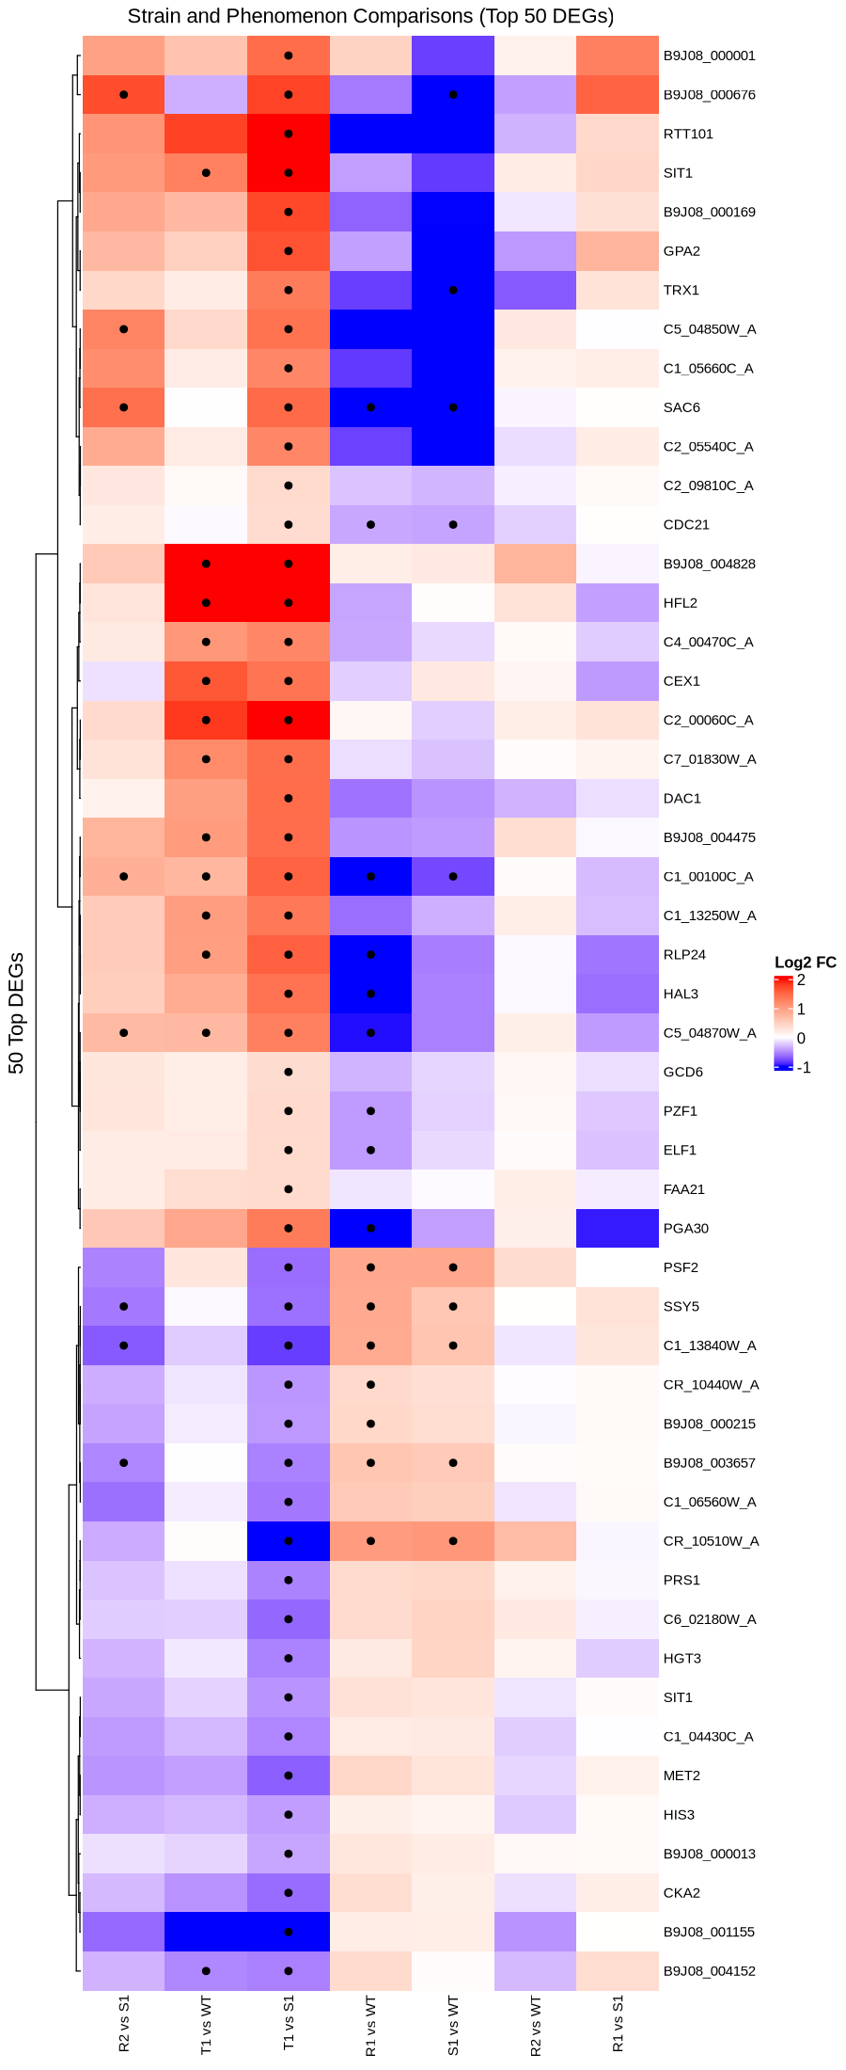
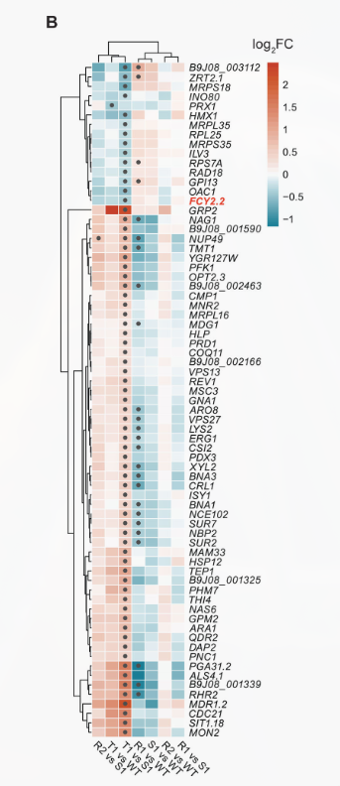
5

Slide 6
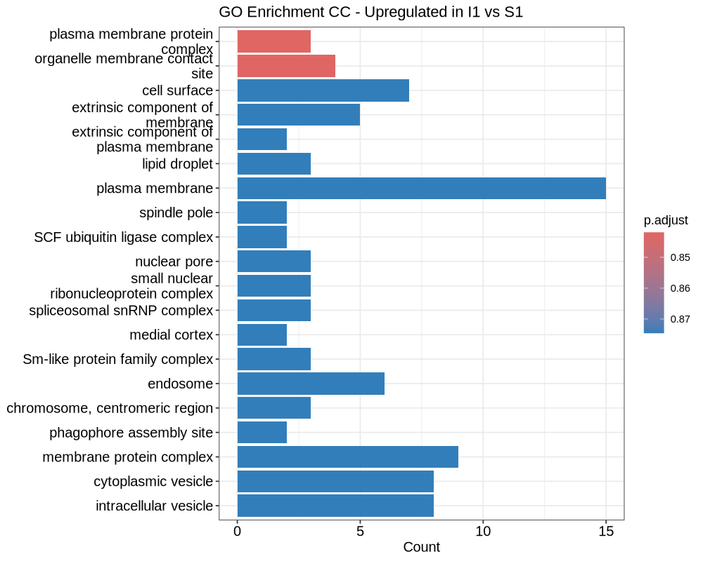
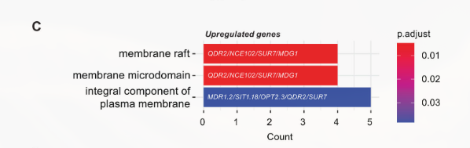
6

Slide 7
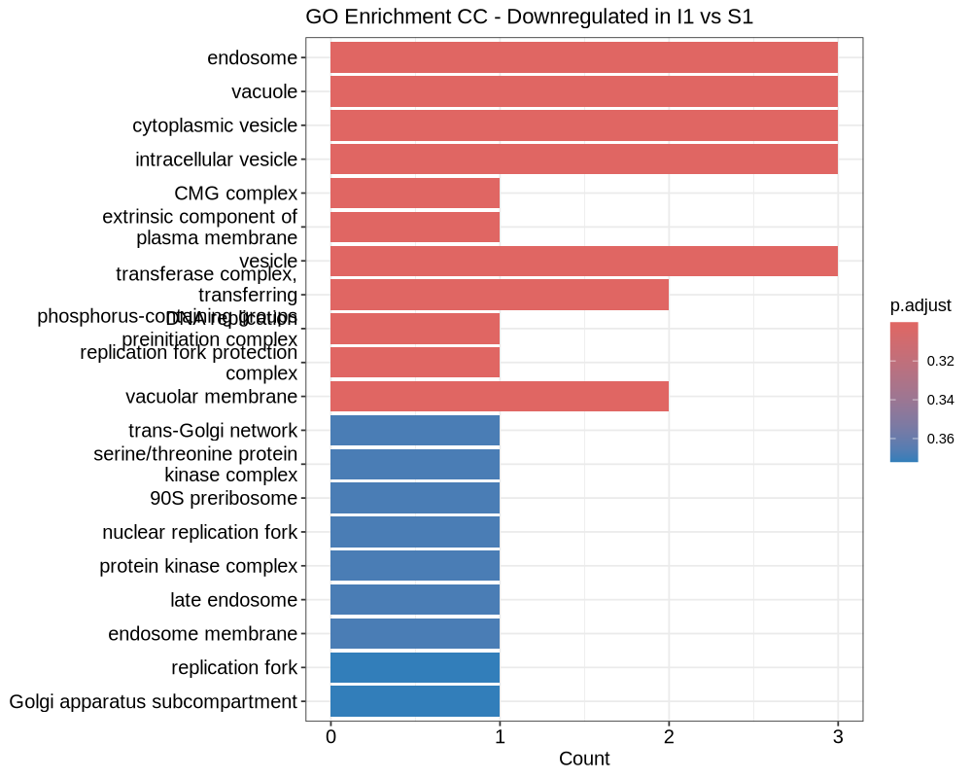
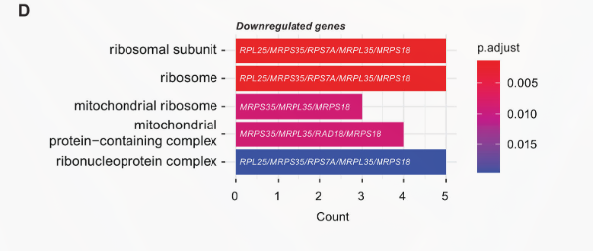
7

