Slide 1


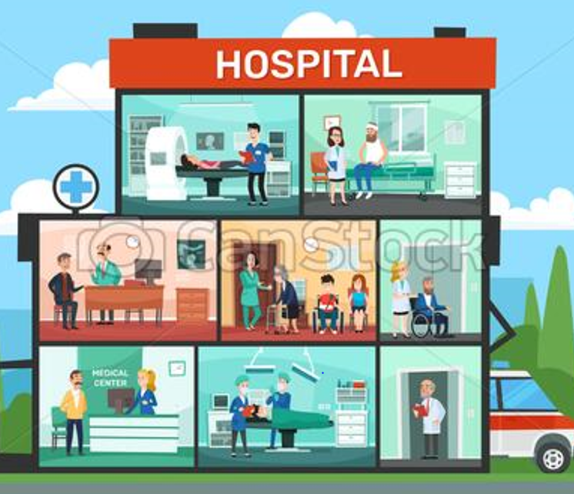
HOSPITAL DATABASE
NUR TARIQUR AND MASHA M. STEPHEN

Slide 2
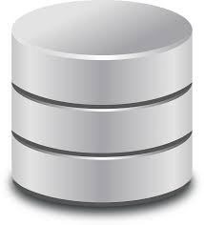
Why a hospital database
A hospital is a very busy place.
It is difficult to maintain day to day activities and keep the records manually.
Easily monitors patients and their information.
Keeps all records illnesses and medications.
Future goal is to store data from all the equipment that the hospital uses to treat and diagnose illnesses.

Slide 3
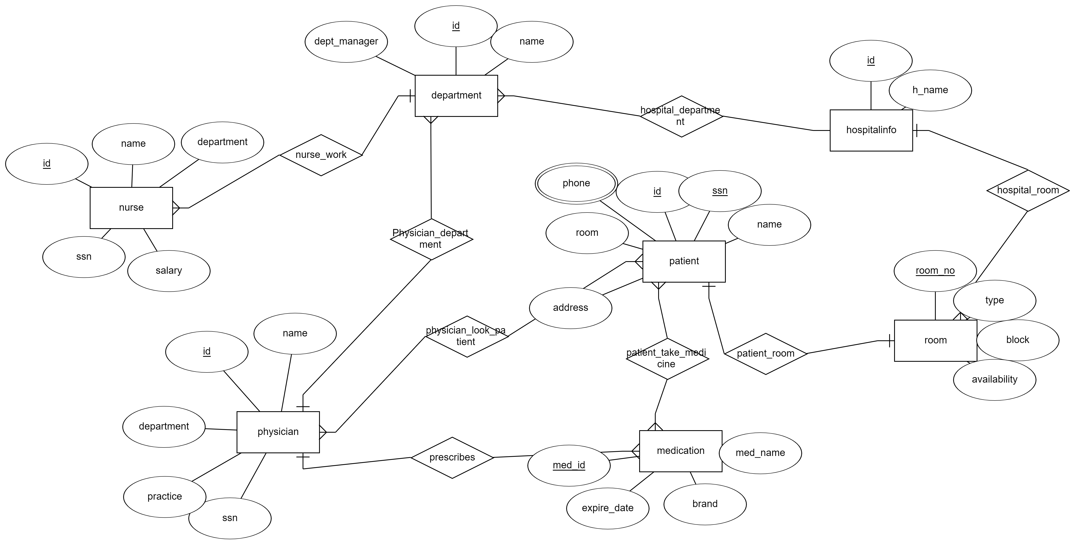
ERD FOR THE HOSPITAL DATABASE

Slide 4
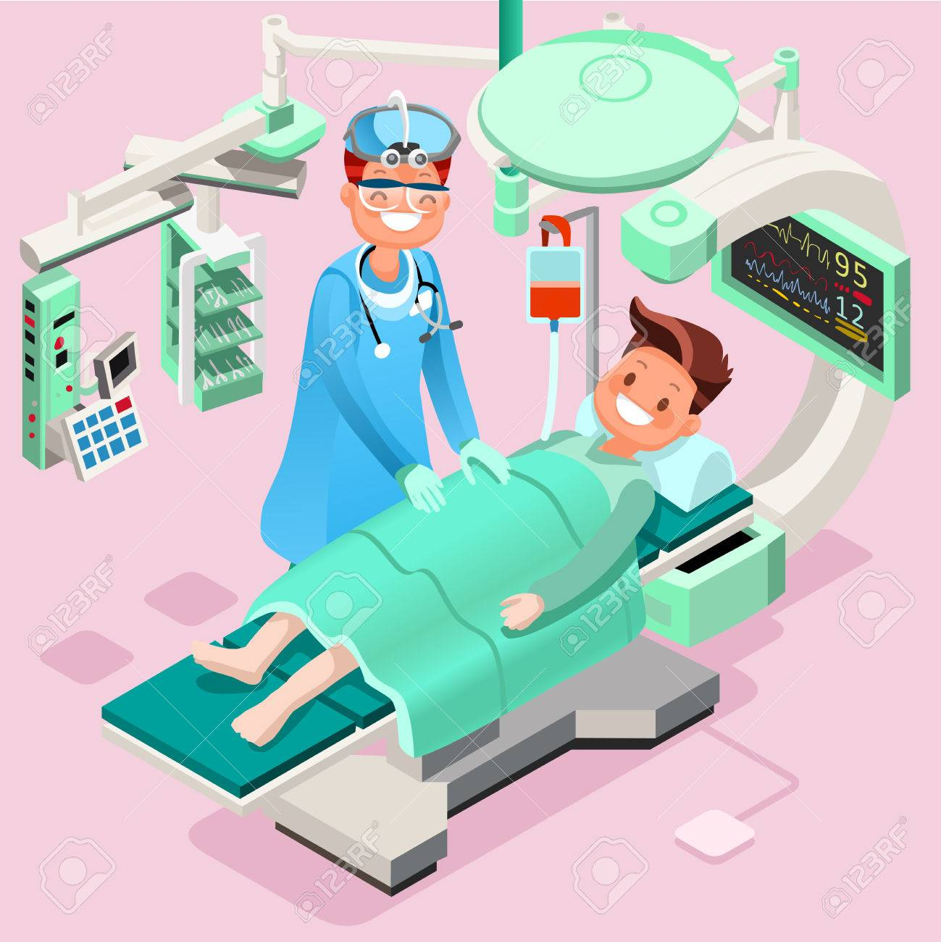
Use cases
Patients fill their information such as address, symptoms and phone number upon arrival.
The rooms have unique ID so that nurses can easily see their availability in the system.
Physicians' information keeps record of their practices so that hospitals are linked. E.g., neurologists, orthopedist and many more
When a doctor wants to see the procedures done on a patient, they can access the data and their different procedure such as surgery and cesarean section
To look at which medicines are available and their expiration so that management knows when to get more

Slide 5
Examples of questions it can solve
Find the nurse who works for Services department?
Find the nurse name and doctor name who works in the same department?
find the salary of the nurse who makes 45000 dollars and their name

Slide 6
Future work
To have a research table where different departments can share the studies
To have a way to read data from equipment in the database

Slide 7
Team
Masha M. Stephen
Tariqur Nur

