Slide 1
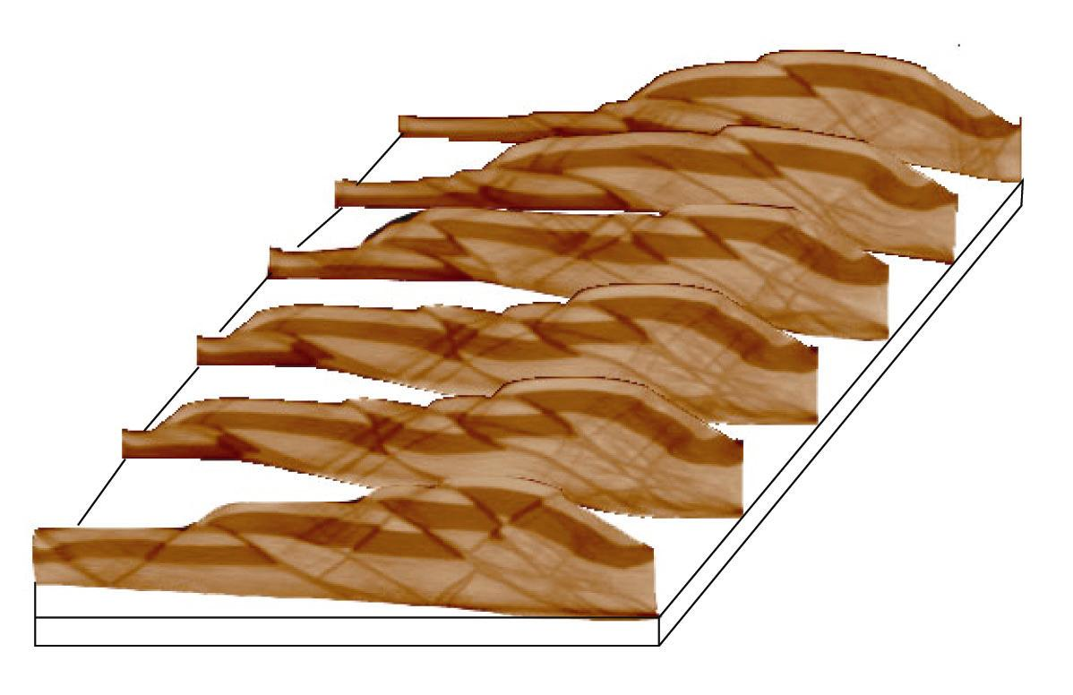

Insights into the 3D Geometry of Thrust Belts using x-ray Tomography of Sandbox Experiments
Jaime Toro
West Virginia University

Slide 2
The Data
A stack of 100 x-ray images through the deformed sandbox
Acquired at IFP in Rueil-Malmaison, France
Also available are slices at intermediate stages

Slide 3
Goals
Understand the relationship between maps and cross sections
Explore the 3D geometry of thrust faults
Think about how shortening is accommodated in different portions of a thrust-belt

Slide 4
Context
After discussing Thrust Systems
After doing conventional sandbox experiments
After some practice with simple cross sections
Before any real field mapping

Slide 5
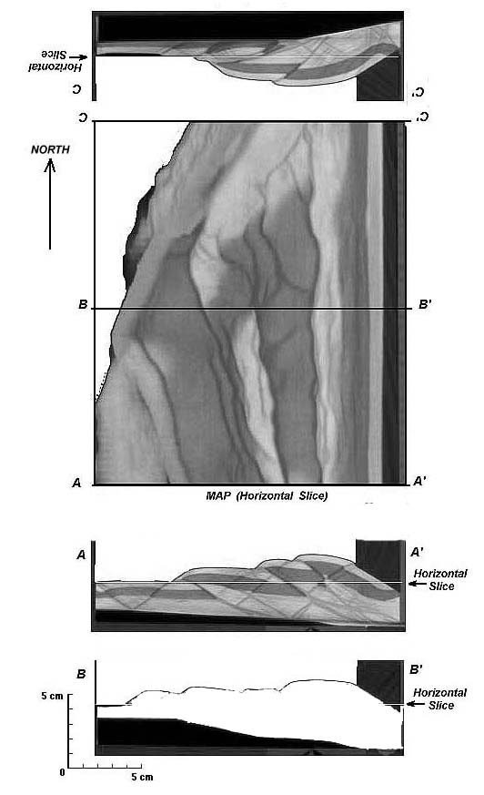
Lab Exercise
Vertical Slice
(Cross section)
Horizontal Slice though the model
(Map View)
Vertical Slice
(Cross section)

Slide 6

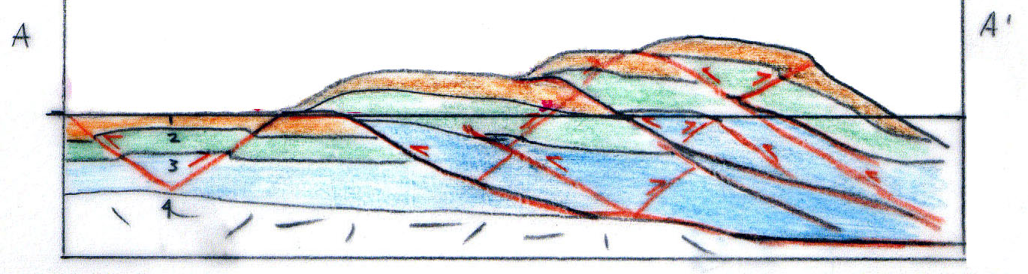
Activities 1: Interpret the Cross Sections
1. Color the two cross sections.
2. Highlight the faults in red.

Slide 7
Activities 2: Make a Geological Map
On overlay paper:
1. Color the stratigraphic units on the map.
2. Draw contacts
3. Draw faults with appropriate symbols
4. Anticline and syncline axes.
5. Strike and dip symbols where possible.

Slide 8
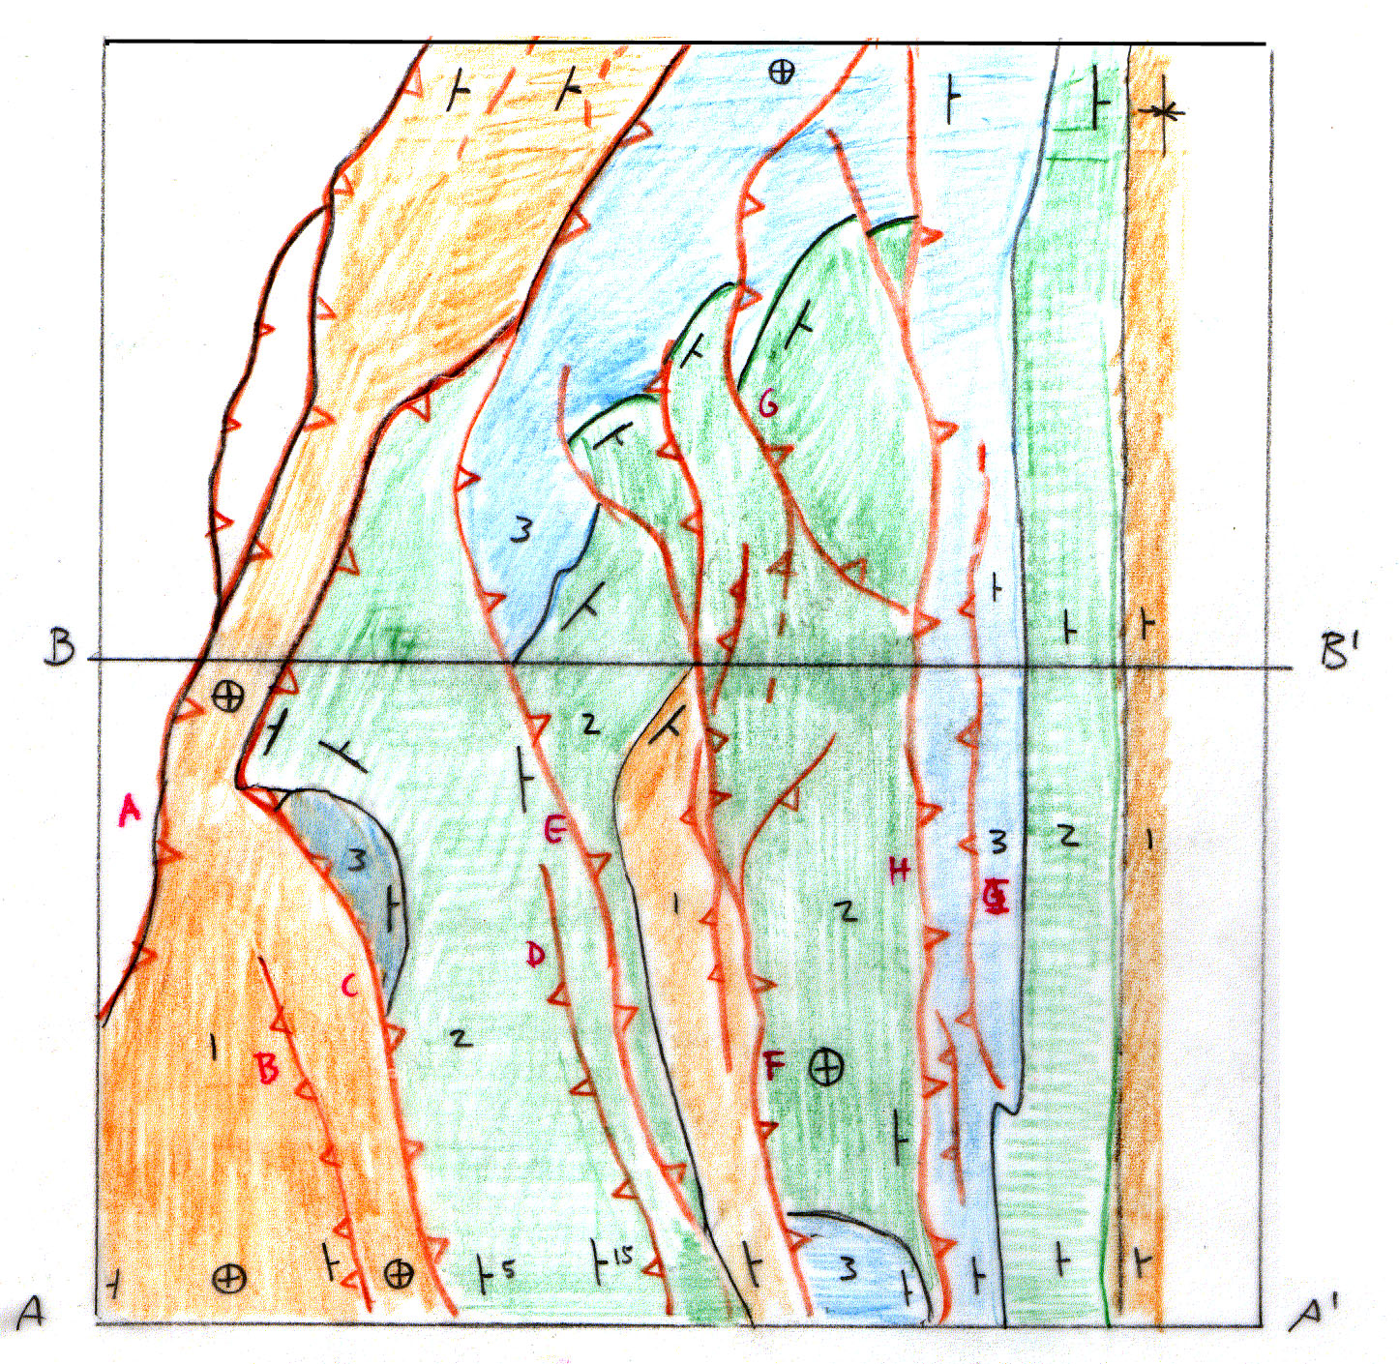
The Maps

Slide 9
Activities 3: Fault linkage
Label all the faults on the map from west to east using A, B, C, etc.
Put the same fault labels on the cross sections.
Discuss how shortening is partitioned among the faults

Slide 10
Fault Linkage
E
A
H
G
E
A
H
C
D
F
B
D
B
E
H

Slide 11
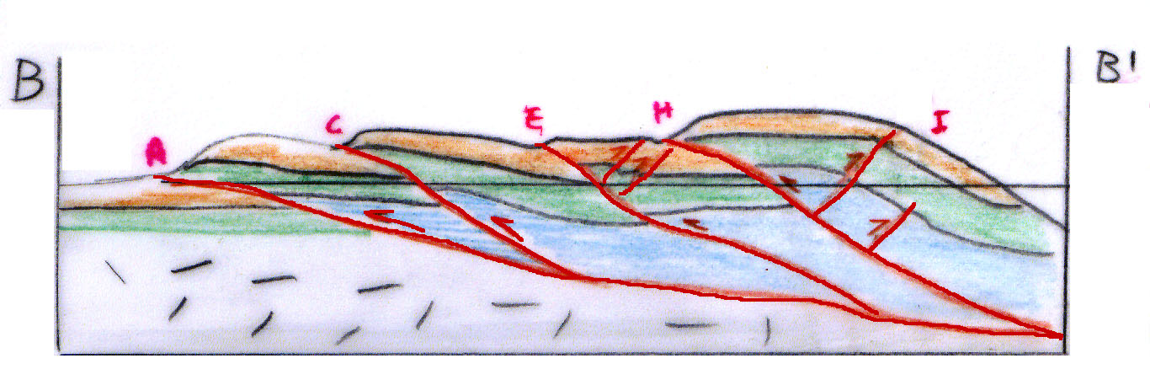
Activity 3-Mystery sections
Make a new cross section on the basis of your map

Slide 12
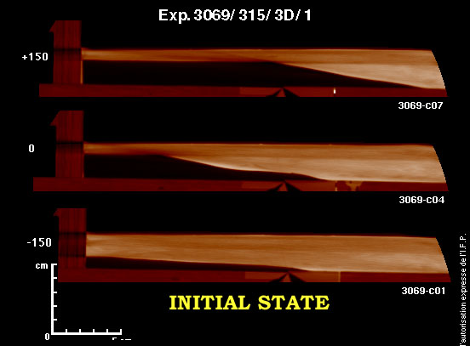
Other Insights- Basement Structure
Thin cover at north end
Thick cover at south end

Slide 13
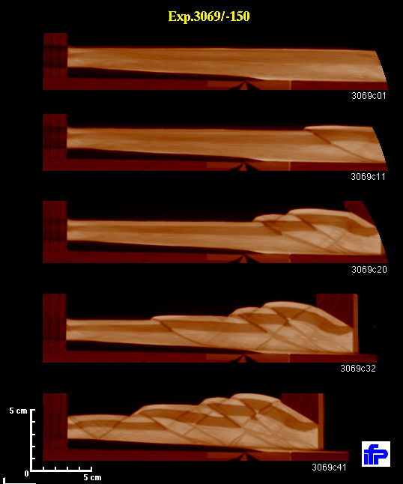
Other Insights:
Deformation Sequence
South End

Slide 14
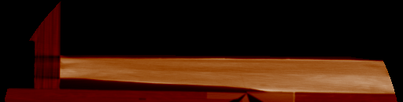
Deformation Movie
South End (A-A’)

Slide 15


Deformation Sequence
Mystery section- middle slice
Final State

Slide 16
Other Insights- Critical Wedge Taper

Slide 17
Conclusion
3D Sandbox models are powerful tools for developing intuition about complex structures both in terms of geometry and kinematics.

