Slide 1
Predicting Train Delays in Saudi Arabia: A Data-Driven Approach
College of Computing and Informatics
Master of Data Science
DS698:Capstone Project
Mashael Alsogair

Slide 2
Contents
1
Introduction
2
Literature Review
3
Methodology
4
Results & Discussion
5
Conclusion

Slide 3




The Challenge of Railway Delays
Operational Efficiency
Passenger Satisfaction
Delays disrupt schedules and resource allocation, creating cascading inefficiencies throughout the network.
Unpredictable service reduces customer confidence and overall experience quality.
Economic Impact
Network Propagation
Delays translate to productivity losses for both operators and passengers, affecting the broader economy.
Initial delays often cascade through interconnected segments, amplifying their impact system-wide.

Slide 4




Key Factors Driving Train Delays
Operational Factors
Infrastructure Constraints
Calendar Events
Saudi-Specific Weather
Holidays and special events create travel surges that strain capacity.
Train type, speed variations, and headway deviations impact punctuality significantly.
Station layout and terminal congestion create bottlenecks throughout the network.
Extreme heat and dust storms pose unique challenges absent in global models.
Understanding these interconnected factors requires tailored predictive models that account for Saudi Arabia's distinctive environmental and operational landscape.

Slide 5




Machine Learning Approaches to Delay Prediction
Advanced algorithms transform complex railway data into actionable delay predictions.
Statistical Regression
Effective for continuous delay estimation but struggles with non-linear relationships.
Conventional ML
SVR, Decision Trees, and Gradient Boosting balance interpretability with predictive power.
Deep Learning
MLP and Deep Extreme Learning excel at capturing complex, non-linear delay patterns.
Ensemble Models
LightGBM and CatBoost show superior accuracy by combining multiple algorithms.

Slide 6



Framing the Prediction Task
Classification Approach
Regression Approach
Research Applications
Categorizes train operations into binary states: "on-time" or "delayed".
Quantifies exact delay duration in minutes with continuous values.
Saudi Arabia's implementation builds on global precedents with local adaptations.
Provides granular temporal predictions
Supports direct operational decision-making
French railways: SVM and Random Forest algorithms
Enhances scheduling precision
Proven effective across international railways studies
Luxembourgish freight: Long-term prediction focus
Saudi context: Hybrid approaches for regional challenges

Slide 7




Saudi Arabia's Unique Context
Extreme Climate
Regional Travel Patterns
Operational Variability
Limited Research
Temperatures exceeding 50°C, sandstorms, and dust.
Unique religious seasonal demand spikes.
New infrastructure with evolving operational procedures requires adaptive models.
Global models fail to address Middle Eastern railway conditions.
Saudi Arabia presents a distinct railway ecosystem where global delay prediction models fall short. This research addresses this gap by developing localized frameworks that account for these unique operational realities.

Slide 8
Research Aims & Objectives
Research Aim: To develop a robust machine learning-based classification framework for predicting train delays in Saudi Arabia by integrating operational, environmental, and calendar-based features.
Research Objectives
Exploring key operational, temporal, and environmental delay factors using EDA and permutation-based importance analysis.
Training and comparing multiple classification models—Logistic Regression, SVM, Random Forest, XGBoost, and LightGBM—for binary delay prediction.
Evaluating the models using accuracy, precision, recall, F1-score, and AUC-ROC, with attention to overfitting diagnostics.

Slide 9




Data Sources and Integration
Operational Records
14,523 historical train operations from Saudi Arabia (2023-2024).
Weather Data
Open-Meteo API data merged by operation date and city.
Holiday Information
Official academic calendar.
Unified Dataset
Holisticmerged dataset that forms the foundation for our predictive modeling framework.
This integrated approach ensures each train record contains comprehensive contextual features.

Slide 10




Preprocessing and Feature Engineering
Data Cleaning
Handled Missing Values
Convert features Format
Normalized Date Formats
Feature Engineering
weekend flags, seasonal labels, and city-specific routing variables.
Encoding
Cyclical encoding for temporal feauted to preserve periodicities in railway schedules.
One hot encoding for other catagorical features.
Feature Selection
Combined correlation analysis with permutation importance to retain high-impact, non-redundant predictors.

Slide 11





Modeling and Evaluation Framework
Model Selection
Five classifiers: Logistic Regression –as bassline model-, SVM, Random Forest, XGBoost, and LightGBM.
Data Split
80% training, 20% testing to ensure robust evaluation.
Hyperparameter Tuning
RandomizedSearchCV.
Evaluation Metrics
AUC-ROC (primary), F1-score, precision, recall, and accuracy.
Overfitting Analysis
Train-test ROC AUC gap assessment for model reliability.
This comprehensive framework ensures fair comparison between models while identifying the most effective classifier for railway delay prediction.

Slide 12



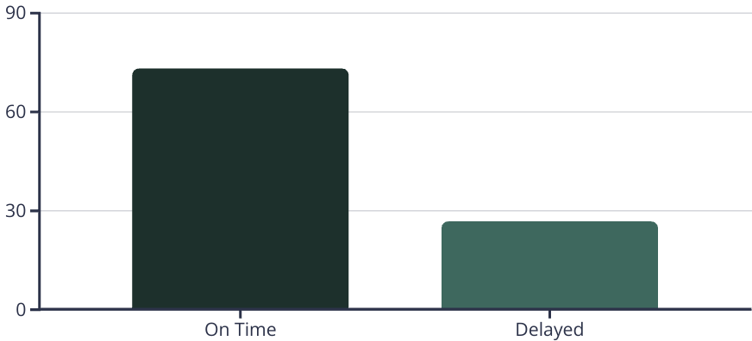
Exploratory Data Insights: Class Distribution
Initial Analysis
Key Metric
Impact & Strategy
Our exploratory analysis revealed significant class imbalance in the dataset.
With 73.1% of trains arriving on time, standard classification models would likely favor the majority class. This observation drove our implementation of cost-sensitive learning techniques.
Addressing this imbalance was crucial to develop models that effectively predict the minority class (delays) without sacrificing overall performance.

Slide 13




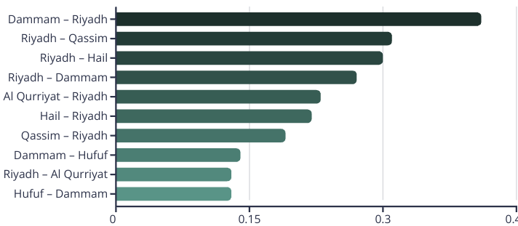
Exploratory Data Insights II — Route Patterns
Daily Operations
Route Popularity
Delay Distribution
An average of 20 trains operate daily across the railway network.
"Riyadh – Dammam" emerges as the most frequently traveled route, while "Riyadh – Jouf" shows minimal traffic.
"Dammam – Riyadh" route demonstrates significantly higher delay frequencies compared to other connections.
Route Length
Association between longer journey durations and reduced punctuality
Modeling Implications: These route-specific patterns provide crucial differentiating factors for our predictive delay models.

Slide 14


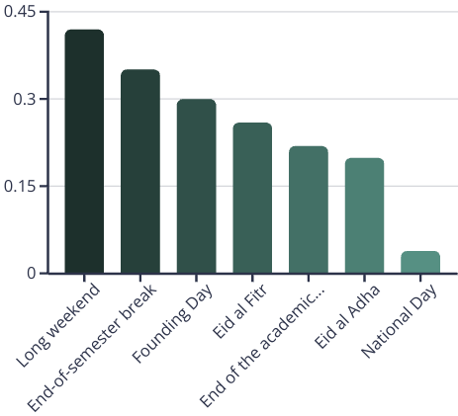
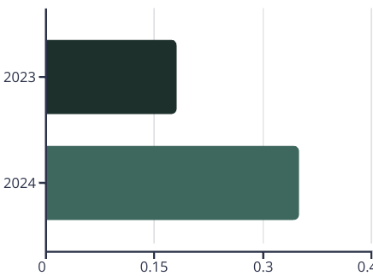
Exploratory Data Insight III – Calendar Factors
Public Holiday Impact
Temporal Patterns
Long weekends and holidays showed markedly increased delay rates across the railway network.
Month-to-month variations revealed seasonal delay trends throughout the year.
Passenger volume surges create significant operational pressure during these periods.
Year-over-year comparison between 2023-2024 captured evolving operational dynamics.
Modling Implication: Incorporating such features into machine learning models enhances contextual awareness and enables more accurate identification of high-risk periods.

Slide 15


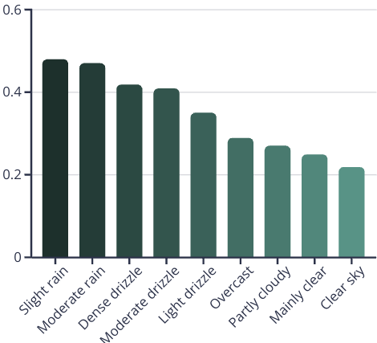
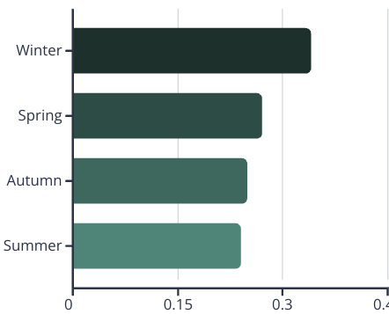
Exploratory Data Insight IV – Environmental Factors
Categorical Weather Conditions Delays were significantly more frequent under weather events such as rainfall, whereas clear skies and mild conditions correlated with improved punctuality.
Numerical Weather Features Delayed journeys tended to experience slightly higher wind speeds and gust values.
Modling Implication: Including such features enables the models to account for environmental disruptions that may not be obvious through operational data alone, thereby enhancing the robustness and responsiveness of the predictive framework.

Slide 16



Feature Importance and Inclusion
To determine the most informative variables for classification, a combination of correlation analysis, Random Forest feature rankings, and permutation importance was employed. The correlation matrix was first used to identify and eliminate highly collinear features
Core Predictor of Train Delay Random Forest importance scores and permutation analysis then revealed that journey time was the most influential predictor. Its high permutation importance score (0.2543, p < 0.001) indicates a strong relationship with delay outcomes.
Supporting Temporal and Environmental Features Temporal features—week number, day of the week, and month, year—demonstrated moderate yet consistent predictive value. Environmental predictors—wind speed, precipitation, and temperature— were retained based on their moderate importance scores and low collinearity with one another.
Additional Contextual Variables
Although these features ranked lower in importance —Vacation Type, Season, and Arrival City —were statistically significant (p < 0.05) and retained as engineered inputs, highlighting their added value in capturing contextual delay patterns.
Modling Implication: The feature selection process confirmed that effective delay prediction requires a blend of internal journey characteristics and external contextual factors.

Slide 17



Evaluation of Machine Learning Model Performance
Tuned LightGBM emerged as the top performer with 0.96 ROC AUC, demonstrating superior capability in handling class imbalance for train delay predictions.
Tree-based models substantially outperformed linear classifiers. XGBoost closely followed LightGBM, while Logistic Regression and SVM struggled with the nonlinear patterns in railway operations.
This performance gap highlights the complex, nonlinear nature of delay factors in railway system, requiring sophisticated ensemble methods for accurate prediction.
Model
Accuracy
ROC AUC
F1 Score
Precision
Recall
LightGBM
0.9041
0.9587
0.9324
0.9624
0.9041
XGBoost
0.8960
0.9570
0.9269
0.9539
0.9014
Random Forest
0.8762
0.9228
0.9166
0.9037
0.9298
SVM
0.5223
0.6997
0.5759
0.8209
0.4436
Logistic Regression
0.6481
0.7262
0.7224
0.8537
0.6261
LightGBM (Tuned)
0.9044
0.9605
0.9327
0.9615
0.9055
XGBoost (Tuned)
0.9004
0.9601
0.9299
0.9577
0.9037
Random Forest (Tuned)
0.8769
0.9323
0.9149
0.9254
0.9046

Slide 18



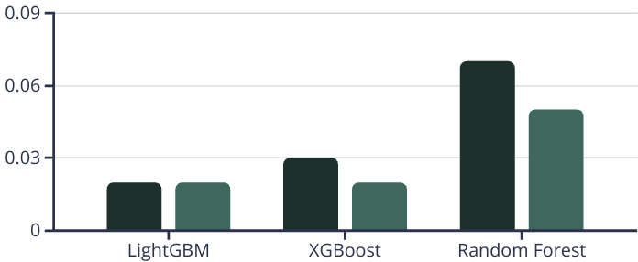
Evaluation of Machine Learning Model Generalization
Model generalization capabilities were assessed by comparing train and test ROC AUC scores across all algorithms.
Some untuned models initially showed signs of overfitting, particularly Random Forest with a 0.0766 gap between train and test scores.
Hyperparameter tuning via RandomizedSearchCV significantly reduced these gaps while improving test performance. This confirms the importance of regularization for real-world deployment.
Before Tuning Gap
After Tuning Gap

Slide 19


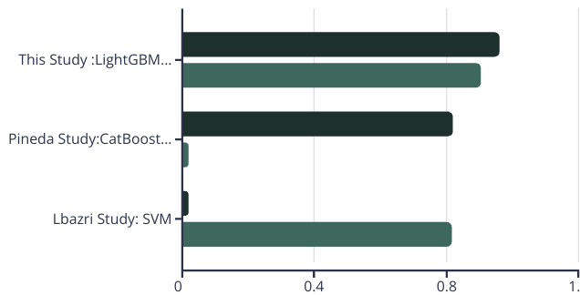
Benchmarking Against Previous Studies
The first, conducted by Lbazri et al. (2020) on the French railway network, utilized Random Forest and SVM. Their best model achieved a test accuracy of 85.38%.
The second benchmark study by Pineda-Jaramillo and Viti (2023), focused on freight rail delays in Luxembourg, used CatBoost and reported a ROC AUC of 0.82 and F1-score of 0.89.
These benchmarking results confirm the relevance of the proposed model for the Saudi context and reinforce the advantage of integrating temporal encodings, cost-sensitive training, and contextual features in delay prediction systems.
ROC AUC
Accuracy

Slide 20



Practical Implications for Saudi Operations
Identify Risk Periods
Proactive Planning
Communication
Predict delays during holidays and extreme weather events with greater accuracy.
Adjust schedules and resource allocation based on contextual variables.
Alert passengers preemptively about potential disruptions to improve satisfaction.

Slide 21


Study Limitations
Historical Data Only
Independent Journey Analysis
Models validated on 2023-2024 data but not tested in live operations. This limits responsiveness to evolving delay triggers in real-time scenarios.
Each train journey treated separately, overlooking network-level dynamics like cascading delays and track occupancy conflicts.
Regional Climate Factors
Global weather datasets used don't fully capture unique Middle Eastern phenomena like dust storms and thermal inversions that affect operations.

Slide 22




Conclusion – Advancing Delay Prediction
This research successfully bridges a critical gap in Middle East railway operations through machine learning-based delay prediction. By integrating region-specific data, we've created a framework that captures unique delay triggers within the Saudi context.
Data Integration
Combined operational, environmental, and calendar datasets spanning 2023-2024 to capture Saudi-specific delay patterns.
Insight Discovery
Confirmed the significant impact of seasonal variation, route direction, and weather patterns on delay occurrence.
Model Development
LightGBM emerged as the superior model with 0.9605 ROC AUC and 0.9327 F1-score, outperforming previous studies.
Practical Application
Established a robust foundation for data-driven operational planning and decision support.

Slide 23




Future Work - Toward Real-Time, Resilient Rail Predictions
Real-Time Data Integration
Incorporate live sensor readings and dispatch logs for dynamic responsiveness in operational environments.
Inter-Train Dependencies
Model cascading delays using graph-based representations to capture network complexity.
Localized Weather Factors
Refine predictions with desert-specific phenomena like dust storms and rapid humidity shifts.
Prescriptive Analytics
Evolve from prediction to actionable recommendations for schedule adjustments and strategic rerouting.

Slide 24
Acknowledgment
Grateful thanks to my supervisor, Dr. Nourah Albarakati, for her support and guidance.

Slide 25

References
Scan to view full reference list

