Slide 1
Student Dropout Prediction Using Machine Learning
DS650 Predictive Analytics for Business 3 May 2025

Slide 2
Agenda
Project Description
Literature Review
Predictive Analytics Problem Formulation
Methodology
Results and Discussion
Comparison with Related Works
Conclusion and Future Work
Notes:
project description, outlining the objective, dataset, and our general approach.
Next, we will move into the literature review, where we discuss previous research and key gaps.
Then, we will walk through the predictive analytics problem formulation, detailing the primary questions we aim to answer.
The methodology section will describe our data preparation steps, modelling, hyperparameter tuning, and evaluation.
We’ll then present our results, starting with EDA moving to performance metrics and insights from the models.
Afterward, we will offer a comparison with related academic works, evaluating our outcomes in context.
Finally, we will conclude with a summary and outline areas for future work that can extend this research.

Slide 3
Project Overview
Objective
Dataset
Approach
Predict dropout or graduation outcomes.
UCI Machine Learning Repository dataset containing 3,630 student records with 37 attributes from a Portuguese higher education institution
Binary classification using six machine learning models, with ensemble methods showing superior performance
Our hypothesis is that patterns in early academic performance, financial factors, and demographic features provide sufficient information to accurately predict future academic outcomes.
Notes:
The core objective of our project is to build a model that predicts whether a student will drop out or graduate, using historical academic, financial, and demographic data.
We utilized a dataset from the UCI Machine Learning Repository, which includes 3,630 student records with 37 variables from a Portuguese higher education institution.
This dataset provides rich information on course enrollment, academic performance across semesters, payment history, and personal background.
Our guiding hypothesis is that patterns in early academic success, financial behavior, and demographic traits are sufficient to accurately predict academic persistence or risk of dropout.

Slide 4
Literature Review
1
Traditional Approaches
Early studies relied on logistic regression for academic outcome predictions, with limited predictive power
2
Ensemble Methods
Recent research shows Random Forest, Gradient Boosting, and XGBoost demonstrate superior performance with complex educational data
3
Advanced Techniques
Latest studies by Ridwan et al. (2024) and Arora (2023) suggest stacking techniques further enhance predictive outcomes
4
Current Challenges
Achieving generalizability across institutions and balancing predictive accuracy with model interpretability remain significant hurdles
Notes:
Our literature review begins with traditional approaches, where earlier studies primarily used logistic regression. While interpretable, these models often failed to capture the complexity of student outcomes and had limited predictive power.
More recent work has shifted toward ensemble learning, particularly Random Forest, Gradient Boosting, and XGBoost, which outperform simpler methods by handling non-linear relationships and high-dimensional data more effectively.
Advanced techniques such as stacking ensembles have also gained traction. Studies demonstrate that combining models can significantly improve precision, recall, and overall classification performance.
Despite these advancements, challenges persist — especially the lack of generalizability across institutions.
Our project builds upon this foundation by applying tuned ensemble models and stacking strategies to a real-world dataset while addressing these challenges head-on.

Slide 5
Predictive Analytics Problem Formulation
We formulated student dropout prediction as a binary classification problem with two distinct outcome classes: "Graduate" or "Dropout".
Primary Question: Can we early academic, financial, and demographic data predict dropout risk?
Feature Analysis: Which attributes most strongly influence student persistence outcomes?
Model Evaluation: Which machine learning approaches yield highest predictive accuracy?
Enhancement Strategy: Do hyperparameter tuning and ensemble stacking improve prediction performance?
Notes:
We formulated our project as a binary classification problem, where each student is categorized as either "Graduate" or "Dropout".
Our primary question was whether we could predict dropout risk based on early academic, financial, and demographic features.
To support this, we conducted feature analysis to identify which variables most strongly influence student persistence.
The model evaluation component involved testing six machine learning algorithms, including both traditional and advanced ensemble models, to identify those with the highest predictive accuracy.
Finally, we posed a critical enhancement strategy question:
Would hyperparameter tuning and stacking ensemble models lead to a meaningful improvement in prediction performance?
This structure not only helped us build accurate models but also guided us in understanding the underlying drivers of student success and failure in a higher education context.

Slide 6




Methodology- Preprocessing
Data Selection
Dataset from UCI Repository with 4,424 records across 37 attributes, reduced to 3,630 observations after removing "Enrolled" students
Data Cleaning
No missing values detected, categorical variables encoded using label encoding, target variable mapped "Dropout" to 0 and "Graduate" to 1
Exploratory Analysis
Count plots for categorical attributes, distribution plots for continuous features, correlation heatmap for numerical variables
Feature Selection
Guided by correlation analysis and Random Forest importance scores, emphasizing semester grades, tuition payment status, and demographic factors
Notes:
Our methodology began with structured data preprocessing.
First, We began by selecting 3,630 student records from the UCI dataset, excluding students still enrolled To focus only on students with confirmed academic outcomes.
During the cleaning process, we found that no missing values were present.
Categorical variables were encoded using label encoding to make them compatible with machine learning models.
The target variable was mapped as 0 for Dropout and 1 for Graduate to suit the binary classification setup.
Exploratory analysis included visualizing distributions and computing correlations. For feature selection, we used both correlation analysis and Random Forest importance scores. Key features included semester grades, tuition payment status, scholarship status, age at enrollment, and admission grade. This process ensured the final dataset was structured, informative, and optimized for robust model training.

Slide 7








Methodology- Modeling
Stacking Classifier
Combining tuned models with Logistic Regression meta-learner
Hyperparameter Tuning
GridSearchCV for top performers
Ensemble Models
Random Forest, Gradient Boosting, XGBoost, LightGBM
Baseline Models
Logistic Regression, Decision Tree
Notes:
We applied six classification models to address the binary prediction of student dropout: Logistic Regression, Decision Tree, Random Forest, Gradient Boosting, XGBoost, and LightGBM. The selection of these models was guided by our literature review, which emphasized the effectiveness of ensemble methods in handling structured educational data and class imbalance. Studies such as Arora (2023) and Ridwan et al. (2024) demonstrated that ensemble models consistently outperform traditional algorithms in similar contexts.
After evaluating baseline results, we identified Gradient Boosting, LightGBM, and Random Forest as top performers. We then conducted hyperparameter tuning using GridSearchCV to improve generalization and reduce overfitting.
To leverage complementary strengths across these models, we implemented a Stacking Classifier combining the three tuned ensembles as base learners and Logistic Regression as the meta-learner. This approach was chosen to enhance predictive robustness and stability.
All models were trained and evaluated using the same preprocessing and feature selection pipeline to maintain fairness and consistency in comparison.

Slide 8
Methodology- Evaluation
1
Cross-Validation
2
Performance Metrics
Implemented stratified 5-fold cross-validation to ensure reliable model assessment across different data subsets
Measured accuracy, precision, recall, F1-score, and ROC-AUC to comprehensively evaluate classification performance
3
Overfitting Detection
4
Standardized Comparison
Systematically compared training scores against cross-validation scores to identify and address potential overfitting
Applied consistent evaluation process across baseline models, tuned models, and the final stacking ensemble
Notes:
For evaluation, we used stratified 5-fold cross-validation to maintain balanced class representation. We assessed models using accuracy, precision, recall, F1-score, and ROC-AUC. To monitor overfitting, we compared training and cross-validation performance—large discrepancies flagged potential issues. All models, from baseline to ensemble, were evaluated using the same metrics and cross-validation structure, ensuring a fair and standardized performance comparison. This approach helped identify the most effective and stable model configuration.

Slide 9



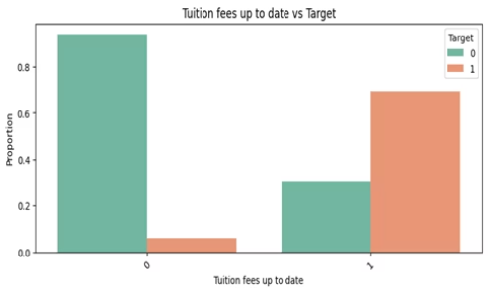
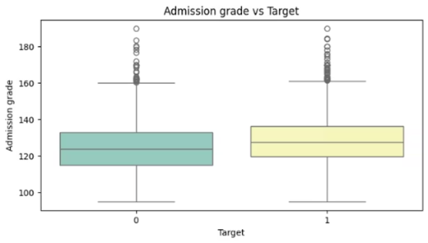
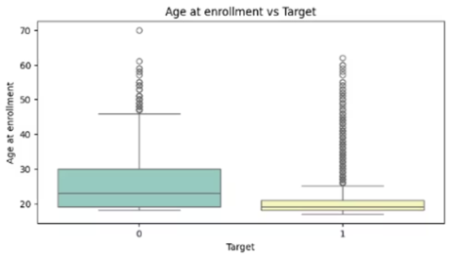
Result& Discussion -EDA
Tuition Payment Status
Admission Grades
Age at Enrollment
Students with on-time payments showed significantly lower dropout rates. Financial stability emerges as a critical persistence factor.
Strong positive correlation between admission scores and graduation success. Academic readiness fundamentally influences completion likelihood.
Younger students graduated at higher rates than older counterparts. External responsibilities may create barriers for non-traditional students.
Notes:
During our exploratory data analysis, we investigated patterns between student characteristics and academic outcomes. One standout insight was the relationship between tuition payment status and graduation: students with up-to-date tuition payments demonstrated stronger persistence, reinforcing the critical role of financial stability. Additionally, a clear upward trend was observed between admission grades and graduation likelihood, suggesting that students who enter with higher academic readiness are more likely to succeed. We also examined age at enrollment. The data indicated that younger students tended to graduate at higher rates, which may be linked to fewer competing life responsibilities compared to older students. These visual findings—presented through bar and box plots—provided an early indication of which features could serve as reliable predictors and helped guide our feature selection for model training. Each of these variables—financial, academic, and demographic—was later validated by machine learning models as having substantial predictive influence. These observations not only aligned with previous literature but also strengthened the empirical foundation of our predictive framework.

Slide 10
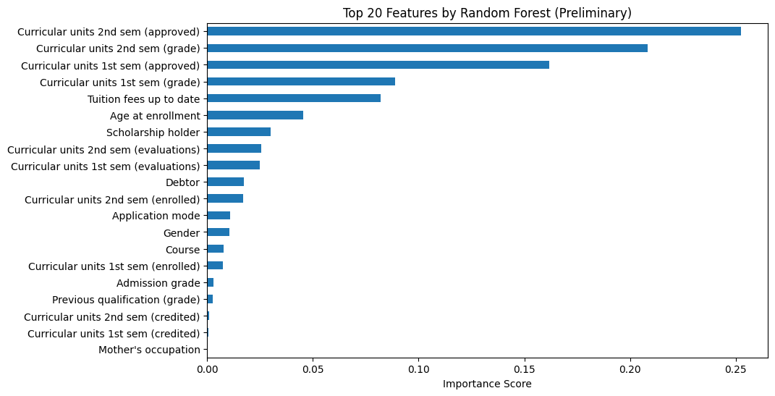




Result& Discussion -EDA
Correlation Analysis
Second semester grades (r=0.605) and first semester grades (r=0.519)
emerged as strongest graduation predictors.
Feature Importance
Random Forest identified semester grades, tuition payment status,
and approved units as top predictive factors.
Modeling Foundation
EDA findings aligned with prior research, confirming both academic
and non-academic factors influence dropout risk
Selected Features
Final model incorporated academic performance metrics,
financial indicators, and key demographic variables.
Notes:
Correlation analysis confirmed that semester grades were the most predictive academic features, with second-semester grades (r = 0.605) and first-semester grades (r = 0.519) showing the strongest associations with graduation. Random Forest feature importance reinforced this, highlighting semester performance, approved units, tuition status, and age at enrollment as top predictors. These findings provided a solid foundation for modeling and ensured our selected features captured both academic and non-academic dropout risks. Our final feature set reflected these validated insights, strengthening the overall modeling reliability.

Slide 11


Result& Discussion - Overfitting Challenge
Challenge: Overfitting in Initial Models
Resolution: Tuning
Decision Tree and Random Forest models achieved near-perfect training accuracy (~1.00).
Hyperparameter tuning (via GridSearchCV) applied to Random Forest, Gradient Boosting, and LightGBM.
However, their cross-validation accuracy dropped sharply (as low as 0.8478).
Tuning effectively minimized the gap between training and cross-validation performance, enhancing the models' ability to generalize to unseen student data.
Clear indication of overfitting — strong performance on training data, poor generalization to unseen data.
Notes:
Our Decision Tree and Random Forest models initially suffered from classic overfitting, extremely high training accuracy, but validation accuracy dropping to 0.8478. To resolve this, we used GridSearchCV to tune key models: Random Forest, Gradient Boosting, and LightGBM. Tuning improved generalization by narrowing the performance gap. This was further reinforced by the Stacking Classifier, which enhanced prediction reliability by blending outputs of the tuned models, resulting in more stable dropout risk predictions across unseen cases.

Slide 12





Result& Discussion -Best Performing Models
Gradient Boosting (Tuned)
90.25% Accuracy, 94.29% ROC-AUC
Stacking Classifier
90.08% Accuracy, 94.30% ROC-AUC
Random Forest (Tuned)
89.91% Accuracy, 94.18% ROC-AUC
Notes:
In this slide, we present the top-performing models in our predictive framework. After tuning and evaluation, Gradient Boosting emerged as the top-performing model with 90.25% accuracy and a 94.29% ROC-AUC, confirming its robust classification capabilities. It consistently performed well across metrics, making it an optimal candidate for dropout prediction. The Stacking Classifier, which strategically integrated outputs from tuned Gradient Boosting, Random Forest, and LightGBM using Logistic Regression as a meta-learner, achieved similarly strong performance, with 90.08% accuracy and 94.30% ROC-AUC. This ensemble leveraged complementary strengths to ensure stable generalization. Random Forest, once tuned, also performed competitively with 89.91% accuracy and 94.18% ROC-AUC, overcoming earlier overfitting issues. These outcomes validate the benefit of hyperparameter tuning and ensemble integration, especially in complex educational datasets.

Slide 13
Comparison with Related Works
Our Study
Arora (2023)
Achieved 90.25% accuracy and 94.29% ROC-AUC with tuned Gradient Boosting, balancing performance and interpretability
Achieved 88% accuracy using ensemble models like Random Forest and XGBoost
1
2
3
Ridwan et al. (2024)
Reported 92.5% accuracy using XGBoost on the same dataset with ROC-AUC around 95%
Notes:
To contextualize our work, we compared it with findings from related studies. Arora (2023) demonstrated the effectiveness of ensemble methods like Random Forest and XGBoost, achieving 88% accuracy in predicting student outcomes. Ridwan et al. (2024) applied XGBoost on the same dataset and reported strong performance, including high accuracy and ROC-AUC near 95%. These studies highlight the value of ensemble learning for educational prediction tasks.

Slide 14



Conclusion and Future Work
Key Predictors Identified
Early academic performance, financial stability, and demographic factors
Successful Prediction Framework
Developed models with up to 90.25% accuracy for student dropout prediction.
Future Enhancements
Focus on expanding the feature set with real-time behavioral data, assessing model generalizability across diverse institutional settings, and ultimately deploying a real-time predictive dashboard for continuous student risk monitoring.
Notes:
Our analysis reveals that academic performance metrics, financial indicators, and demographics are powerful predictors of student persistence. Guided by exploratory data analysis and supported by model evaluation, we constructed a successful prediction framework, achieving up to 90.25% accuracy. The use of tuned ensemble models and stacking techniques allowed us to improve model stability and mitigate overfitting. For future work, we propose expanding the feature set to include behavioral and real-time academic engagement data. Further, testing model adaptability across institutions will ensure broader generalizability. Finally, developing a real-time dropout risk monitoring dashboard could transform this predictive framework into a proactive student support system.

Slide 15
References
Andrade-Girón, D., Sandivar-Rosas, J., Marín-Rodriguez, W., Susanibar-Ramirez, E., Toro-
Dextre, E., Ausejo-Sanchez, J., & Angeles-Morales, J. (2023). Predicting student dropout based on machine learning and deep learning: A systematic review. EAI Endorsed Transactions on Scalable Information Systems.
Arora, D. (2023). Predicting Students Academic Success and Dropout Using Supervised Machine Learning. International Journal of Scientific Study, 11(6).
Dake, D. K., & Buabeng-Andoh, C. (2022). Using Machine Learning Techniques to Predict Learner Drop‐out Rate in Higher Educational Institutions. Mobile Information Systems, 2022.
Ridwan, A., Priyatno, A. M., & Ningsih, L. (2024). Predict Students' Dropout and Academic Success with XGBoost. Journal of Education and Computer Applications, 1(2), 1–8.
Realinho, V., Machado, J., Baptista, L., & Martins, M. V. (2022). Predicting Student Dropout and Academic Success. Data, 7(11), 146.
Sulak, S. A., & Koklu, N. (2024). Predicting Student Dropout Using Machine Learning Algorithms. Intelligent Methods in Engineering Sciences, 3(3), 91-98.
Villar, A., & Andrade, C. R. V. (2024). Supervised machine learning algorithms for predicting student dropout and academic success: A comparative study. Discover Artificial Intelligence, 4(2).

