Slide 1
World university ranking

Slide 2
Introduction

Slide 3
Tools
Python
Query by SQL

Slide 4
Workflow Of The Project
Collect Dataset
Clean Dataset
Describe and visualize Dataset

Slide 5
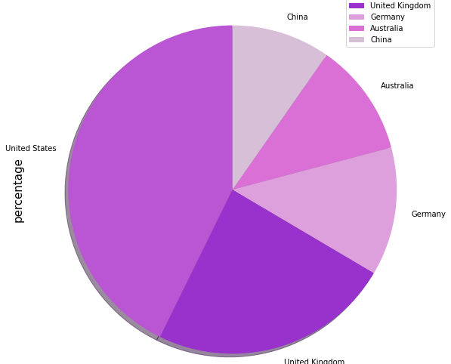
The top 5 countries contain most of the universities studied in this rank system

Slide 6
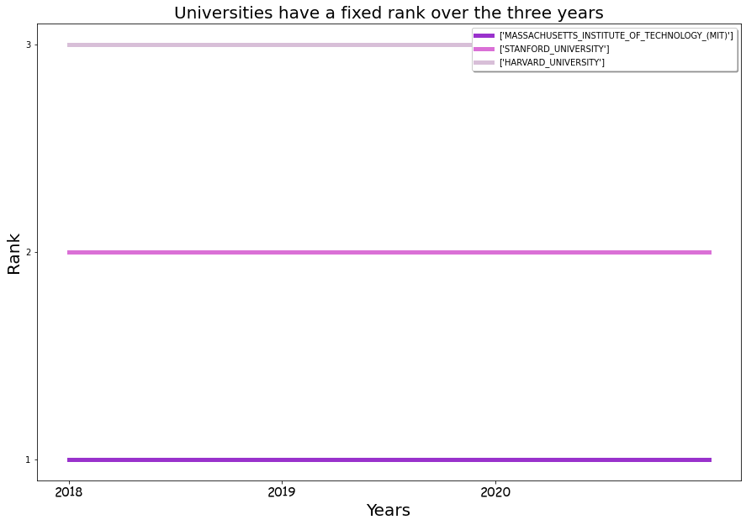
Universities have a fixed rank over the three years

Slide 7
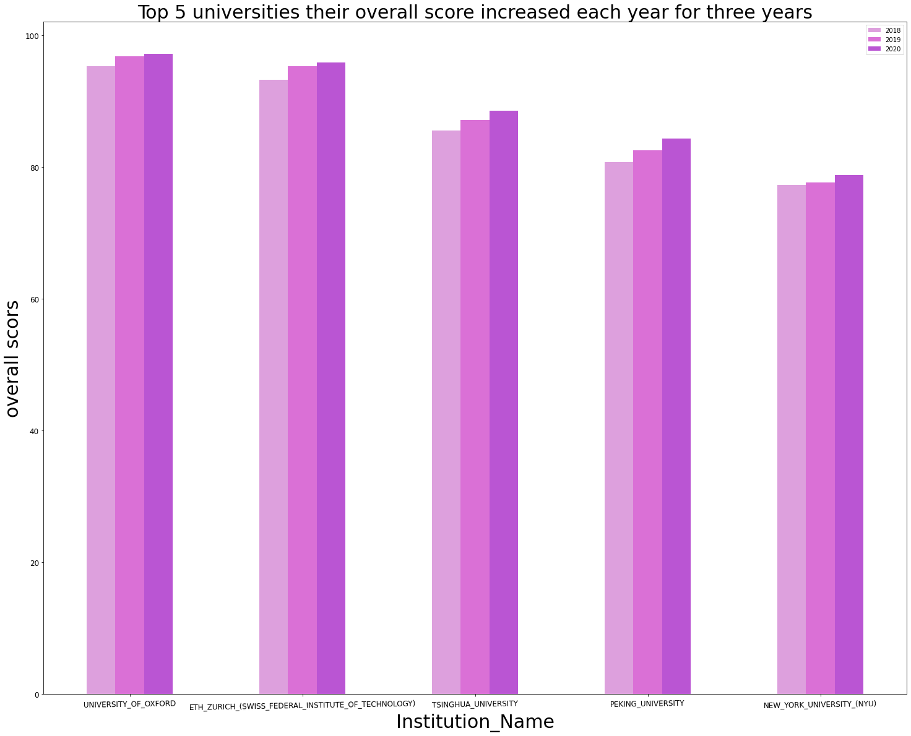
Top 5 universities their overall score increased each year for three years

Slide 8
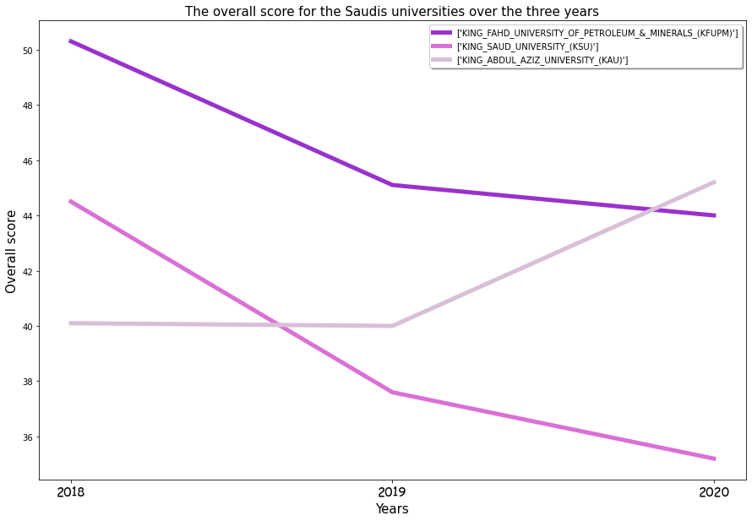
The overall score for the Saudis universities over the three years

