Slide 1


Introduction To Writing Signal Processing Applications In Python Using GNURadio
What is it?
What is built with it?
How to build something with it!

Slide 2
Outline
What is GNURadio
Building a block
Connecting Blocks
Packaging and deploying

Slide 3
What GNURadio Provides
Framework
Currently C++ and Python
Development tools
Tools to packages and interface your code with others
Scheduler
Use all the cores
Interface and abstraction of hardware
Both radio and some acceleration
Library of DSP
Graphical interface / GNURadio Companion

Slide 4

What is GNURadio
Collection of stuff needed for software defined radio
Also applies to other signal processing applications
Collection of functions and algorithms
Standard means of interacting with the outside
Many of the things you don’t want to write
Things build with GNURadio
gr-specest
gr-lte
gr-radar
gr-sigmf
gr-air-modes
gr-limesdr
gr-pdu_utils
gr-satellites
gr-iio
gr-doa
gr-fosphor

Slide 5
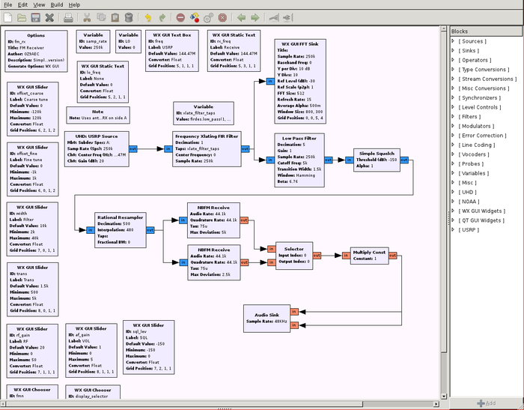
Graphical interface / GNURadio Companion
Most recognized feature of GNURadio
Maybe least useful
Just an opinion
Provides graphical means of connection operations
Color shows type
Makes descriptive graphics
Not used in talk

Slide 6
Library of DSP
Gr-filter
Filter stuff
Gr-digital
Modulation, demodulation
Gr-analog
AGC, AM, FM...
Gr-fec
Error correction
Gr-vocoder
Vocoders
Gr-channel
Channel simulation
Gr-fft
FFT
Volk
Vector optimized library of kernels

Slide 7
Let's Build a Block
Think of some piece of code you want in a block

Slide 8
What is a block?
User space/code
GNURadio Scheduler
GNURadio Block
Setup and initialization
Control
User defined methods
Input
Circular ring FIFO
Work function
Output
Circular ring FIFO

Slide 9
What is a block?
User space/code
GNURadio Scheduler
GNURadio Block
Setup and initialization
Control
User defined methods
Your Code Here
Input
Circular ring FIFO
Work function
Output
Circular ring FIFO

Slide 10
Types of blocks
Sync
Synchronous, one in one out
Source
Where the data comes from
Sink
Where the data goes
Interpolator
One in many out
Tagged stream
Labeled in labeled out
General
Something in maybe something else out
Decimator
Many in one out
Hier
Blocks in blocks

Slide 11
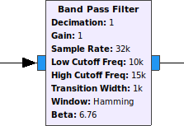
What does a block ​need?
What does a block needs
Setup
constructor or __init__
Work
Code to do the task
Schedule
For data in how much comes out
Inherits from base class
Not needed but nice to have
Graphical description for GRC
Was XML, +3.8.0 uses YAML
Works with tags
Unit testing and profiling
Version control

Slide 12
Example Empty Block
form gnuradio import gr
class MyBlock(gr.sync_block):
def __init__(self, *args, **kwargs):
gr.sync_block.__init__(self,
in_sig=[complex],
out_sig=[complex])
# Add constructor stuff
def work(self, input_items, output_items):
in0 = input_items[0]
out = output_items[0]
out[:] = in0
# Add signal processing
Return len(out)
Notes:
Talk about how to put code into a block

Slide 13
Constructor and Initializer
Builds the block
Inherits from one of the block types
Source, Sink, Sync, Interpolator, Decimator, Tagged stream, Hier
Must call parent constructor/initializer
Executes once
Contains user's setup code
def __init__(self, *args, **kwargs):
gr.sync_block.__init__(self,
in_sig=[complex],
out_sig=[complex])
# Add constructor stuff

Slide 14
Work Function
Where the work happens
Executes are on each buffered chuck of data
Called multiple times
Maps buffers as input arguments
input_items, output_items
Each input is a list of buffers
Python buffer protocol
Numpy array
Returns the number of items written to the output buffer
def work(self, input_items, output_items):
in0 = input_items[0]
out = output_items[0]
out[:] = in0
return len(out)

Slide 15
Building with Blocks
Assembling your application with blocks

Slide 16
Top block
Provides common interface to a signal processing chain
How the schedular interacts with your code
Contains all the blocks
Distributes across multiple processes and cores
Graphical tools produce sub-class of top block
Implementation uses inheritance
Provides methods
Start
Gets the data moving
Run
Gets the data moving and waits for it to finish
Wait
Waits for it to finish
Stop
Stops the movement of data

Slide 17
Connecting the blocks
class FlowGraph(gr.top_block):
def __init__(self):
gr.top_block.__init__(self, name="Flow graph")
# Creating the blocks
self.block1 = Block1(...)
self.block2 = Block2(...)
# Connecting the blocks
self.connect((self.block1, 0), (self.block2, 0))
# Connect takes 2 tuples of the block instance and the number

Slide 18
Note on Types and Vectors
Types
Complex float 32
Float 32
Int 32
Short 16
int 8 / byte
Vectors
Vectors of samples
Currently no explicit support for heterogenous types or structures
easily be worked around

Slide 19
Starting and Stopping the Process
Starting the top block
Start method
None blocking
Run method
Blocking
Stopping the top block
Call the stop method on the top block
Blocks work functions returns a negative number
Raise an exception

Slide 20
Questions ?
Comments
Concerns
Complaints
Accusations
Allegations

Slide 21
The End
Thank you for your time
And thanks to the following people for helping
Richard Gutierrez, Marissa Navarro, Derek Kozel

Slide 22
Missing from this talk
Reconfiguration
Packaging and deployment
Tagged streams
Polymorphic types
Vectors
Libraries of existing components
MAC Layer
Proper unit testing
GRC and GUI
Messaging
C++
Building useful things
Hardware
Simulation

Slide 23
Packaging everything into an OOT
Out Of Tree package

Slide 24
What is OOT
Standard way of packaging code
Directory structure
Build tools
Cmake, make
Testing tools
Ctest, python nose, CppUnit
Install tools
Make install

Slide 25
General Structure of an OOT’s
Directories
./apps/
./cmake/
./docs/
./examples/
./grc/
./include/yourOOT/
./lib/
./python/
./swig/
CMakeFiles.txt
The place to list dependences

Slide 26
Build, Test, Install, Deploy, Reuse
Build
$ mkdir ./build
$ cd ./build
$ cmake ../
$ make
Test
$ make test
Install
$ make install

Slide 27
Graphical part
GNURadio 3.8 forward
YAML file describing
Input and output ports
Graphical appearance
Construction arguments
Documentation
GNURadio 3.7
XML

Slide 28
Outline
What is GNURadio
Building a block
Connecting Blocks
Packaging and deploying

