Slide 1


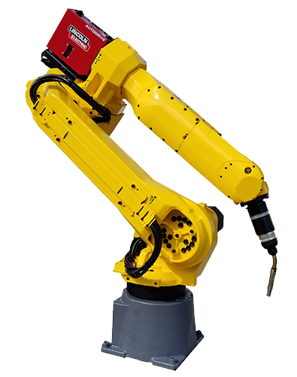
Detecting Road Signs Using AI
MECHATRONICS PROJECT
K. N. Toosi University of Technology

Slide 2
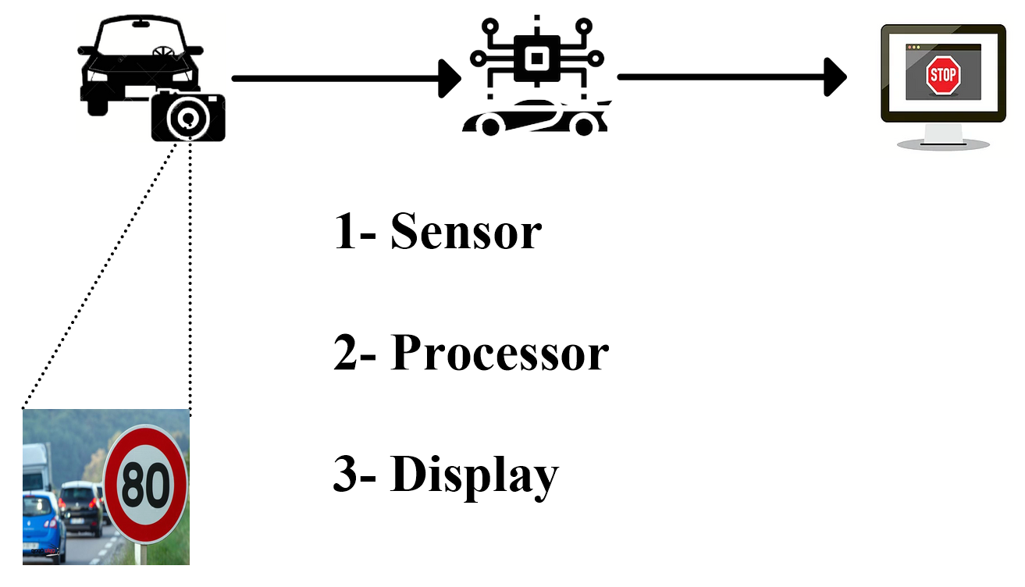
Components of the system

Slide 3
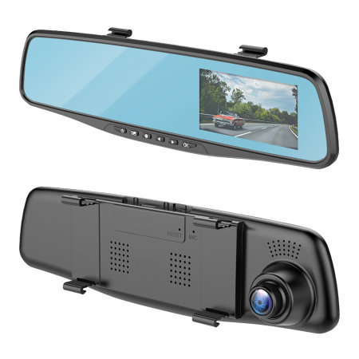
sensor
Dash Camera
1080 quality
8 GB – 55 minutes
Uses car’s power

Slide 4
Processor
Raspberry Pi
Huge processing power in a compact board
Supports Linux, Python
Low cost (~35$)
Many interfaces

Slide 5
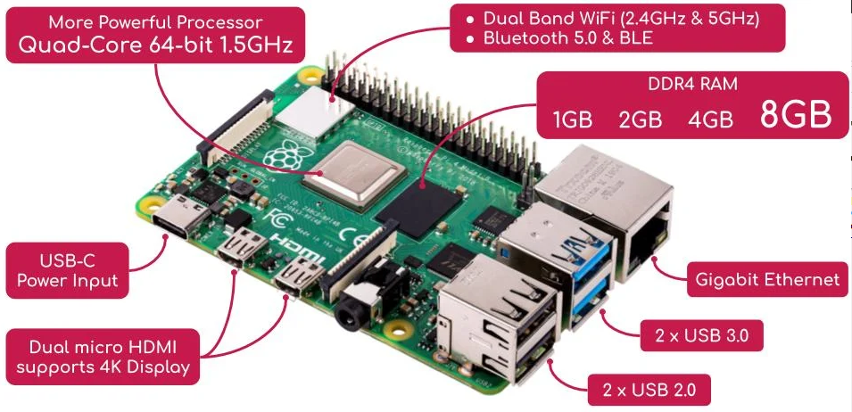
Raspberry Pi

Slide 6
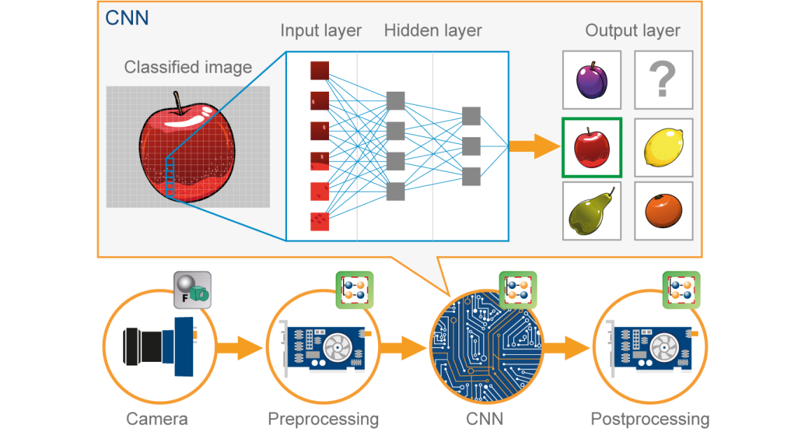
Classification (CNN)
3000 data
12 classes
2 CNN, 1 max pooling, and 2 dense layers

Slide 7
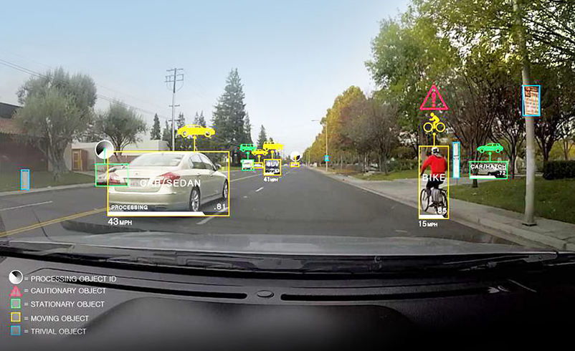
Object detection
YOLO – You Only Look Once
As a real-time object detection system, YOLO object detection utilizes a single neural network. The latest release of ImageAI v2.1.0 now supports training a custom YOLO model to detect any kind and number of objects.

Slide 8
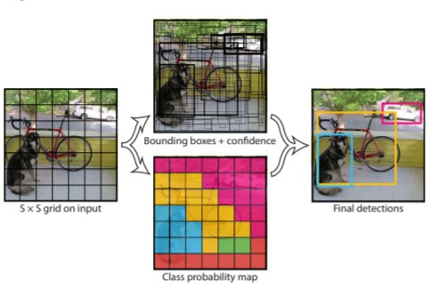
YOLO Algorithm

Slide 9
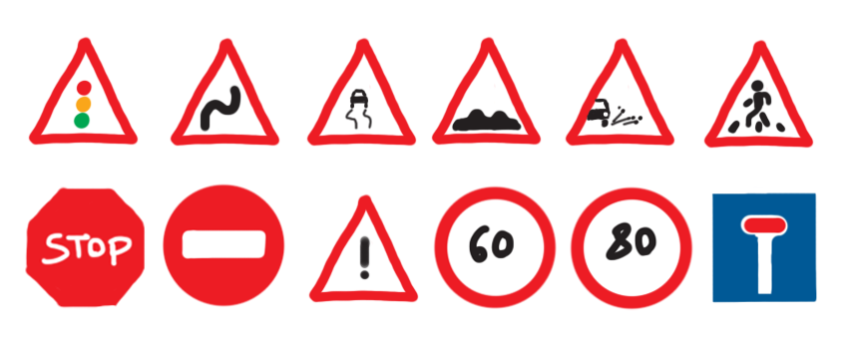
Classes

Slide 10
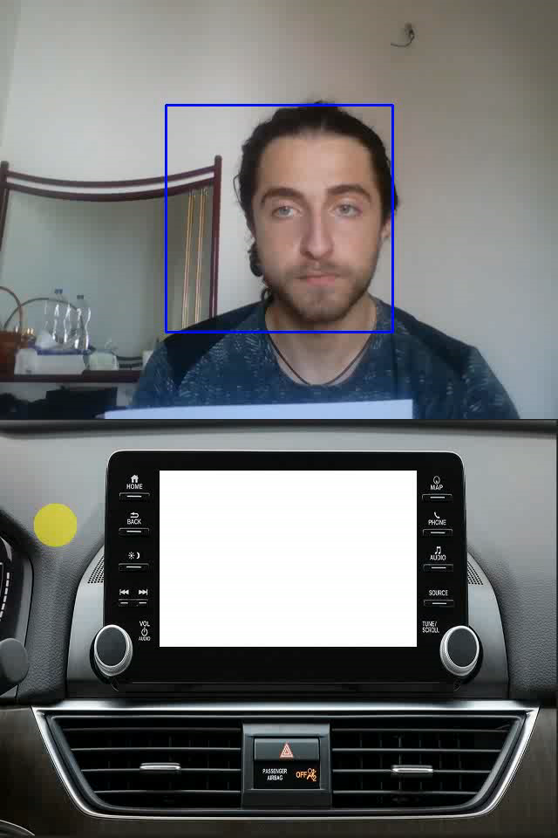
Real-time
Accuracy of 90%
Low cost
Easy to change the functions
Hard deadline
Can help drivers with disabilities

Slide 11
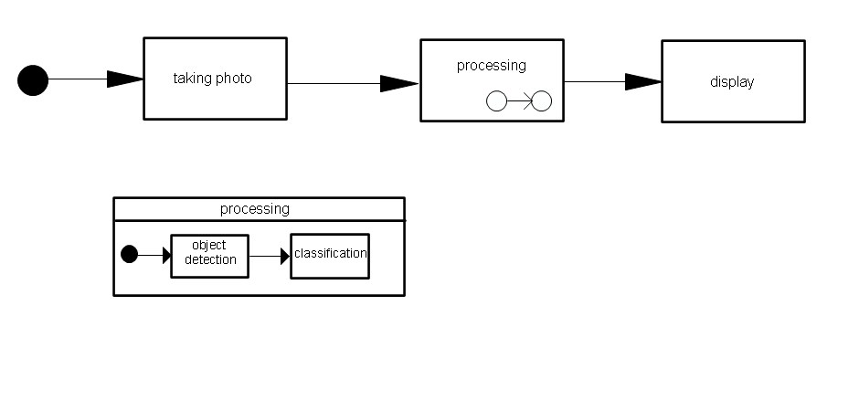
UML Diagram

