Slide 1
Group MEmBErs
M.Muneeb Ahmad
Abdul Rehman
Mashood Farqaleet

Slide 2
Objectives
Definition of shopping cart.
A simple shopping cart application.
User registration and login functionality.
Ability to add, remove, and view products in the cart.

Slide 3
Shopping Cart
Definition:
A shopping cart is a temporary storage for items that users intend to purchase.
It plays a crucial role in e-commerce, allowing users to manage their selected products.

Slide 4
Shopping Cart application
The first step in implementation is to create basic key classes. These classes will manage the items, including adding, removing, and updating products. Use properties to maintain the state of the cart and ensure data integrity.
Basic Key Classes:
Product
User
Shopping_Cart
Program

Slide 5
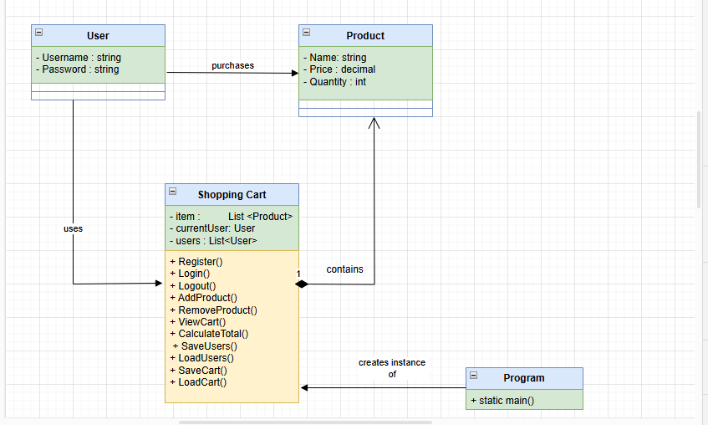
UML Class Diagram

Slide 6
Class - Product
Purpose:
Represents an item that can be added to the shopping cart.
Properties:
string Name
decimal Price
int Quantity

Slide 7
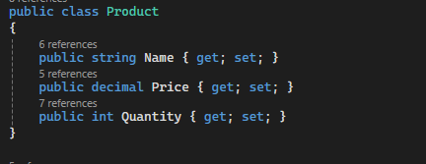
Code Snippet
Product Class:

Slide 8
Class - User
Purpose:
Represents a user of the application who can register or login cart using his name and password.
Properties:
string Username
string Password

Slide 9
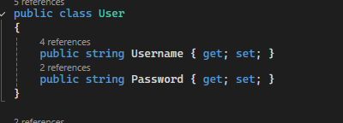
Code Snippet
User Class:

Slide 10
Class - ShoppingCart
Purpose:
Manages user interactions and cart items.
Properties:
List<Product> items
User currentUser
List<User> users
Methods:
Registration, login, logout
Add, remove, view products
Calculate total price
Save/load users and cart items

Slide 11
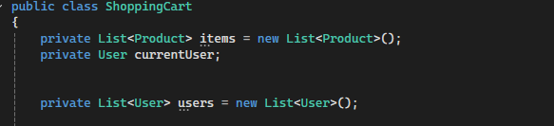
Code Snippet
Shopping Cart Class:

Slide 12
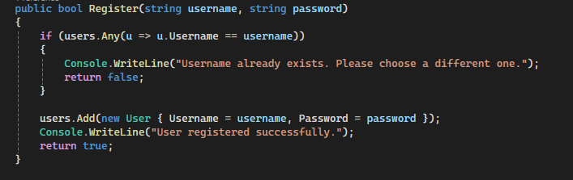
User Registration and Login
Registration:
Checks for existing usernames.
Adds new users to the list.
Login:
Validates username and password.
Sets the current user

Slide 13
Shopping Cart Functions
Add Product:
Adds a product to the cart if logged in.
Remove Product:
Removes specified product from the cart.
View Cart:
Displays current items and total cost.
Calculate Total:
Computes the total price of items in the cart.

Slide 14
File Handling
Purpose:
Persist user and cart data between sessions.
Methods:
SaveUsers(): Saves user data to a file.
LoadUsers(): Loads user data from a file.
SaveCart(): Saves cart items to a file.
LoadCart(): Loads cart items from a file.

Slide 15
Main Program Flow
Flow:
Prompt user for registration or login.
Handle user input.
Perform operations based on user authentication.
Sample Operations:
Add products to cart.
View cart contents and total.
Logout and attempt to modify cart.

Slide 16
Conclusion
In conclusion, building a dynamic shopping cart in C# involves several steps, from setting up your environment to implementing the checkout process.
Continue enhancing your cart with features like user authentication and product recommendations to improve user engagement.

