Slide 1
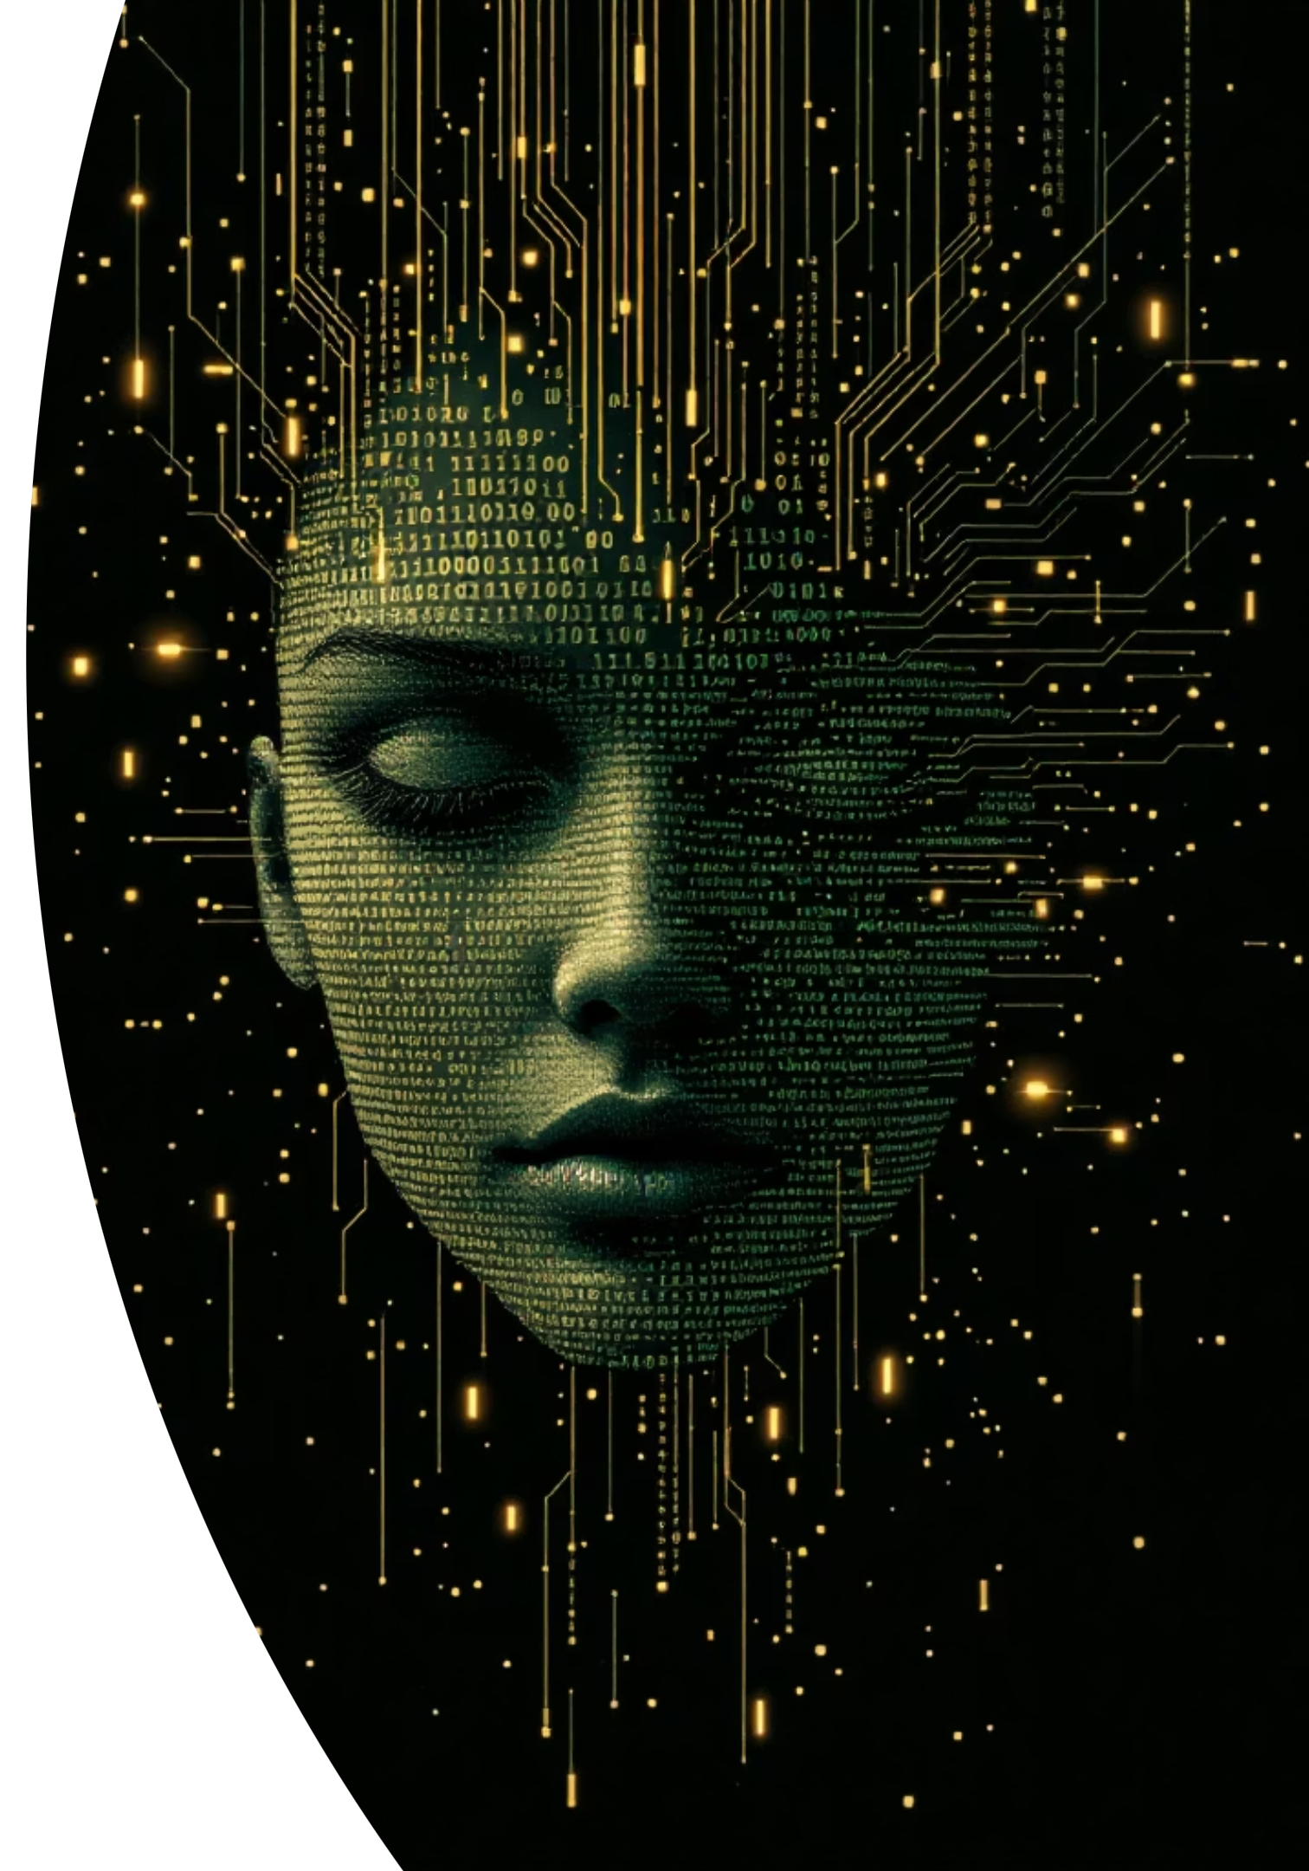
Deepfake Image & Video Analyzer
AI-Based Fake Media Detection using CNN – MobileNetV2
FINAL YEAR PROJECT · PART 1
SUBMITTED TO: KNOWLEDGE STREAMS

Slide 2

Introduction
What are Deepfakes?
Deepfakes are synthetic media — images, videos, or audio — generated using AI that convincingly depict people saying or doing things they never actually did.
The Rise of AI-Generated Media
With the democratization of generative AI tools, creating realistic fake content has become accessible to non-experts, accelerating the spread of misinformation.
Why Detection Matters
Unchecked deepfakes threaten journalism, legal evidence, personal reputation, and national security — making reliable automated detection critical.

Slide 3
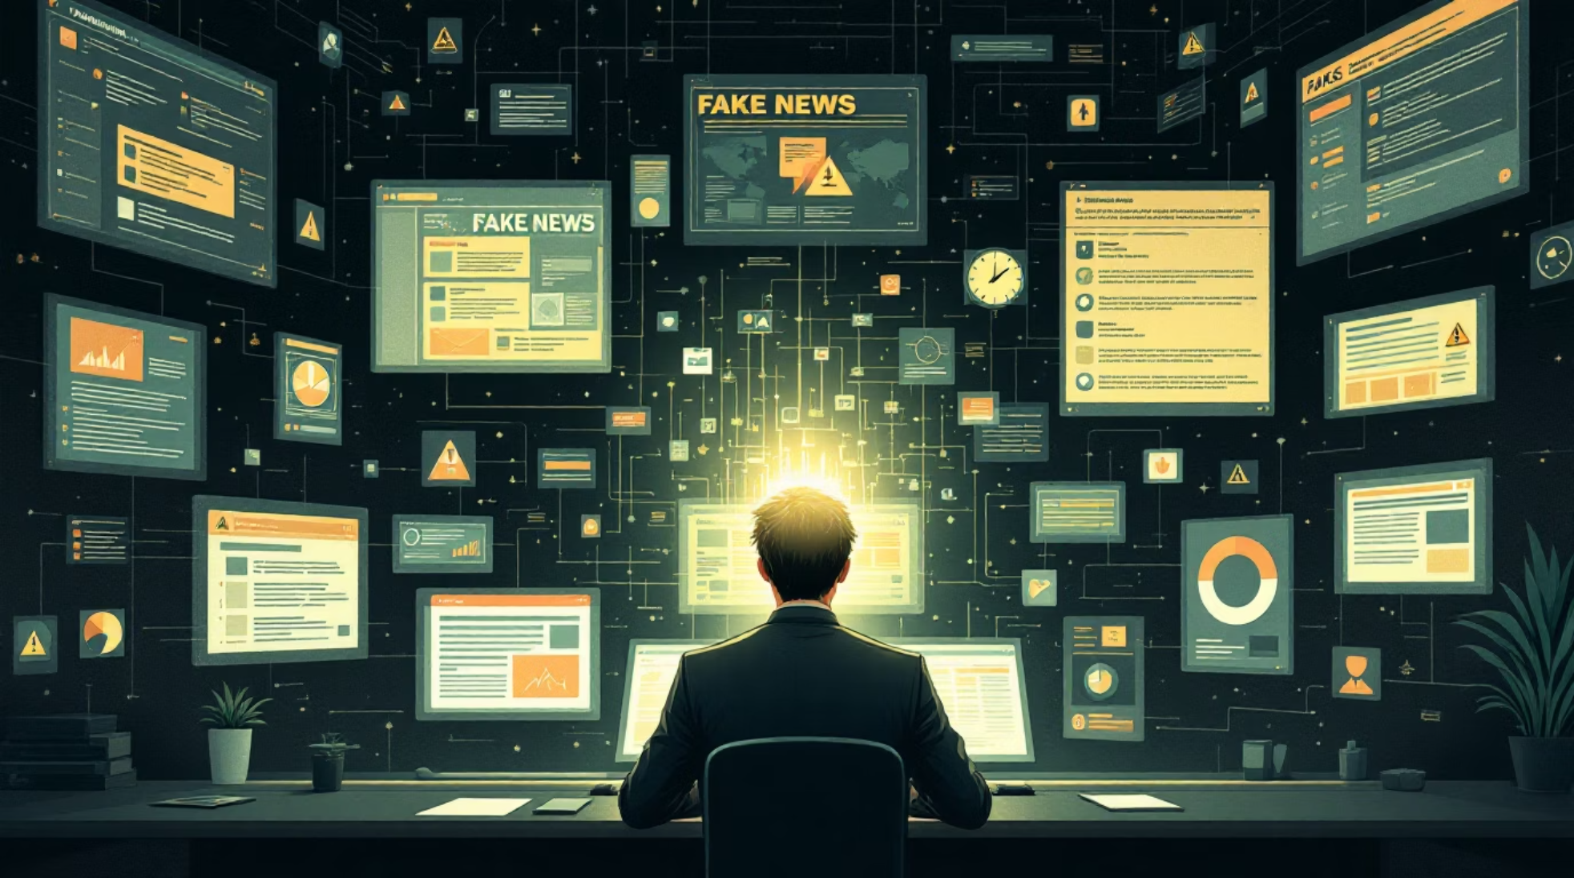
Problem Statement
Human Detection is Inadequate
Modern deepfakes are visually indistinguishable from real media — even trained experts struggle to identify manipulation reliably.
Widespread Misuse
Deepfake technology is exploited for political disinformation, financial fraud, non-consensual imagery, and identity theft.
No Accessible Detection Tools
Existing solutions are either research-grade only or lack a simple, user-friendly interface for real-world deployment.

Slide 4

Project Objectives
This system is designed to deliver a complete, production-ready deepfake detection pipeline with interpretable outputs.
Image Detection
Video Detection
Classify input images as real or fake with high accuracy using a pretrained CNN backbone.
Analyze video frames sequentially to detect manipulated video content at scale.
Confidence Score
Heatmap Visualization
Output a probability score indicating the model's certainty for each prediction.
Generate Grad-CAM heatmaps to highlight manipulated regions within the media.

Slide 5

Proposed System
What We Are Building
An end-to-end AI-powered deepfake detection system that accepts both images and videos, processes them through a deep learning model, and returns an interpretable verdict.
CNN with Transfer Learning
Multi-Modal Support
User-Friendly Interface
Leverages MobileNetV2 pretrained on ImageNet for robust feature extraction.
Handles both image and video inputs through a unified pipeline.
Built on Gradio for instant, no-code web deployment.

Slide 6





Technology Stack
A modern, open-source stack chosen for performance, compatibility, and ease of deployment.
Python
TensorFlow / Keras
MobileNetV2
OpenCV · NumPy · PIL
Core language for model development, preprocessing, and orchestration.
Deep learning framework for building, training, and serving the CNN model.
Lightweight, efficient CNN architecture optimized for speed and accuracy.
Libraries for image loading, frame extraction, normalization, and augmentation.
Gradio
Rapid UI layer enabling interactive web-based inference without a custom frontend.

Slide 7

System Workflow
Preprocessing
Input
Prediction
Output
The pipeline is designed for low-latency inference — from upload to verdict in seconds — making it suitable for real-time or near-real-time detection scenarios.

Slide 8
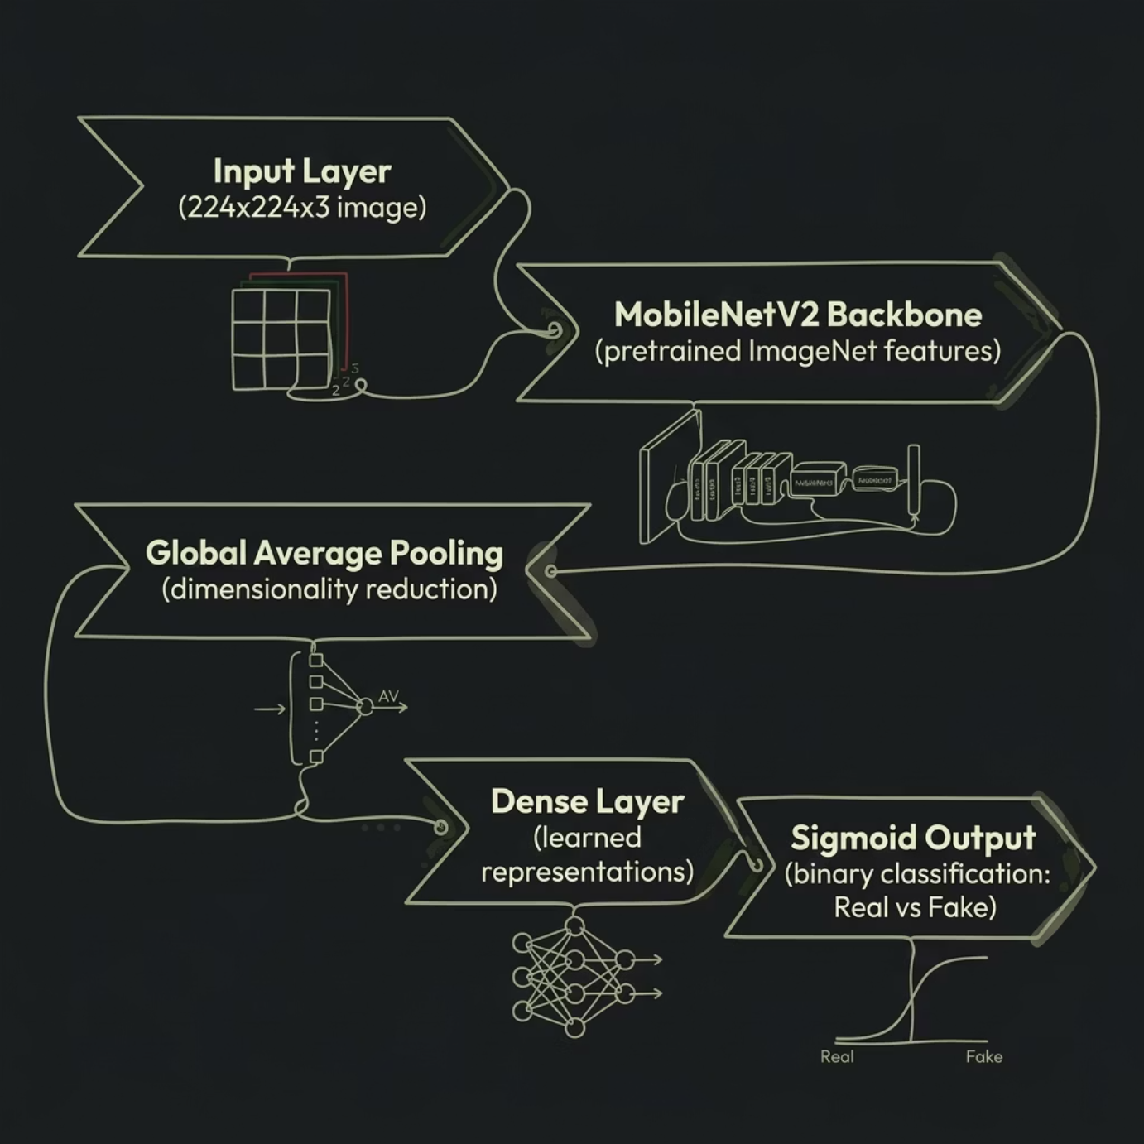

Model Architecture
Why MobileNetV2?
MobileNetV2 uses inverted residual blocks and depthwise separable convolutions, delivering high accuracy with significantly fewer parameters than traditional CNNs — ideal for deployment on resource-constrained hardware.
Binary Classification
Transfer Learning
Sigmoid activation outputs a probability between 0 (fake) and 1 (real).
Pretrained weights accelerate convergence and improve generalization on limited deepfake datasets.

Slide 9

FYP PRESENTATION · PART 2
Deepfake Image & Video Analyzer
CNN · MobileNetV2 · Gradio Interface

Slide 10
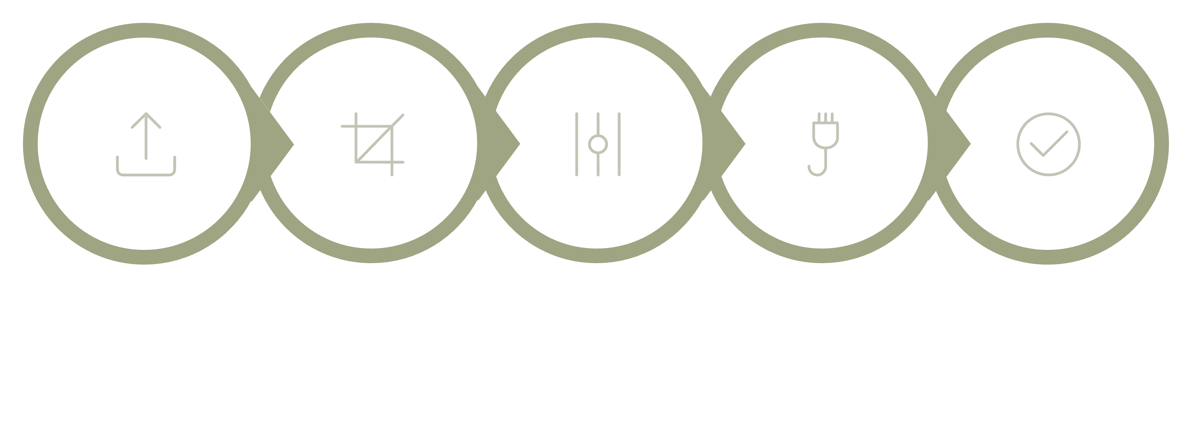
Image Detection Pipeline
Resize 224×224
Normalize Pixels
Model Prediction
Upload Image
Result
Every uploaded image is preprocessed uniformly before MobileNetV2 returns a real-time deepfake classification.

Slide 11

Heatmap Visualization
Grayscale Conversion
Input image converted to single-channel grayscale
JET Colormap
Heat intensity mapped to color spectrum
Overlay Output
Highlights regions the model focuses on

Slide 12

Video Detection Pipeline
Sample Every 10th
Resize & Normalize
Predict Each Frame
Upload Video
Sparse frame sampling balances accuracy with computational efficiency for video analysis.

Slide 13
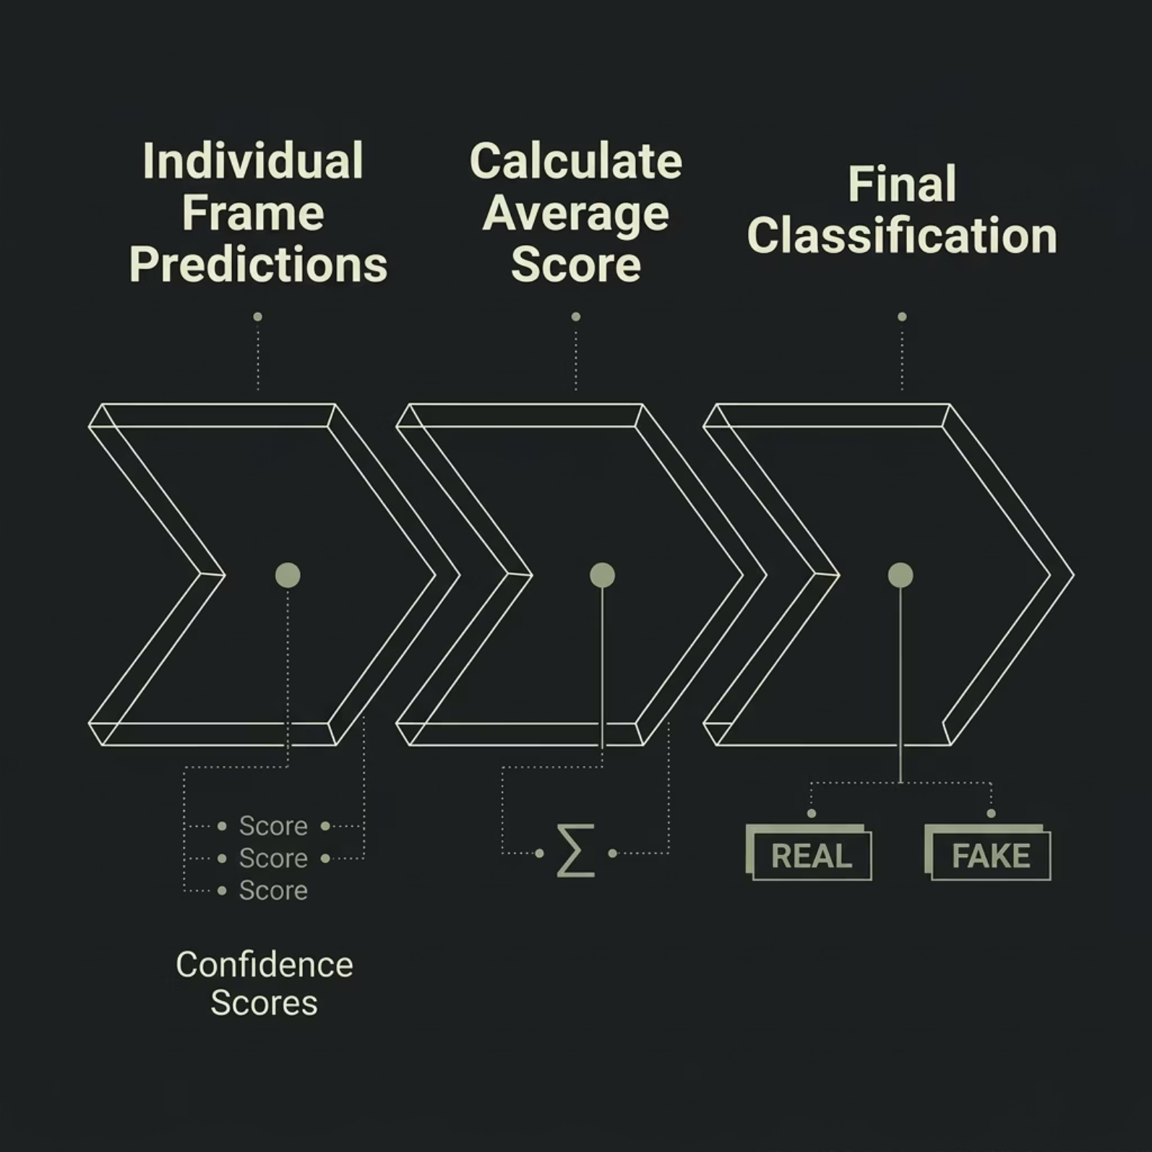


Video Processing Logic
Aggregation Strategy
Frame-level predictions are aggregated into a single video-level verdict using mean confidence scoring.
Sampling every 10th frame reduces redundancy while preserving temporal coverage.

Slide 14
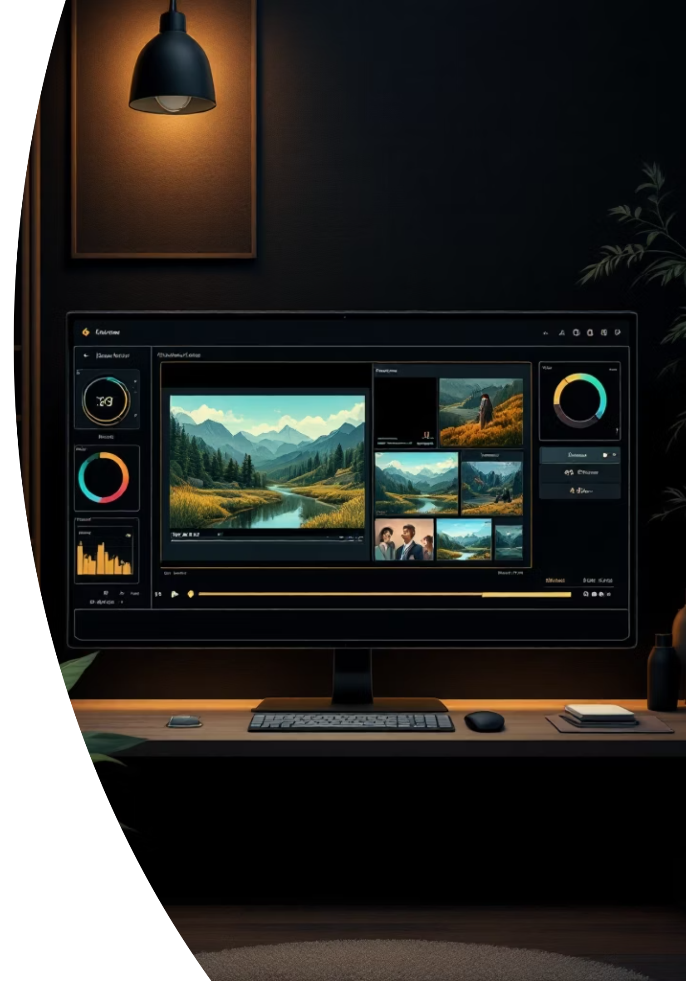
Video Output
Confidence Score
Preview Video
Displayed per frame and aggregated for the full video
Generated output with annotated results
Processed Frames
Key sampled frames shown with classification labels

Slide 15

User Interface — Gradio
Built with Gradio
A lightweight, interactive web UI requiring minimal setup.
🖼 Image Detection
Upload & classify single images
🎬 Video Detection
Upload & analyze video files

Slide 16
Results, Advantages & Limitations
✅ Advantages
⚠️ Limitations
Real-time predictions
Confidence scores per output
Visual heatmap outputs
Fast & lightweight (MobileNetV2)
Simple, intuitive UI
Performance tied to training data
Struggles with advanced GAN-based deepfakes

Slide 17

Conclusion & Future Work
Conclusion
Deepfake detection is essential. This project demonstrates a practical, deployable AI solution using MobileNetV2.
Future Roadmap
Improve accuracy with larger, diverse datasets
Real-time webcam detection
Web & mobile deployment

