Slide 1
ASRAN Implementation in NS3
Project Update 2
1705005 - Mashiat Mustaq

Slide 2
Summary
File 1 : Transient Link Instability with multiple flows in FANET
File 2 : Congestion with multiple flows in FANET
File 3 : Simulation topology similar to paper
Metrics Calculation : Throughput
Congestion Control Algo : TCPNewReno
Wifi Standard : 802.11b

Slide 3
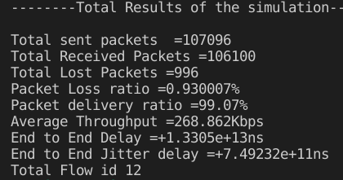
Transient Link Instability with Multiple Flows
Parameters
Nodes : 12
Flows : 6 ( 12 in flow monitor)
WifiMacType : Adhoc
Mobility : GaussMarkovMobilityModel
Bound : x, y, z = All (-100,100)
Speed : 20, position Change after 0.1 sec
Routing Algo : DSDV

Slide 4
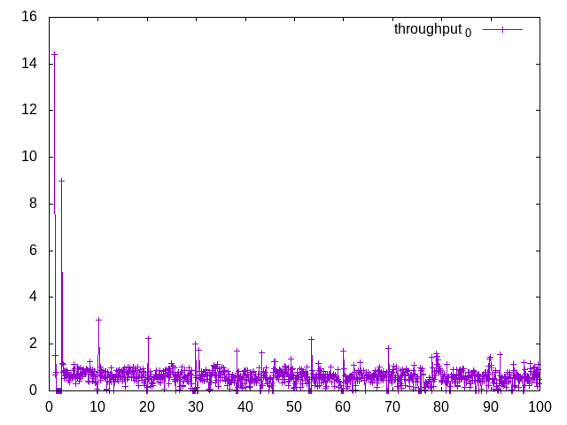
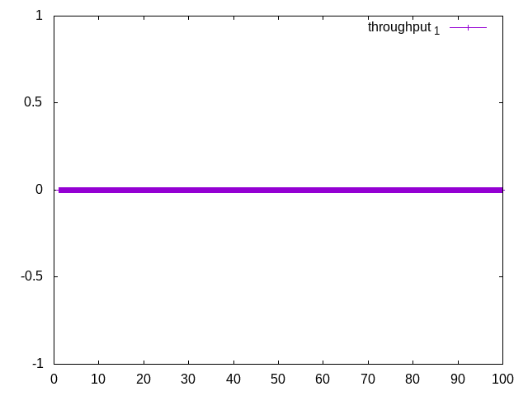
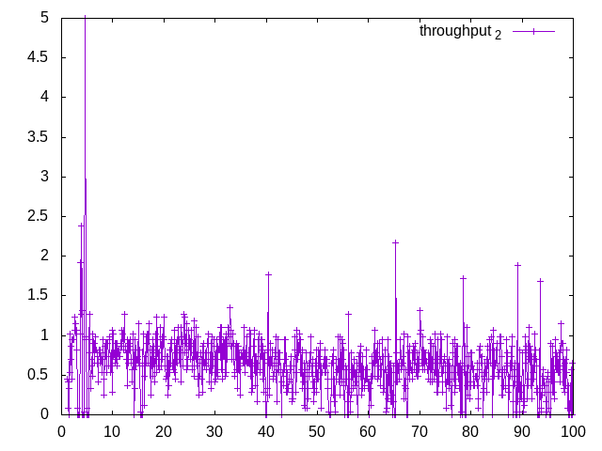
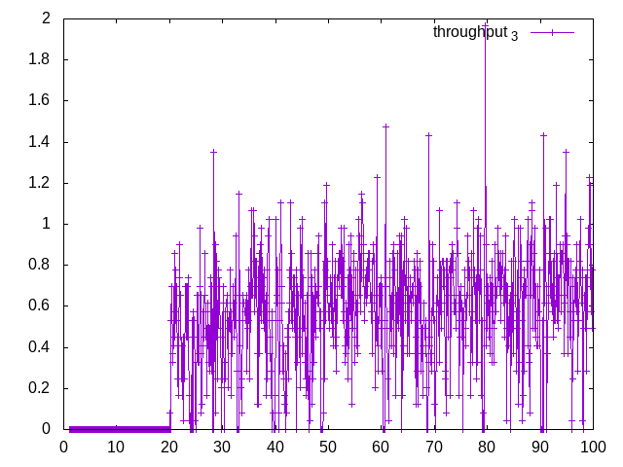
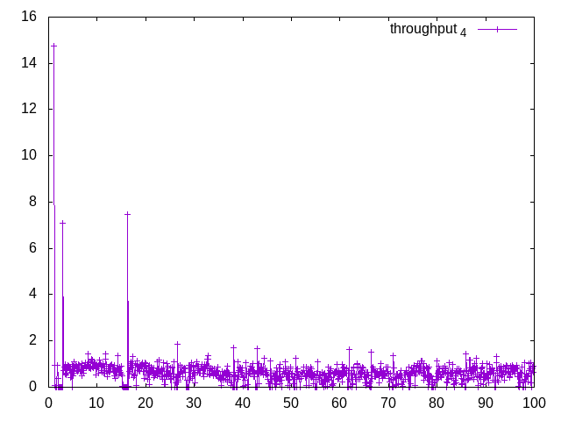
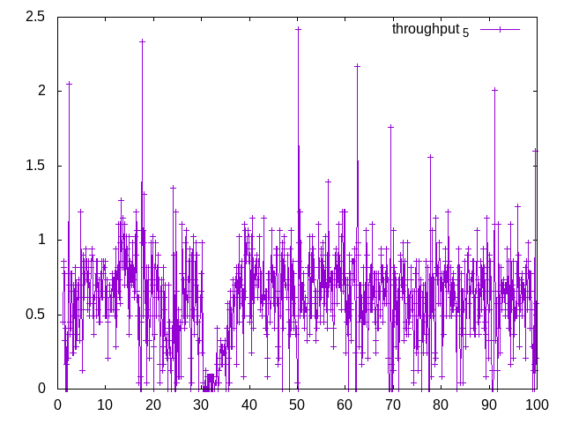
Throughput vs Time
6 packets sent in total

Slide 5
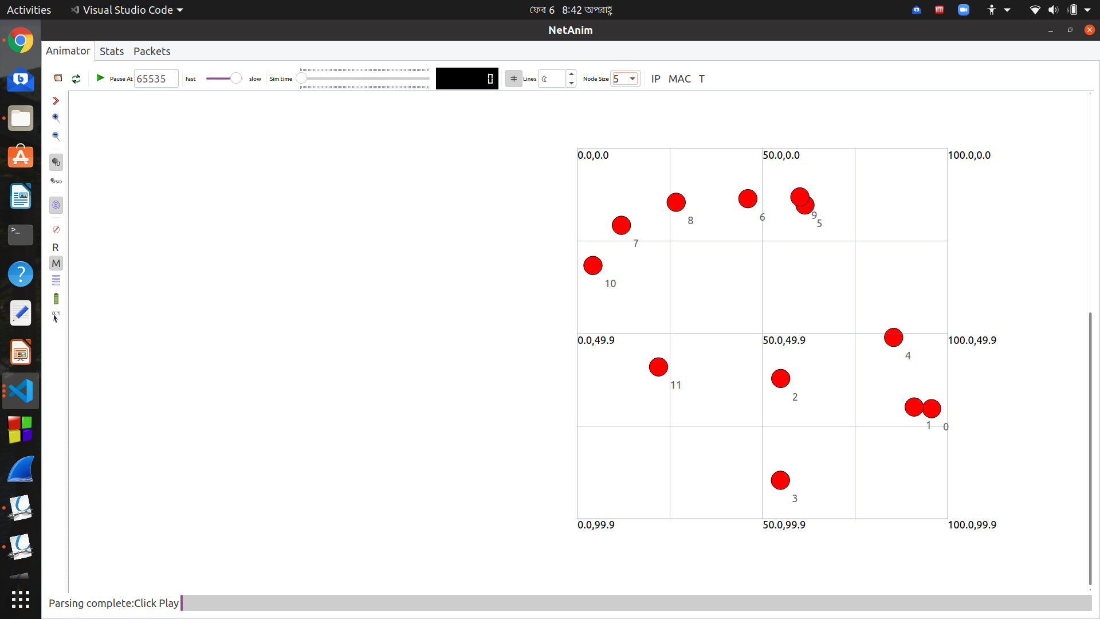
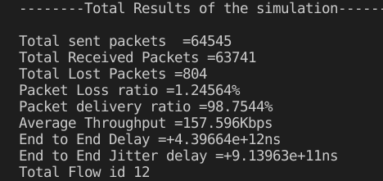
Congestion Control
Parameters
Error Rate : 0.001

Slide 6
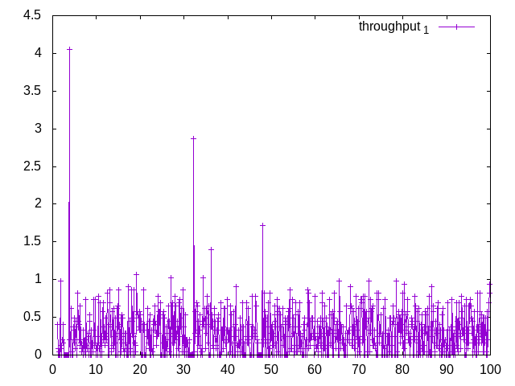
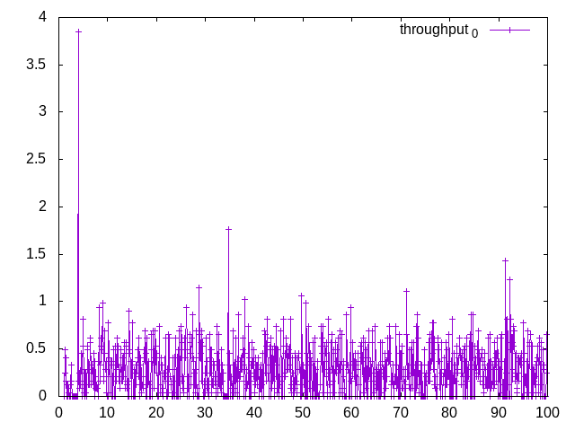
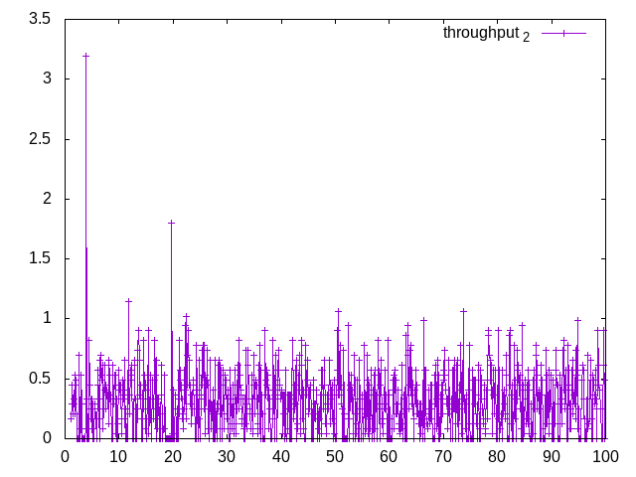
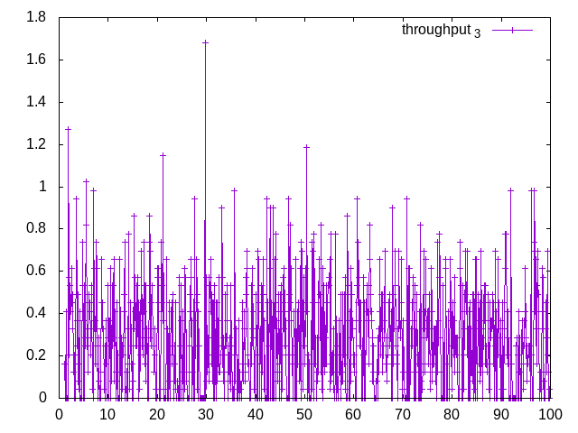
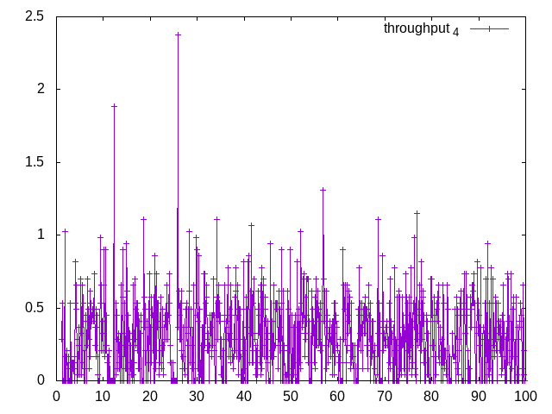
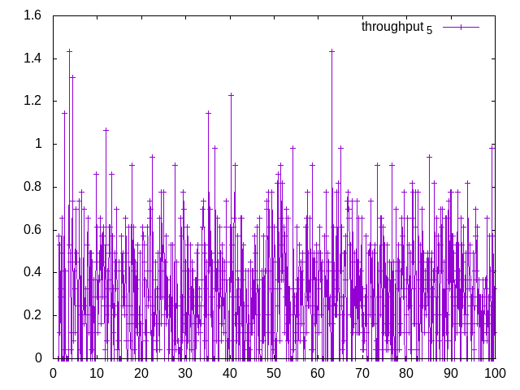
Throughput vs Time

Slide 7
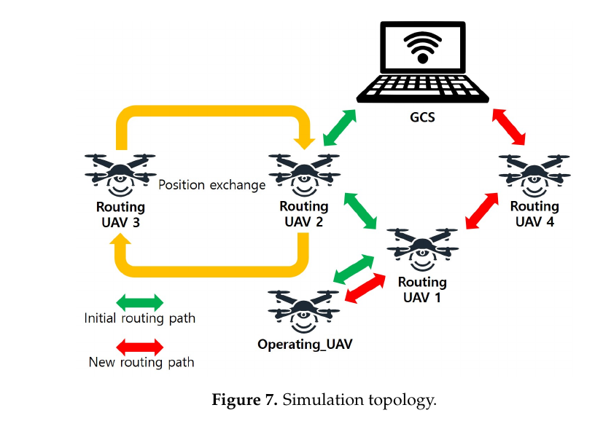
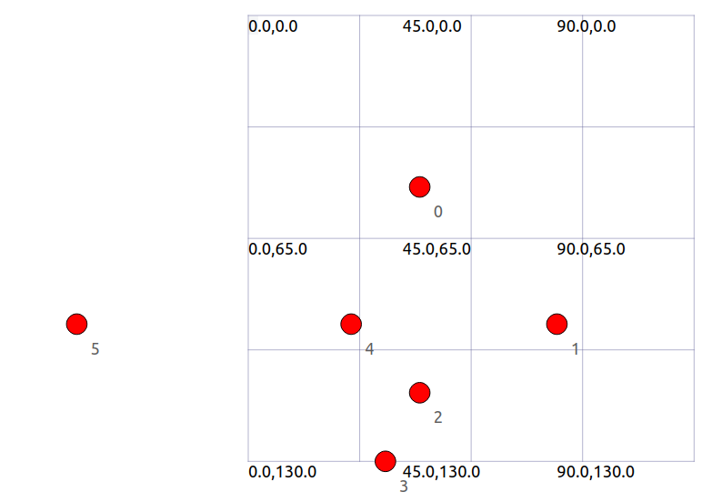
Paper Simulation Topology

Slide 8
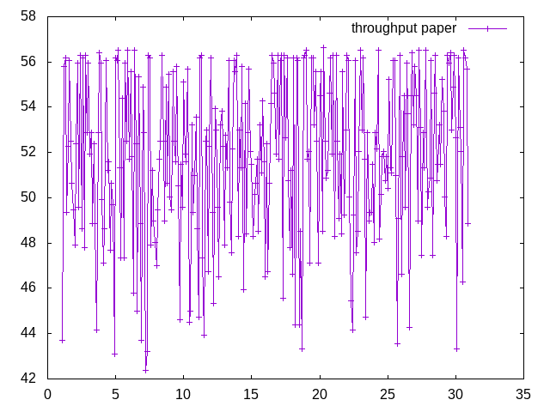
Paper Simulation Topology
Nodes : 6
Flows : 1 ( GCS -> Operating UAV)
WifiMacType : Adhoc
Mobility : ConstantPositionMobilityModel
Routing Algo : DSDV
Change position in 20 and 25 seconds

Slide 9
Problems
XML File for NetAnim requires me to set Maxbytes which ultimately leads to less packets sent
DSDV Algo makes one hop to all nodes in the same network. As a result no packets are dropped during exchange of position
Total packets change when error model are introduced
Model congestion with 3D

Slide 10
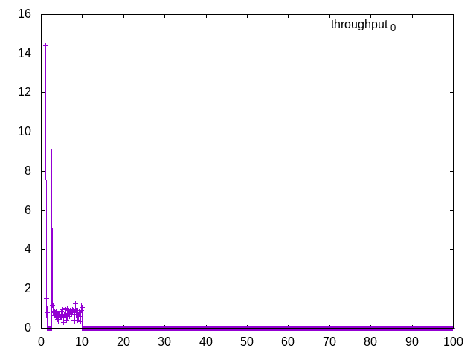
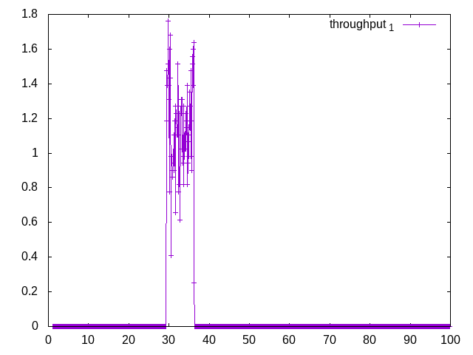
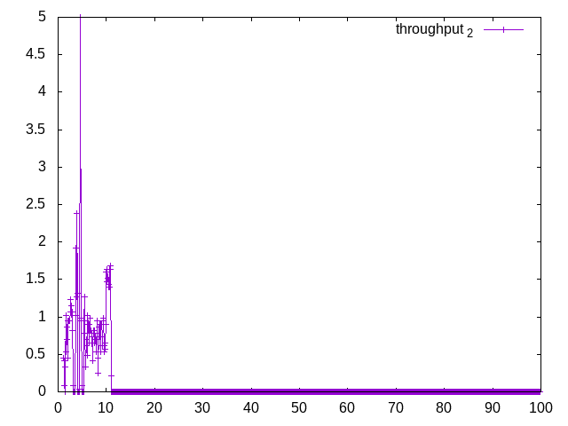
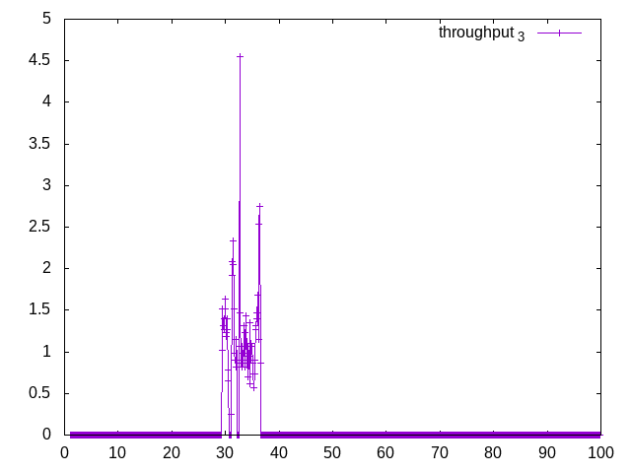
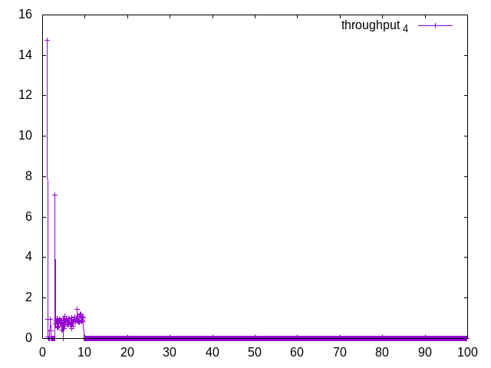
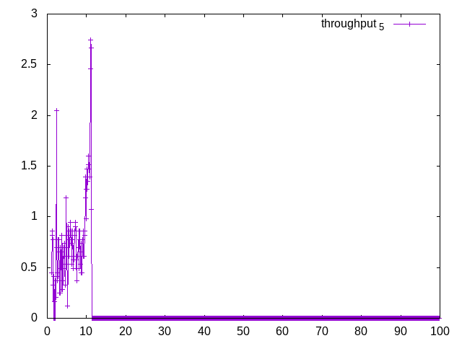
Throughput vs Time (MaxBytes = 1000000 )

