Slide 1
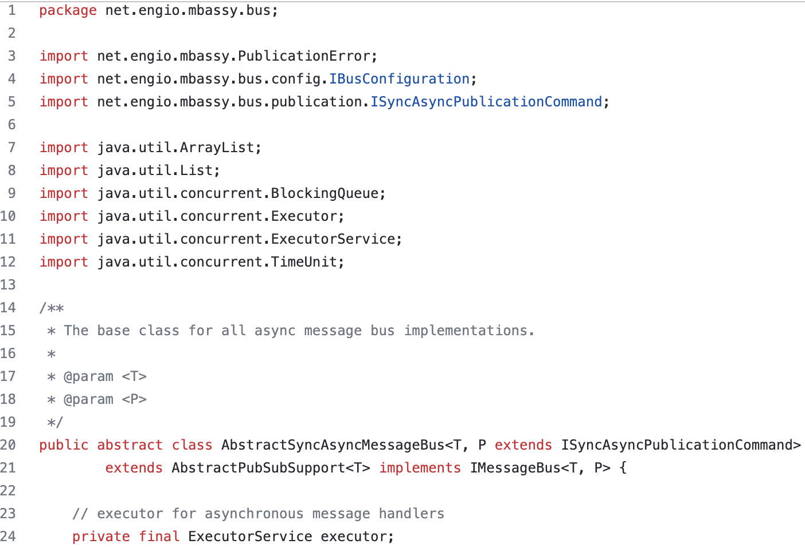
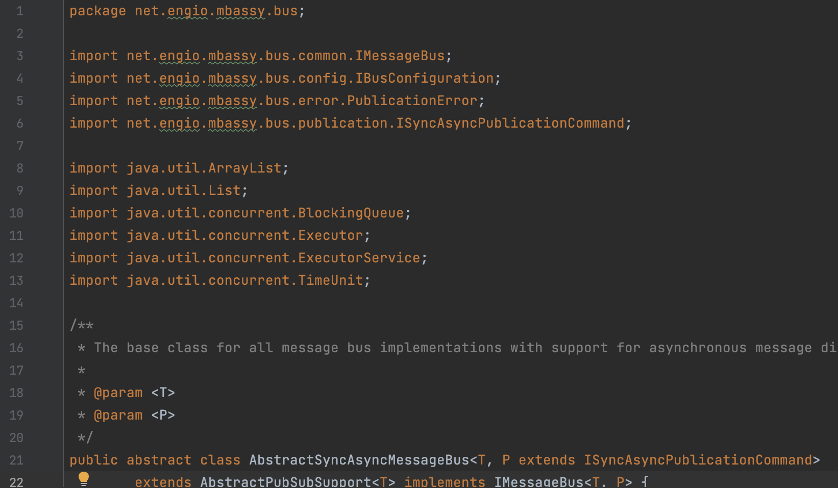
Code in fine grained commit
Code in coarse grained commit
Adding of an import change the startLine of the Extract Superclass
Repo: mbassador
Fine grained commits:
4034024e30c5033878ae9905495fa8dce28a9732
,54f7bd72b90ff7608c97b8ba4708ca95bc4de573
Coarse grained commit:
d8ca41c9562f09d5dc0dddb87b5e07594bf8b191

Slide 2
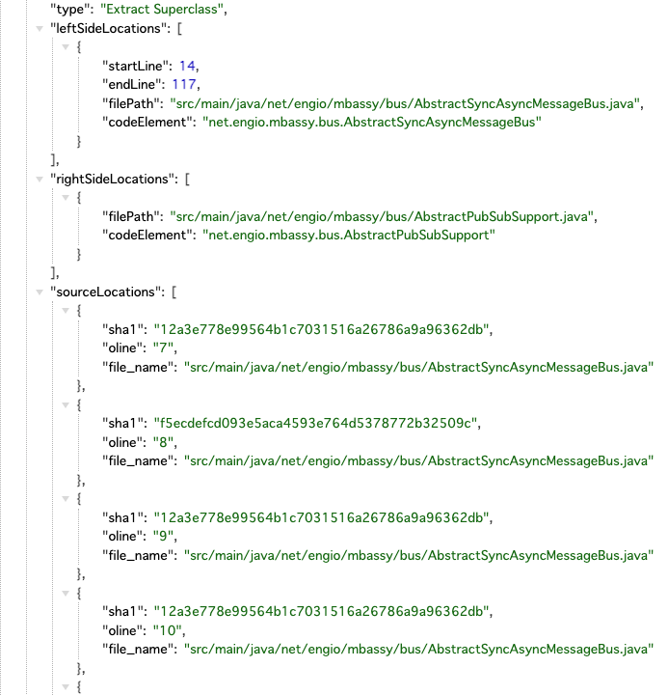
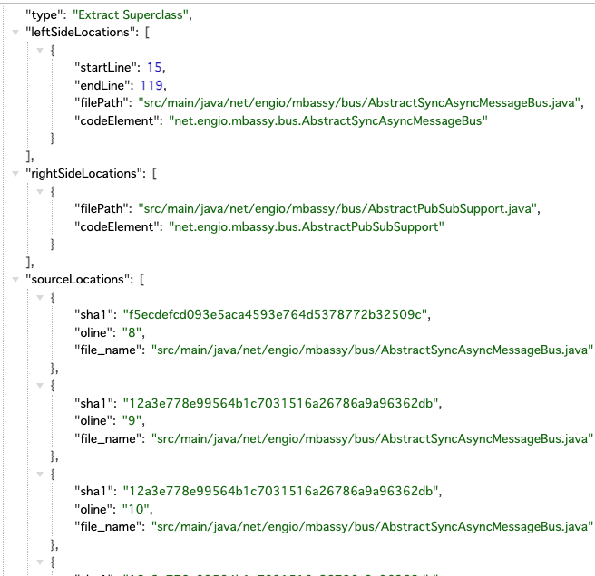
Ref in fine grained commit
Same ref in coarse grained commit
Adding of an import change the startLine of the Extract Superclass
Repo: mbassador
Fine grained commits:
4034024e30c5033878ae9905495fa8dce28a9732
,54f7bd72b90ff7608c97b8ba4708ca95bc4de573
Coarse grained commit:
d8ca41c9562f09d5dc0dddb87b5e07594bf8b191

Slide 3
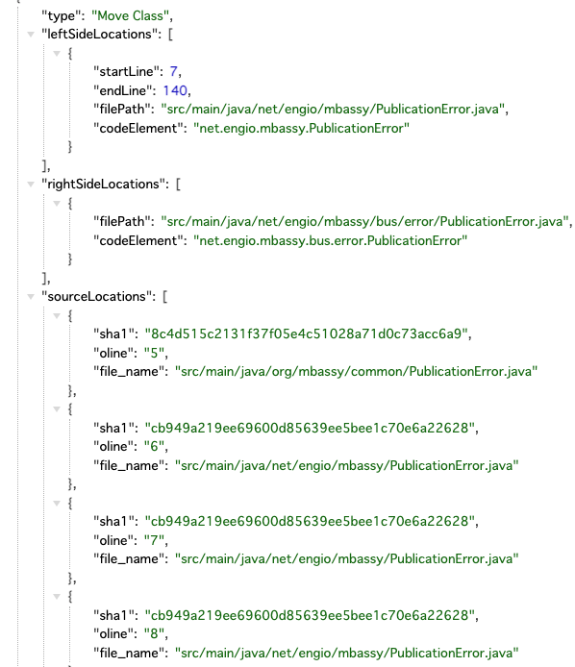
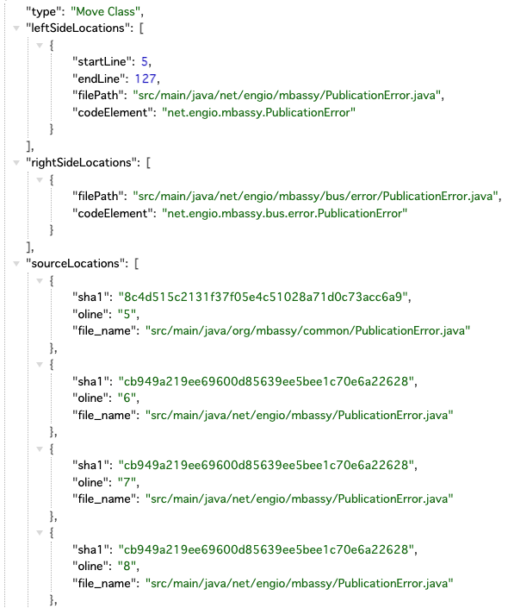
Ref in fine grained commit
Same ref in coarse grained commit
Adding of an import change the startLine of the Extract Superclass
Repo: mbassador
Fine grained commits:
4034024e30c5033878ae9905495fa8dce28a9732
,54f7bd72b90ff7608c97b8ba4708ca95bc4de573
Coarse grained commit:
d8ca41c9562f09d5dc0dddb87b5e07594bf8b191

