Slide 1
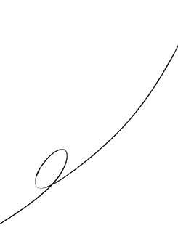





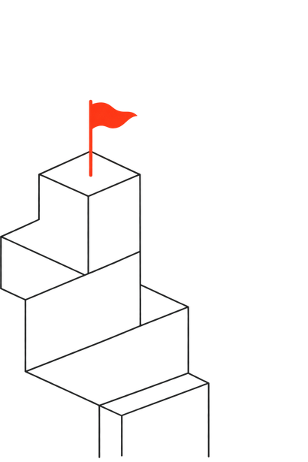


CERTIFICATE OF COMPLETION
O F H O N O R
THIS RECOGNITION IS PRESENTED TO
Alex Rivera
has demonstrated exemplary mastery in Fullstack System Architecture,
spearheading open source initiatives with passion and persistence,
and inspiring the community toward innovation.
Dr. Rajesh Kumar
Prof. Priya Sharma
C H A I R P E R S O N
M E N T O R
CUSAT Innovation Labs
CUSAT Innovation Labs
BUILD. CODE. DEPLOY.
ELEVATES OS 2026
Notes:
1

