Slide 1



Founded 1991 by Md. Alimullah Miyan
1991-2026
Human Resource Management (HRM) System
Course Code: Practicum CSC 490
Prepared for:
Practicum Defense Committee
Department of Computer Science and Engineering
Supervised by:
Prepared by:
Rubayea Ferdows
Student Name: Mashrafe Uddin Tarafder
Assistant Professor
Student ID: 22303075
25th September, 2026

Slide 2
Contents
1. Introduction
2. Objectives
3. Methodology and Process Model
4. Organization Overview
5. System Requirements (User & System, Functional, Non-Functional)
6. Use Case Diagram
7. Database Design
8. Implementation (Screenshots)
9. Testing
10. Limitations and Future Plan
11. Conclusion
12. References
Human Resource Management (HRM) System
2/26

Slide 3
1. Introduction
Problem: small and medium organizations still track attendance on paper or spreadsheets, handle leave by e-mail, and calculate salaries by hand – slow, error-prone and opaque to employees.
Solution: a web-based, multi-company HRM System that automates attendance, leave and monthly payroll with role-based access.
Roles: Super Admin (onboards companies), Company Admin (manages own company), Common employee (checks in/out, applies for leave, views own records).
Automation: a daily job marks absent employees; a monthly job generates the previous month’s payroll.
AI HR Assistant: answers HR questions in natural language from the company’s own data.
Human Resource Management (HRM) System
3/26

Slide 4
2. Objectives
Broad objective
Design and develop a secure, web-based, multi-company HRM system that automates attendance, leave and payroll administration.
Specific objectives
Role-based access control scoped to the user’s own company
Check-in/check-out with automatic late and early-leave detection; scheduled absent marking
Leave workflow: request → approve/reject → reflected in attendance
Automatic monthly payroll with deduction rules; live payroll projection
Daily, monthly and per-employee attendance analytics
AI assistant using read-only, company-scoped data tools
JWT authentication, refresh-token rotation, BCrypt password hashing
Human Resource Management (HRM) System
4/26

Slide 5
3. Methodology and Process Model
Process model: Agile – iterative and incremental with feedback at the end of every iteration.
Iterations (12–13 weeks)
Sprint 0 – requirements, Clean Architecture skeleton, database schema
Sprint 1 – JWT authentication, company / role / department management
Sprint 2 – employee management, pagination, Swagger security
Sprint 3 – attendance, automatic absent marking, leave workflow
Sprint 4 – payroll job, live payroll status, AI assistant
Final – Angular integration, testing, documentation
Why Agile: requirements were refined from working software (e.g. the check-in rule after auto-absent marking), modules could be demonstrated early, defects found early.
Stack: Angular · ASP.NET Core Web API (.NET 10) · Clean Architecture + CQRS (MediatR) · EF Core · SQL Server · Microsoft.Extensions.AI.
Human Resource Management (HRM) System
5/26

Slide 6

Organization Overview
Organization: AKIJ iBOS Ltd., Dhaka, Bangladesh
Services: Provides AI-driven software, enterprise solutions, and full-stack digital services designed for modern businesses
Vision / Mission: Vision is to build smart systems
My position: Backend Intern – analysis, design and full-stack development of the HRM System
Organizational supervisor: Saidur Rahman Akash, Software Engineer L-2
Duration: 12 weeks (1st June, 2026 – 31st August, 2026)
[Insert image: Organization logo / working environment photo]
Human Resource Management (HRM) System
5/26

Slide 7
5. System Requirements
User & system requirements – each user need with the system requirements derived from it (report §3.1.1).
1. Users need to securely access the system according to their assigned roles.
The system needs to allow registered users to log in using their e-mail address and password.
The system needs to issue a short-lived access token and a refresh token on successful login.
The system needs to renew the access token silently using the refresh token without asking for the password again.
The system needs to restrict every API endpoint and every page according to the user’s role.
The system needs to scope all company data to the company of the logged-in user.
The system needs to allow authenticated users to log out and revoke their refresh token.
2. The Super Admin needs to manage the companies that use the platform.
The system needs to allow the Super Admin to create and update company profiles (name, e-mail, phone, address, logo, subscription plan).
The system needs to allow companies to be activated or deactivated.
The system needs to list all companies with pagination and view a single company’s details.
3. The Company Admin needs to manage departments.
The system needs to allow departments to be created and updated under the admin’s company.
The system needs to display the number of employees in each department.
The system needs to list departments with pagination and sorting.
Human Resource Management (HRM) System
7/26

Slide 8
5. System Requirements (Cont.)
4. The Company Admin needs to manage roles and employee profiles.
The system needs to allow roles (e.g. Company Admin, Common) to be created and updated.
The system needs to allow employee profiles to be created and updated with code, name, contact details, department, role, join date, salary and status.
The system needs to store passwords only as salted hashes.
The system needs to allow employees to be activated or deactivated.
The system needs to list employees of a company, optionally filtered by department, with pagination.
5. Employees need to record daily attendance.
The system needs to allow an employee to check in; the first check-in of the day creates the attendance record.
The system needs to allow the same employee to check out later in the day and calculate working hours.
The system needs to classify a check-in as Present or Late against the configured shift start time and record the minutes late.
The system needs to record early leave minutes when check-out happens before the shift end.
The system needs to prevent a second check-out for the same day.
6. The system needs to mark absent employees automatically.
The system needs to run a scheduled job every working day at a configured time (9:30 AM Bangladesh time) that marks every active employee without an attendance record as Absent.
The job needs to skip weekly holidays and employees on approved leave.
If the server was not running at the scheduled time, the job needs to catch up when the server starts.
A late employee who checks in after being auto-marked Absent needs to have the record converted to Late rather than being blocked.
Human Resource Management (HRM) System
8/26

Slide 9
5. System Requirements (Cont.)
7. Employees and administrators need to manage leave.
The system needs to allow an employee to submit a leave request with type, date range and reason; total days are calculated by the system.
The system needs to allow a Company Admin to approve, reject or cancel a leave request and record who approved it and when.
The system needs to reflect approved leave in attendance as “On Leave” for each working day in the range.
The system needs to list leave requests by status and show an employee’s leave history.
8. The system needs to generate payroll automatically.
The system needs to generate the payroll of the previous month for all active employees on the first day of each month.
The payroll needs to deduct a fixed penalty for each absence and convert every three late arrivals into one absence.
The system needs to guarantee that a month’s payroll is generated only once, even if the server restarts.
The system needs to allow a Company Admin to view the payroll of an employee or of the whole company for a month.
The system needs to show a live, non-stored projection of the current month’s payroll for an employee.
9. The Company Admin needs attendance analytics.
The system needs to provide a daily summary (present, late, on leave, absent) for the company.
The system needs to provide a monthly summary with average attendance rate, late arrivals, perfect attendance, most punctual department and highest absentee(s), reporting all names in case of a tie.
The system needs to provide per-employee monthly statistics and day-by-day records.
Human Resource Management (HRM) System
9/27

Slide 10
5. System Requirements (Cont.)
10. HR staff need to ask questions in natural language.
The system needs to provide an AI assistant endpoint that accepts a question and returns an answer based only on the company’s own attendance, leave and employee data.
The assistant needs to be able to resolve an employee’s name to their record before answering employee-specific questions.
The assistant needs to answer in the language the question was asked in.
The assistant needs to state clearly when a question cannot be answered from the available data.
The response needs to include which data tools were used so the answer can be trusted and audited.
11. The system needs to expose a documented API for the frontend.
The system needs to publish an OpenAPI (Swagger) description of every endpoint with bearer-token support for testing.
The system needs to return consistent paginated responses (items, page number, page size, total count, total pages).
The system needs to return meaningful validation errors and HTTP status codes.
Human Resource Management (HRM) System
10/27

Slide 11
5. Functional Requirements
FR-01: The system shall allow registered users to log in with e-mail and password, refresh their session and log out securely.
FR-02: The system shall enforce different permissions for Super Admin, Company Admin and Common users on every endpoint.
FR-03: The system shall scope every query and command to the company identified in the caller’s token.
FR-04: The system shall allow the Super Admin to create, update, activate/deactivate and list companies.
FR-05: The system shall allow the Company Admin to create, update and list departments with employee counts.
FR-06: The system shall allow the Company Admin to create, update and list roles.
FR-07: The system shall allow the Company Admin to create, update, activate/deactivate, search and list employees with pagination.
FR-08: The system shall record employee check-in and check-out, computing status, late minutes, early-leave minutes and working hours.
FR-09: The system shall automatically mark absent employees every working day and catch up on missed runs at startup.
Human Resource Management (HRM) System
11/27

Slide 12
5. Functional Requirements (Cont.)
FR-10: The system shall allow employees to submit leave requests and administrators to approve, reject or cancel them.
FR-11: The system shall convert approved leave into “On Leave” attendance records for the affected working days.
FR-12: The system shall generate the previous month’s payroll automatically on the first day of each month, exactly once.
Human Resource Management (HRM) System
12/27

Slide 13
5. Non-Functional Requirements
NFR-01 (Security): The system shall use JWT authentication with 15-minute access tokens, HttpOnly/Secure/SameSite refresh-token cookies, BCrypt password hashing and role-based authorization on every endpoint.
NFR-02 (Data isolation): No request shall be able to read or modify data of a company other than the caller’s own company.
NFR-03 (Performance): List endpoints shall be paginated (default 50, maximum 100 items) and typical API responses shall be returned within one second; AI answers within ten seconds.
NFR-04 (Reliability): Scheduled jobs shall be idempotent and shall recover from missed runs when the server restarts.
Human Resource Management (HRM) System
13/27

Slide 14
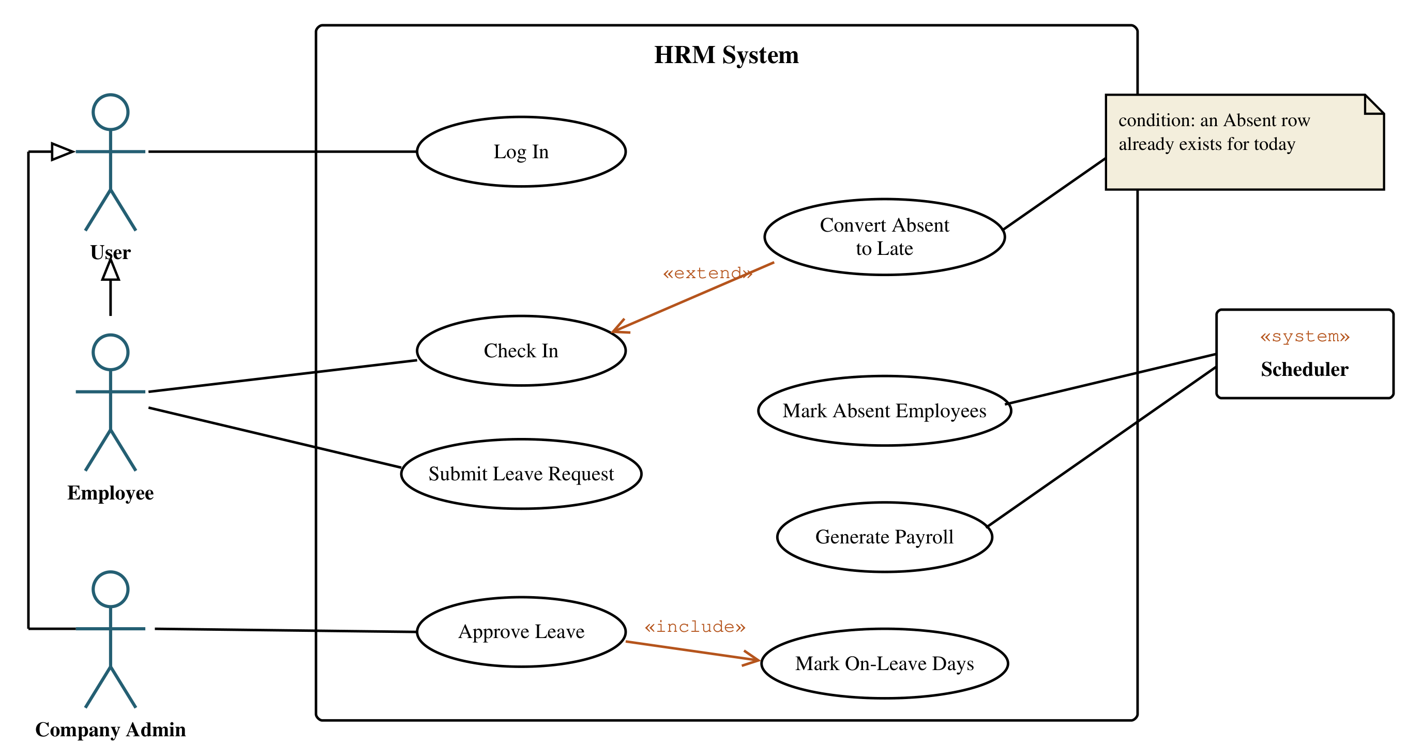
6. Use Case Diagram
Figure: Use case diagram of the HRM System – Employee and Company Admin generalize User; Scheduler is a secondary «system» actor; Approve Leave «includes» Mark On-Leave Days; Convert Absent to Late «extends» Check In when an Absent row already exists.
Human Resource Management (HRM) System
14/27

Slide 15
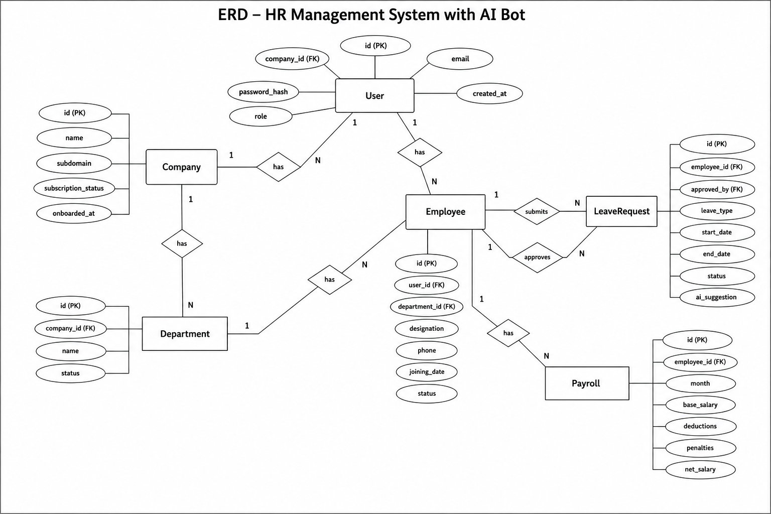
7. Database Design
[Insert image: Entity Relationship Diagram]
Table | Purpose
Company | Tenant organizations
Department, Role | Company structure, authorization roles
Employee | Users: profile, credentials, salary
Attendance | One row per employee per day
LeaveType, LeaveRequest | Leave workflow
Payroll | Monthly salary with deductions
RefreshToken | Session renewal / revocation
AiConversation, AiAuditLog, AiReport | AI usage and audit
12 normalized tables; every business table carries CompanyId for tenant isolation.
Attendance status: Present / Late / Absent / On Leave; Payroll: Basic − AbsentDeduction − LateDeduction = Net.
Human Resource Management (HRM) System
16/27

Slide 16
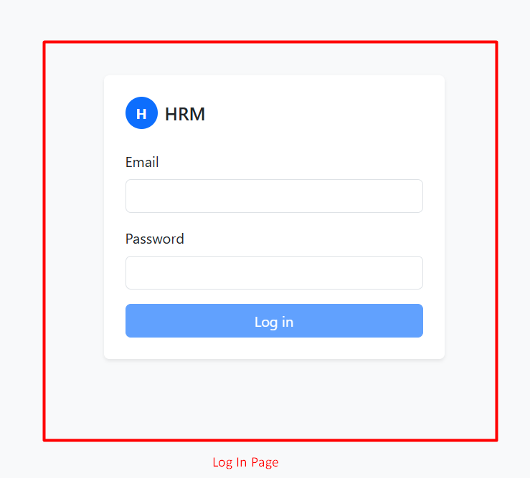
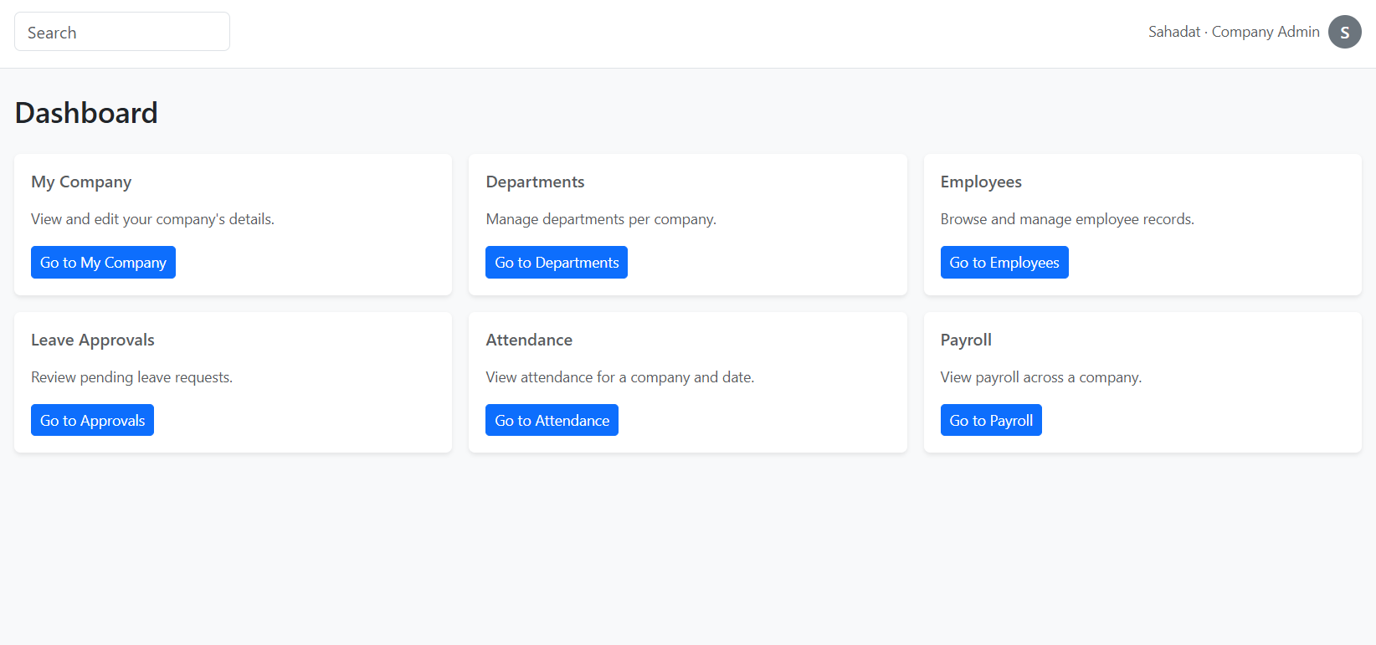
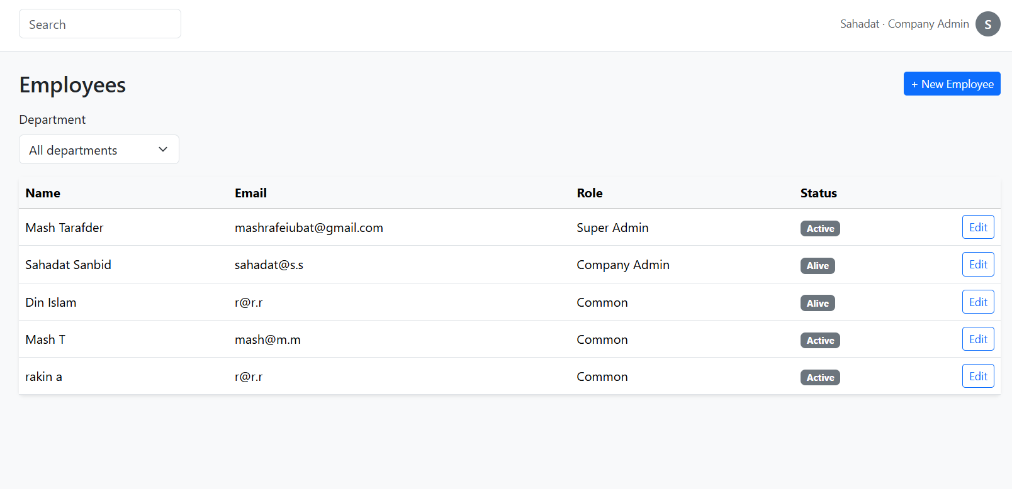
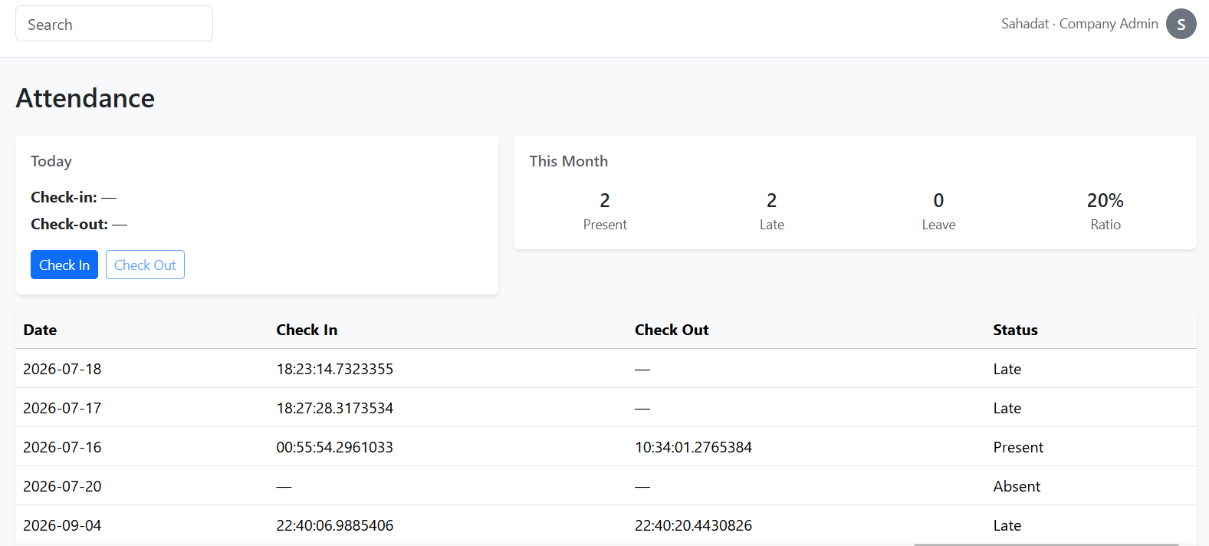
8. Implementation – Screenshots
[Insert image: Login page]
[Insert image: Company Admin dashboard]
[Insert image: Employee management (paginated)]
[Insert image: Check-in / check-out]
Angular frontend consuming the Web API; role decides the dashboard after login.
Human Resource Management (HRM) System
17/27

Slide 17
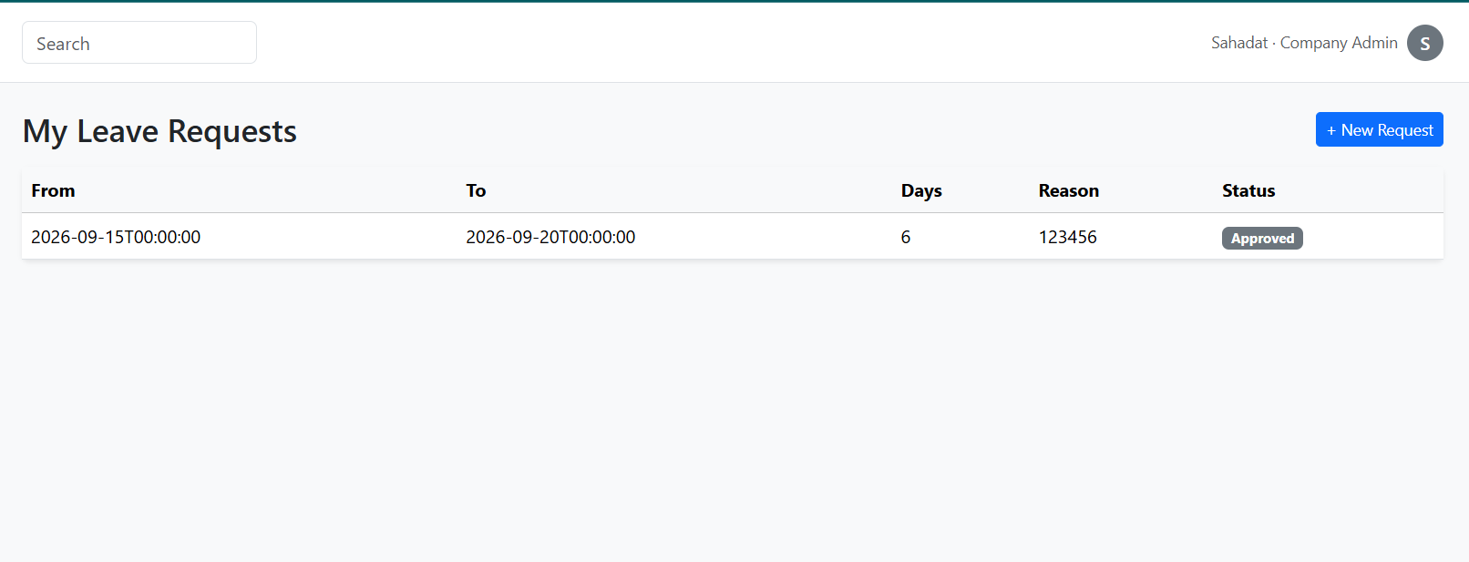
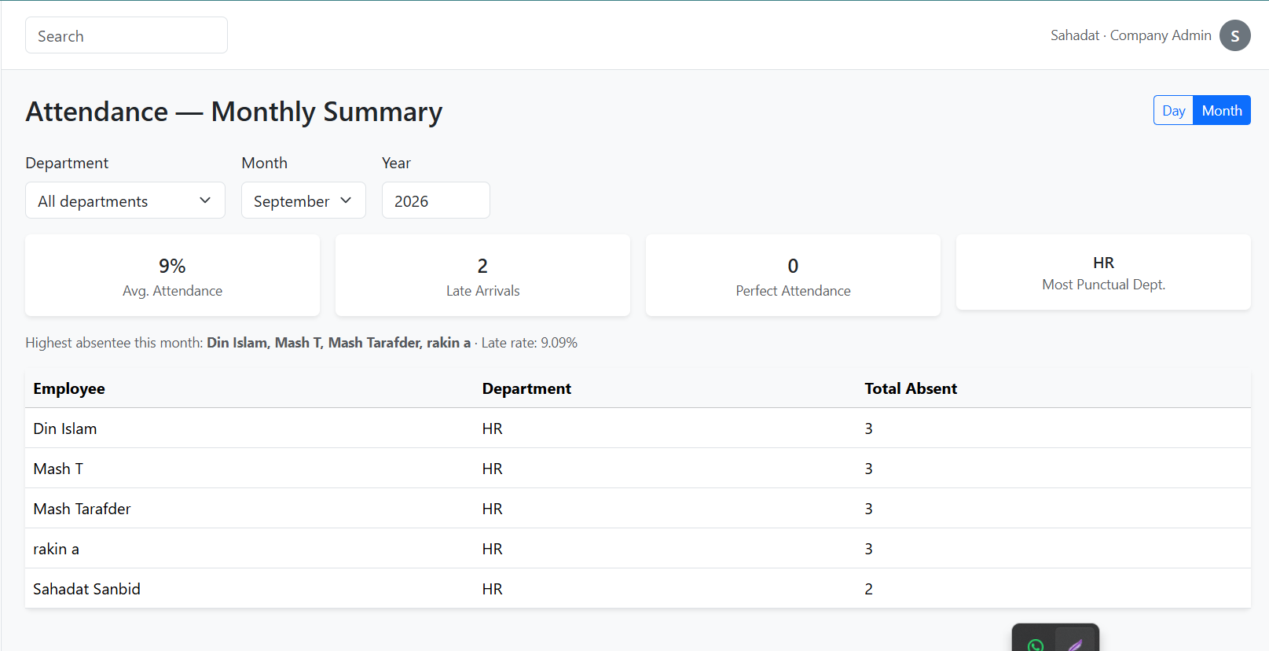
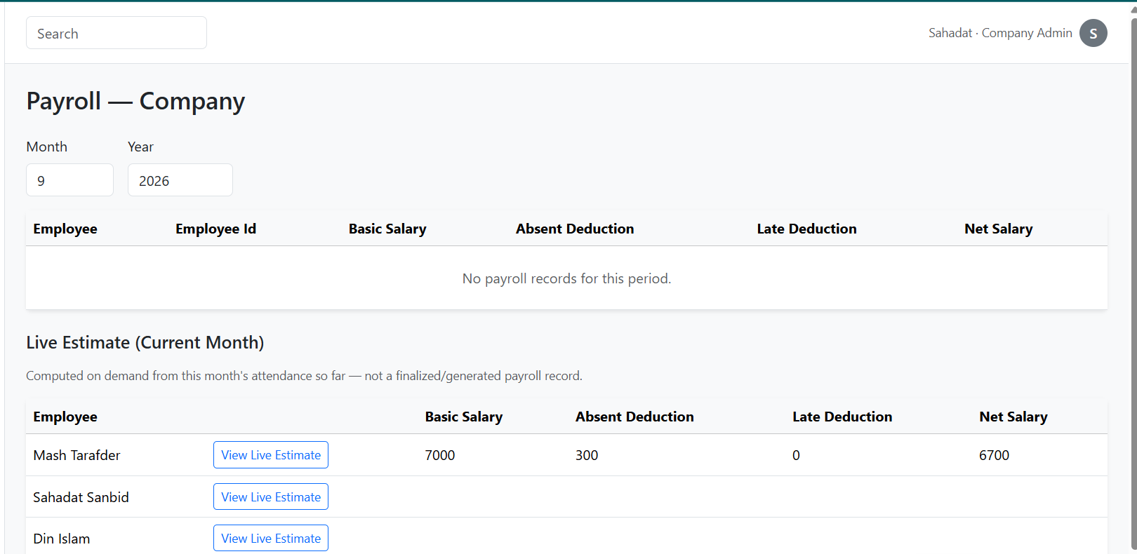
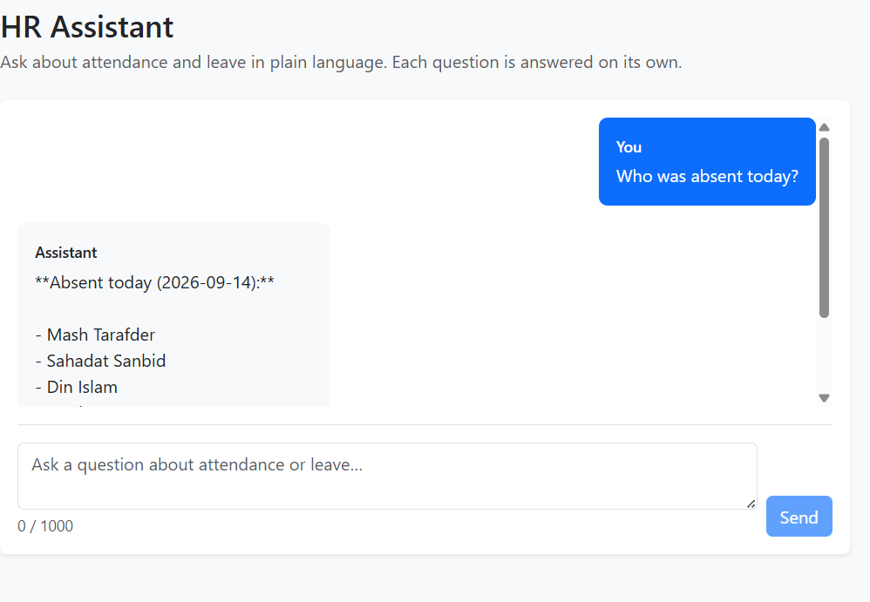
8. Implementation – Screenshots (Cont.)
[Insert image: Leave request and approval]
[Insert image: Monthly attendance summary]
[Insert image: Payroll / live payroll status]
[Insert image: HR Assistant chat]
Payroll rule: 100 BDT per absence; every 3 late arrivals = 1 absence. AI answers list the data tools used.
Human Resource Management (HRM) System
18/27

Slide 18
9. Testing
Approach: black-box (Swagger + Angular UI), white-box (handlers, branches), grey-box (DB verification); unit → integration → system → acceptance.
Scenario | Expected | Result
Login and token refresh | Token with Role & CompanyId; refresh only with valid cookie | Pass
Role-based, company-scoped access | 401 without token, 403 wrong role, no cross-company data | Pass
Check-in after auto-absent marking | Absent row converted to Late, no duplicate | Pass (after fix)
Payroll idempotency | Exactly one row per employee per month | Pass
AI question “Who was late the most?” | Correct name + count; toolsUsed listed | Pass
Non-functional: 15-min token expiry, cookie flags, pagination limits, AI response time (2–10 s), Windows/Linux portability.
Human Resource Management (HRM) System
19/27

Slide 19
10. Limitations and Future Plan
Limitations
Shift times, holidays and penalty are global constants, not per-company settings
Payroll covers basic salary and deductions only; generated globally
AI assistant: attendance and leave only, no payroll, no conversation memory
No notifications; no dedicated mobile app
Future plan
Per-company configuration of shifts, holidays, leave balances and deductions
Allowances, tax, bonus and payslip export (PDF/Excel)
AI: payroll tools, memory, proactive monthly reports
E-mail/push notifications; mobile app with location/biometric check-in
Automated test suites with CI/CD
Human Resource Management (HRM) System
20/27

Slide 20
11. Conclusion
Delivered a working, secure, multi-company HRM System: attendance, leave, payroll, analytics and an AI assistant.
Automation removes manual registers and hand-calculated salaries; company-level isolation is enforced by design.
Applied the full lifecycle – requirements, Clean Architecture/CQRS design, FP estimation, RMMM, testing.
Practicum value: hands-on experience with Angular, .NET 10, EF Core, JWT security, background services and LLM tool-calling, plus documentation and communication skills.
The system is a solid base for the per-company configuration and payroll extensions planned next.
Human Resource Management (HRM) System
21/27

Slide 21
12. References
[1] L. Bass, P. Clements, and R. Kazman, Software Architecture in Practice, 3rd ed. Boston, MA, USA: Addison-Wesley, 2013.
[2] G. Booch, J. Rumbaugh, and I. Jacobson, The Unified Modeling Language User Guide, 2nd ed. Boston, MA, USA: Addison-Wesley, 2005.
[3] C. J. Date, An Introduction to Database Systems, 8th ed. New Delhi, India: Pearson Education, 2019.
[4] M. Fowler, UML Distilled: A Brief Guide to the Standard Object Modeling Language, 3rd ed. Boston, MA, USA: Addison-Wesley, 2004.
[5] R. C. Martin, Clean Architecture: A Craftsman’s Guide to Software Structure and Design. Boston, MA, USA: Prentice Hall, 2017.
[6] Microsoft, “ASP.NET Core Documentation,” 2025. [Online]. Available: https://learn.microsoft.com/aspnet/core
[7] Microsoft, “Entity Framework Core Documentation,” 2025. [Online]. Available: https://learn.microsoft.com/ef/core
[8] Microsoft, “Microsoft.Extensions.AI Libraries,” 2025. [Online]. Available: https://learn.microsoft.com/dotnet/ai/microsoft-extensions-ai
[9] MediatR Documentation, “Simple mediator implementation in .NET,” 2025. [Online]. Available: https://github.com/jbogard/MediatR
[10] Angular Documentation, “Angular – The web development framework,” 2025. [Online]. Available: https://angular.dev
[11] Swashbuckle.AspNetCore, “Swagger tools for ASP.NET Core APIs,” 2025. [Online]. Available: https://github.com/domaindrivendev/Swashbuckle.AspNetCore
[12] M. Jones, J. Bradley, and N. Sakimura, “JSON Web Token (JWT),” RFC 7519, IETF, 2015. [13] R. S. Pressman and B. R. Maxim, Software Engineering: A Practitioner’s Approach, 9th ed. New York, NY, USA: McGraw-Hill, 2020.
Human Resource Management (HRM) System
22/27

Slide 22
Any Questions ?

Slide 23
THANK YOU

