Slide 1



Founded 1991 by Md. Alimullah Miyan
1991-2026
Human Resource Management (HRM) System
Course Code: Practicum CSC 490
Prepared for:
Practicum Defense Committee
Department of Computer Science and Engineering
Supervised by:
Prepared by:
Rubayea Ferdows
Student Name: Mashrafe Uddin Tarafder
Assistant Professor
Student ID: 22303075
25th September, 2026

Slide 2
Contents
Introduction
Objectives
Organization Overview
Methodology and Process Model
System Requirements
Use Case Diagram
System Architecture
Database Design
Project Estimation and Schedule
Risk Management
Implementation (Screenshots)
Testing
Limitations and Future Plan
Conclusion
References
Human Resource Management (HRM) System
2/23

Slide 3
Introduction
Problem: small and medium organizations still track attendance on paper or spreadsheets, handle leave by e-mail, and calculate salaries by hand – slow, error-prone and opaque to employees.
Solution: a web-based, multi-company HRM System that automates attendance, leave and monthly payroll with role-based access.
Roles: Super Admin (onboards companies), Company Admin (manages own company), Common employee (checks in/out, applies for leave, views own records).
Automation: a daily job marks absent employees; a monthly job generates the previous month’s payroll.
AI HR Assistant: answers HR questions in natural language from the company’s own data.
Human Resource Management (HRM) System
3/23

Slide 4
Objectives
Broad objective
Design and develop a secure, web-based, multi-company HRM system that automates attendance, leave and payroll administration.
Specific objectives
Role-based access control scoped to the user’s own company
Check-in/check-out with automatic late and early-leave detection; scheduled absent marking
Leave workflow: request → approve/reject → reflected in attendance
Automatic monthly payroll with deduction rules; live payroll projection
Daily, monthly and per-employee attendance analytics
AI assistant using read-only, company-scoped data tools
JWT authentication, refresh-token rotation, BCrypt password hashing
Human Resource Management (HRM) System
4/23

Slide 5

Organization Overview
Organization: AKIJ iBOS Ltd., Dhaka, Bangladesh
Services: Provides AI-driven software, enterprise solutions, and full-stack digital services designed for modern businesses
Vision / Mission: Vision is to build smart systems
My position: Backend Intern – analysis, design and full-stack development of the HRM System
Organizational supervisor: Saidur Rahman Akash, Software Engineer L-2
Duration: 12 weeks (1st June, 2026 – 31st August, 2026)
[Insert image: Organization logo / working environment photo]
Human Resource Management (HRM) System
5/23

Slide 6
Methodology and Process Model
Process model: Agile – iterative and incremental with feedback at the end of every iteration.
Iterations (12 weeks)
Sprint 0 – requirements, Clean Architecture skeleton, database schema
Sprint 1 – JWT authentication, company / role / department management
Sprint 2 – employee management, pagination, Swagger security
Sprint 3 – attendance, automatic absent marking, leave workflow
Sprint 4 – payroll job, live payroll status, AI assistant
Final – Angular integration, testing, documentation
Why Agile: requirements were refined from working software (e.g. the check-in rule after auto-absent marking), modules could be demonstrated early, defects found early.
Human Resource Management (HRM) System
6/23

Slide 7
System Requirements
Role | Key functional requirements
Super Admin | Create, update, activate/deactivate and list companies (paginated)
Company Admin | Manage departments (with employee counts), roles and employees; view attendance by date/employee and daily/monthly summaries; approve, reject or cancel leave; view payroll and live projection; ask the AI assistant
Common (Employee) | Log in; check in / check out once per day; submit leave requests; view own attendance, statistics and payroll
System (Scheduler) | Mark absent employees every working day at 09:30 (skip holidays and approved leave, catch up at startup); generate previous month’s payroll on the 1st, exactly once
Non-functional: JWT security and company-level data isolation; paginated lists (default 50, max 100); idempotent jobs; responsive Angular UI; Clean Architecture + CQRS for maintainability.
Human Resource Management (HRM) System
7/23

Slide 8
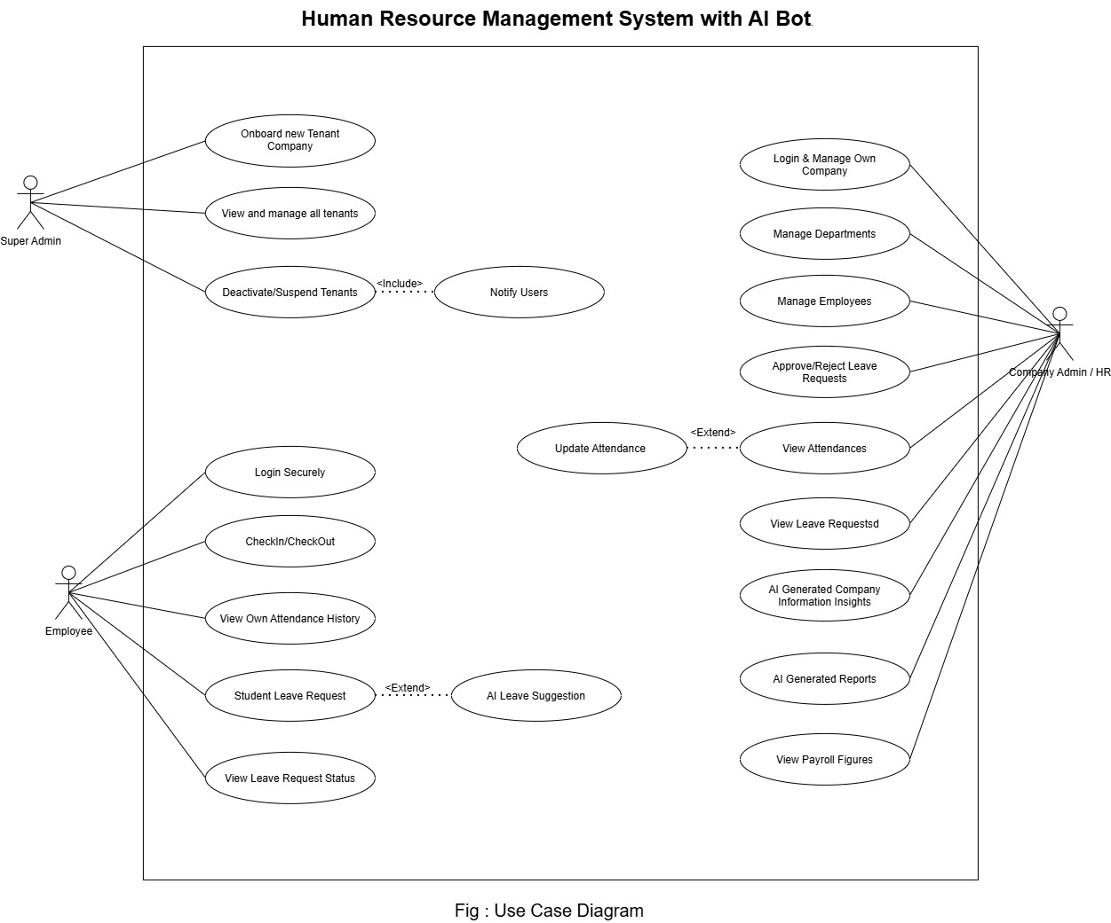
Use Case Diagram
Figure: Use case diagram of the HRM System (three primary actors, Scheduler as secondary actor; «include» Mark On-Leave Days, «extend» Convert Absent to Late).
Human Resource Management (HRM) System
8/23

Slide 9
System Architecture
Presentation Tier
Angular SPA – login, role-based dashboards, attendance, leave, payroll, HR assistant chat
Application Tier – ASP.NET Core Web API (.NET 10)
Web API (controllers, JWT, Swagger, hosted jobs) → Application (MediatR commands/queries, DTOs, validation) → Domain (entities) ← Infrastructure (EF Core, repositories, token/password services, AI service)
Data Tier
Microsoft SQL Server – 12 tables + stored procedure sp_MarkAbsentEmployees
External: LLM provider (Groq, OpenAI-compatible API) via Microsoft.Extensions.AI – tool calling over company-scoped repositories
Pattern: Three-tier client–server with Clean Architecture and CQRS (MediatR) – every use case is an isolated command/query handler.
Security: HS256 JWT (15 min) + HttpOnly refresh cookie (7 days); company id read only from the token.
Human Resource Management (HRM) System
9/23

Slide 10
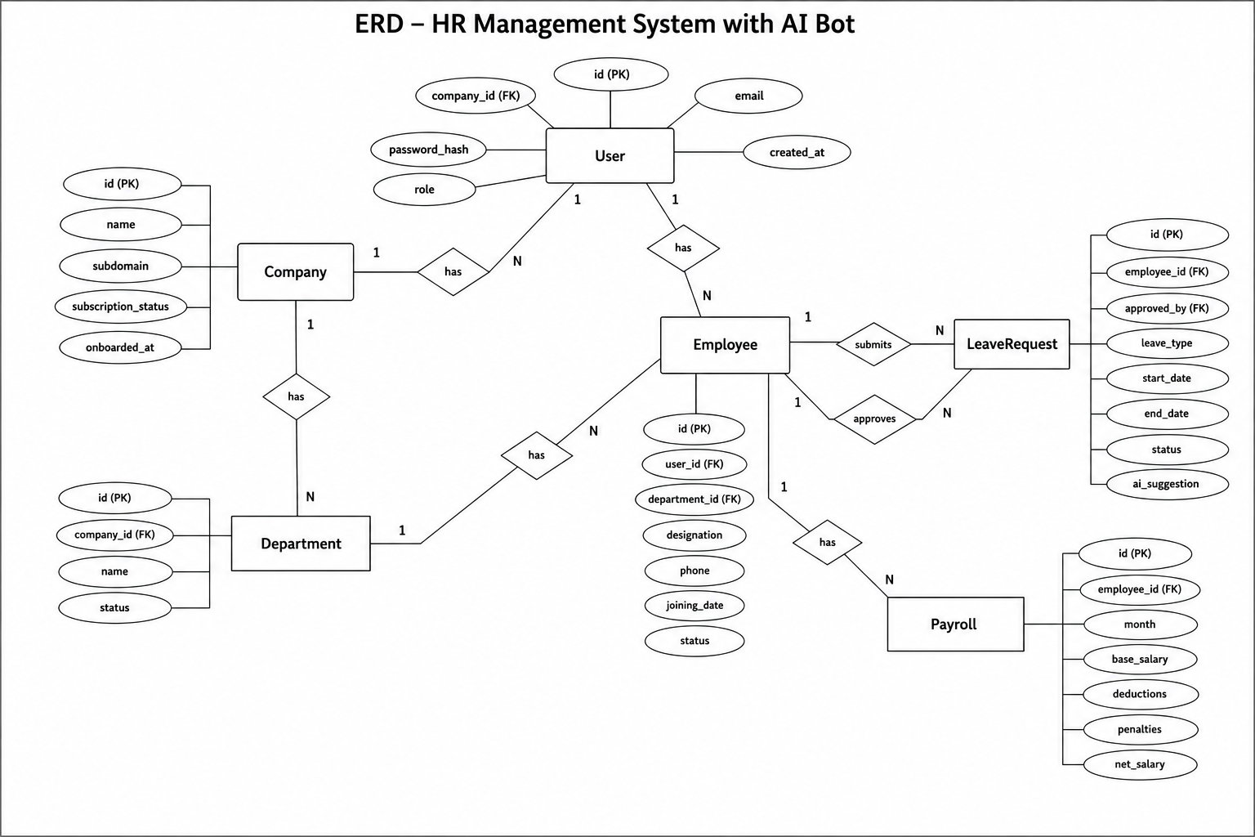
Database Design
Table | Purpose
Company | Tenant organizations
Department, Role | Company structure, authorization roles
Employee | Users: profile, credentials, salary
Attendance | One row per employee per day
LeaveType, LeaveRequest | Leave workflow
Payroll | Monthly salary with deductions
RefreshToken | Session renewal / revocation
AiConversation, AiAuditLog, AiReport | AI usage and audit
12 normalized tables; every business table carries CompanyId for tenant isolation.
Attendance status: Present / Late / Absent / On Leave; Payroll: Basic − AbsentDeduction − LateDeduction = Net.
Human Resource Management (HRM) System
10/23

Slide 11
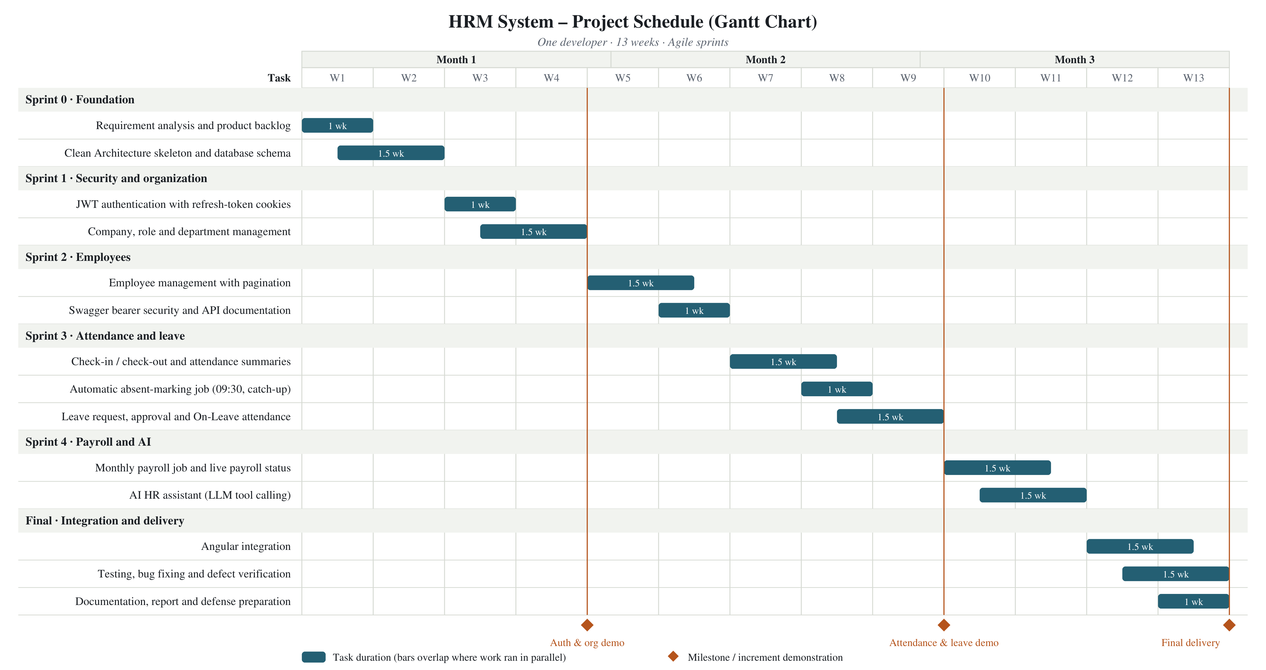
Project Estimation and Schedule
Metric | Value
Transactional UFP (14 EI + 7 EO + 11 EQ) | 59 + 36 + 41 = 136
Data UFP (12 ILF × 7) | 84
Total UFP | 220
VAF = 0.65 + 0.01 × TDI (41) | 1.06
Adjusted Function Points | 233.2 FP
Actual effort (1 dev × 3 months × 22 days × 8 h) | 528 person-hours ≈ 2.26 h/FP
Cost item | BDT
Personnel (528 h × 227.27) | 120,000.00
Hardware (depreciation) | 3,083.33
Other (internet, power, backup) | 12,450.00
Software (all open source) | 0.00
Total | 135,533.33
[Insert image: Gantt chart – 6 sprints over 12–13 weeks]
Sprint 0 (wk 1–2) · Sprint 1 (3–4) · Sprint 2 (5–6) · Sprint 3 (7–9) · Sprint 4 (10–11) · Final (12–13)
Salary and hardware figures are illustrative assumptions (BDT 40,000/month, laptop BDT 85,000).
Human Resource Management (HRM) System
11/23

Slide 12
Risk Management (RMMM)
Risk | P / I | Mitigation | Contingency
Unauthorized or cross-company access | Mod / Cat | JWT + roles, company id from token, BCrypt, refresh rotation | Revoke tokens, rotate key, fix
Incorrect attendance from auto-absent job | High / Ser | Idempotent SP, holiday calendar, startup catch-up, Absent→Late conversion | Admin corrects; re-run job
Duplicate / wrong payroll | Mod / Cat | Existence check; single formula for generation and projection | Regenerate after fixing data
LLM provider failure or wrong answer | High / Tol | Configurable model; read-only scoped tools; toolsUsed returned | Switch model / disable
Database or server failure | Mod / Ser | Backups, transactions, monitoring | Restore backup
User operation error | Mod / Tol | Validation, confirmations, training | Assisted correction
P = probability, I = impact (Tolerable / Serious / Catastrophic). Risks 2 and 4 were actually encountered during development and resolved.
Human Resource Management (HRM) System
12/23

Slide 13
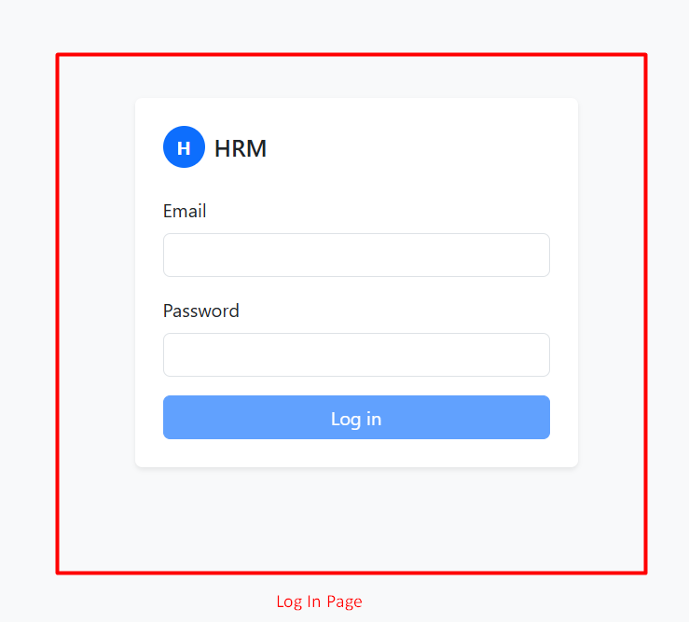
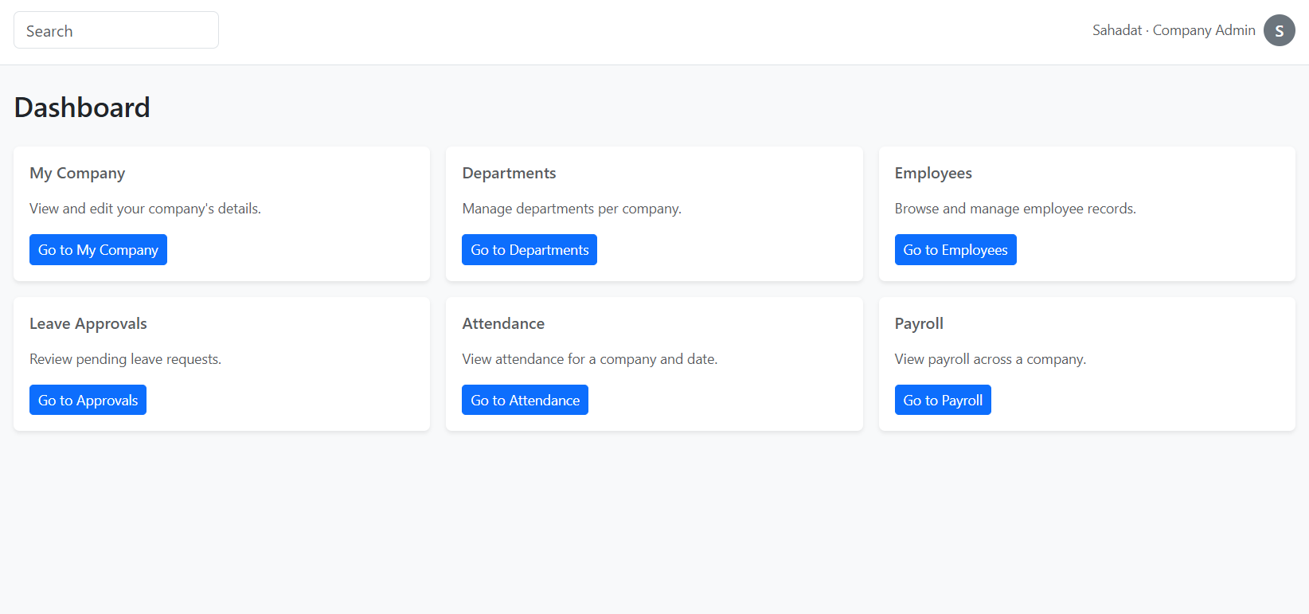
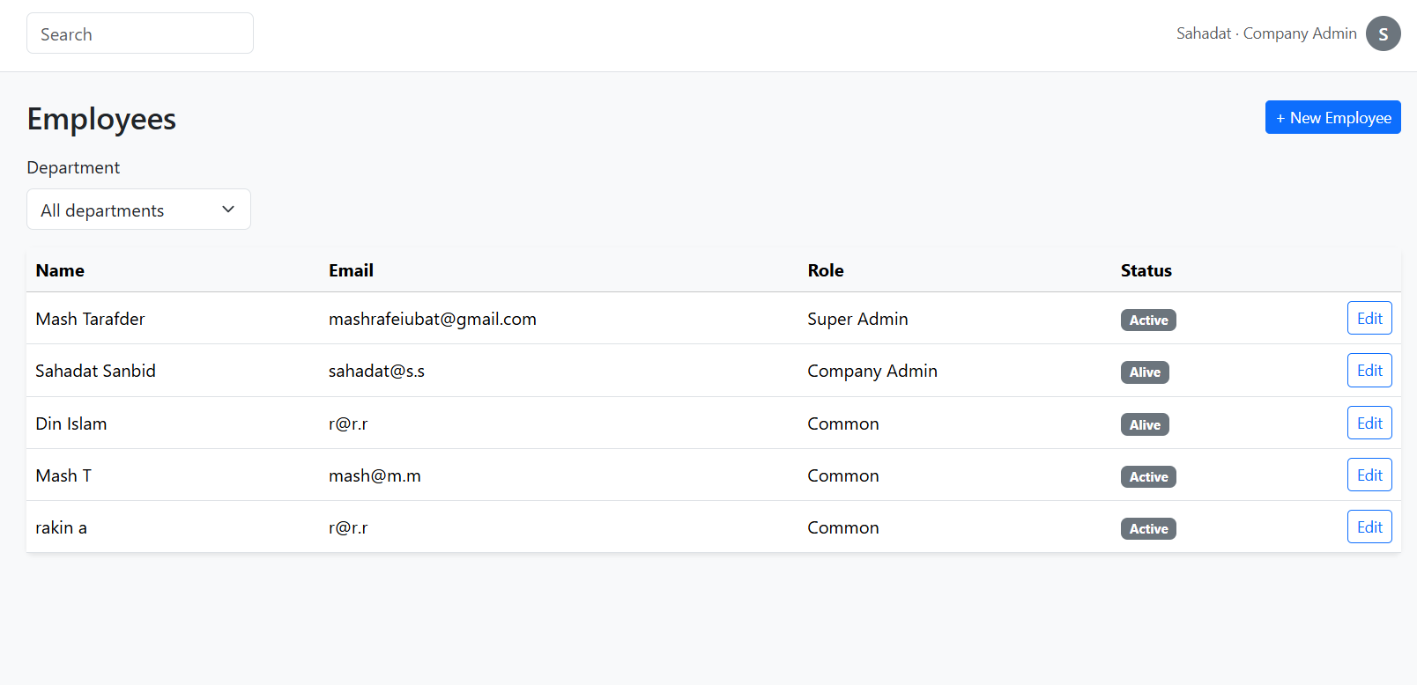
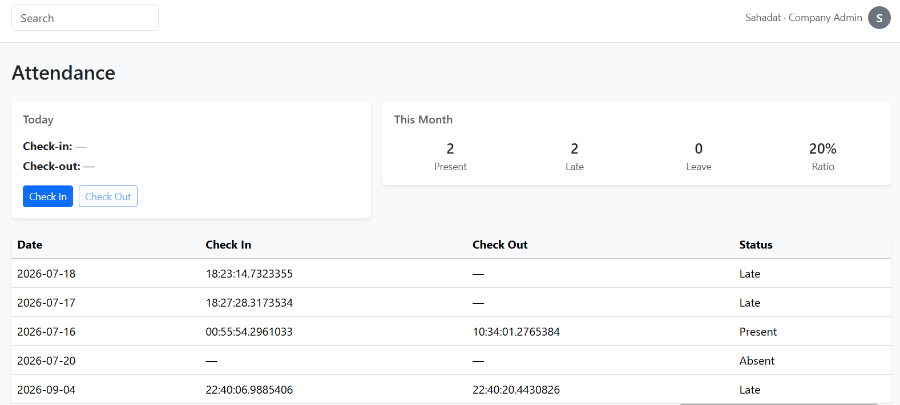
Implementation – Screenshots
Angular frontend consuming the Web API; role decides the dashboard after login.
Human Resource Management (HRM) System
13/23

Slide 14
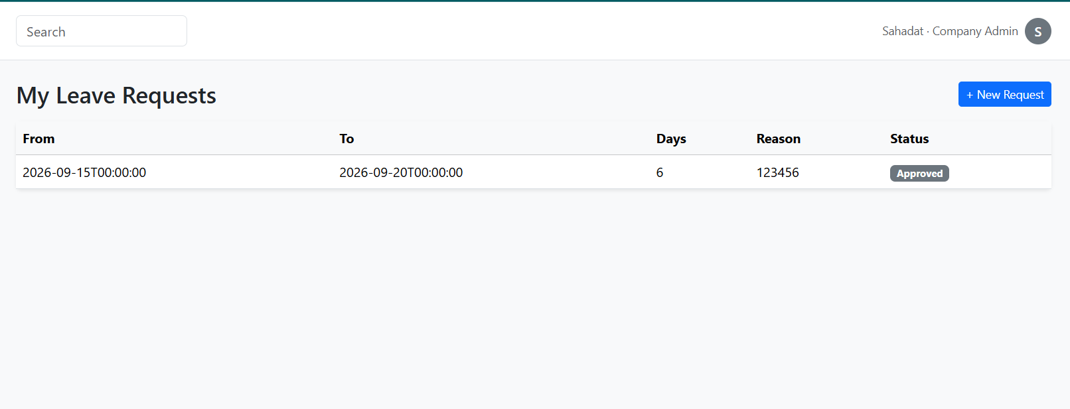
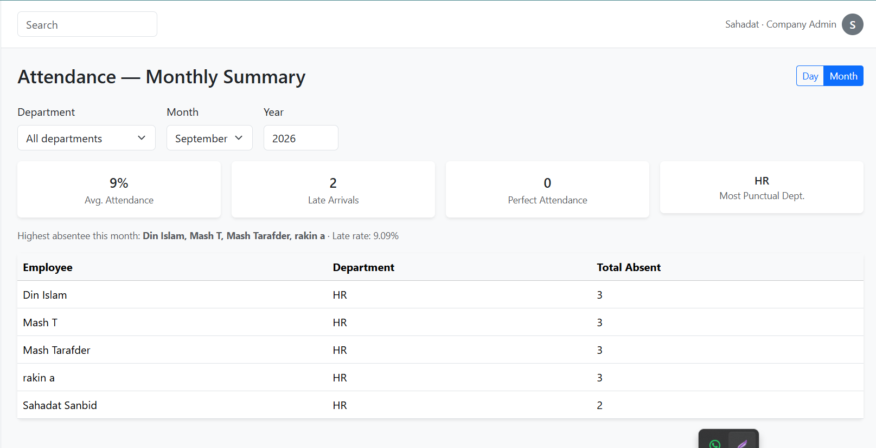
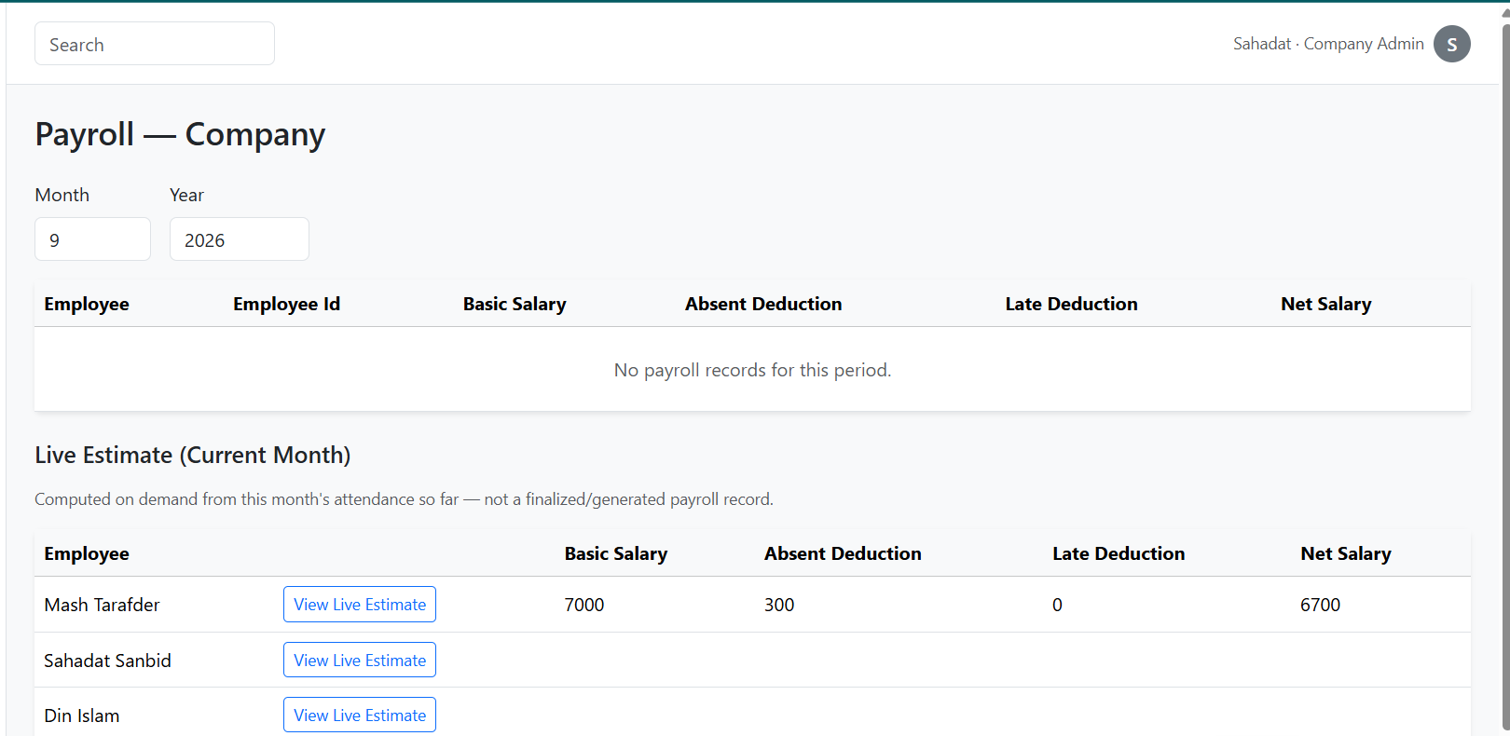
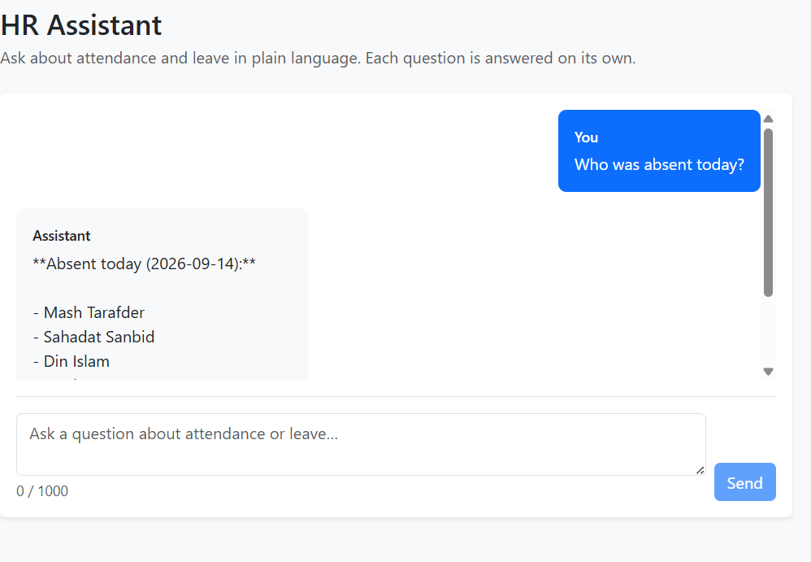
Implementation – Screenshots (Cont.)
Payroll rule: 100 BDT per absence; every 3 late arrivals = 1 absence. AI answers list the data tools used.
Human Resource Management (HRM) System
14/23

Slide 15
Testing
Approach: black-box (Swagger + Angular UI), white-box (handlers, branches), grey-box (DB verification); unit → integration → system → acceptance.
Scenario | Expected | Result
Login and token refresh | Token with Role & CompanyId; refresh only with valid cookie | Pass
Role-based, company-scoped access | 401 without token, 403 wrong role, no cross-company data | Pass
Check-in after auto-absent marking | Absent row converted to Late, no duplicate | Pass (after fix)
Payroll idempotency | Exactly one row per employee per month | Pass
AI question “Who was late the most?” | Correct name + count; toolsUsed listed | Pass
Non-functional: 15-min token expiry, cookie flags, pagination limits, AI response time (2–10 s), Windows/Linux portability.
Human Resource Management (HRM) System
15/23

Slide 16
Limitations and Future Plan
Limitations
Shift times, holidays and penalty are global constants, not per-company settings
Payroll covers basic salary and deductions only; generated globally
AI assistant: attendance and leave only, no payroll, no conversation memory
No notifications; no dedicated mobile app
Future plan
Per-company configuration of shifts, holidays, leave balances and deductions
Allowances, tax, bonus and payslip export (PDF/Excel)
AI: payroll tools, memory, proactive monthly reports
E-mail/push notifications; mobile app with location/biometric check-in
Automated test suites with CI/CD
Human Resource Management (HRM) System
16/23

Slide 17
Conclusion
Delivered a working, secure, multi-company HRM System: attendance, leave, payroll, analytics and an AI assistant.
Automation removes manual registers and hand-calculated salaries; company-level isolation is enforced by design.
Applied the full lifecycle – requirements, Clean Architecture/CQRS design, FP estimation, RMMM, testing.
Practicum value: hands-on experience with Angular, .NET 10, EF Core, JWT security, background services and LLM tool-calling, plus documentation and communication skills.
The system is a solid base for the per-company configuration and payroll extensions planned next.
Human Resource Management (HRM) System
17/23

Slide 18
References
[1] R. S. Pressman and B. R. Maxim, Software Engineering: A Practitioner’s Approach, 9th ed. New York, NY, USA: McGraw-Hill, 2020.
[2] I. Sommerville, Software Engineering, 10th ed. Harlow, U.K.: Pearson, 2016.
[3] R. C. Martin, Clean Architecture: A Craftsman’s Guide to Software Structure and Design. Boston, MA, USA: Prentice Hall, 2017.
[4] Microsoft, “ASP.NET Core documentation.” [Online]. Available: https://learn.microsoft.com/aspnet/core. Accessed: date.
[5] Microsoft, “Entity Framework Core documentation.” [Online]. Available: https://learn.microsoft.com/ef/core. Accessed: date.
[6] Microsoft, “Microsoft.Extensions.AI libraries.” [Online]. Available: https://learn.microsoft.com/dotnet/ai/microsoft-extensions-ai. Accessed: date.
[7] M. Jones, J. Bradley, and N. Sakimura, “JSON Web Token (JWT),” IETF RFC 7519, May 2015.
[8] D. Longstreet, “Fundamentals of function point analysis,” 2005. [Online]. Available: http://www.softwaremetrics.com/fpafund.html.
[9] Internship Guidelines, Department of Computer Science and Engineering, IUBAT, Dhaka, Bangladesh, 2026.
[10] Company website: Organization Name. [Online]. Available: https://www.example.com. Accessed: date.
NOTE: consult your supervisor before and after preparing the final defense slides.
Human Resource Management (HRM) System
18/23

Slide 19
Any Questions ?

Slide 20
THANK YOU

