Slide 1
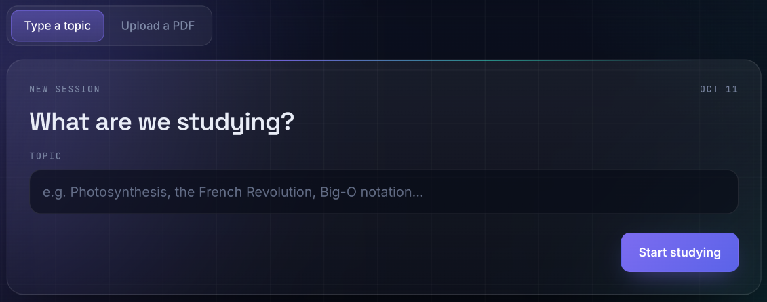
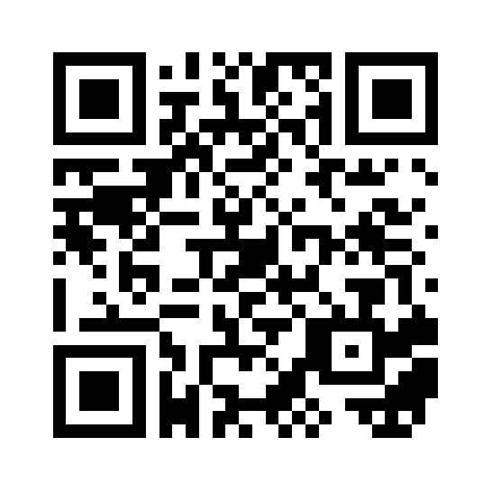
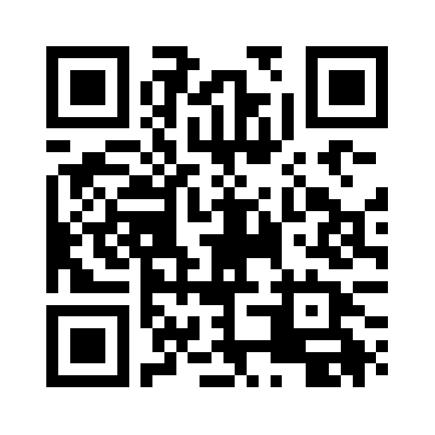
AI-POWERED ADAPTIVE LEARNING & SELF-ASSESSMENT
SmartStudy
Understand the topic.
Find the gap.
Plan the next review.
Assistant
EXPLAIN / EXAMINE / DIAGNOSE / RE-TEACH / RECALL
01
The learning challenge
THE APPLICATION
Reading a lesson does not show which concepts a learner can explain or apply. A useful study tool should connect understanding, feedback and revision.
Project objective
Turn a topic or PDF into a guided cycle of learning, assessment and targeted review.
Actual interface: topic entry and PDF upload
02
A connected learning cycle
INPUT: TOPIC OR TEXT-BASED PDF
1
Explain
2
Examine
3
Diagnose
4
Re-teach
5
Recall
Study an overview, examples and common mistakes.
Answer MCQs and short-answer questions.
Use concept tags and scores to locate learning gaps.
Revisit gaps with focused lessons and mini-checks.
Review due concepts and rate recall difficulty.
Review ratings update the next due date, continuing the revision cycle.
03
System architecture
04
How adaptation works
Browser interface
Assess understanding
HTML + CSS + vanilla JavaScript
MCQs use answer matching; short answers receive AI-generated scores and feedback.
Identify weak concepts
Node.js + Express
Question-level concept tags connect incorrect or low-scoring answers to specific learning gaps.
Serves the interface and coordinates the APIs
Prioritize the first review
OpenRouter LLM
PostgreSQL
High-severity gaps are scheduled after 1 day; medium-severity gaps after 2 days.
Lessons, exams, grading
and focused re-teaching
Supabase database for
study and review records
Adapt future intervals
PDF extraction: pdf-parse | Hosting: Render
Again, Hard, Good and Easy ratings feed SM-2 to update the next review date.
05
Implemented capabilities
06
Evaluation & next steps
Flexible study input
Current scope: a functional learning workflow in the source code. Learning gains have not been measured in this review.
Topics and text-based PDF uploads.
Visible learning progress
Study history, scores and due-review queue.
Next: evaluate grading agreement, retention and usability; add secure authentication and OCR for scanned PDFs.
Structured AI responses
JSON schemas, validation and retry/fallback logic.
FROM CONTENT TO TARGETED REVISION
One workflow connects explanation, assessment,
concept-level feedback and scheduled recall.
Source: IMRAN-8/smartstudy-assistant | commit 09f93df
TRY THE APP
SOURCE CODE
Notes:
Source: https://github.com/IMRAN-8/smartstudy-assistant, commit 09f93df. Screenshot supplied by the user. Text, shapes and diagram labels are native editable slide objects. Screenshot and QR codes are embedded images.

