Slide 1
Sales data analysis
By Keshav sharma

Slide 2
objective
To contribute the success of a business by utilizing data analysis techniques, specifically focusing on Profitability Analysis and Exploratory Data Analysis (EDA) to provide valuable insights and accurate sales forecasting.

Slide 3
description
The objective can be broken down into the following detailed components:
Data Analysis: Provide valuable insights to business entities regarding the effectiveness of their sales strategies through visualization and charts.
Dashboard Creation : Identify the KPIs, design an intuitive and visually appealing dashboard, add interactive visualizations and filtering capabilities to allow users to explore the data at various levels of granularity.
Actionable Insights and recommendations: End goal is to share valuable insights and actionable information that can drive strategic decision making and support the company’s goal for growth, efficiency and customer satisfaction.

Slide 4
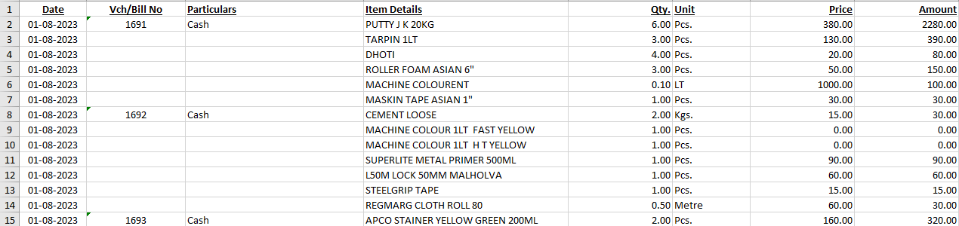
overview of the dataset

Slide 5
Technologies and Tools Used:
Microsoft Excel:
Utilized Microsoft Excel for initial data exploration, importing, and basic data manipulation.
Python for Data Analysis:
Employed Python, along with libraries such as Pandas, NumPy, and Matplotlib, for in-depth data analysis and manipulation.
Conducted Exploratory Data Analysis (EDA) using Jupyter Notebook for data visualization and statistical analysis.
Executed data preprocessing tasks, including handling missing values.
Applied machine learning algorithms for predictive analysis and insights generation.
Power BI for Visualization:
Leveraged Power BI for advanced data visualization and interactive dashboards.
Created visually appealing charts, graphs, and reports to present key findings and insights.
Enabled stakeholders to interact with the data and explore it dynamically.

Slide 6
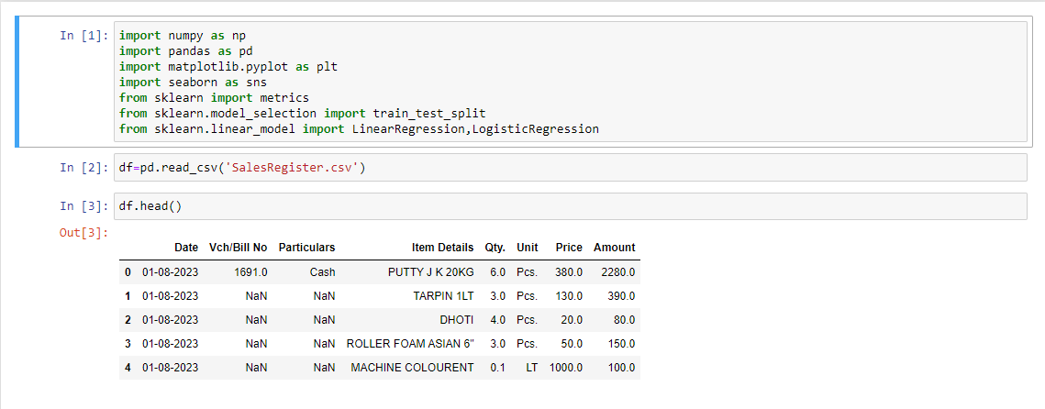
Data Preparation
Importing Libraries and making and importing csv file.

Slide 7
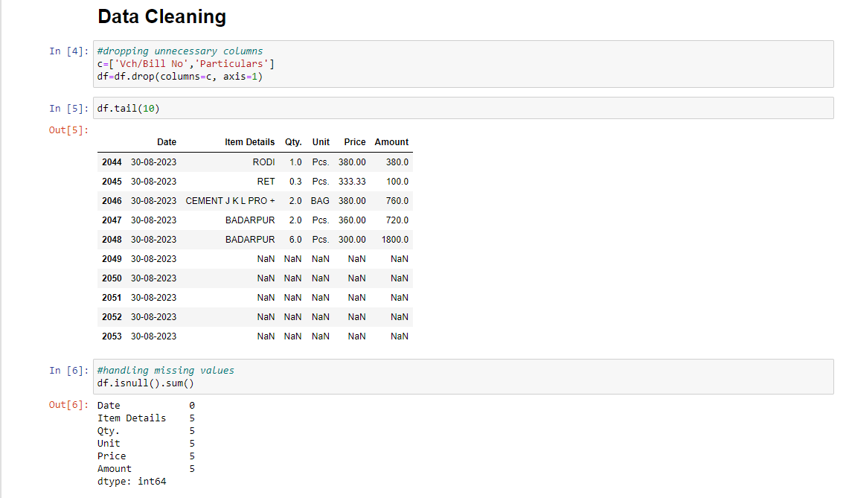
Data pre-processing

Slide 8
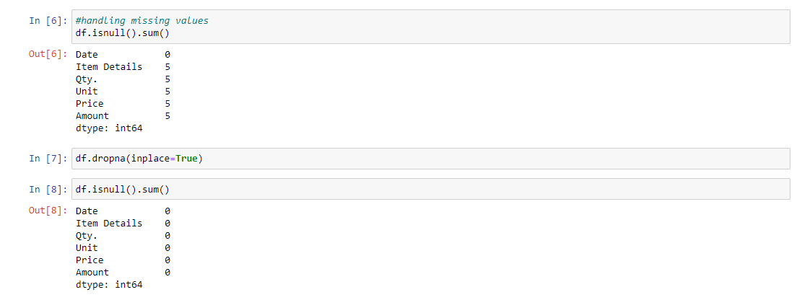
Data cleaning

Slide 9
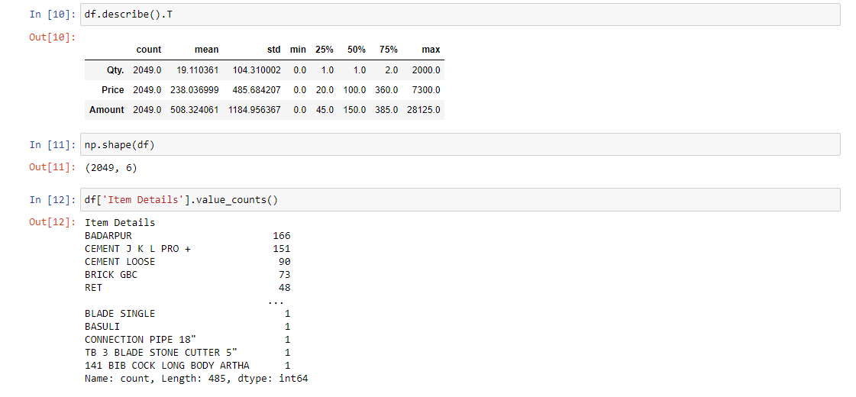
Data analysis

Slide 10
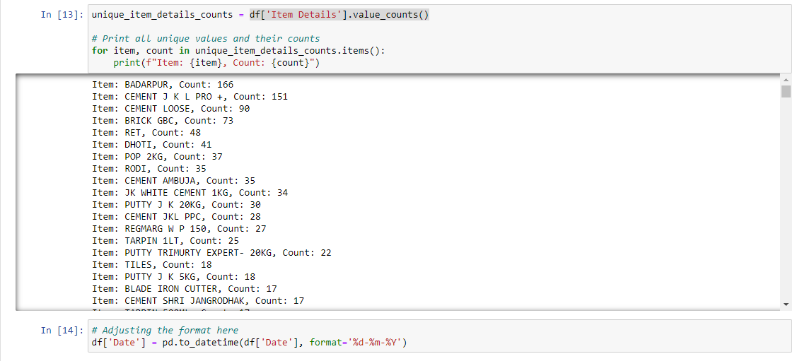
Data analysis

Slide 11
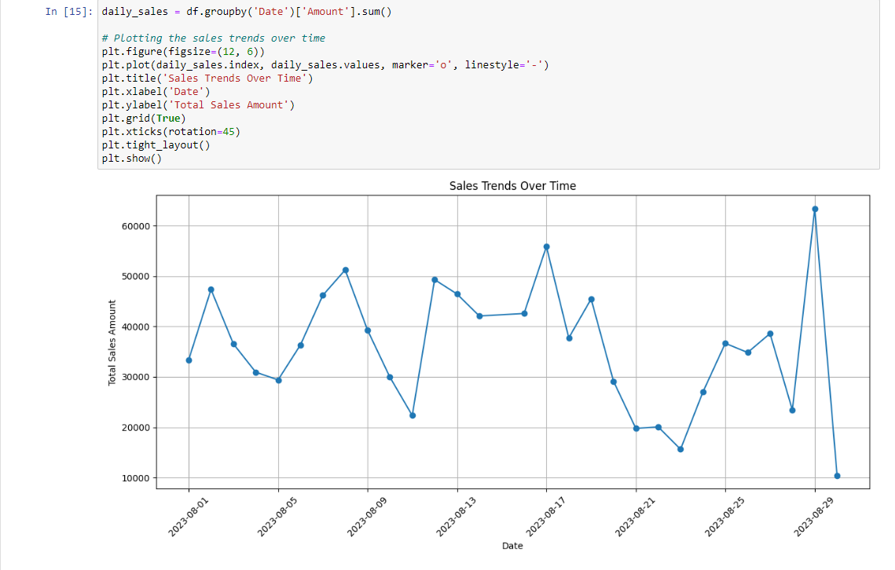
Sales trends over time

Slide 12
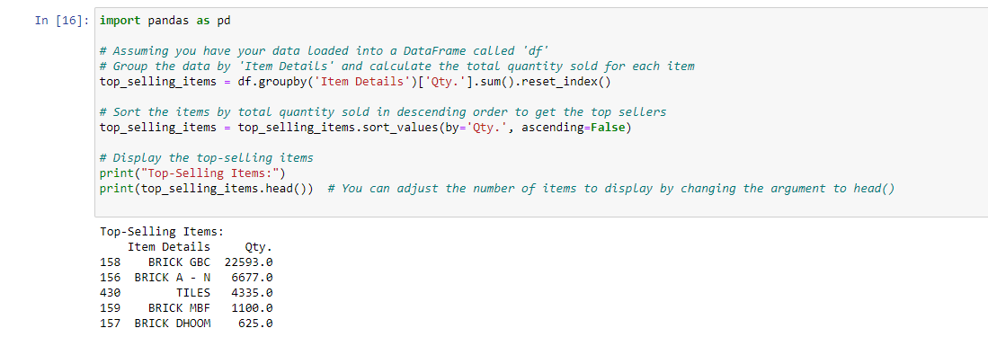
Top 5 most selling items by quantity

Slide 13
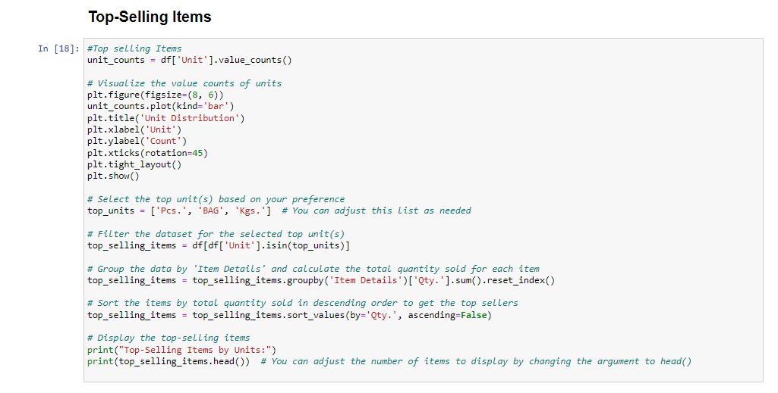
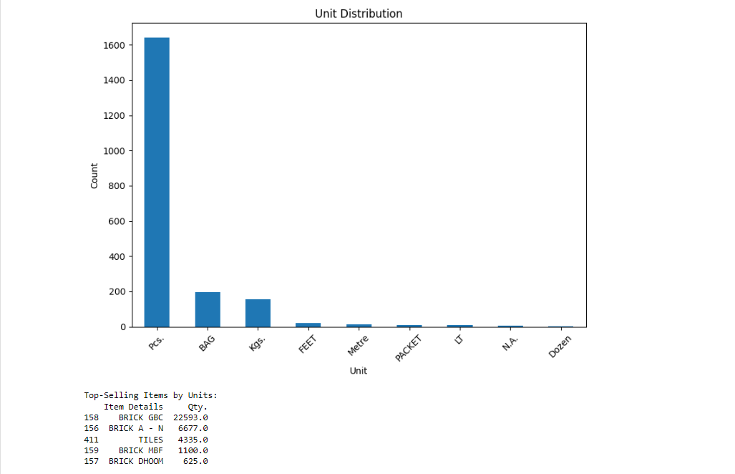
Top selling items by units

Slide 14
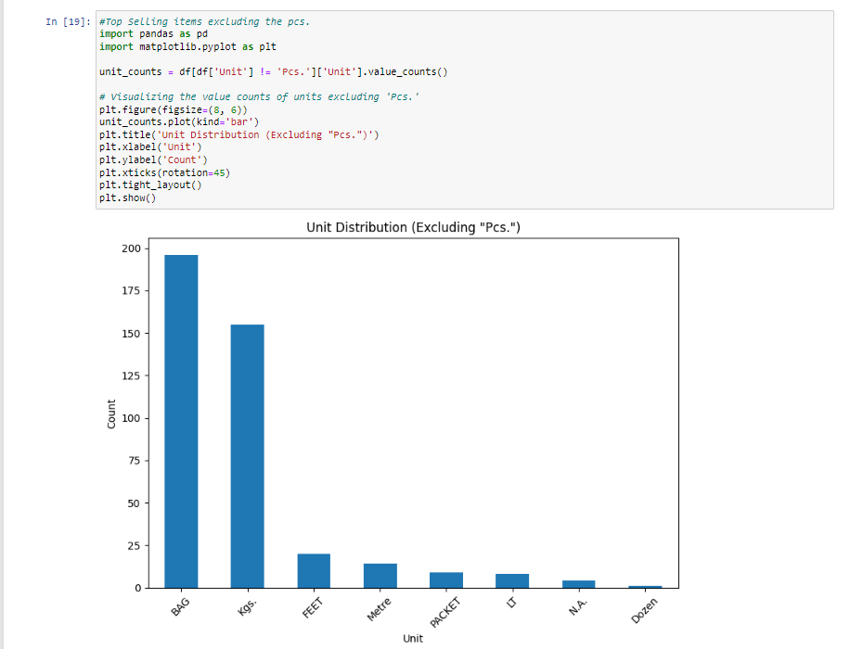
Top selling items excluding “pcs.”

Slide 15
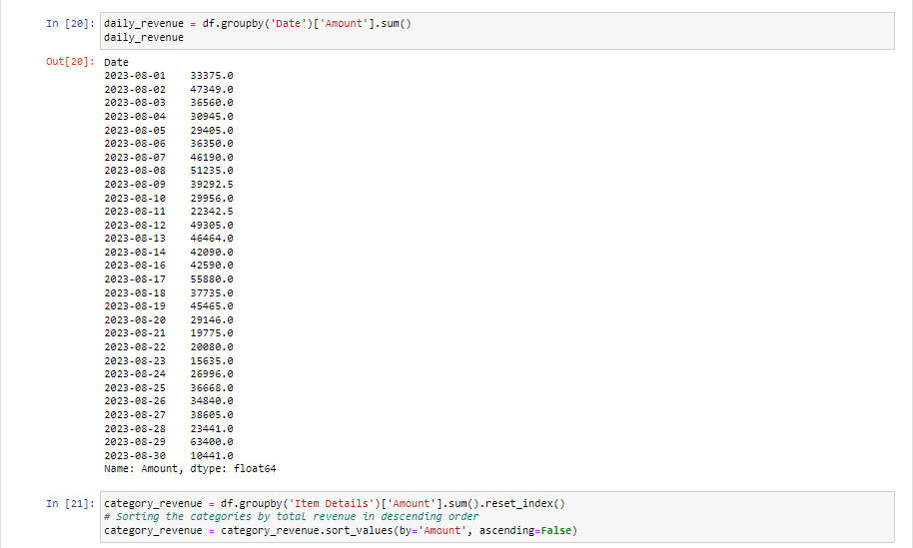
Revenue analysis

Slide 16
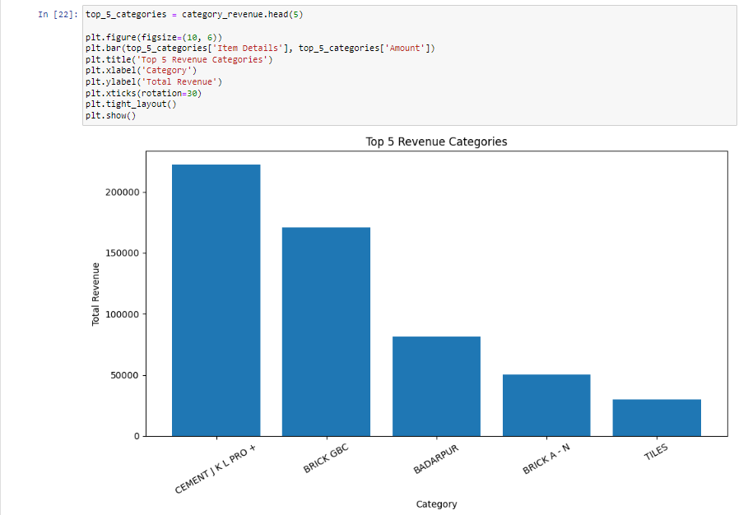
Visualizing revenue by top 5 revenue categories

Slide 17
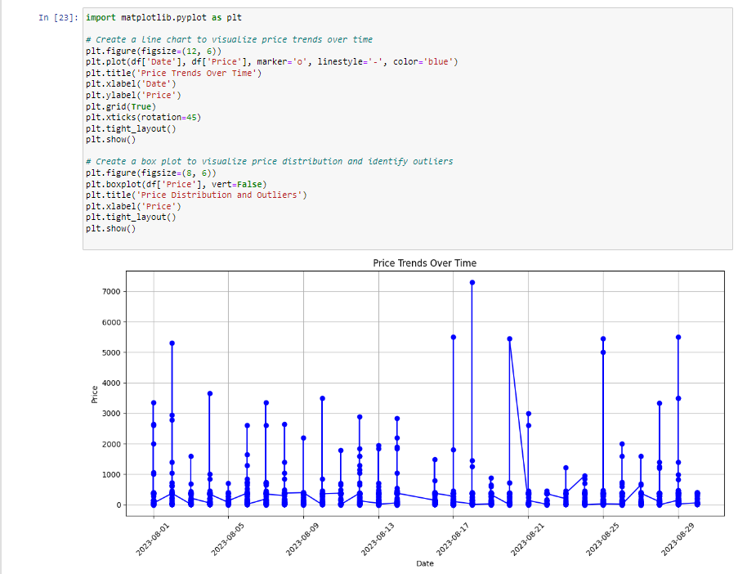
Prize trends over time

Slide 18
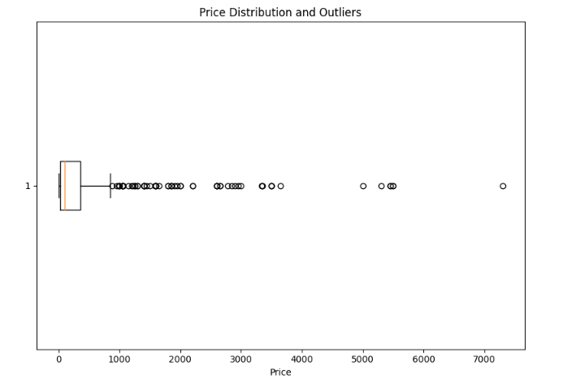
Price distribution and outliers

Slide 19
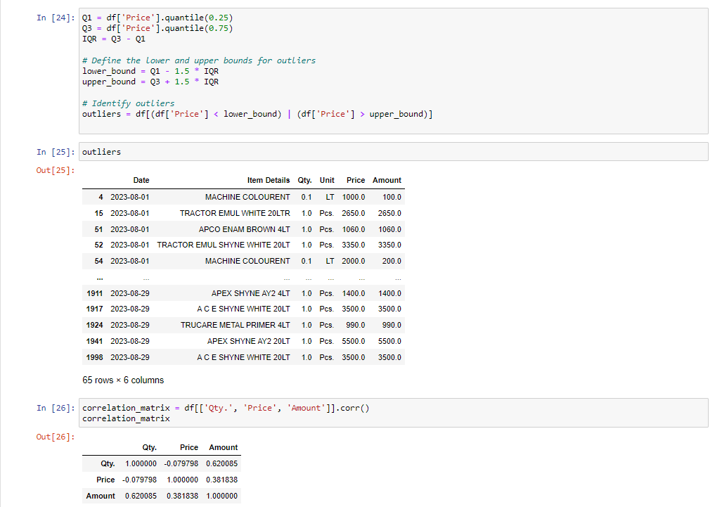
outliers

Slide 20
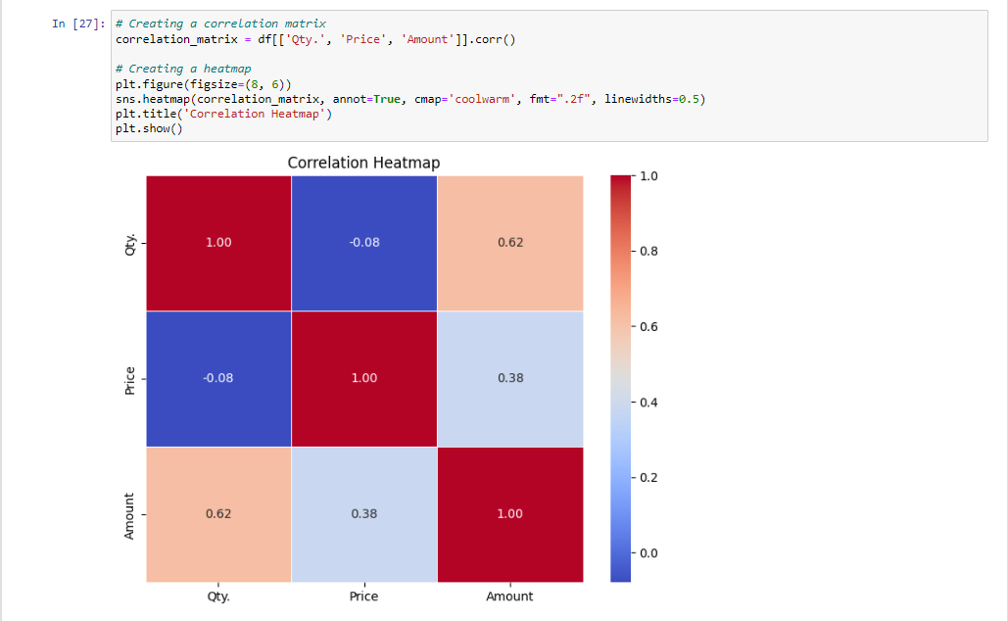
Correlation heat map

Slide 21
Correlation heat map Analysis
1) Qty. vs. Price
The correlation between 'Qty.' and 'Price' is approximately -0.079798, which indicates a weak negative correlation. This suggests that there's a slight tendency for the quantity sold ('Qty.') and the price of the item ('Price') to move in opposite directions, but the correlation is not strong.
2) Qty. vs. Amount
The correlation between 'Qty.' and 'Amount' is approximately 0.620085, which indicates a moderate positive correlation. This means that there is a moderate tendency for the quantity sold ('Qty.') and the total sales amount ('Amount') to move together, with an increase in quantity sold associated with an increase in the total sales amount.
3) Price vs. Amount
The correlation between 'Price' and 'Amount' is approximately 0.381838, indicating a moderate positive correlation. This means that there is a moderate tendency for the price of the item ('Price') and the total sales amount ('Amount') to move together, with an increase in price associated with an increase in the total sales amount.
These correlation coefficients provide insights into the relationships between the variables in the data.

Slide 22
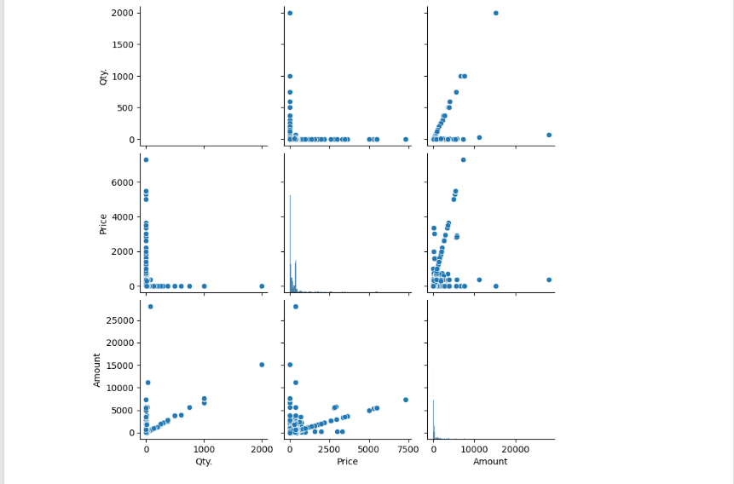
visualising using Scatter matrix

Slide 23
Profitability analysis
The primary objective was to assess the profitability of each item in our inventory, assuming a 20% profit margin. This analysis is crucial for making informed decisions regarding pricing, product management, and overall business strategy.
Methodology:
Profit Margin: We calculated the profit for each item by applying a 20% profit margin to the 'Amount' column in our dataset. The profit margin represents the portion of revenue that contributes to profit after covering costs.

Slide 24
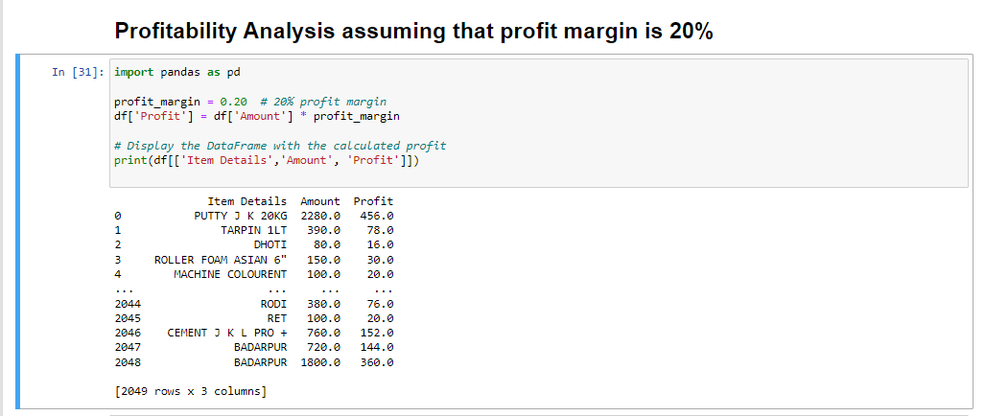
results

Slide 25
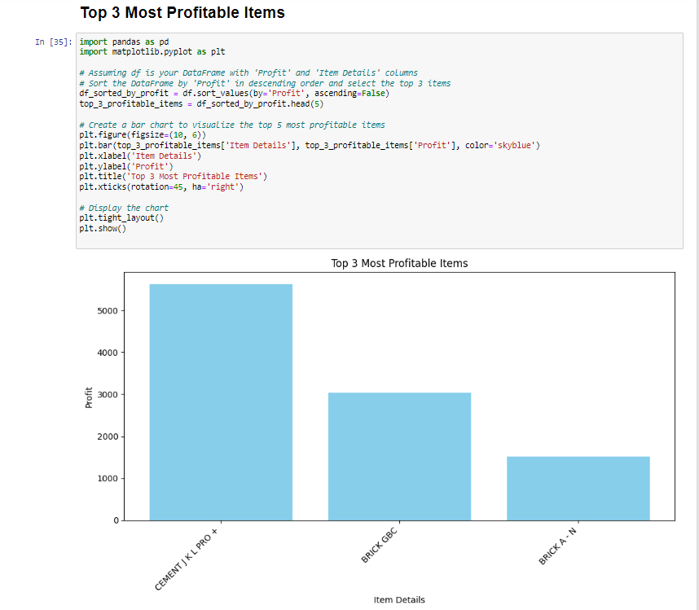
Top 3 most profitable items

Slide 26
Key insights
With this profitability analysis, we are better equipped to make informed decisions regarding pricing strategies, product promotions, and inventory management. We can identify products with higher profit margins and focus our efforts accordingly.
The profitability analysis has provided valuable insights into the financial performance of the products. It serves as a foundation for data-driven decision-making, enabling and optimizing the pricing strategies and enhance overall profitability. Moving forward, we will continue to monitor and analyze profitability to adapt to changing market conditions and business objectives.

Slide 27
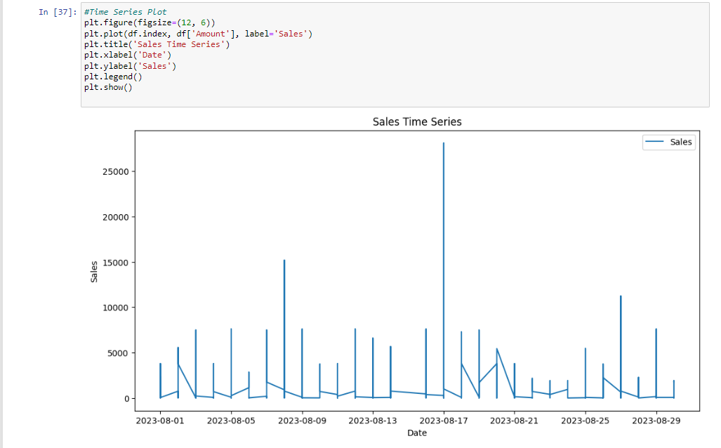
Time-series plot

Slide 28
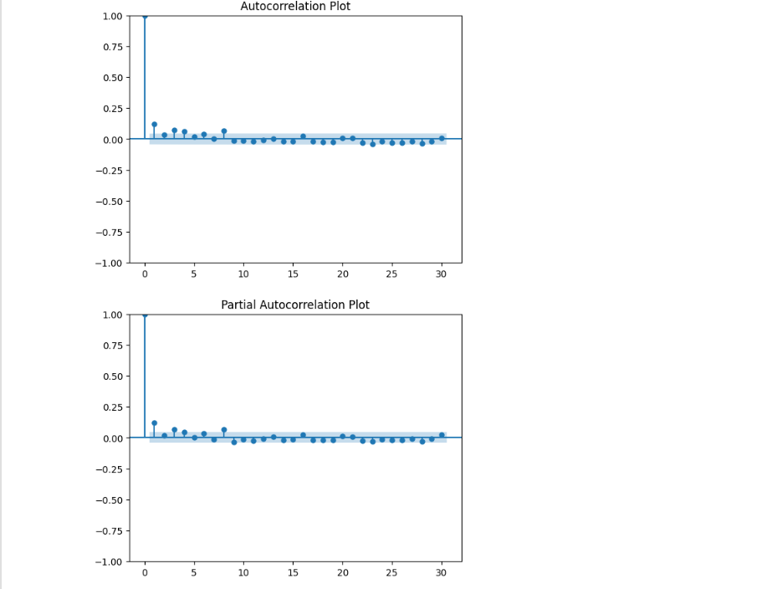
autocorrelations plots

Slide 29
Regression analysis
Model Used: Decision Tree Regression model.
Decision Tree Regression is a supervised machine learning technique used for predicting a continuous target variable based on one or more input features. It is a versatile and interpretable model that builds a tree-like structure to make predictions.
Advantages:
Interpretability: Decision Trees are easy to interpret and explain. You can visualize the tree structure and understand the decision-making process.
Nonlinearity: Decision Trees can capture nonlinear relationships between features and the target variable, making them suitable for complex datasets.
Handling Multicollinearity: Decision Trees can handle multicollinearity (correlations between independent variables) effectively.

Slide 30
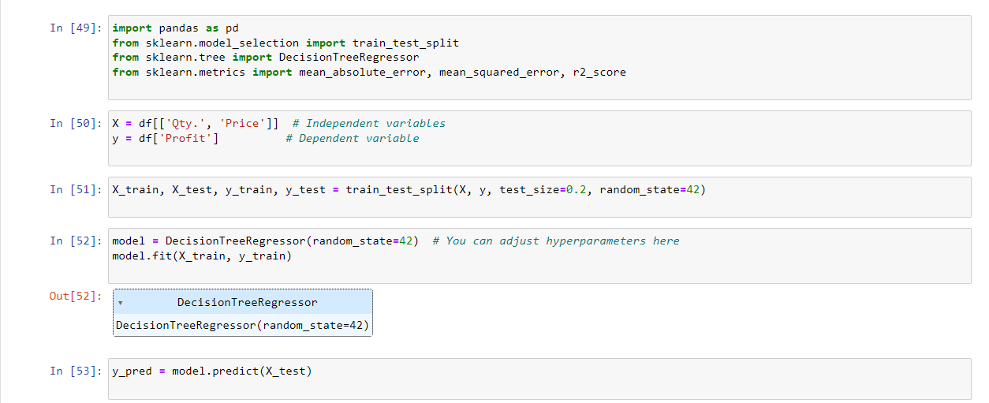
Implementing the model

Slide 31
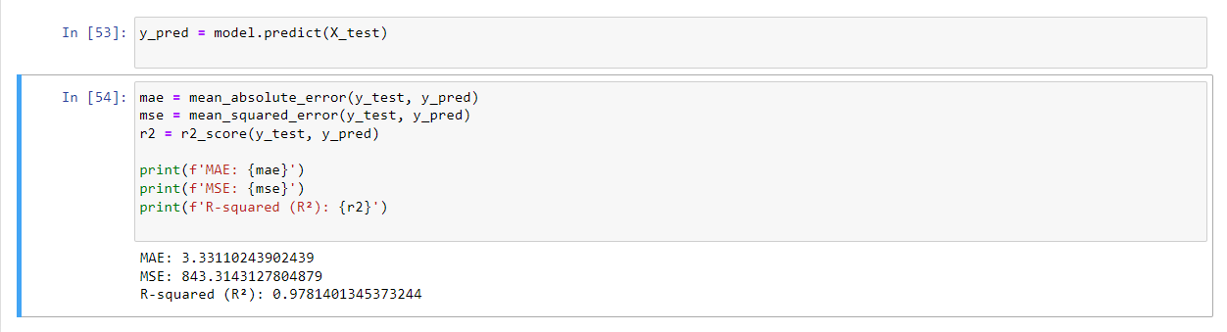
predictions

Slide 32
Conclusion
Decision Tree Regression model achieved impressive results, as indicated by the low MAE, MSE, and high R-squared values. This suggests that the model effectively captures the relationships between the quantity, price, and profit, making it a suitable choice for predicting profit based on these features.

Slide 33
Creating Dashboard
Creating a dashboard is an essential step in presenting and visualizing the insights and results of your data analysis or reporting. Dashboards provide a clear and concise way to convey complex information to your audience. Here's a description of how to create a dashboard
Dashboard Tool Used: PowerBI

Slide 34
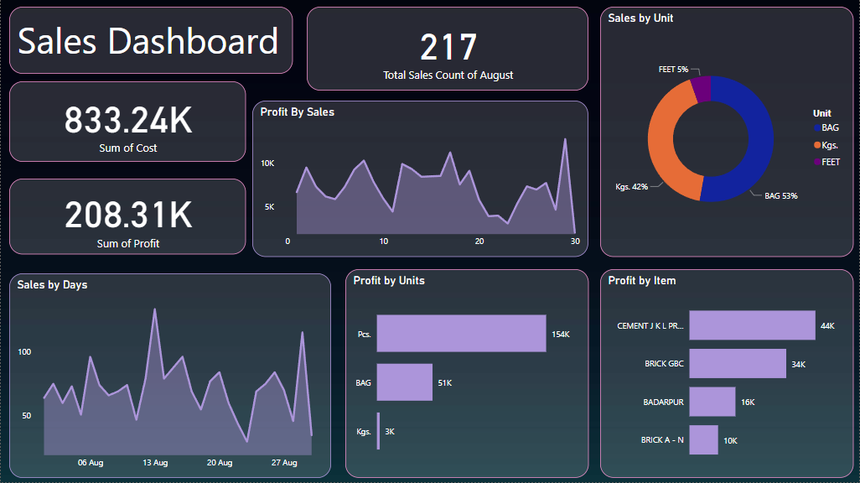

Slide 35
Forecasting THE sales of next month
In the ongoing quest to harness the power of data-driven decision-making, I have achieved a significant milestone by successfully predicting the sales values for the next 15 days using Power BI. This accomplishment reflects commitment to leveraging the data analytics to optimize operations, improve inventory management, and drive profitability.

Slide 36
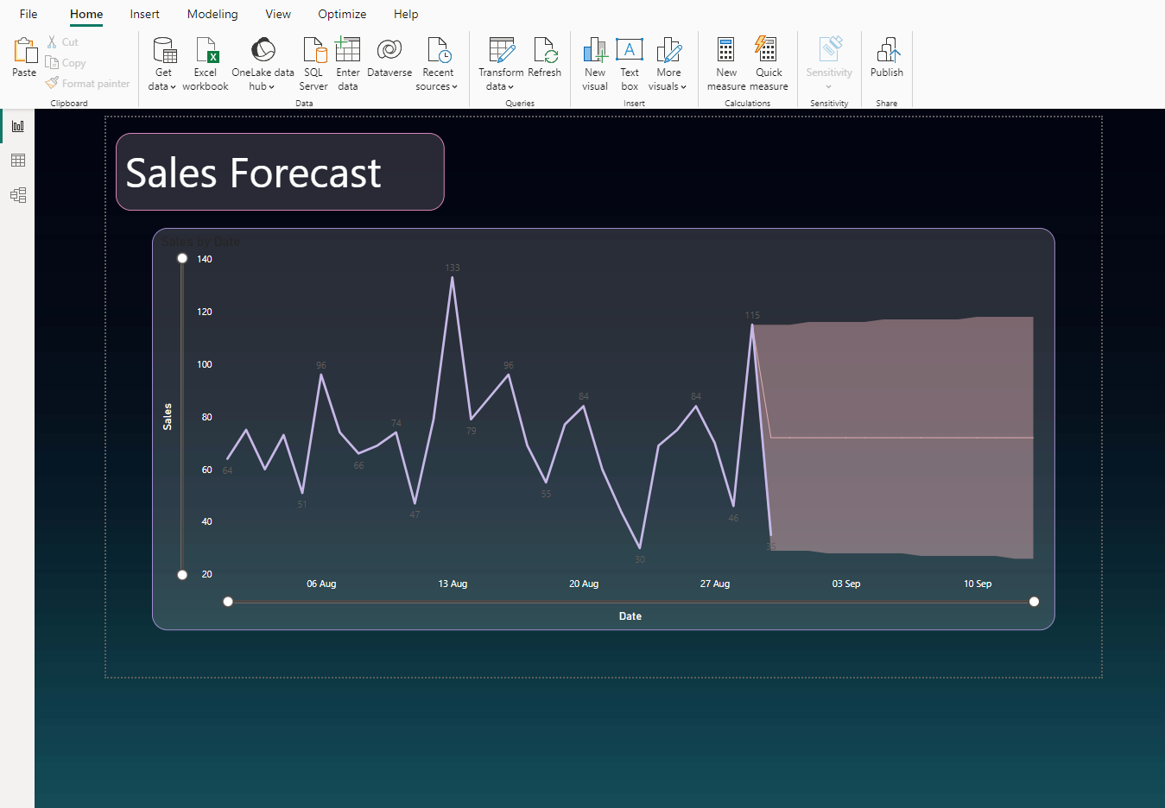
Forecasting

Slide 37
Actionable insights
The Exploratory Data Analysis (EDA) showed Marvelous Visualizations for gaining deeper insights into our dataset. These visualizations not only highlight key patterns and trends but also provide a visually engaging representation of our data, making complex information more accessible and actionable for our decision-makers.
The correlation between 'Qty.' and 'Amount' is approximately 0.620085, which indicates a moderate positive correlation.
The profitability analysis has provided valuable insights into the financial performance of the products. It serves as a foundation for data-driven decision-making, enabling and optimizing the pricing strategies and enhance overall profitability. Moving forward, we will continue to monitor and analyze profitability to adapt to changing market conditions and business objectives.
Decision Tree Regression model achieved impressive results, as indicated by the low MAE, MSE, and high R-squared values. This suggests that the model effectively captures the relationships between the quantity, price, and profit, making it a suitable choice for predicting profit based on these features.
In the end, by successfully predicting the sales values for the next 15 days using Power BI, this accomplishment reflects commitment to leveraging the data analytics to optimize operations, improve inventory management, and drive profitability.

Slide 38
Recommendations To Increase sales
Lowering the Prices to attract customers :
Price Sensitivity: Lowering the profit margin typically results in reduced prices for your products or services. This can make your offerings more attractive to price-sensitive consumers who were previously hesitant to make a purchase.
Expanded Customer Base: Lower prices can widen your customer base by attracting a larger segment of the market. Customers who were previously out of reach due to high pricing may now consider your products as affordable options.
Competitive Advantage: In competitive markets, lower prices can give your business a competitive advantage. It allows you to stand out from competitors and potentially capture market share from them.

Slide 39
Recommendations To Increase sales
Customer Acquisition:
Attracting New Customers: Lower prices are likely to draw in new customers who were previously unaware of your brand or reluctant to try it. This is particularly effective in industries with high competition.
Trial Purchases: Lower prices can encourage customers to try your products or services. Once they experience the quality and value you offer, they may become loyal customers in the long run.

Slide 40
Recommendations To Increase sales
Word of Mouth Marketing:
Customer Advocacy: Satisfied customers are more likely to recommend your brand to others when they perceive value in your offerings. This word-of-mouth marketing can lead to organic growth through referrals.
Social Media Buzz: Positive reviews and experiences shared on social media platforms can create buzz around your brand, attracting new customers who trust the opinions of their peers.

Slide 41
thankyou

