Slide 1

Proposal Presentation
Fitness Tracking Software Application
Michael Gravino
Matthew Masi
Rabih El-Bitar
Lucia Racine

Slide 2
Introduction
Maximize your potential
See Improvement
Become what you desire

Slide 3

Problem
Motivation is a key problem for the target demographic to realise their fitness goals.
This application focuses on being a motivating factor for the average user to go out there and run. As well as being a great fitness tool.
Notes:
Talk about target audience = average population, average worker, motivate to go for a run instead of relaxing, watching tv/ playing video games, etc...

Slide 4
Why You Should Use Our Product
Motivates through gathering points and trophies
Allows you to explore a new path to take without forgetting it
Displays common paths taken by other runners and interesting landmarks
Easy, fun and encouraging way to get in shape and stay healthy

Slide 5
Fitness Tracking Software Application Requirements
Track your movement during the exercise using GPS
Display your route on the map
Profile Page to make the application customly fit for you
See improvement with auto-generated statistics after every run
Save runs for future access and keep a scoreboard of your best runs
Collect different trophies Demonstrating your commitment to fitness
Notes:
Rabih.

Slide 6
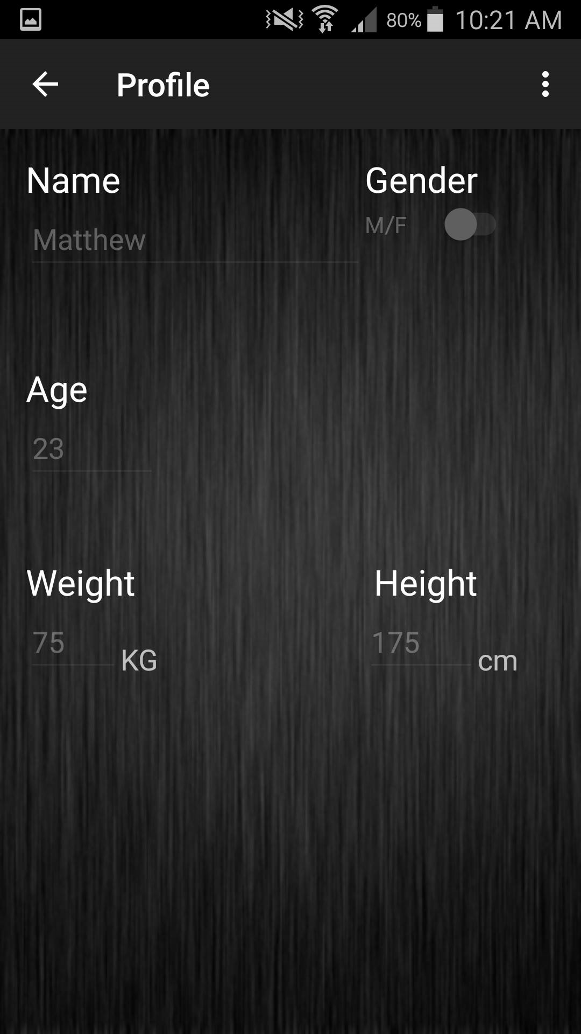
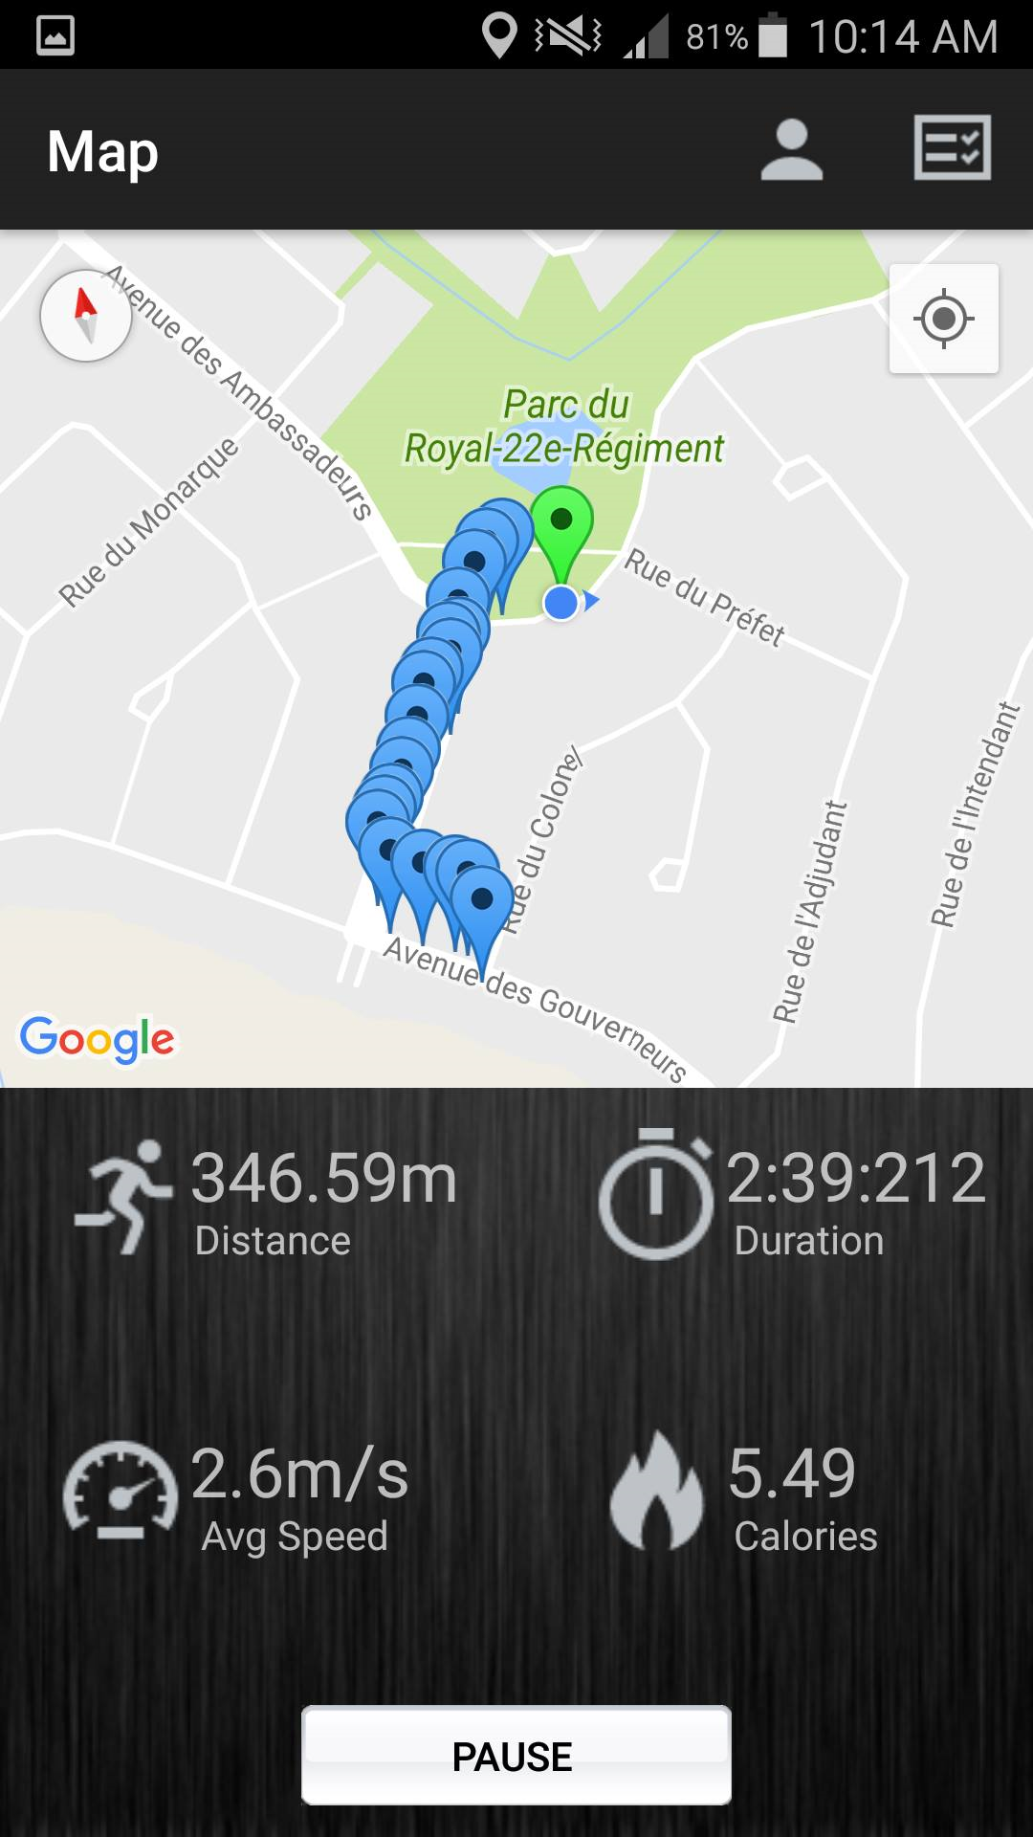
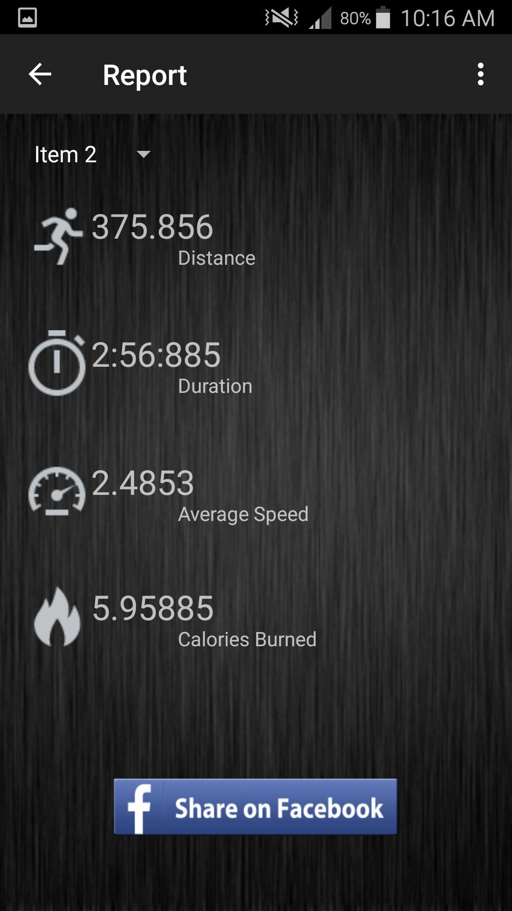
Design
Notes:
trophies

Slide 7
Detailed Plan
Sprint 1 : Track the user, update location (show route), add profile
Sprint 2 : Implement a Database, calculate and display statistics.
Sprint 3 : Display the best runs (scoreboard), Add trophies, social network compatibility, better the tracking algorithm and create a new UI.
Notes:
Rabih

Slide 8
Human Resources
Matthew Masi : Head of Development Team
Michael Gravino : Documenter and Programmer
Lucia Racine : Documenter and Tester
Rabih El-Bitar : Documenter and Tester
Notes:
Rabih

Slide 9
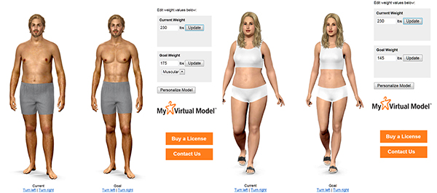
Future Plan
Based on BMI and goal of the user, the application will create the best workout plan that suits the user’s goal
Motivational challenges will help the user progress the decided plan
Shows the progress that would be made in an image simulation

Slide 10

Conclusion
Thank you for your attention!
Any Questions?

