Slide 1
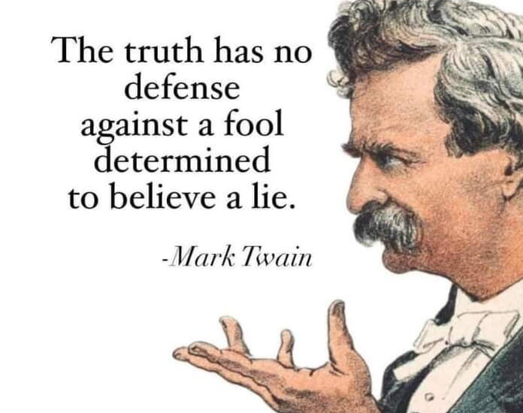
Joe Soap
Magwebus!

Slide 2
Carwash steps:
Washup
Brush up
Clean up
Polish up
Shine up
Yay!

Slide 3
Carparts
Tyres
Bonnet
Grill
Engine
Interior
Exterior
Hood
Boot

