Slide 1
Computer Vision (Bildverarbeitung 2)
Practical Session
Prof. Dr. Jens Grubert | Seyedmasih Tabaei | Summer Term 2025
Department of Electrical Engineering and Computer Science
Coburg University of Applied Sciences and Arts

Slide 2
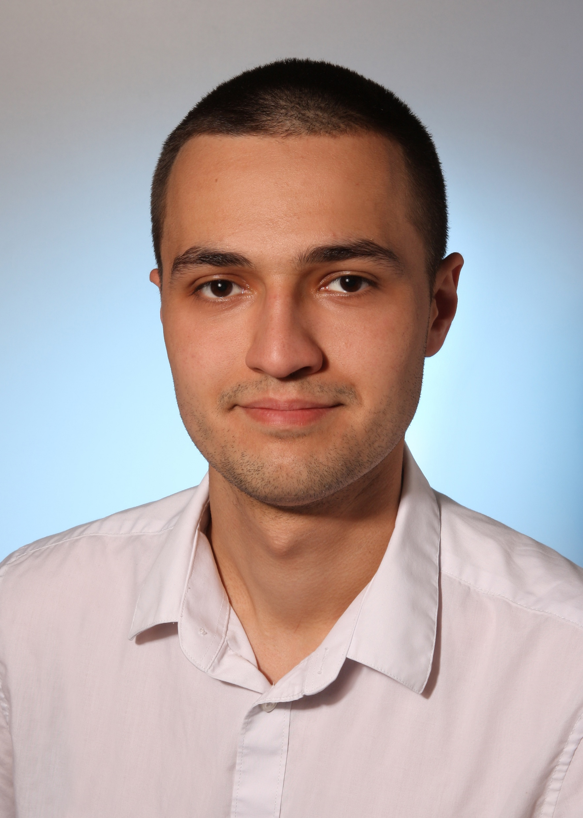
whoami: Introduction
Name: Seyedmasih Tabaei
Nickname: Masih
Studiengang: Informatik
Sprachen:
Deutsch
Englisch
Persisch
#GernePerDu
Credits: Foto-Mitschke

Slide 3



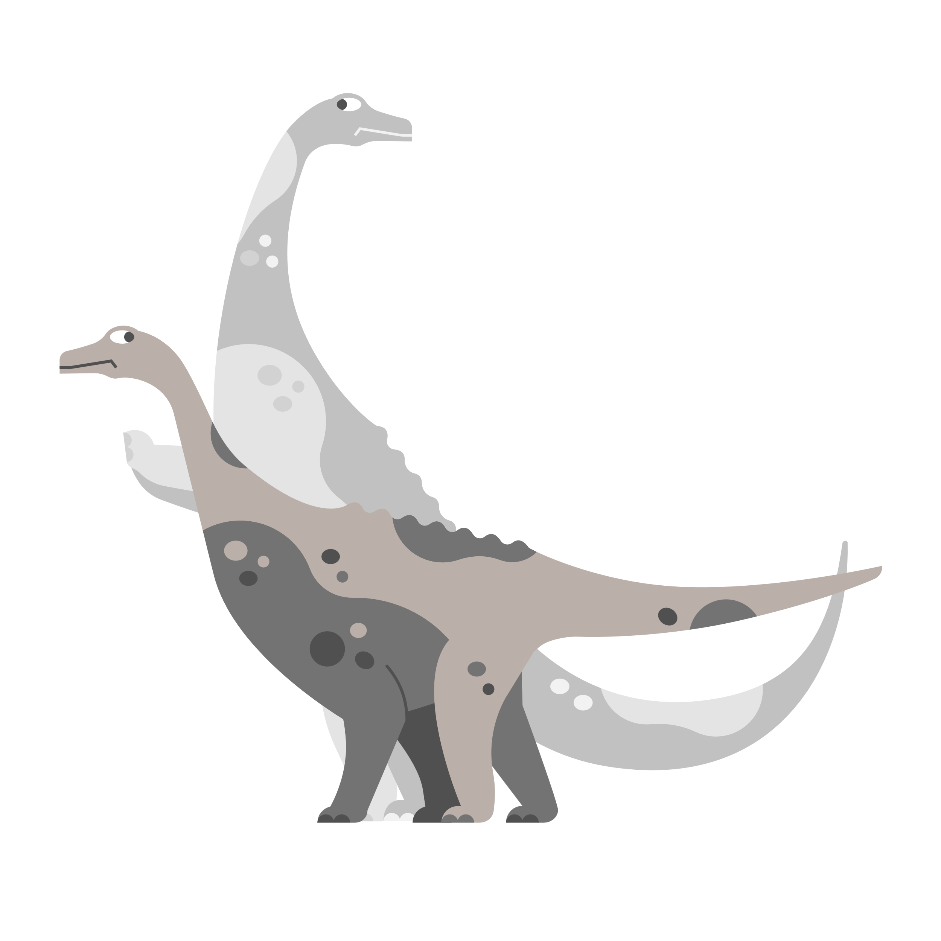

capsh: Offers
Regular practical sessions (Mondays 10. und 11. unit)
Question answering
Code review
Peer and group discussion
Exam preparation

Slide 4



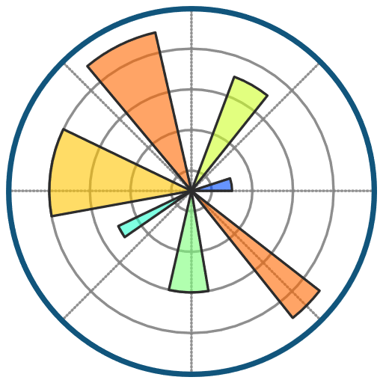



man: Tutorials
ruff + uv
PyTorch
NumPy + Linear algebra
Matplotlib
GitHub + Actions
OpenCV
Credits:
https://techicons.dev/
https://github.com/astral-sh

Slide 5
man: Assignments
Combination of both mathematical and practical tasks
Samples and examples
Collaborative tasks
Assignments (should be submitted and will be reviewed)
Optional tasks
Mini-project (mandatory for optional bonus points)

Slide 6



ping: Communication - 0
WhatsApp group (see next slide)
seyedmasih.tabaei@stud.hs-coburg.de
+491525-2862814 (please use only for communication via WhatsApp)

Slide 7
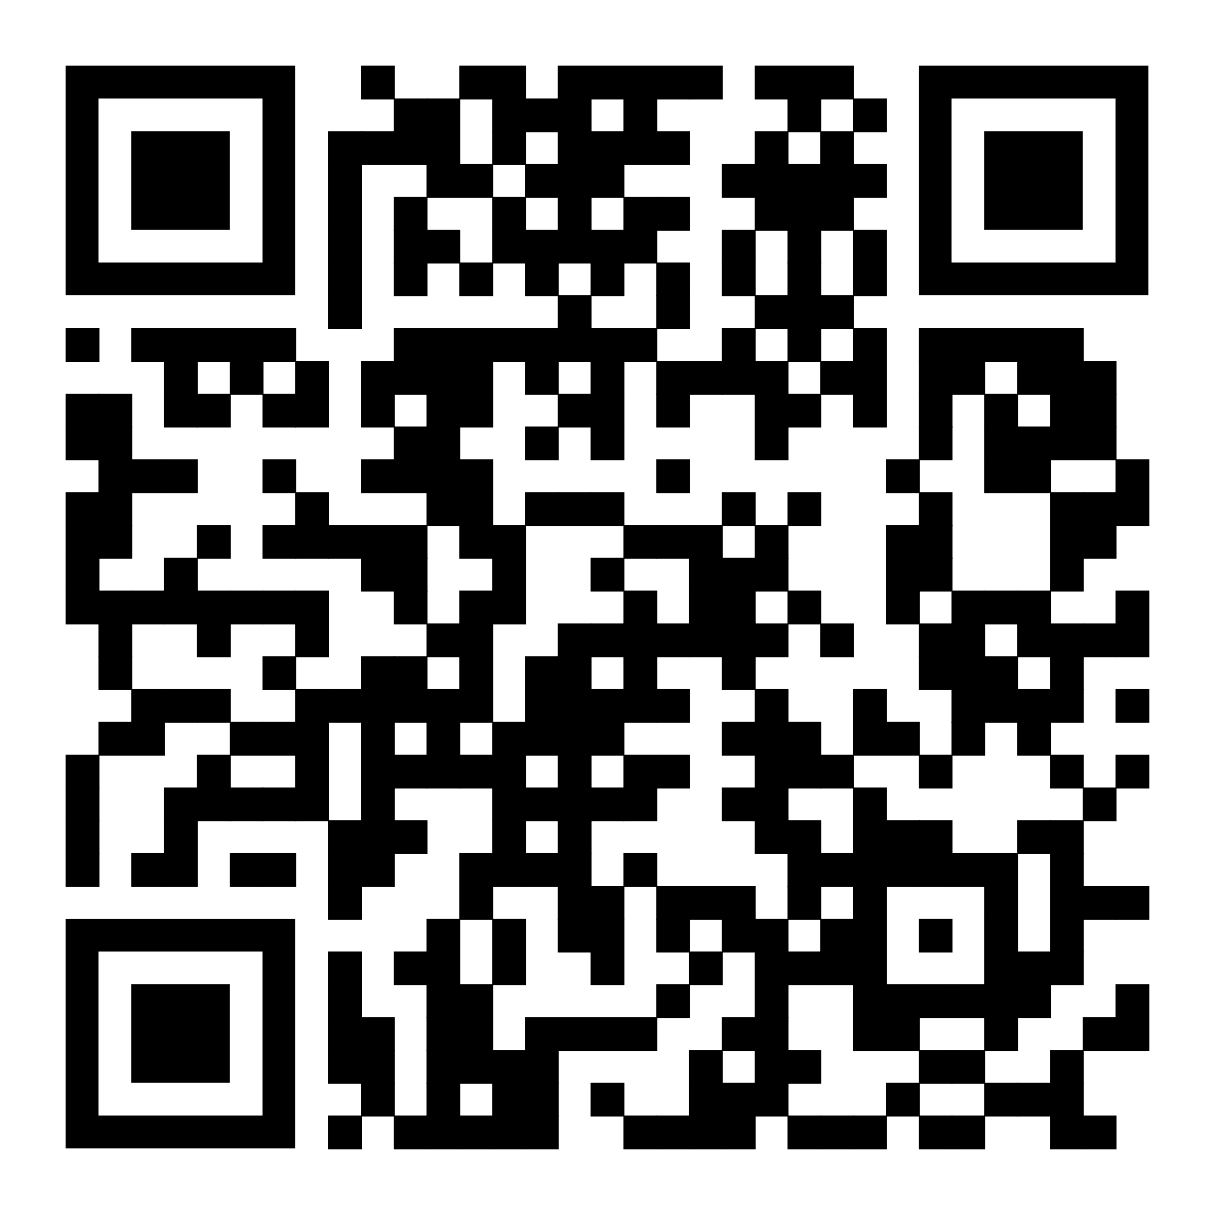


ping: Communication - 1
Question and answering
Joint discussion
Planning and organization
Or via following link
https://chat.whatsapp.com/DOtNx29P2HEEzhfheVfT2Y

Slide 8

Everybody on board?
Are you ready to start your journey into the world of computer vision?
Let’s Go!

