Slide 1
Facial Emotion Recognition
DIP Project
Group Id : FER-1
Team Members
Shaik Masihullah | S20180010159
Shikhar Arya | S20180010162
Kalyan Inguva | S20180010066
Rithika Nenavath | S20180010148

Slide 2
Problem Statement
We were assigned to solve a challenge in the field of facial emotion recognition.
In the field of facial emotion detection, the major challenges arise due to poor lighting conditions, variable facing directions, ethnic differences and cultural differences. And a pile of unlabelled data !!
We took on the challenge of improving the emotion recognition accuracy by applying curated preprocessing techniques on the train images based on the problems, employing one solution for each issue.

Slide 3
Introduction
We searched for the challenges researchers are looking forward to solve in facial emotion recognition and selected some of them to solve as part of this project.
Notably, lighting issues, face occlusion, racial differences and cultural differences are the main challenges being faced. [1].
Our idea is to employ traditional image processing techniques and improve upon these edge cases present in the current facial emotion recognition methods.
We aim to merge these techniques with the existing deep learning approach and increase their performance and accuracy.

Slide 4
Algorithm we used
We have chosen a deep learning implementation of facial emotion recognition model. [2].
It employs a mini Xception architecture as the backbone network.
It uses the FER2013 faces dataset. [3].
The model has an accuracy of 66% on validation dataset and also provides a pretrained model using usual preprocessing techniques.
The upcoming slides will describe the problems we are solving and their possible solutions using the preprocessing techniques in detailed manner.

Slide 5
Lighting Issues
01
Incorrect lighting on the faces while capturing images has always been a problem.
To tackle this we need to make the complete face to be in the same lighting condition.
One can achieve this by using histogram equalization.
This generates a normalized lighting image which will have almost same lighting all over the face.
1
Handled by Shikhar Arya

Slide 6
Different Skin Tones
02
People from different countries have different skin colors. A model trained on specific ethnic faces faces difficulties in detecting others.
To overcome this, as the images are grayscale images, multiple images can be generated with variable intensities levels.
These will depict the same as different skin colors in color images.
All these different intensity generated images can be used for training, which could make the model forbid the skin color specific details.
Handled by Rithika Nenavath

Slide 7
Cultural Differences
03
People from different cultures express their emotions differently.
Inorder to make our model universal for multicultural people, datasets of people faces from different cultures are considered for training
This makes model learn cross cultural features and make it culture independent.
For this data we scraped images from google and extract faces from the images.
Handled by Kalyan Inguva

Slide 8
Face Occlusion & Facial Features
04
Detecting face and emotion upon wearing masks, glasses and other face covering materials is a difficult task.
In some cases, where at least half of the face is visible, we can extract numerical face encodings.
Train the model on that encodings data.
Moreover, face segmentation can also be used to extract only the face leaving out hair, background, etc.
Handled by Shaik Masihullah

Slide 9
Pseudo Labelling
05
The multi cultural data we have scraped don't have emotion labels.
So, to accompany that we employ pseudo labelling technique.
The unlabelled data will first be predicted by the trained model of labelled data
Then predicted labels of unlabelled data by the trained model will be used
The model is re-trained with the newly labelled data.
Handled by Shaik Masihullah

Slide 10
Dataset
The dataset we have used is also FER2013[3] which consists of 27000+ grayscale images of faces sized 48x48 pixels.
There are seven emotions in the dataset, which are represented by their numeric labels.
0=Angry, 1=Disgust, 2=Fear, 3=Happy, 4=Sad, 5=Surprise, 6=Neutral
Apart from this to add faces of different ethnicity and culture, the multi-cultural dataset was scraped from Google Images (American, African, Asian and Hispanic).
These are labelled using pseudo labelling technique discussed further.

Slide 11
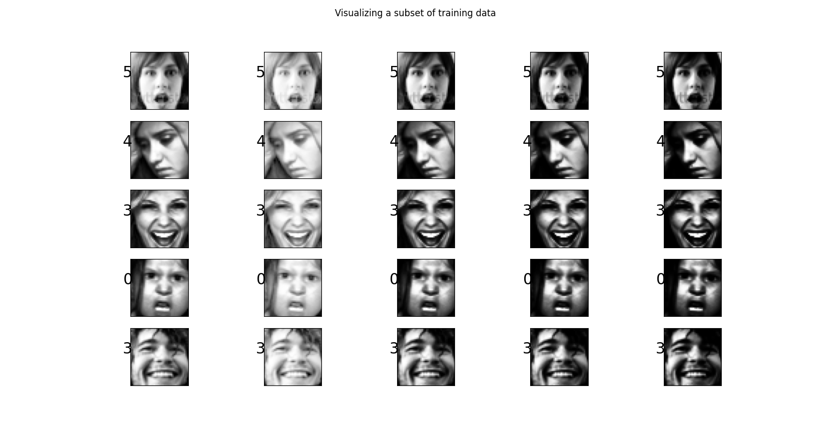

Slide 12
Procedure
Firstly, we train the model with the original dataset and observe the results.
Then we apply the discussed preprocessing on each image in the dataset and produce variations in dataset.
The model is then trained with the newly curated dataset and the results are noted.
At last we compare the results of the model on both the datasets and report our observations and improvements achieved.

Slide 13
Hyperparameters
Trained both the models for 100 epochs
Batch size 32
Patience of 5 for callback
Validation split of 20%
Adam optimizer
Categorical cross entropy loss

Slide 14
Results
Model | Train Accuracy | Test Accuracy | F1 Score
Usual Preprocessing Model | 70% | 66% | 0.5719
Our Custom Preprocessing Model | 76% | 75% | 0.7703

Slide 15
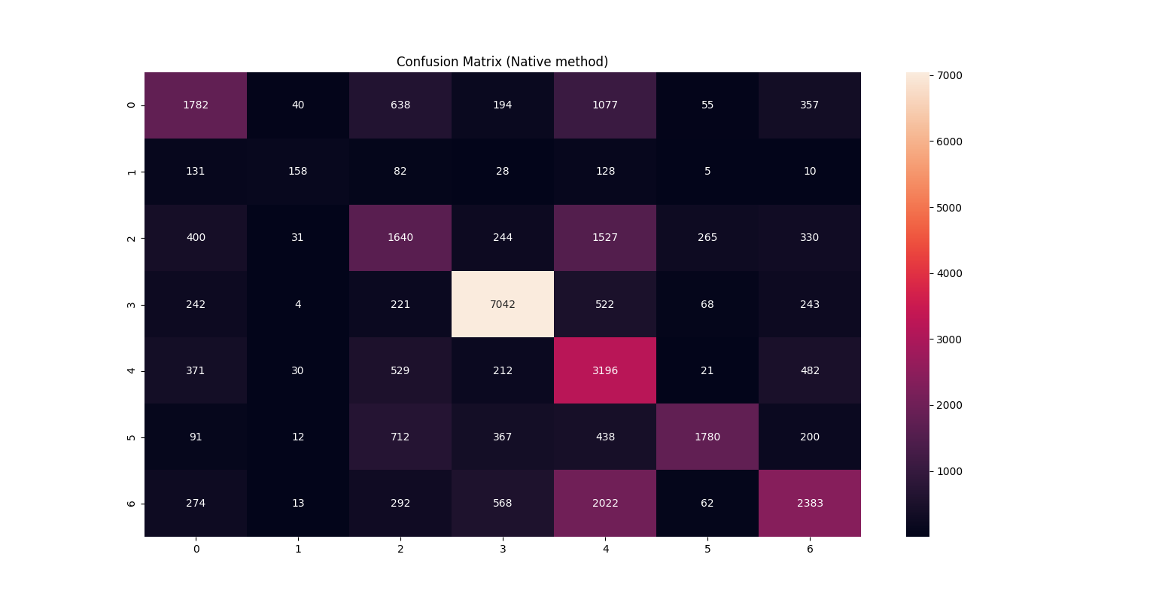
0=Angry, 1=Disgust, 2=Fear, 3=Happy, 4=Sad, 5=Surprise, 6=Neutral

Slide 16
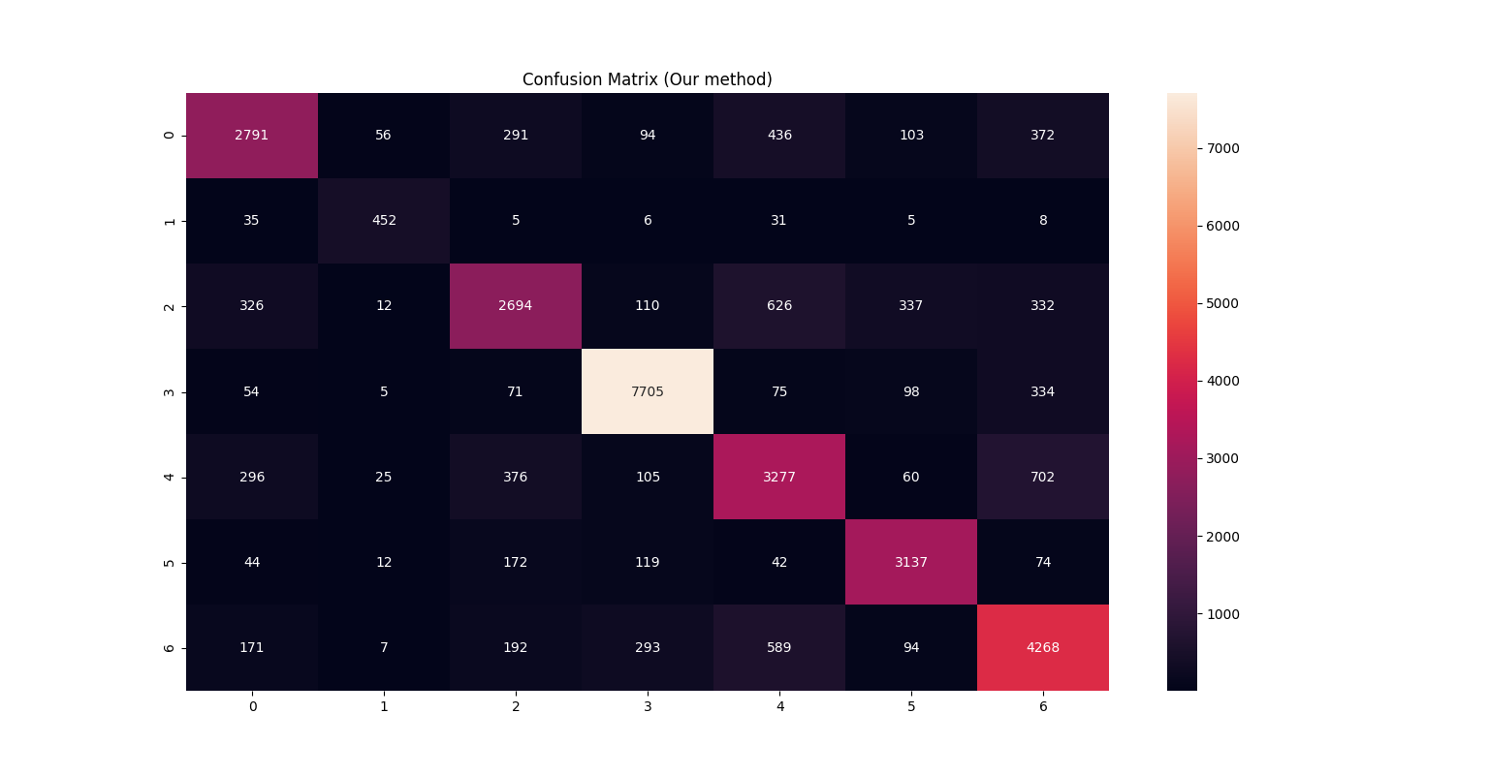
0=Angry, 1=Disgust, 2=Fear, 3=Happy, 4=Sad, 5=Surprise, 6=Neutral

Slide 17
Conclusion
In conclusion we can say, after analysing the results of both the models with custom preprocessing techniques, that the accuracy has improved than the original preprocessing techniques.
Our preprocessing techniques normalize the data irrespective of light shades, skin color and variability by changing their contrast, intensity levels and trying to accommodate the ethnic and cultural differences.
We got an increase of 9% in accuracy and 20% hike in F1 score compared to the usage of usual preprocessing techniques.

Slide 18
Project Demo

Slide 19
Questions?

Slide 20
References
[1] Challenges of Emotion Recognition in Images and Video
[2] omar178/Emotion-recognition: Real time emotion recognition
[3] Challenges in Representation Learning: Facial Expression Recognition Challenge

