Slide 1
EMPLOYEE MANAGEMENT SYSTEM
BY
MASIREDDY VAMSHIDHAR REDDY

Slide 2
About me
I am Masireddy Vamshidhar Reddy, a B.Tech (2025) graduate in Computer Science and Engineering from Bharath Institute of Higher Education and Research. I chose Data Science because I enjoy deriving meaningful insights from data, identifying patterns, and applying analytical thinking to real-world problems. The ability to analyze data, build models, and make predictions motivates me, as it enables data-driven decision-making.
I have strong fundamentals and hands-on skills in Python, Pandas, NumPy, SQL, Advanced Statistics, Matplotlib, and Seaborn, with a focus on data analysis, visualization, and statistical reasoning.
As a fresher, I bring a strong analytical mindset, curiosity to explore data deeply, and the discipline to convert raw data into clear, actionable insights while continuously upgrading my skills to meet industry demands.
My goal is to grow into a Data Scientist who builds reliable analytical and predictive models, contributes to data-driven business decisions, and creates measurable impact through data.
LinkedIn
GitHub

Slide 3
Agenda (This should be the PPT flow)
Objective of the Project
ER Diagram and schema explanation
Key analysis questions (use cases)
SQL query results with screenshots or summaries
Final business insights and recommendations
Conclusion (Key finding overall)
Q&A Slide
Your Experience/Challenges working on SQL – Data Analysis Project.

Slide 4

Developed an Employee Management System (EMS) to store and manage employee-related information in a structured manner
Manages key employee details such as personal information, job roles, departments, salary, leave, and payroll
Designed using a relational database to ensure accurate and consistent data storage
Uses foreign keys and table relationships to connect employee, job, and payroll data
Supports easy querying and analysis for payroll calculation, leave tracking, and department-wise roles
Helps simplify HR operations and improves overall data management within an organization
Introduction

Slide 5

Objective of the Project
The objective of this project is to design and develop an Employee Management System that provides a structured and reliable way to store, manage, and analyze employee data within an organization. The system aims to integrate key employee information such as personal details, job roles, salary structures, qualifications, leave records, and payroll data into a well-designed relational database.
By implementing proper table relationships, foreign key constraints, and cascading rules, the system ensures data accuracy, consistency, and integrity across all modules. The project also focuses on enabling efficient querying and analysis of employee data to support functions such as payroll processing, leave management, and department-wise role tracking.
Overall, the goal is to simplify HR operations, reduce data redundancy, and provide meaningful insights that support data-driven decision-making within the organization.

Slide 6
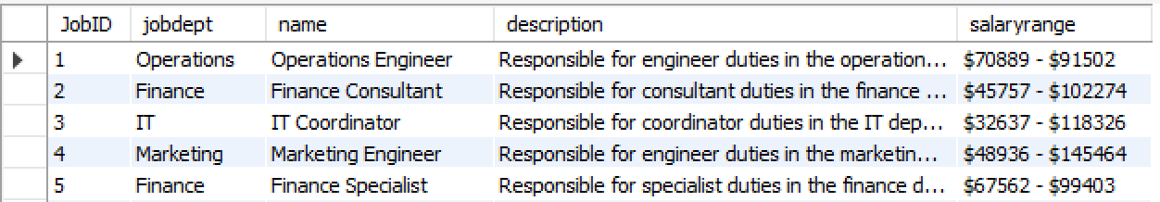
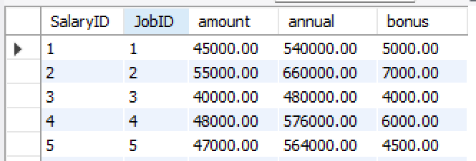
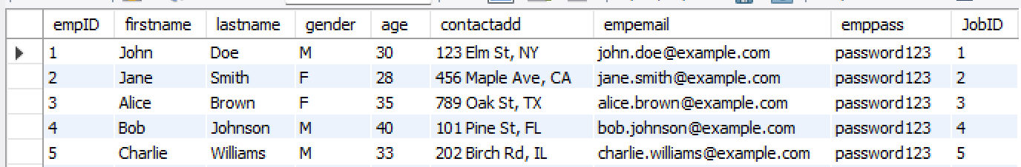
Database Schema Overview
JobDepartment
SalaryBonus
Employee

Slide 7
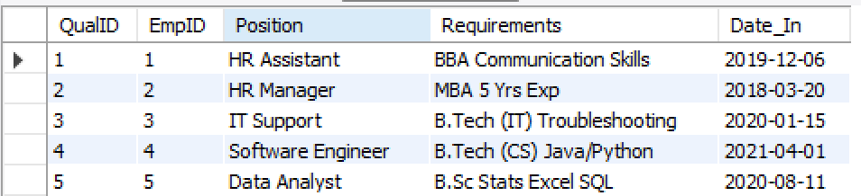
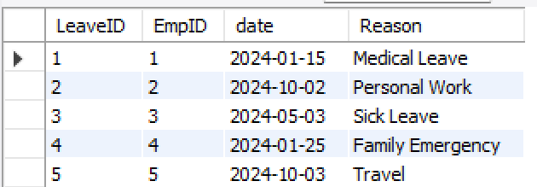
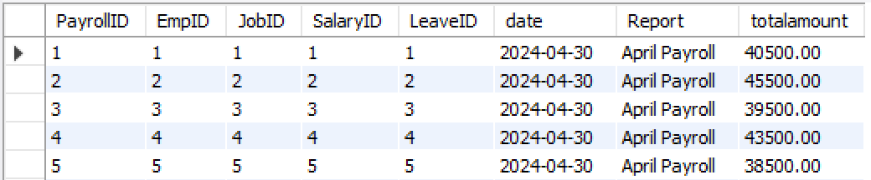
Database Schema Overview
Qualification
Leaves
Payroll

Slide 8
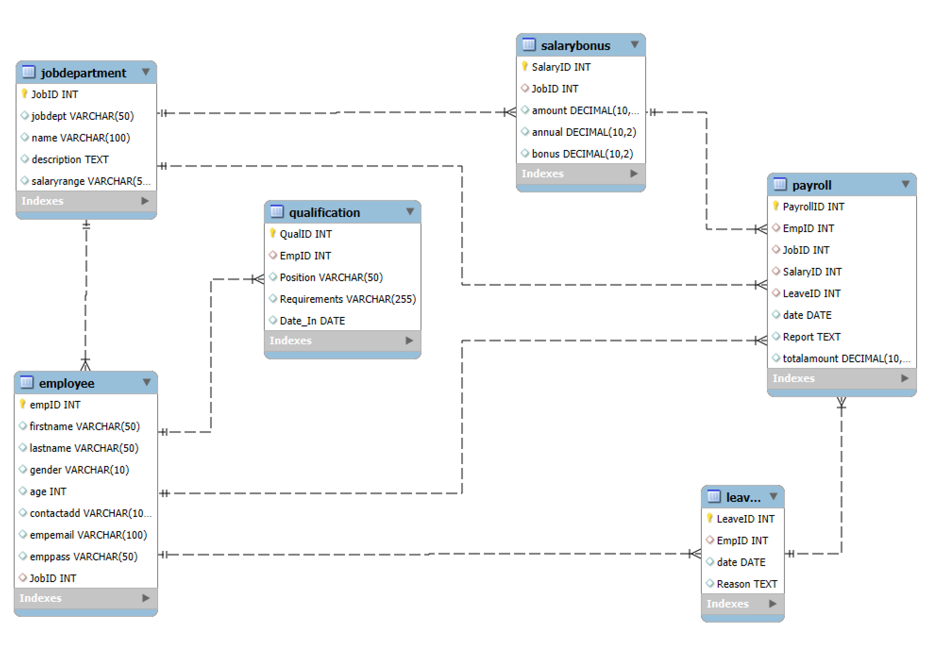
ER Diagram
An ER Diagram (Entity–Relationship Diagram) is a visual representation of a database structure that shows what data is stored and how different data entities are related to each other.

Slide 9
Schema Explanation
Job Department → Employee (One-to-Many)
One job department can have multiple employees, but each employee belongs to only one department.
Job Department → Salary Bonus (One-to-Many)
One job role or department can have multiple salary structures, but each salary record is linked to only one job role.
Employee → Qualification (One-to-Many)
One employee can have multiple qualifications, but each qualification belongs to only one employee.
Employee → Leaves (One-to-Many)
One employee can take multiple leaves, but each leave record is associated with only one employee.
Employee → Payroll (One-to-Many)
One employee can have multiple payroll records (monthly payrolls), but each payroll record belongs to one employee.
Salary Bonus → Payroll (One-to-Many)
One salary structure can be used in multiple payroll records, but each payroll record uses only one salary structure.
Leaves → Payroll (One-to-One per payroll cycle)
Each payroll record can reference leave details for that specific period to apply leave deductions.

Slide 10
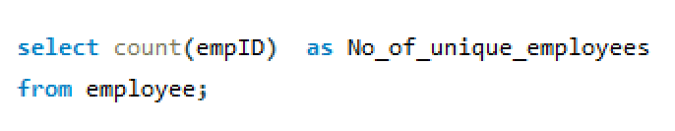

1. EMPLOYEE INSIGHTS
How many unique employees are currently in the system?
Result:
There are 60 unique employees currently present in the organization.

Slide 11
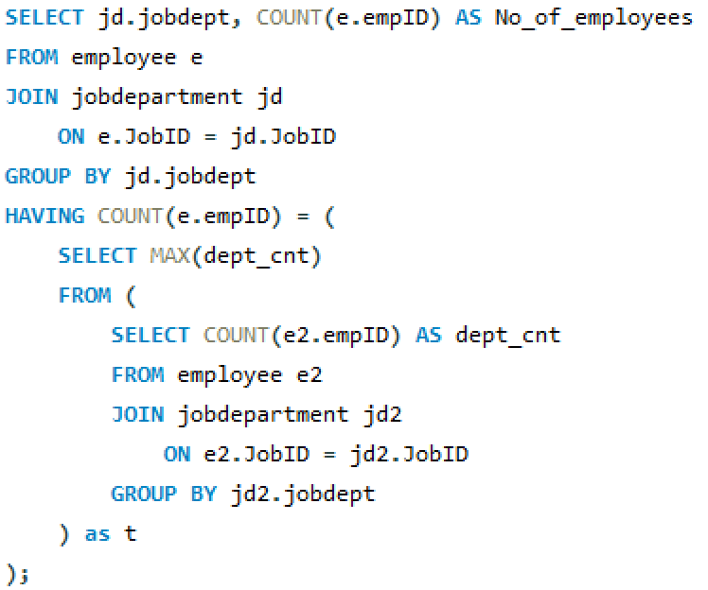
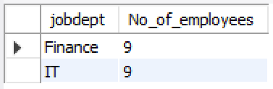
Which departments have the highest number of employees?
Result:
Finance and IT departments have the highest number of employees, with 9 employees each, making them the largest departments in the organization.

Slide 12
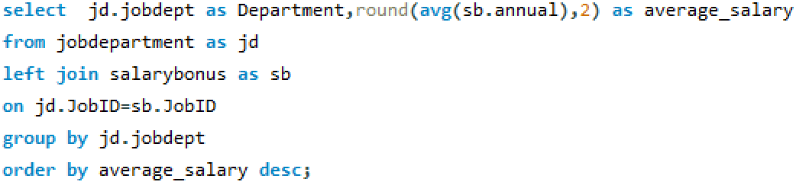
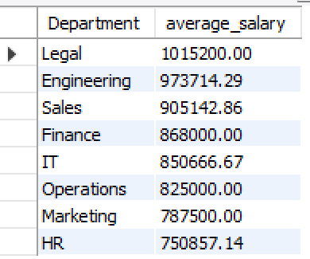
What is the average salary per department?
Result:
The Legal department has the highest average salary, followed by Engineering and Sales, while HR has the lowest average salary among all departments.

Slide 13
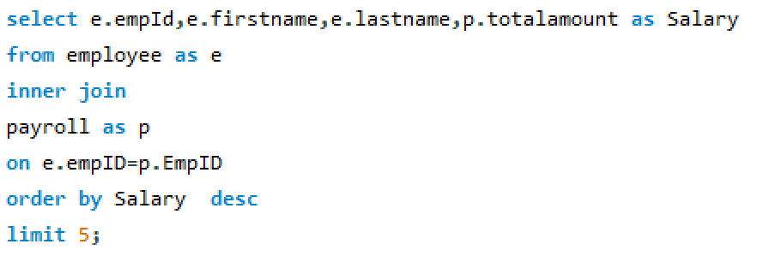
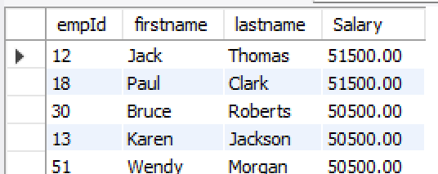
Who are the top 5 highest-paid employees?
Result:

Slide 14

What is the total salary expenditure across the company?
Result:
The total salary expenditure across the company amounts to 2,778,000, indicating the overall payroll cost incurred by the organization for employee compensation.

Slide 15
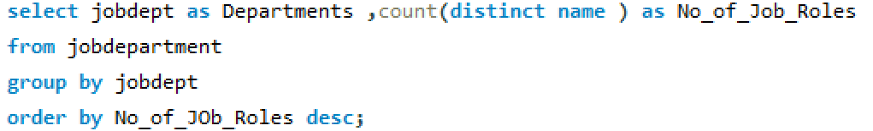
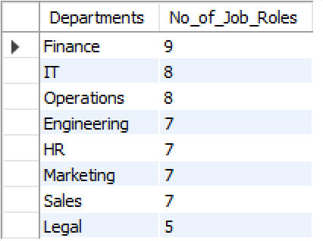
JOB ROLE AND DEPARTMENT ANALYSIS
How many different job roles exist in each department?
Result:

Slide 16
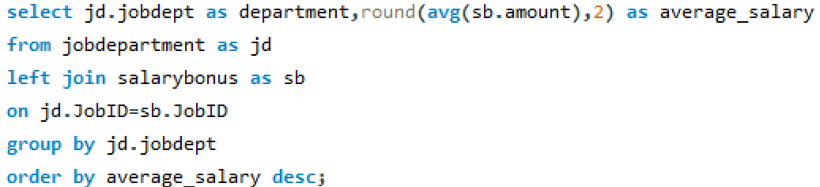
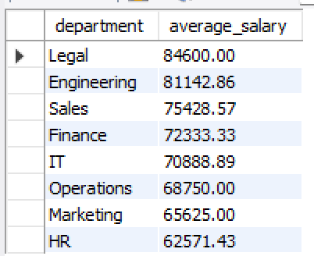
What is the average salary range per department?
Result:

Slide 17
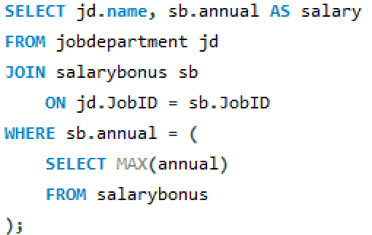

Which job roles offer the highest salary?
Result:
The Finance Director role offers the highest salary in the organization, with an annual compensation of 2,040,000, indicating it is the top-paying job position.

Slide 18
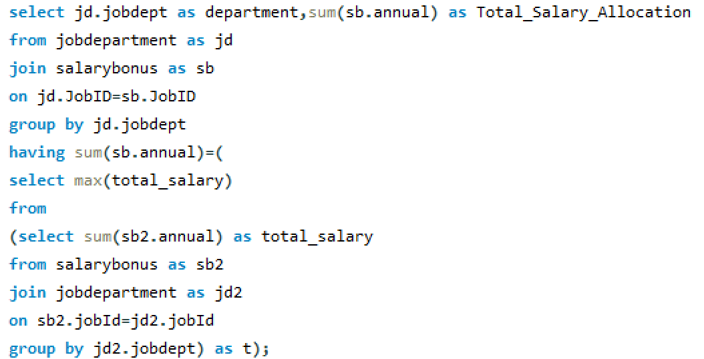

Which departments have the highest total salary allocation?
Result:
The Finance department has the highest total salary allocation in the organization, with a total expenditure of 7,812,000, indicating it accounts for the largest share of payroll costs.

Slide 19


3. QUALIFICATION AND SKILLS ANALYSIS
How many employees have at least one qualification listed?
Result:
All 60 employees in the organization have at least one qualification recorded, indicating complete qualification coverage across the workforce.

Slide 20
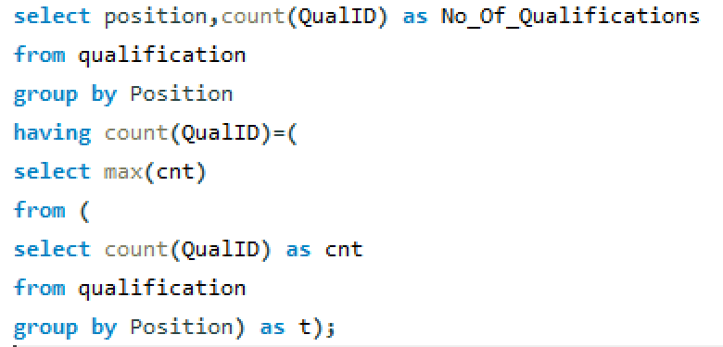
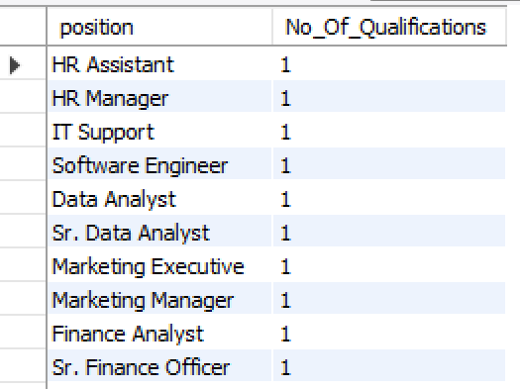
Which positions require the most qualifications?
Result:

Slide 21
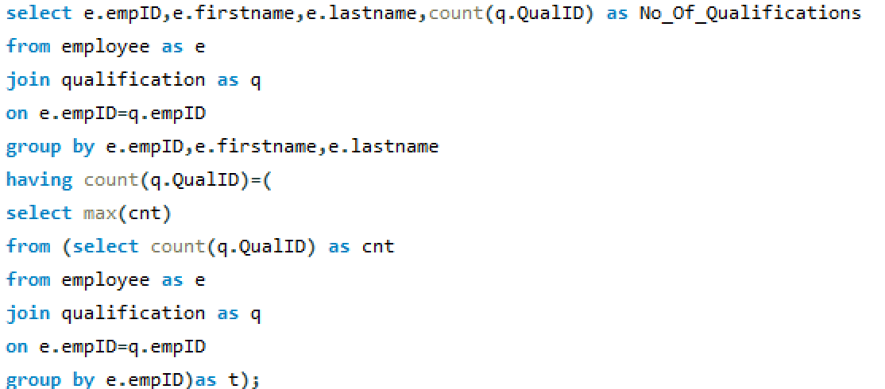
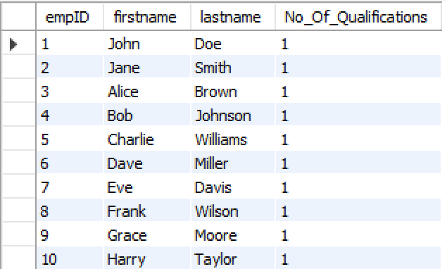
Which employees have the highest number of qualifications?
Result:

Slide 22
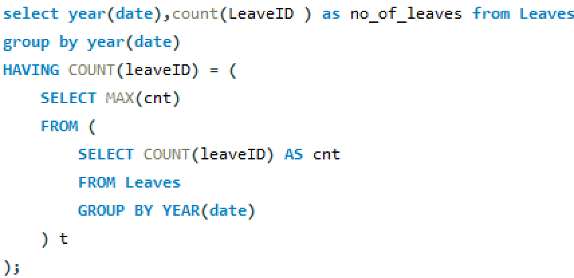

4.LEAVE AND ABSENCE PATTERNS
Which year had the most employees taking leaves?
Result:
The year 2024 recorded the highest number of employee leave entries, with a total of 60 leaves taken.

Slide 23
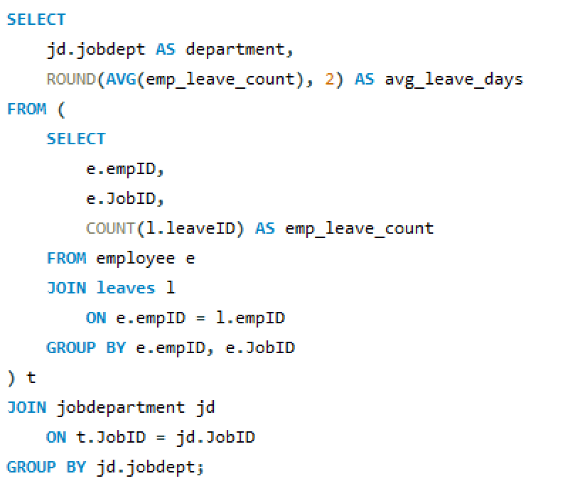
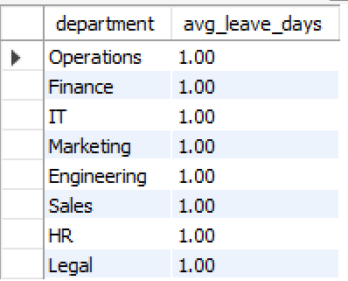
What is the average number of leave days taken by its employees per department?
Result:

Slide 24
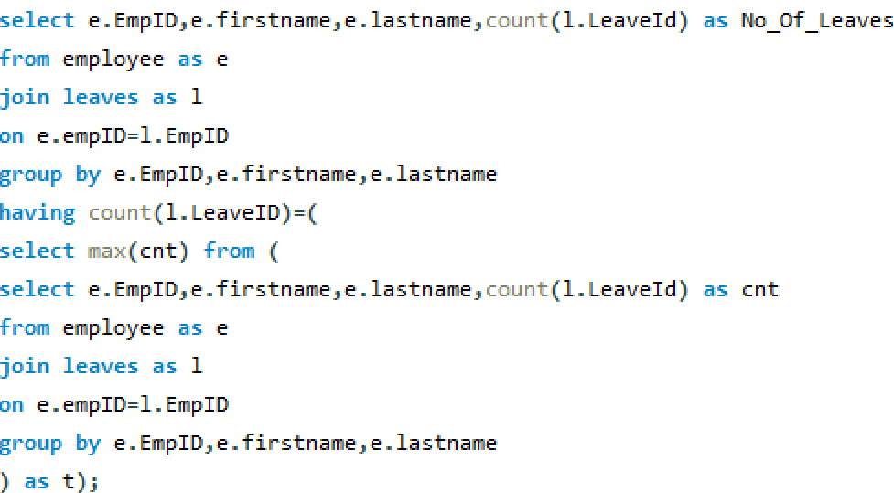
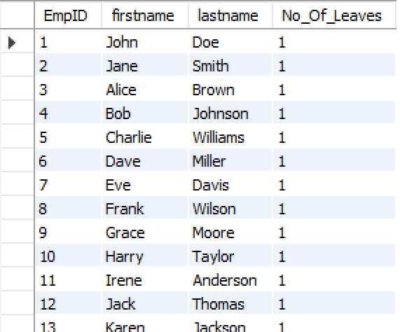
Which employees have taken the most leaves?
Result:

Slide 25

What is the total number of leave days taken company-wide?
Result:
A total of 60 leave days have been taken across the company.

Slide 26
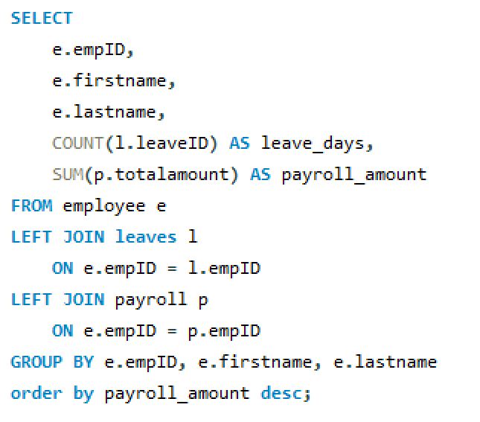
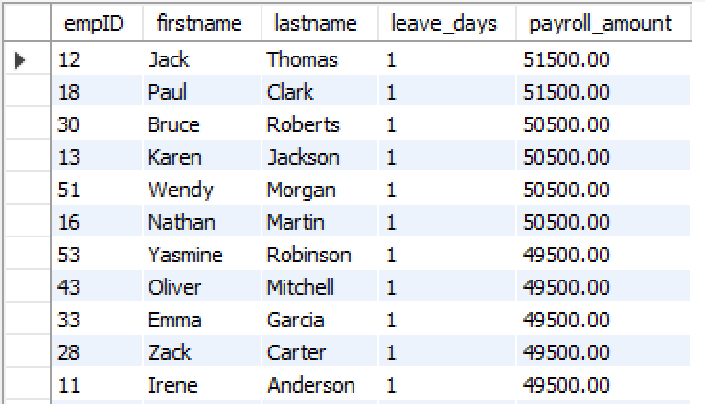
How do leave days correlate with payroll amounts?
Result:

Slide 27
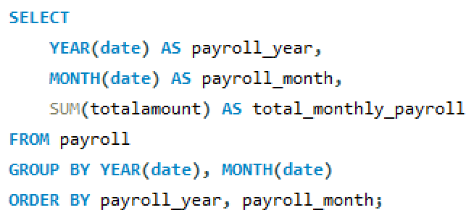
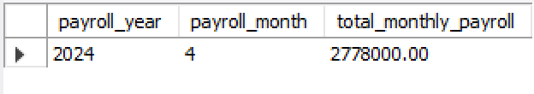
PAYROLL AND COMPENSATION ANALYSIS
What is the total monthly payroll processed?
Result:
In April 2024, the total payroll processed by the company amounted to 2,778,000.

Slide 28
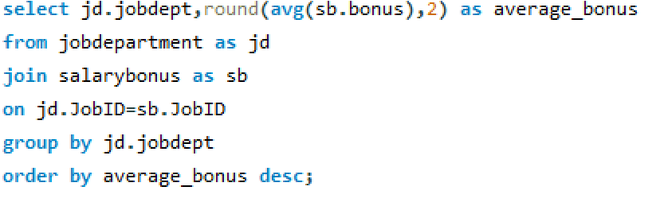
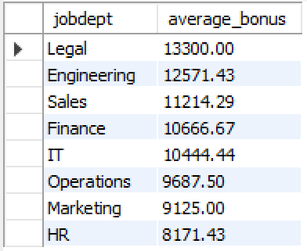
What is the average bonus given per department?
Result:

Slide 29
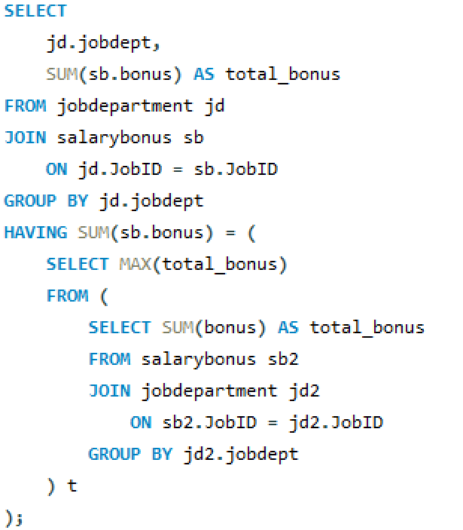

Which department receives the highest total bonuses?
Result:
The Finance department receives the highest total bonuses, with a total bonus allocation of 96,000.

Slide 30
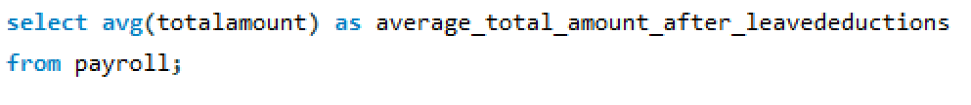

What is the average value of total amount after considering leave deductions?
Result:
After accounting for leave deductions, the average total payroll amount per employee is 46,300.

Slide 31
Final business insights and recommendations
Key Business Insights
The organization has 60 employees, with Finance and IT being the largest departments.
Finance department has the highest salary and bonus allocation, making it the most cost-intensive unit.
Legal and Engineering roles receive the highest average salaries, reflecting specialized skills.
100% of employees have at least one qualification, indicating a well-skilled workforce.
2024 recorded the highest leave usage, with leave deductions properly reflected in payroll.
Total monthly payroll processed is ₹2,778,000, showing a significant operational expense.
Business Recommendations
Regularly review high-cost departments (especially Finance) to ensure cost vs performance balance.
Improve workforce distribution and workload management in Finance and IT departments.
Introduce skill-based incentives and performance tracking to justify salary variations.
Monitor leave trends to prevent productivity loss and employee burnout.
Extend the Employee Management System to support performance evaluation, forecasting, and strategic HR decisions.

Slide 32

Conclusion
Successfully designed and implemented an Employee Management System (EMS) using a relational database.
Integrated employee, department, salary, qualification, leave, and payroll data with proper relationships.
Ensured data accuracy, consistency, and integrity using foreign keys and constraints.
Performed SQL-based analysis to extract meaningful HR and payroll insights.
Identified key trends in workforce distribution, compensation, and leave patterns.
Demonstrated how data supports efficient HR operations and decision-making.
The system is scalable and can be enhanced with performance tracking and predictive analytics.

Slide 33

Challenges
Designing a proper database schema and identifying correct relationships between tables.
Implementing foreign key constraints without causing dependency and reference errors.
Handling data consistency issues while linking employee, payroll, and leave records.
Writing complex SQL queries involving multiple joins, grouping, and subqueries.
Ensuring accurate payroll calculations after considering leave deductions.
Interpreting SQL results and converting them into meaningful business insights.
Debugging errors related to table names, joins, and MySQL limitations.

Slide 34


Slide 35
THANK YOU

