Slide 1


Title: Web Scraping and Exploratory Data Analysis of OYO Rooms Hotel Data

Slide 2
About Me:
I am Vamshidhar Reddy, a B.Tech graduate in Computer Science and Engineering with a strong interest in Data Analytics and Data Science.
Passionate about working with real-world data to identify patterns and extract meaningful insights.
Experienced in web data collection, data cleaning, and exploratory data analysis.
Comfortable using Python-based tools for data processing and data visualization.Continuously learning and applying machine learning and advanced analytical techniques to solve real-world problems.
GitHub: https://github.com/Masireddyvamshi/oyo-rooms-analytics-project
LinkedIn: https://www.linkedin.com/in/vamshidhar00

Slide 3
Preface:
INTRODUCTION
BUSINESS PROBLEM
OBJECTIVE
TOOLS USED
WEB SCRAPPING
DATA CLEANING STEPS
DATA VISUALIZATION
FINAL BUSINESS INSIGHTS AND RECOMMENDATIONS
CONCLUSION

Slide 4
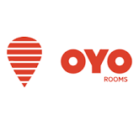
Introduction:
OYO Rooms is a leading hospitality platform that provides affordable and standardized hotel stays across India and several international markets.
It was founded in 2013 by Ritesh Agarwal.
OYO’s goal is to make quality accommodation accessible and affordable for travelers.
The platform partners with hotels to offer budget-friendly rooms with consistent amenities and services.
OYO also uses data and technology to optimize pricing, improve customer experience, and support hotel partners.

Slide 5
Business Problem:
Hotel pricing data across online platforms is highly variable and influenced by multiple factors such as city, hotel type, amenities, and customer ratings.
Customers struggle to understand price differences between similar hotels and identify value-for-money options.
Hotel operators lack clear, data-driven insights into how pricing, ratings, and amenities impact hotel popularity and customer preference.
There is limited visibility into pricing patterns across cities and hotel categories, making benchmarking difficult.
There is a need for data-driven analysis to understand pricing behavior, customer ratings, and popularity trends to support better decision-making for both customers and businesses.

Slide 6
Objectives:
To analyze and compare OYO Rooms hotels using pricing, ratings, amenities, and popularity data across different cities.
To provide data-driven insights that help customers identify value-for-money hotels based on price, ratings, and amenities.
To explore pricing patterns and customer preference trends across different hotel types and locations.
To understand the impact of hotel categories and amenities on final pricing and hotel popularity.

Slide 7
Web Scraping:
OYO Rooms website was selected as the data source to collect hotel-level information.
Used browser developer tools (Inspect Element) to identify relevant HTML tags containing hotel details.
Extracted hotel data such as hotel name, city, price, ratings, amenities, and hotel type from web pages.
Performed data cleaning and preprocessing to structure the scraped data for analysis.
Conducted Exploratory Data Analysis (EDA) to identify pricing patterns and customer trends.

Slide 8
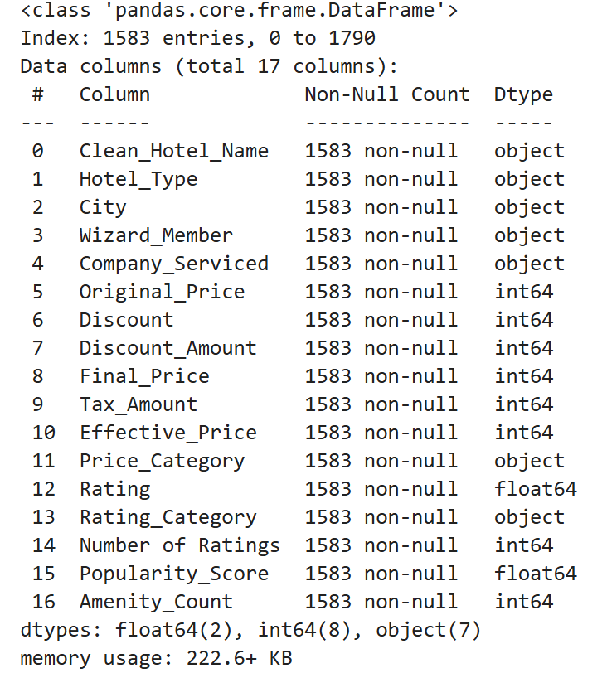
Dataset Dictionary
Final_Price – The actual room price paid after discounts, used as the main pricing metric.
City – Represents the hotel location and is used to compare city-wise pricing and availability.
Hotel_Type – Categorizes hotels and helps analyze pricing and popularity across hotel formats.
Rating – Shows average customer satisfaction for each hotel.
Number of Ratings – Indicates customer engagement and trust in the hotel.
Amenity_Count – Measures the number of amenities offered, reflecting service value.
Popularity_Score – A derived metric combining ratings and review volume to represent popularity.
Original_Price – Used to understand base pricing before discounts are applied.
Discount_Amount – Represents the monetary value of discounts offered to customers.
Price_Category – Groups hotels into budget, mid, or premium segments for simplified analysis.

Slide 9
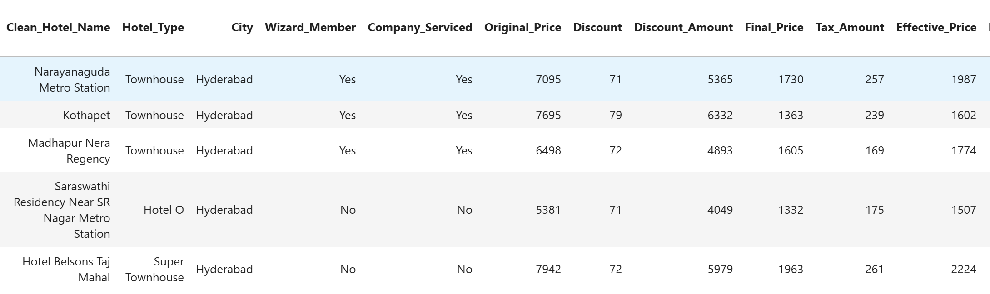
Dataset:

Slide 10






Tools Used:

Slide 11
Data Cleaning Steps:
Cleaned price-related columns by removing currency symbols, commas, and extra text to convert them into numerical values.
Standardized hotel names by cleaning raw text and creating a consistent Clean_Hotel_Name column.
Converted rating and review count fields from string format to numeric values for reliable analysis.
Handled missing and inconsistent values across pricing, ratings, amenities, and hotel attributes.
Removed duplicate records to ensure data accuracy and avoid repeated hotel entries.

Slide 12
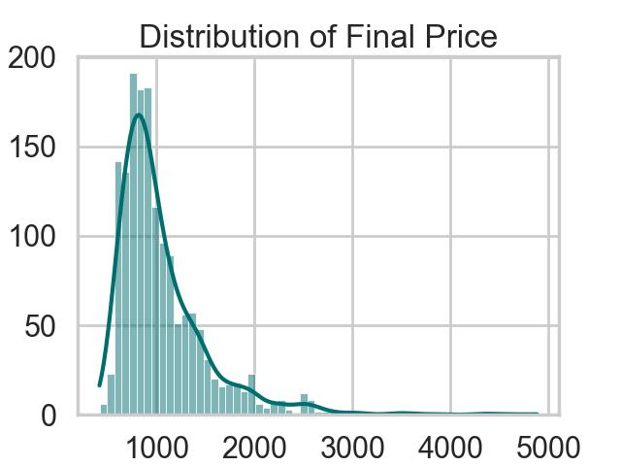
Univariate Analysis: Distribution of OYO Hotel Final Prices
The final price of OYO hotels ranges from ₹417 to ₹4,883, showing a wide variation in pricing.
Most hotels are priced between ₹500 and ₹1,500, indicating a strong focus on budget and mid-range stays.
The price distribution is right-skewed, with only a few premium hotels at higher price levels.

Slide 13
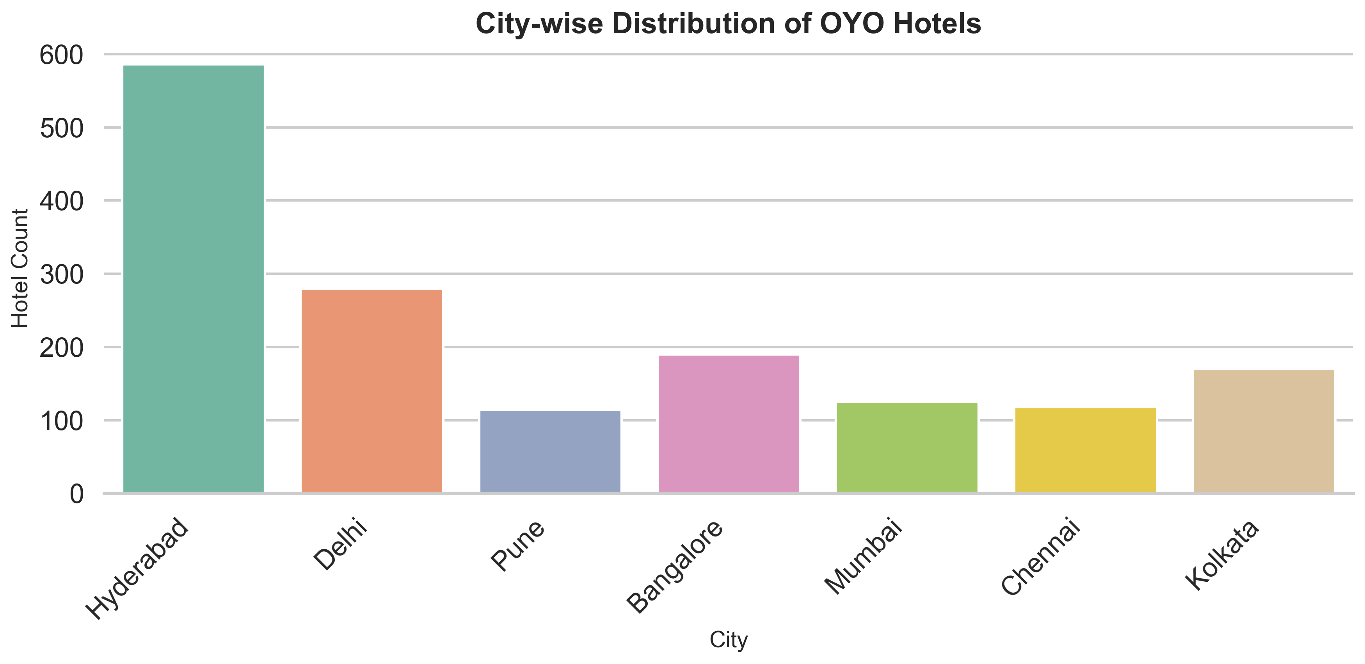
City-wise Distribution of OYO Hotels
Hyderabad has the highest number of OYO hotels, mainly because many people live and work there due to IT and other industries.
Delhi and Bangalore also have a high number of hotels, as they are major cities with business and travel demand.
Kolkata has a moderate number of OYO hotels, while Mumbai, Chennai, and Pune have fewer hotels compared to the top cities. Overall, OYO hotels are more concentrated in big cities where population and travel demand are high.

Slide 14
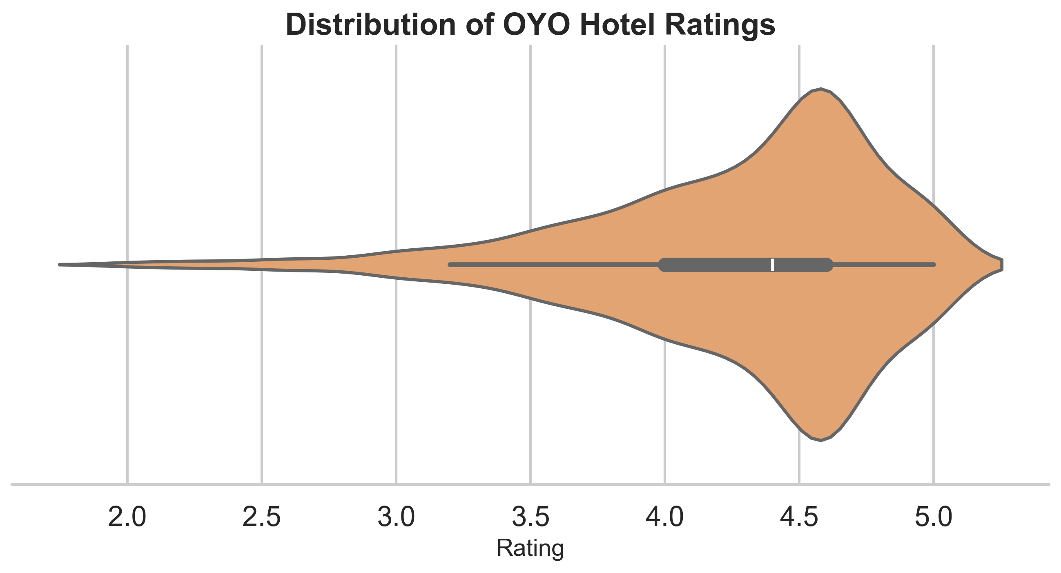
Distribution of OYO Hotel Ratings
50% of the ratings lie between 4.0 and 4.65, showing that most customers are highly satisfied with their stay.
Ratings are concentrated around 4.6, indicating consistently positive customer experiences across hotels.
Very few low ratings (below 3) suggest limited customer dissatisfaction and fewer service issues.
High satisfaction is likely driven by affordable pricing, good amenities, and convenient locations, making OYO a preferred choice for many travelers.

Slide 15
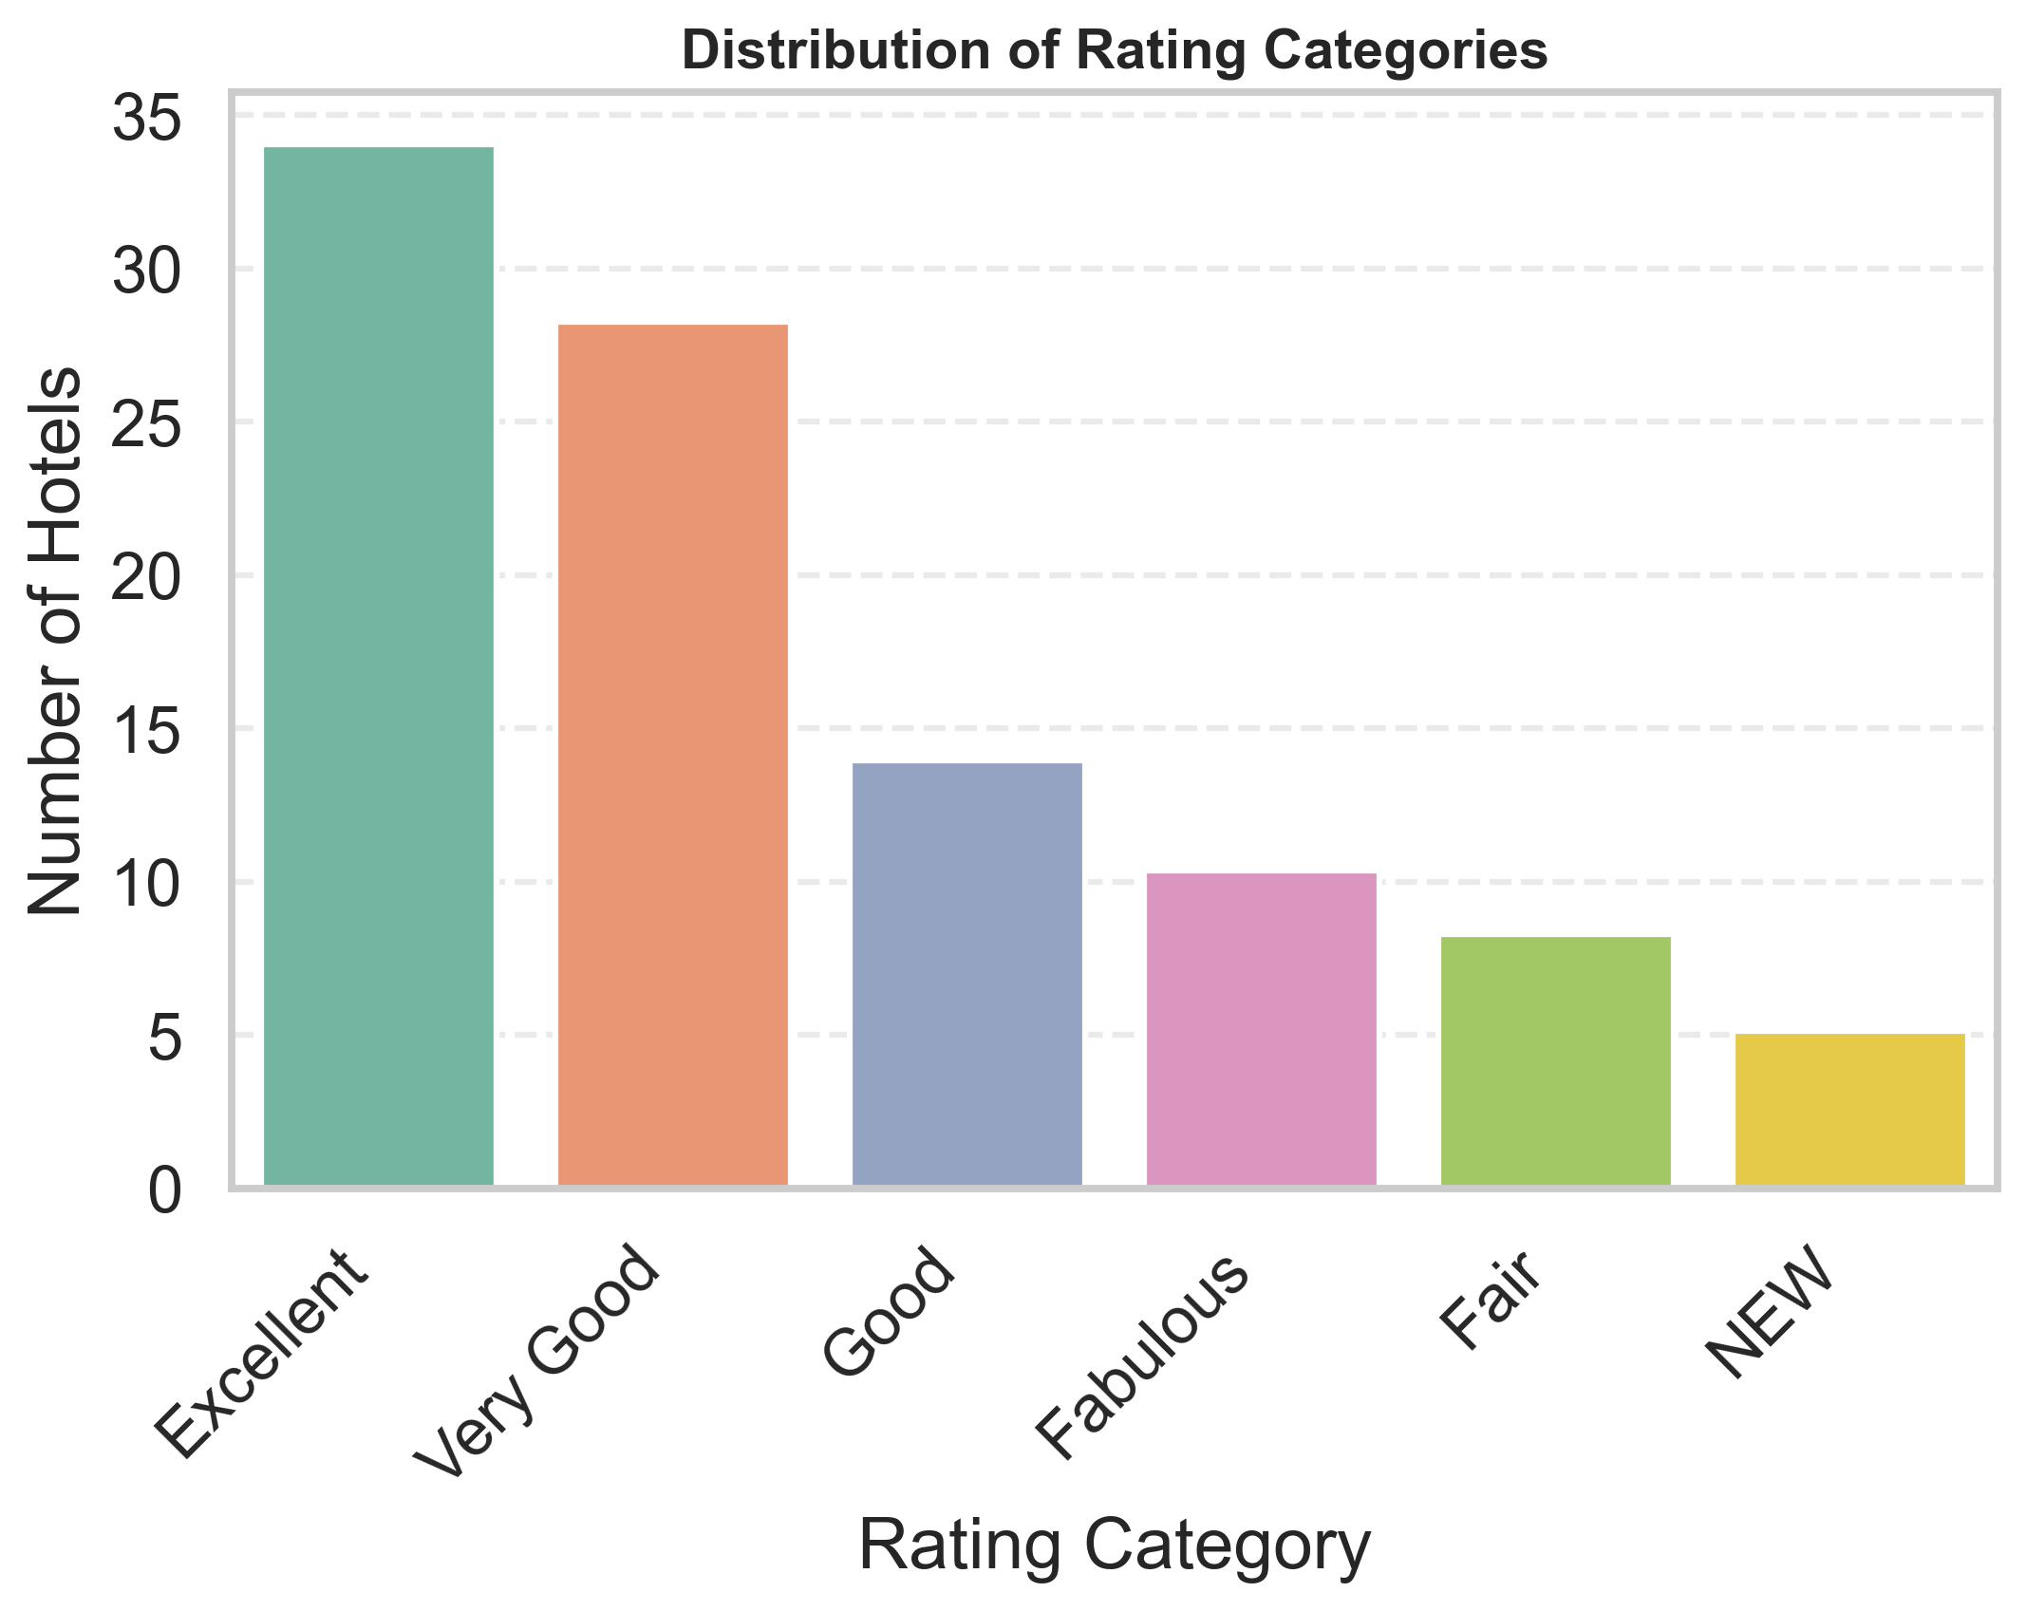
Distribution of OYO Hotel Rating Categories
Most OYO hotels fall under “Excellent” and “Very Good” categories, indicating strong overall customer satisfaction.
“Good” rated hotels form a moderate share, suggesting acceptable service quality with scope for improvement.
Very few hotels are rated as “Fair” or “NEW”, showing limited negative feedback and fewer newly listed properties.
Overall, the rating distribution is positively skewed, highlighting consistent service quality across most OYO hotels.

Slide 16
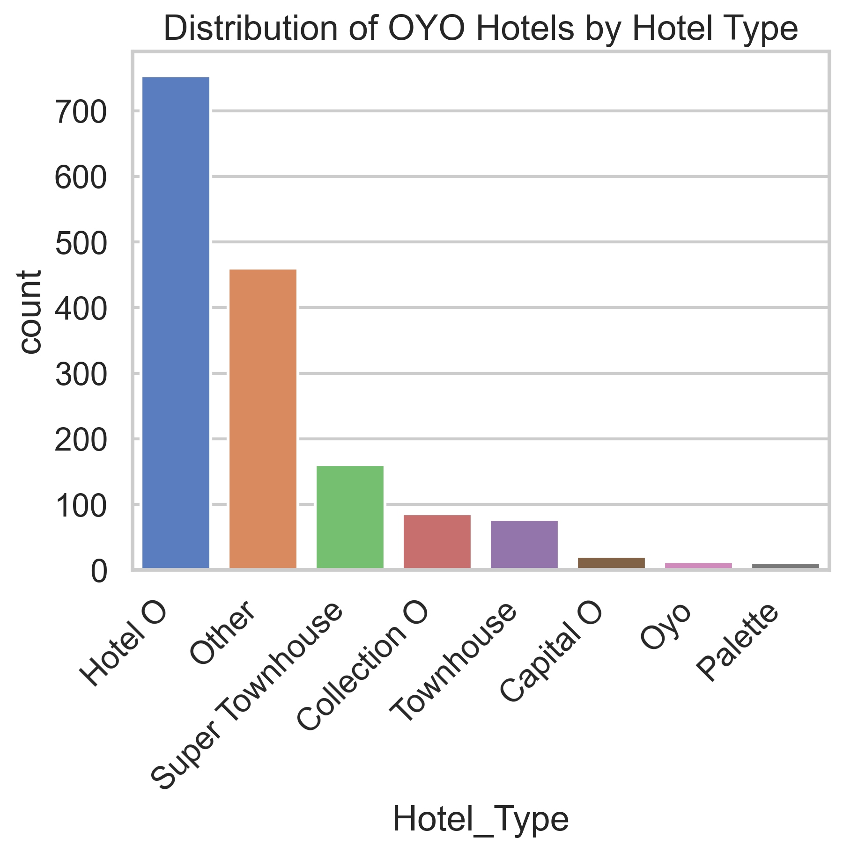
Distribution of OYO Hotels by Hotel Type
“Hotel O” is the most dominant category, showing that OYO primarily focuses on standard budget hotel offerings.
“Other” and “Super Townhouse” categories also have a strong presence, indicating diversification into premium and alternative stays.
Townhouse and Collection O hotels form a moderate share, catering to customers looking for better amenities and comfort.
Capital O, Palette, and OYO-branded hotels are limited, suggesting niche or premium segments with selective availability.

Slide 17
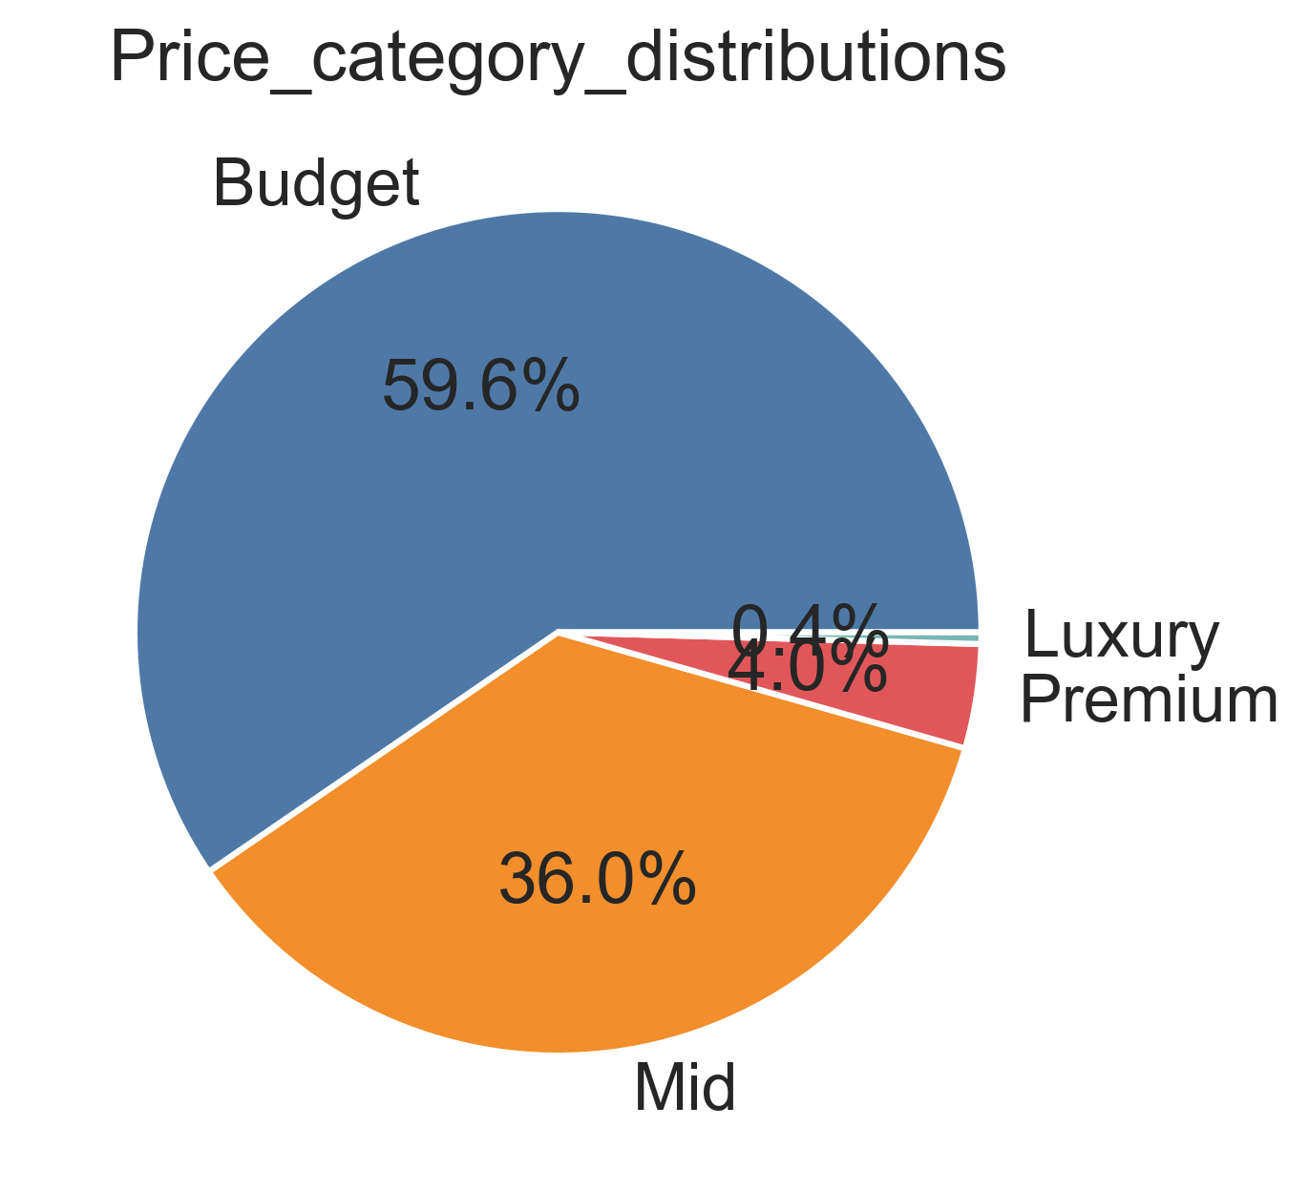
Price Category Distribution of OYO Hotels
Most OYO hotels are budget hotels, so they are affordable for common travelers.
Many hotels are in the mid-price range, giving customers better comfort at reasonable prices.
Very few hotels are premium or luxury, showing OYO is not focused on costly stays. Overall, OYO mainly targets people looking for affordable and value-for-money hotels.

Slide 18
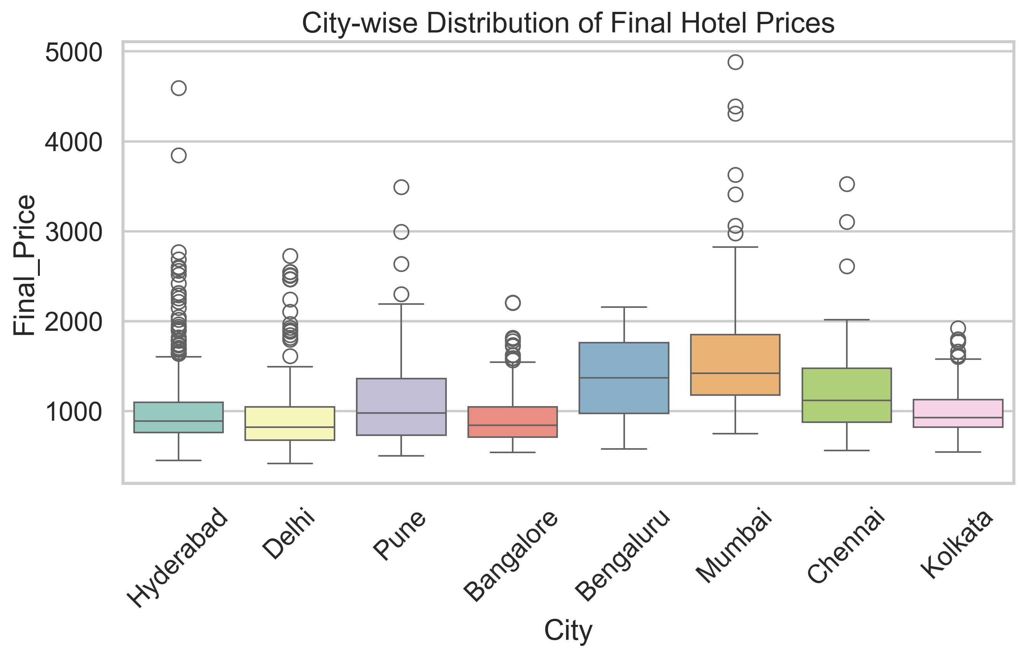
Bivariate Analysis: City-wise Comparison of OYO Hotel Final Prices
Mumbai has the highest median hotel price, making it the most expensive city among the selected locations.
Hyderabad and Delhi show lower and more stable prices, indicating better affordability for budget travelers.
Price variation is highest in Mumbai and Pune, reflecting the presence of both budget and premium hotels.
Bangalore, Chennai, and Kolkata fall in the mid-price range, offering a balanced mix of affordability and price spread.

Slide 19
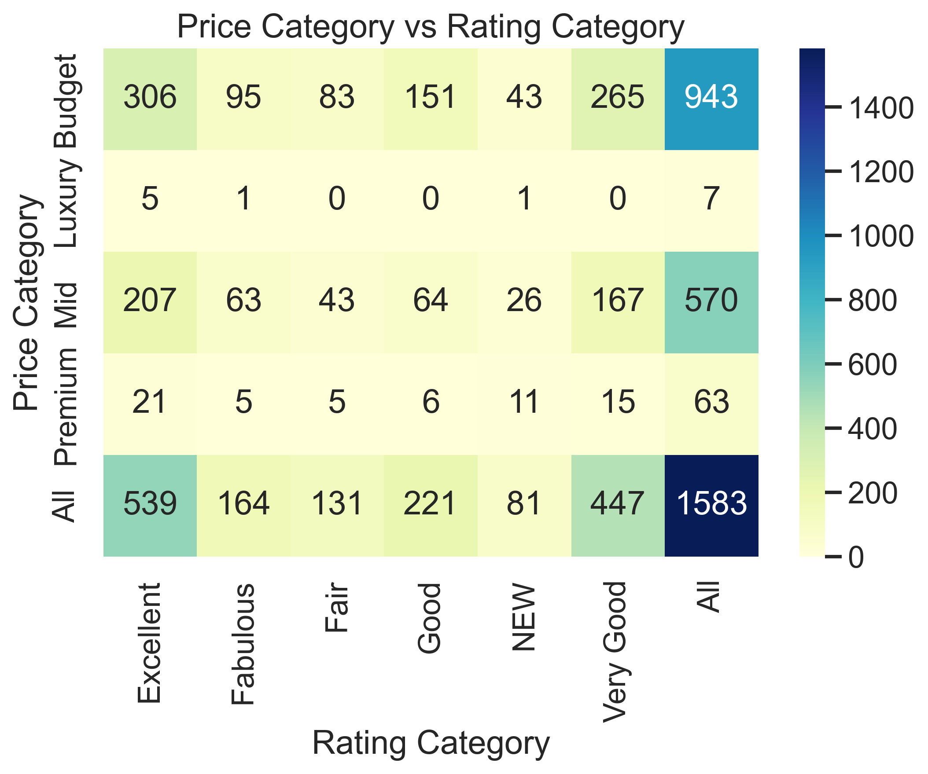
Price Category vs Rating Category Analysis
Budget hotels receive many high ratings, showing that affordable hotels can still deliver good customer satisfaction.
Higher prices do not always lead to better ratings, indicating price alone doesn’t guarantee quality.
Mid-range hotels perform consistently well, offering a good balance between cost and service quality.
Ratings across all price categories highlight that value for money and service quality matter more than price.

Slide 20
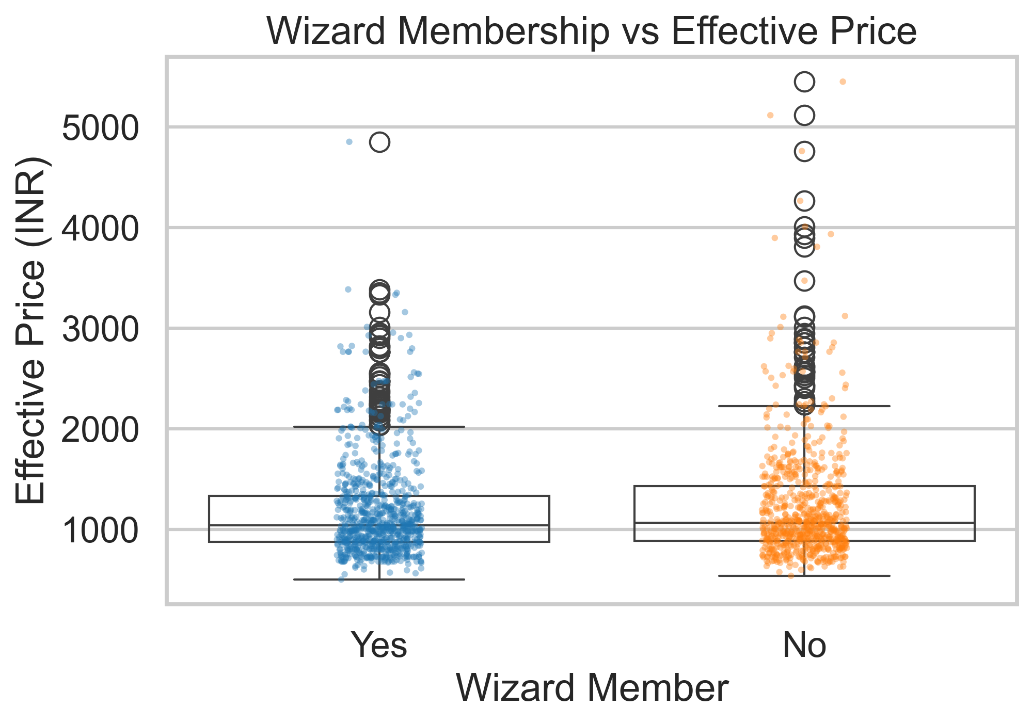
Impact of Wizard Membership on Hotel Prices
Hotels with Wizard membership generally offer slightly lower prices.
Both Wizard and non-Wizard hotels are available across similar price ranges.
Higher-priced hotels are more commonly seen without Wizard membership.
Wizard hotels are more concentrated in affordable price options

Slide 21
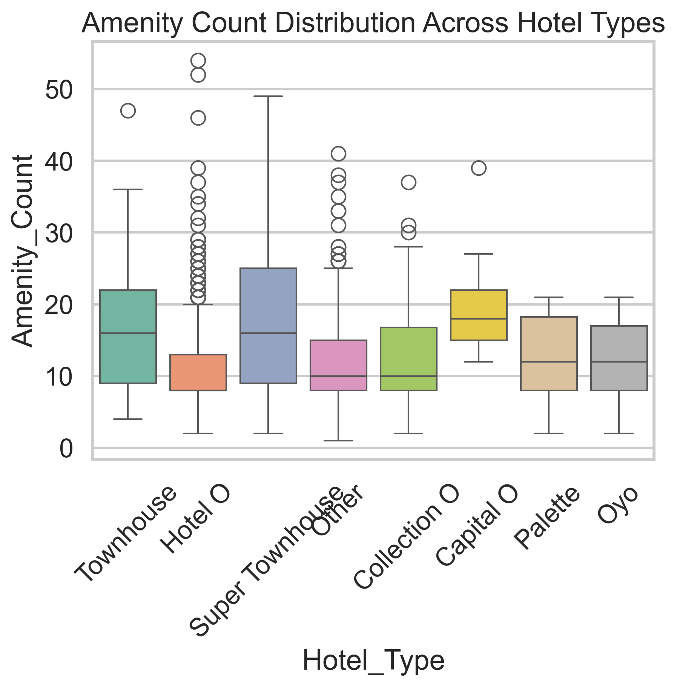
Amenity Availability Across Different OYO Hotel Types
Super Townhouse, Townhouse, and Capital O hotels offer the highest number of amenities, making them more comfortable for customers. More amenities generally mean better comfort and stay experience, which customers value more than just the hotel name.
OYO and Palette hotels also provide a reasonable number of amenities, making them good affordable options.
Some Hotel O and Collection O properties offer very high amenities, showing that amenities can vary a lot within the same hotel type

Slide 22
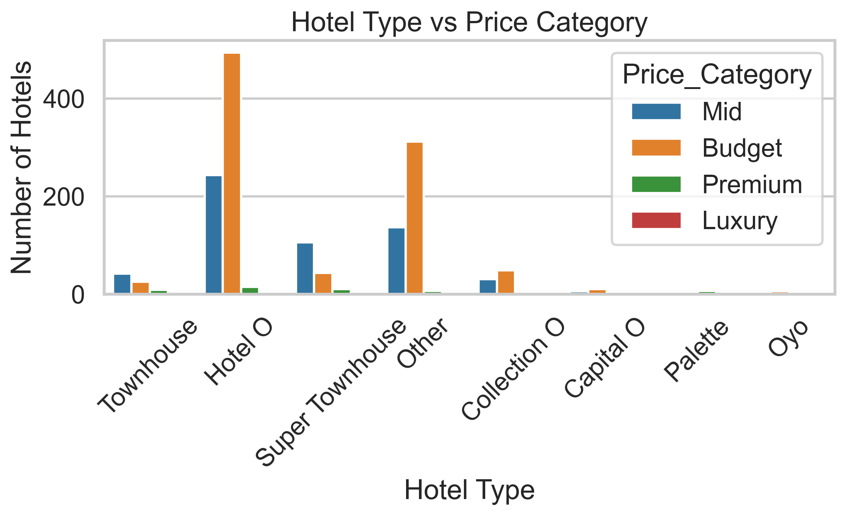
Price Category Distribution Across OYO Hotel Types
Hotel O and Collection O are mainly in the budget category, offering affordable stays with decent service.
Hotel O, Super Townhouse, and Other hotels dominate the mid-price segment, balancing comfort and cost.
Super Townhouse, Palette, and OYO also appear in the premium category, though in smaller numbers.
Overall, OYO offers multiple hotel types across price ranges, allowing customers to choose based on budget and comfort needs.

Slide 23
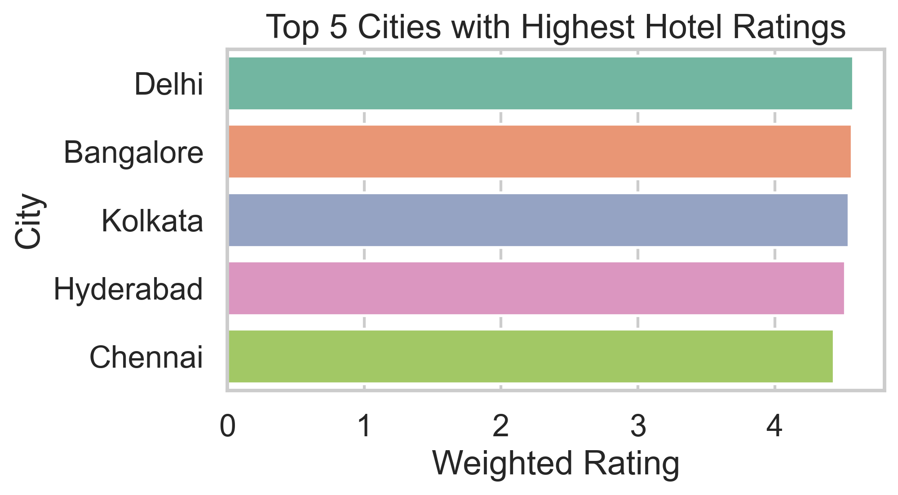
Top Cities Based on Review-Weighted Ratings
Bangalore has the highest overall hotel rating based on customer reviews
Delhi and Kolkata closely follow, showing consistently high hotel ratings
Hyderabad and Mumbai also appear among the top-rated cities
Higher ratings may be influenced by service quality, hotel standards, and customer expectations in these cities

Slide 24
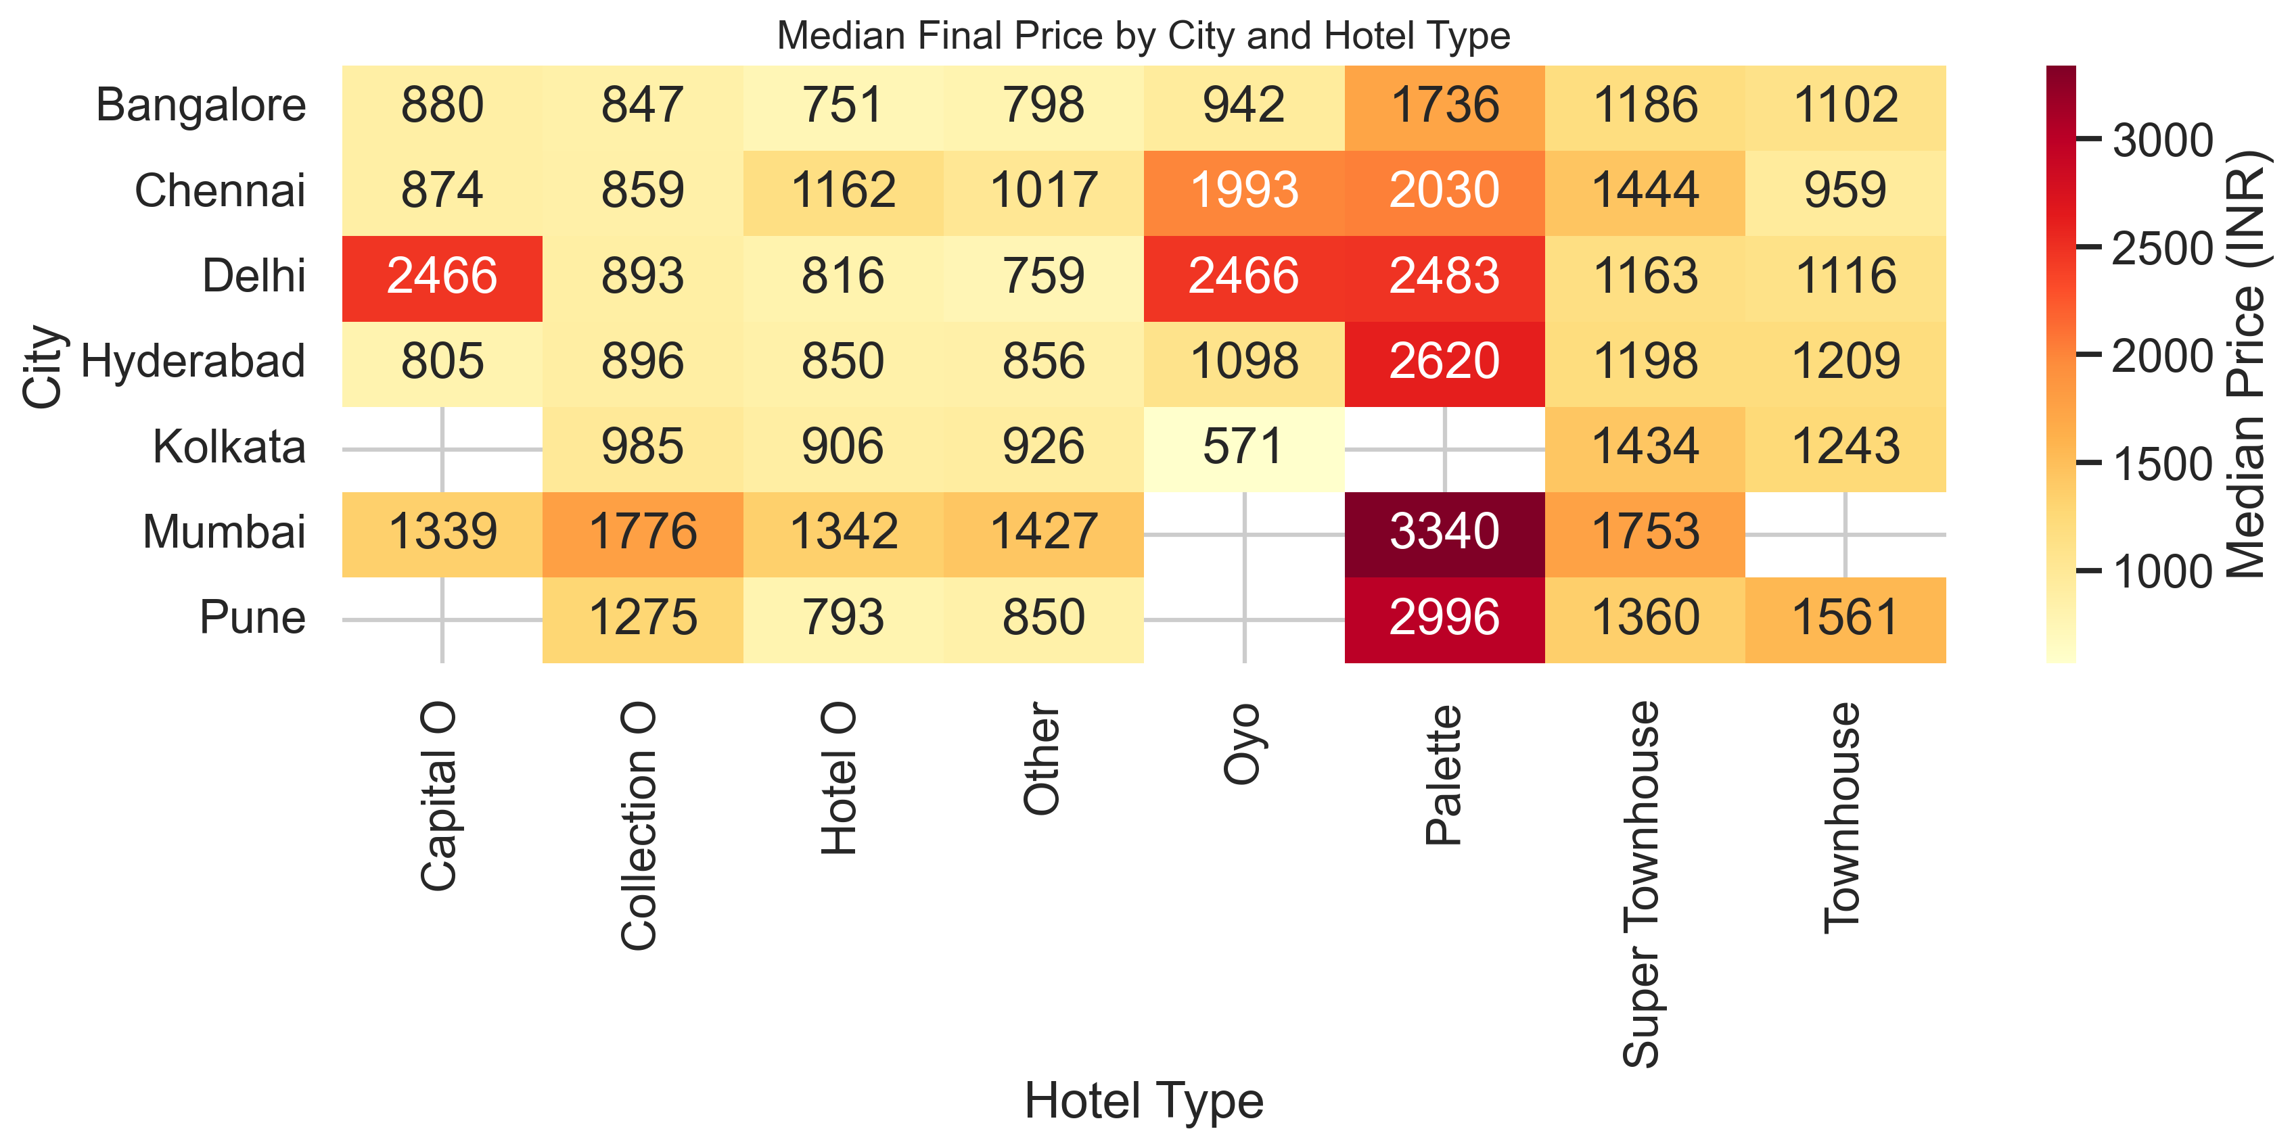
Multivariate Analysis City & Hotel Type Pricing Landscape (Median Prices)
Hotel O and Collection O are the most budget-friendly options across most cities.
Townhouse and Super Townhouse mainly fall in the mid-price range, balancing comfort and cost.
Palette hotels have the highest median prices, especially in Mumbai, Delhi, and Pune, reflecting premium positioning.
Mumbai and Delhi are generally more expensive across hotel types, while Bangalore and Hyderabad remain relatively affordable.

Slide 25
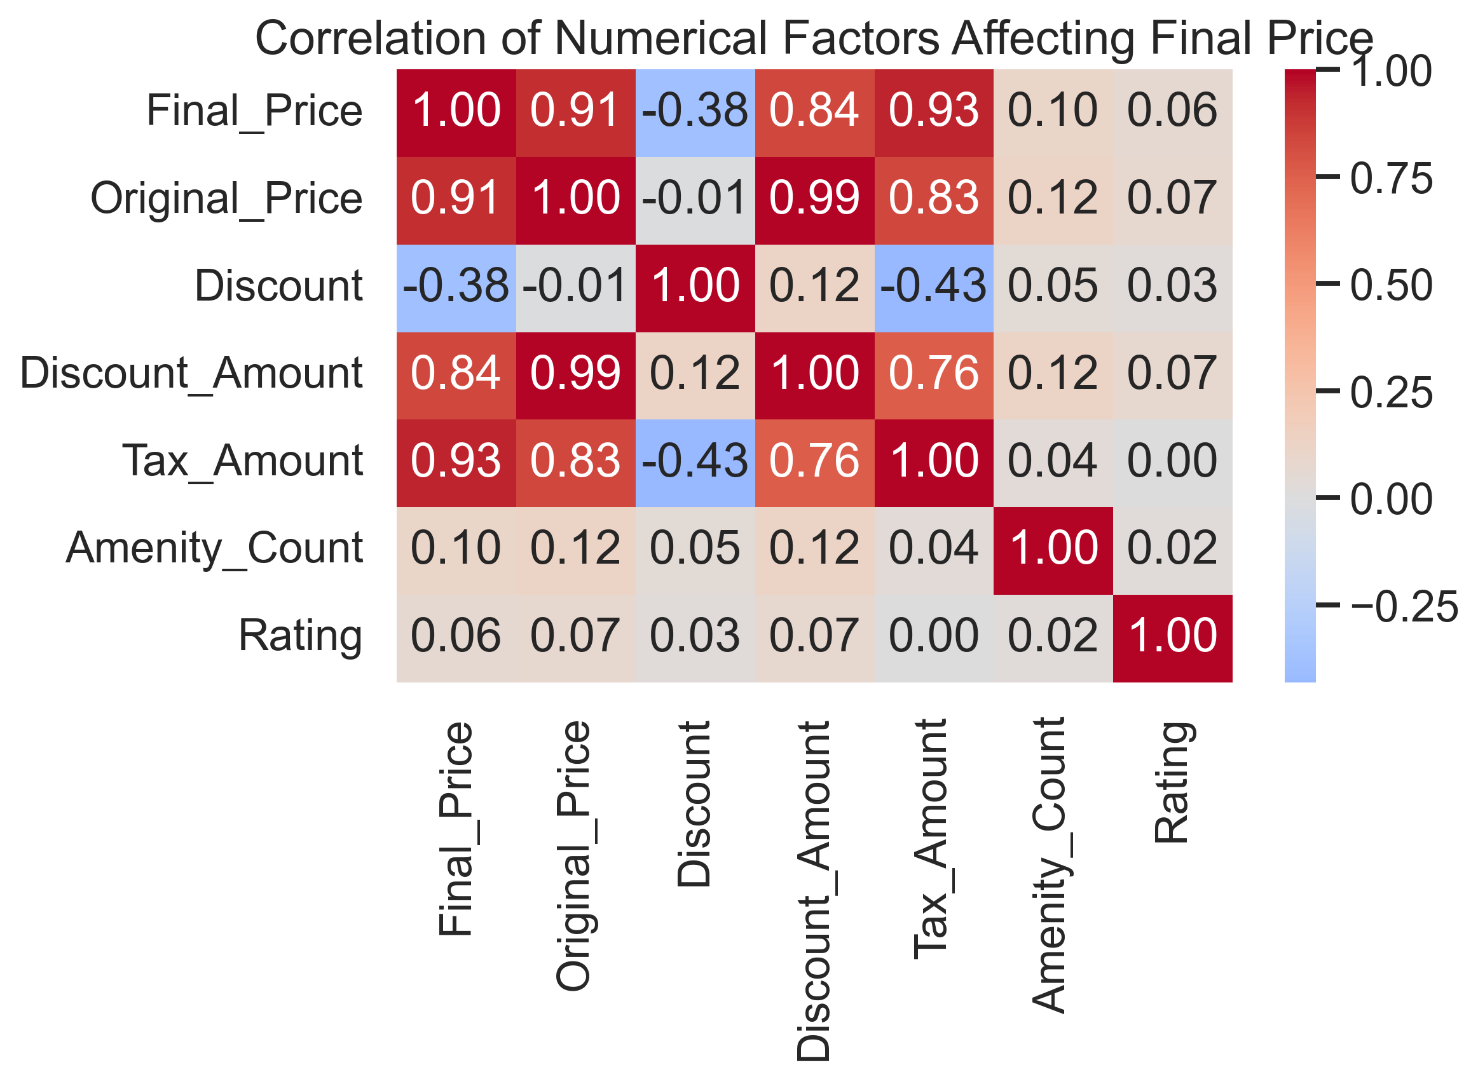
Key Numerical Factors Influencing Final Hotel Price
Final price is mainly driven by the original price — higher listed prices directly lead to higher final prices
Taxes increase along with room prices, which means expensive hotels add a bigger tax burden to customers
Discounts help reduce the final price, showing that promotions play a real role in making hotels more affordable
Amenities have only a small impact on pricing, suggesting hotels don’t increase prices heavily just for adding amenities
Hotel ratings have very little influence on price, meaning highly rated hotels are not always expensive

Slide 26
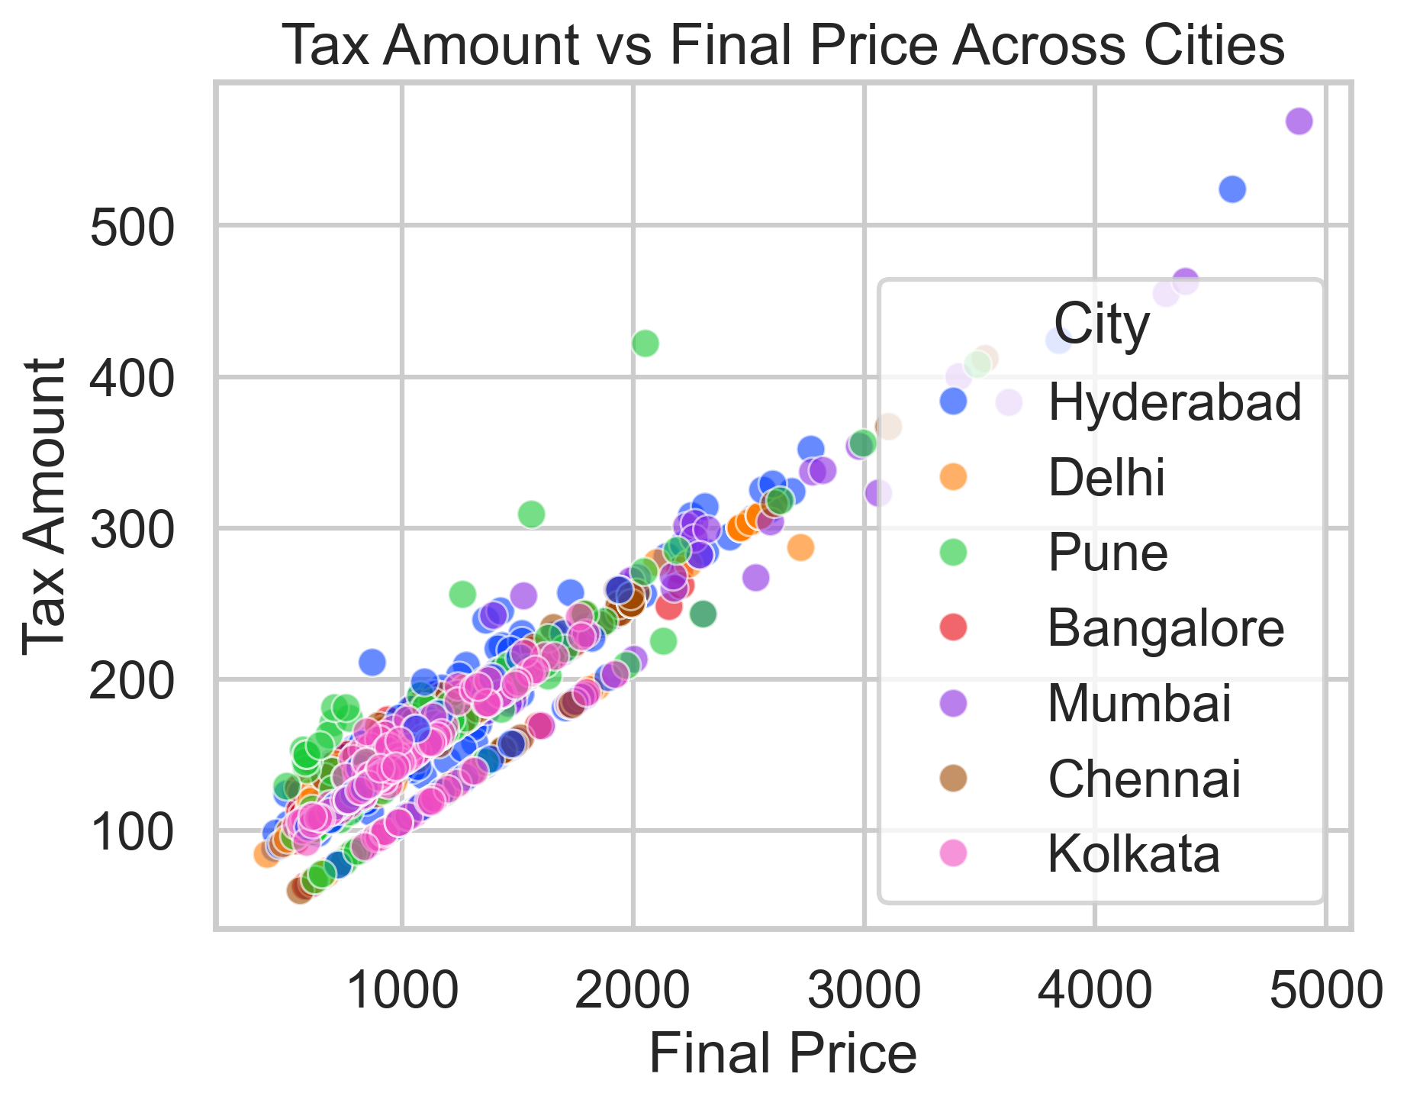
Relationship Between Final Price and Tax Amount Across Cities
Tax amount increases steadily with final price across all cities, showing a consistent pricing–tax structure
Mumbai and Hyderabad show the highest tax values at higher price levels, indicating a higher overall cost burden for expensive hotels
Bangalore and Kolkata are more concentrated in lower price and tax ranges, making them relatively more affordable for budget travelers
Delhi and Chennai fall in the mid-to-high range, with taxes rising sharply as hotel prices increase
At similar final prices, tax amounts remain fairly consistent across cities, suggesting tax is largely price-driven rather than city-specific

Slide 27
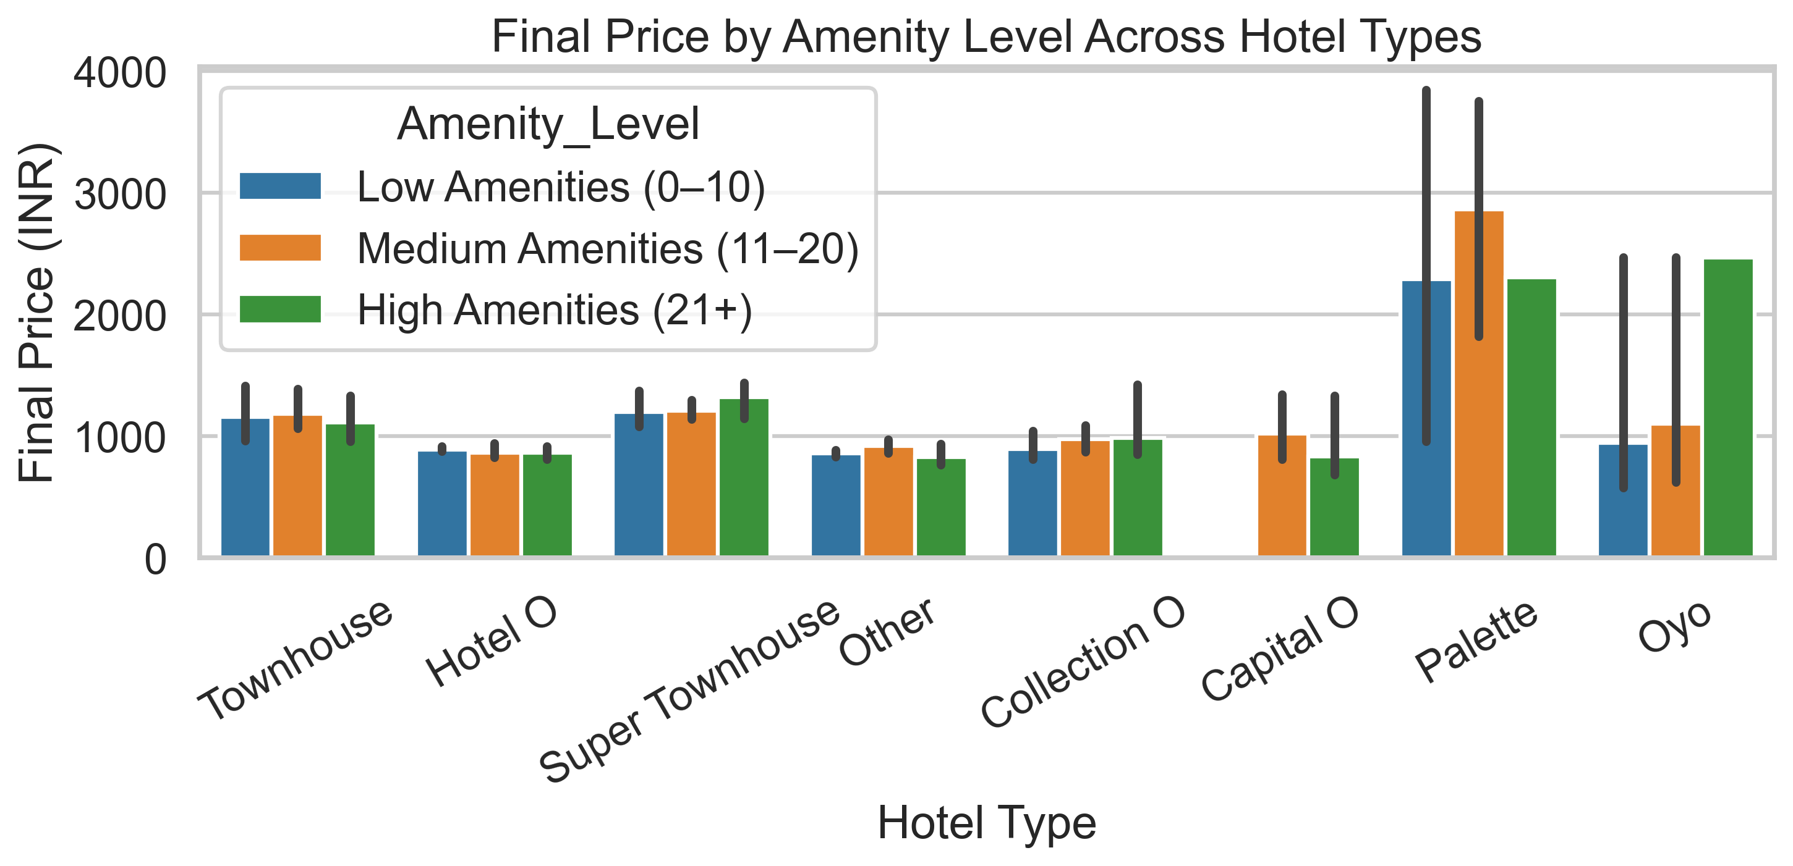
Impact of Amenities on Final Price Across Hotel Types
Hotels with more amenities usually charge higher prices across most hotel types
In budget hotel types, prices increase only slightly even when amenities increase
Mid-range hotel types show a clear price increase as amenities move from low to high
Premium hotel types already start at higher prices, so additional amenities change prices less.
Overall, amenities influence price, but hotel type matters more.

Slide 28
FINAL BUSINESS INSIGHTS AND RECOMMENDATIONS:
Key Insights
➤ Budget and mid-range hotels form the majority of OYO listings, showing strong customer preference for affordable stays. ➤ Cities like Mumbai and Delhi have higher hotel prices and taxes, while cities like Bangalore and Hyderabad remain more affordable. ➤ High customer ratings are achieved across all price ranges, proving that good service matters more than high pricing.
Recommendations
➤ Hotels should focus on delivering consistent service and essential amenities rather than increasing prices to improve ratings. ➤ OYO should strengthen budget and mid-range offerings and promote Wizard membership to attract price-sensitive customers. ➤ City-based pricing strategies should be optimized so hotels stay competitive while customers receive fair value.

Slide 29
CONCLUSIONS:
Budget and mid-range hotels attract most customers, showing strong demand for affordable stays.
Higher hotel prices do not always result in better customer ratings; service quality matters more.
Hotel pricing varies significantly across cities and hotel types, with metro cities generally being more expensive.
Data-driven analysis helps hotels improve pricing decisions and helps customers choose value-for-money options.

Slide 30
Experiences & Challenges:
Collected hotel data from the OYO website and handled challenges while extracting information from web pages.
Faced missing values, duplicate records, and inconsistent text formats, and cleaned the data using Python and regex techniques.
Created meaningful new columns such as price categories, rating categories, popularity score, and amenity count for better analysis.
Managed large datasets and organized the data properly to make analysis and visualization easier.
Used appropriate and clear visualizations to explain pricing, ratings, and customer behavior from both business and customer perspectives.

Slide 31


Slide 32

THANK YOU

