Slide 1

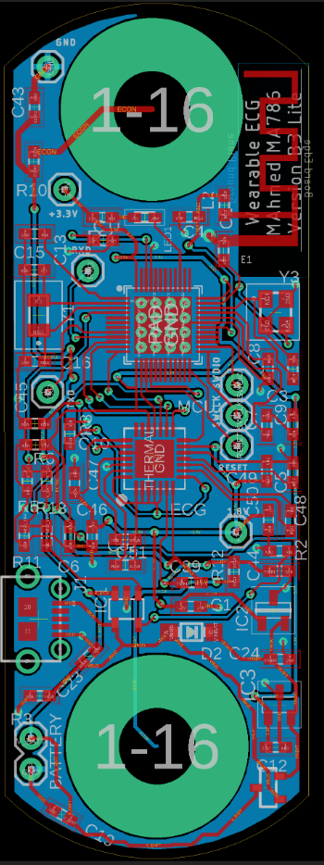
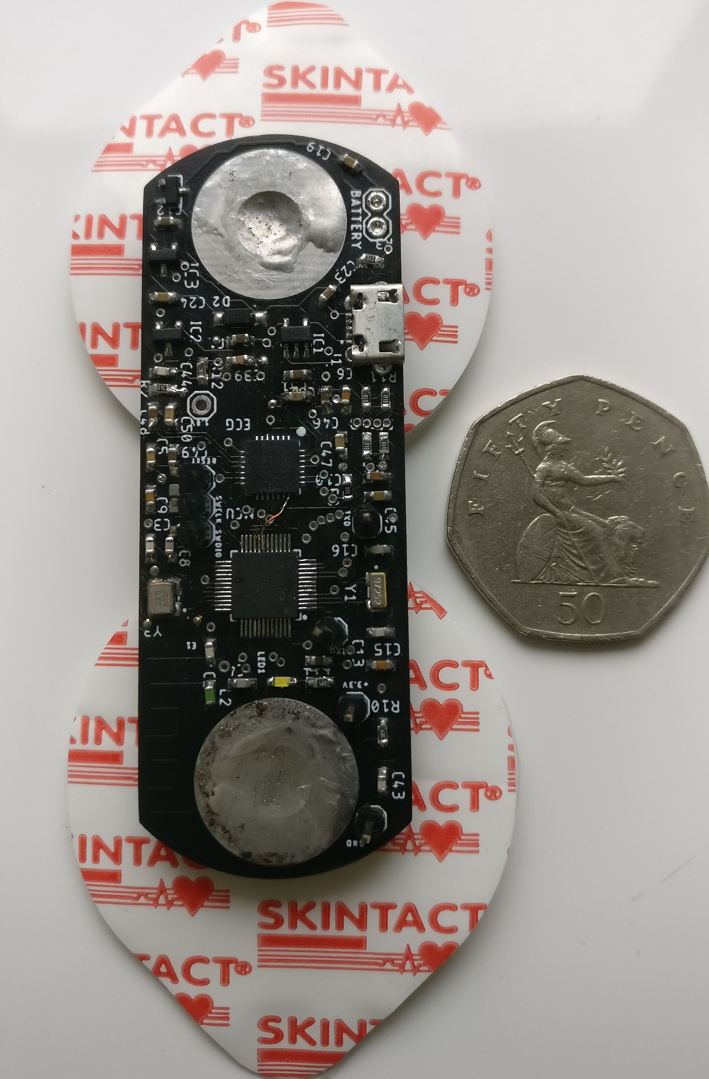
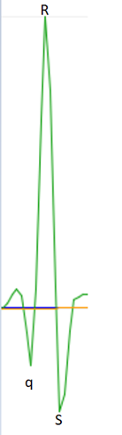
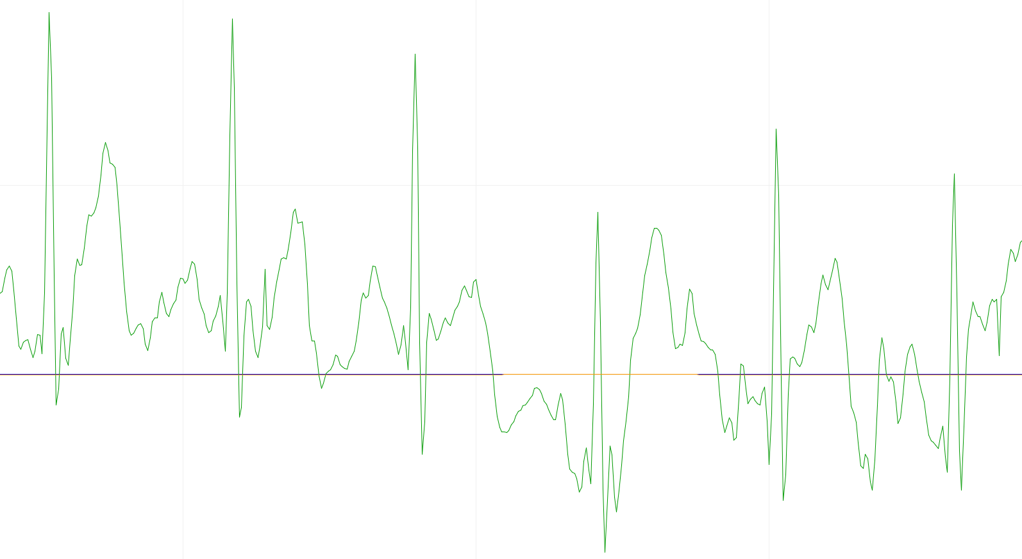
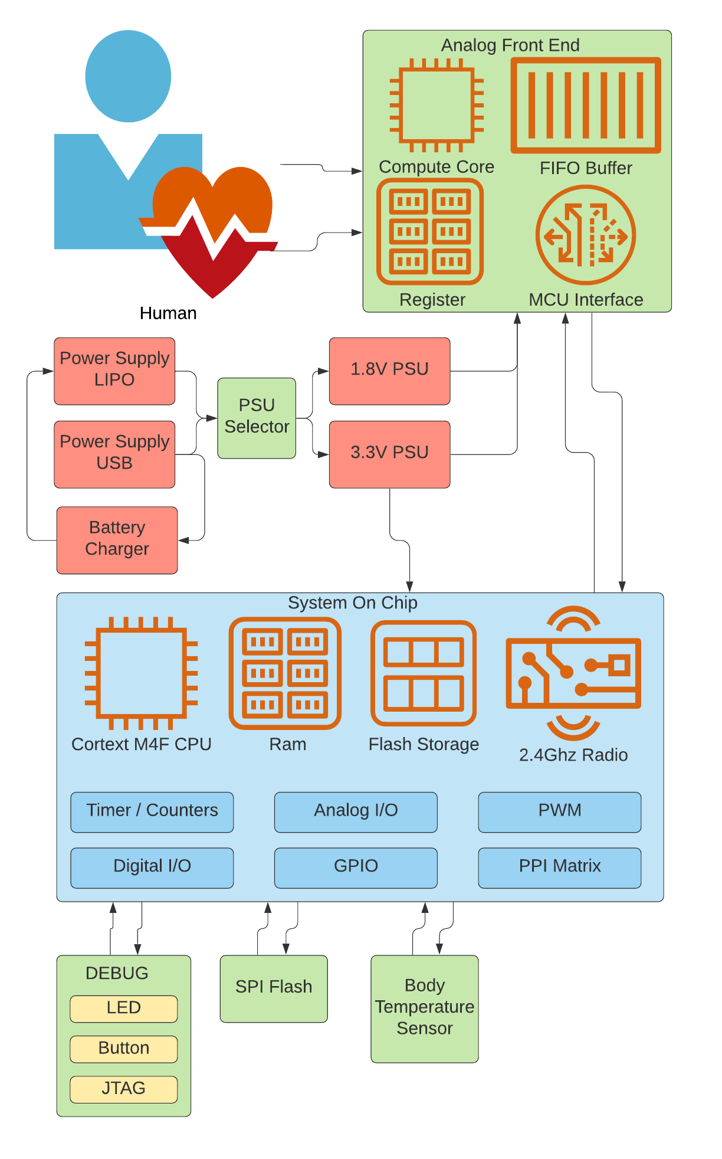
Wearable ECG Monitor
By M Ahmed Supervisor: Dr S Hoque
INTRODUCTION
The IoT (internet of things) field in wearable healthcare has received a lot of attention in the last few years due to advancement in computing paradigms: cloud computing, fog computing and edge computing.
This project aims to develop a highly integrated battery-powered wearable embedded system with wireless capability that can measures ECG from bipotential input. To get an understanding of engineering development that moves past the educational / preconfigured hardware module and into the industrial territory. Implementing custom design at chip-level using manufacture provided datasheets.
SYSTEM ARCHITECTURE
TEST RESULT
Top-level design of the system outlines the different subsystems and how they are interconnected.
At the heart of the system is the ECG analogue front end and the Nordic semiconductor Bluetooth microcontroller.
The system interfaces with a human using 2 wires, positive and negative leads to take differential measurements. The 15bit analogue to digital data is pre-processed using hardware low and high pass filters. The data is accessed from the FIFO buffer by the microcontroller once it reached 4 or more samples via SPI interface. The microcontroller implements MBED RTOS which manages various task pseudo- simultaneously. The microcontroller is responsible for: system power management, Bluetooth packet advertisement using GAP protocol, streaming signed normalised ECG voltages, heart rate and battery level information using GATT service.
qRS
TEST |  | Result
ECG Data Acquisition |  | PASS
BLE (HR, Battery GATT) |  | PASS
BLE ECG (Custom GATT) |  | PASS
Peak Power Consumption |  | 7.6mA
Idle Power Consumption |  | <1mA
Power Efficiency |  | 88%
Battery life** |  | 263 Hours
Wearability (75*25*1.6mm) |  | 13 Grams
Compatibility |  | 2/3 **
Extensive hardware, software and data quality tests have been performed to ensure the system works under a range of different conditions and variables.
The system performed well with low power consumption during data streaming over Bluetooth low energy. The system uses GATT which allows developers to write software apps for the ECG monitor without direct access to the code. The system was custom designed in eagle software, manufactured in China and assembled in the engineering lab. The system designed meets the current aims, objective and deliverable with further changes to make the system more robust
**2000mAh Lithium-ion polymer battery was used for testing.
PRESS RELEASE
It is estimated by WHO 17 million people die of cardiovascular disease-related every year. To put that in perspective, it’s the equivalent of the population of the Netherlands. This project developed a wearable device that can measures a human hearts electrical activity using a current-gen chip technology from maxim semiconductor. The data can be transmitted to any supporting Bluetooth device for monitoring. It is anticipated in the future wearable health devices will be widely adopted among consumer users, as it will not just benefit the doctors and patient but help tackle pandemics.

