Slide 1
K-Means Based On MapReduce
Reporter: Hao-Ying Cheng, Yueh Tang
Student ID: 109598001, 109598033

Slide 2
Introduction

Slide 3
K-Means Clustering & MapReduce
K-Means is an unsupervised clustering algorithm designed to partition unlabelled data into a certain number (that’s the “K”) of distinct groupings. [1]
MapReduce is a software framework for processing data sets in a distributed fashion over a several machines. The core idea behind MapReduce is mapping your data set into a collection of <key, value> pairs, and then reducing over all pairs with the same key. [2]

Slide 4
Motivation

Slide 5
Why does K-Means Clustering apply into MapReduce
MapReduce has several advantages that improves K-Means Clustering.
Parallel Computing: make the best of multicore.
Simplicity: Only Map and Reduce Concepts
Distribution: assign loose-coupling tasks to several workers
This example implies that some algorithm based on MapReduce is possible.

Slide 6
Implementation

Slide 7
K-Means Algorithm
Randomly assign a number, from 1 to K, to each of the observations.
Randomly select the centroid of the cluster
Group objects based on the closest distance (used Euclidean Distance)
Recalculate centroids to get new centroids
Have objects moved?
If yes, jump to 3
If no, terminate training

Slide 8
Split K-Means Algorithm into Map and Reduce
Randomly assign a number, from 1 to K, to each of the observations.
Randomly select the centroid of the cluster
Group objects based on the closest distance (used Euclidean Distance)
Recalculate centroids to get new centroids
Have objects moved?
If yes, jump to 3
If no, terminate training
Map Phase
Reduce & Map Phase

Slide 9
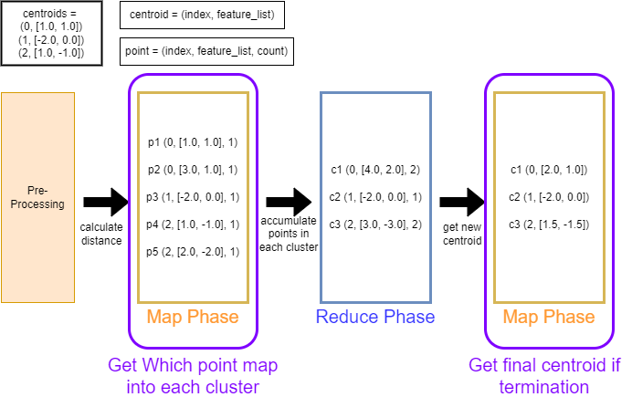
Diagram: K-Means Based On MapReduce

Slide 10
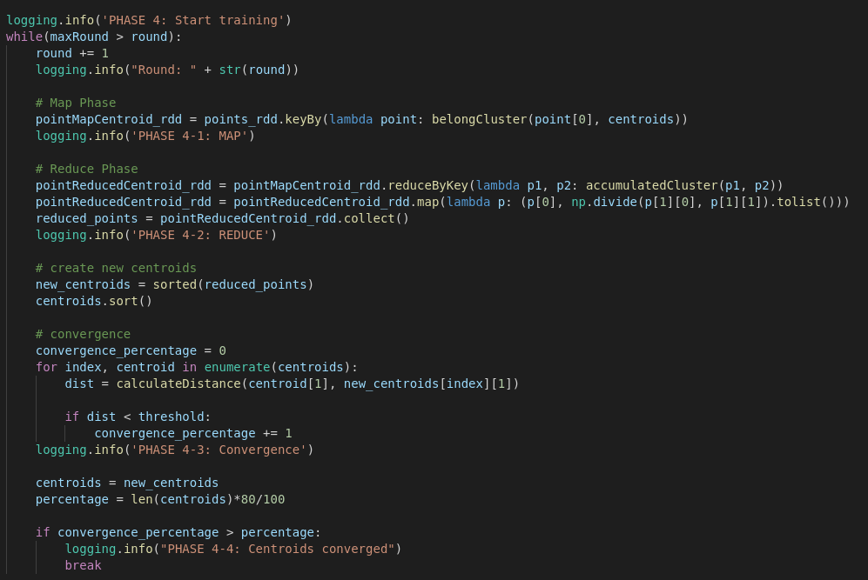
Code Block: K-Means implemented by MapReduce
Map Phase
Reduce Phase
Map Phase
Convergence Phase

Slide 11
Experiments

Slide 12
Dataset
Iris, online available: https://www.kaggle.com/arshid/iris-flower-dataset [4]
Weather Data, online available: https://www.kaggle.com/prakharrathi25/weather-data-clustering-using-k-means/notebook [5]

Slide 13
Environment Setup
Local Mode:
Vender: Dell
CPU: Intel(R) Core(TM) i5-2450U CPU @ 2.50GHz
Memory: 8GB
Number of CPU: 2C (Cores) 4T (Threads)
Cluster Model— Raspberry Pi:
Raspberry Pi 4 Model B
OS: Linux Ubuntu 20.04 Server
CPU: Broadcom BCM2711, Quad core Cortex-A72 (ARM v8) 64-bit SoC @ 1.5GHz
Number of CPU: 4C (CPU) 1T (Thread Per CPU)

Slide 14
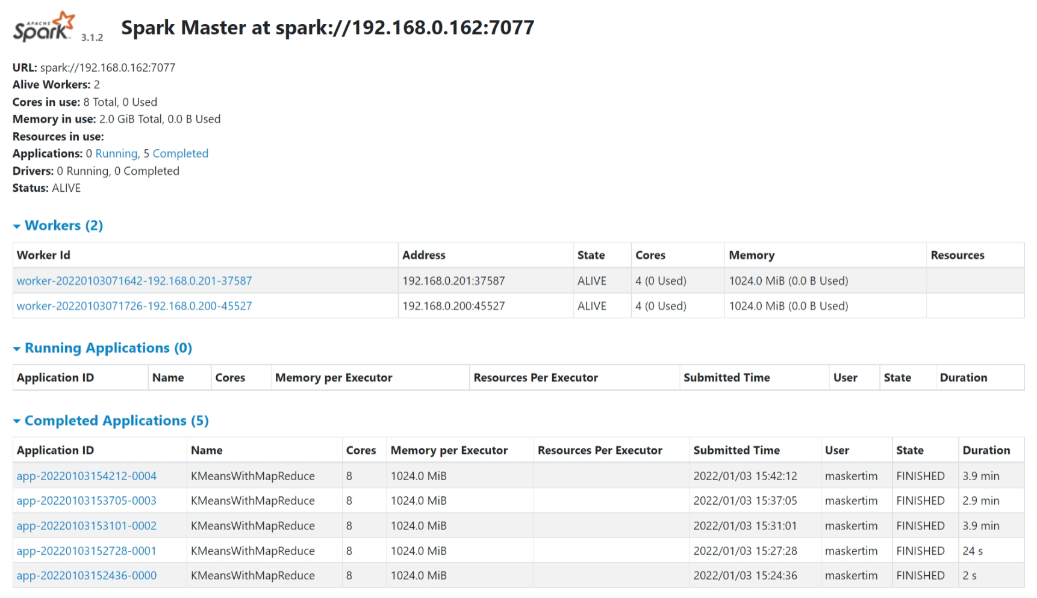
Cluster Based On Spark
Setup:
1. Raspberry Pi 4 Model B
a. OS: Linux Ubuntu 20.04 Server
b. CPU: Broadcom BCM2711, Quad core Cortex-A72 (ARM v8) 64-bit SoC @ 1.5GHz
c. Number of CPU: 4C (CPU) 1T (Thread Per CPU)

Slide 15
IRIS Dataset

Slide 16
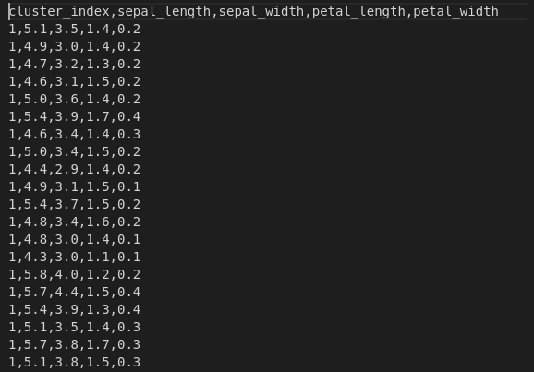
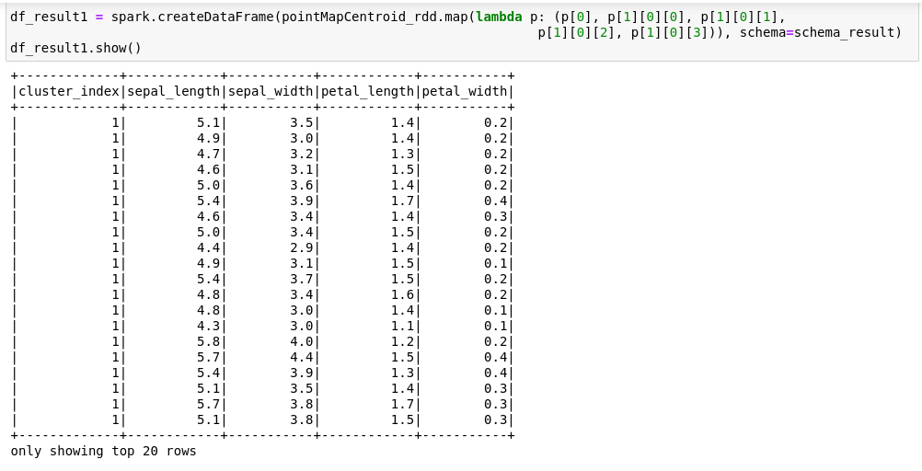
Table: Each Point maps into each cluster
Dataset: Iris, online available: https://www.kaggle.com/arshid/iris-flower-dataset [4]; Data Size: 151
Feature Selection: Sepal_Length, Sepal_Width, Petal_Length, Petal_Width

Slide 17
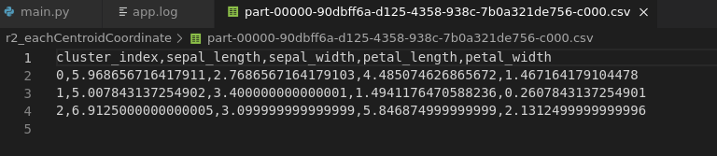
Table: Final Centroids

Slide 18
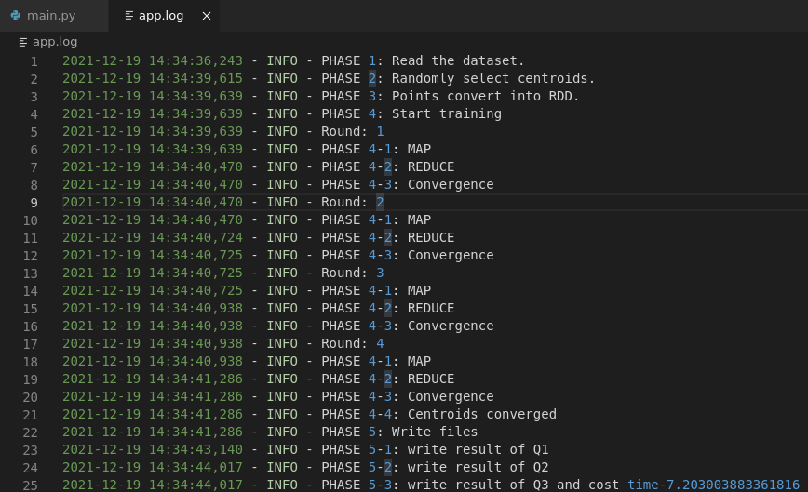
Log: Phase of Implementation

Slide 19
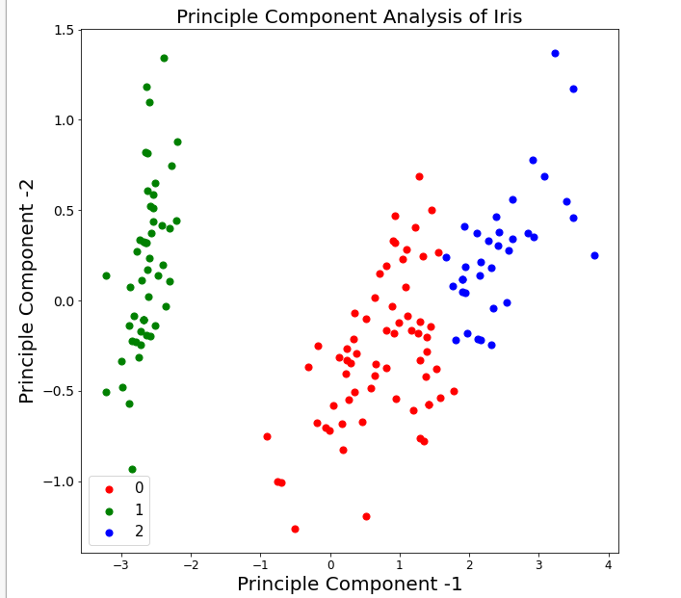
Visualization: Points belong to each cluster
K clustering = 3
Dimension Reduction: Principle Component Analysis (PCA)

Slide 20
Weather Dataset

Slide 21
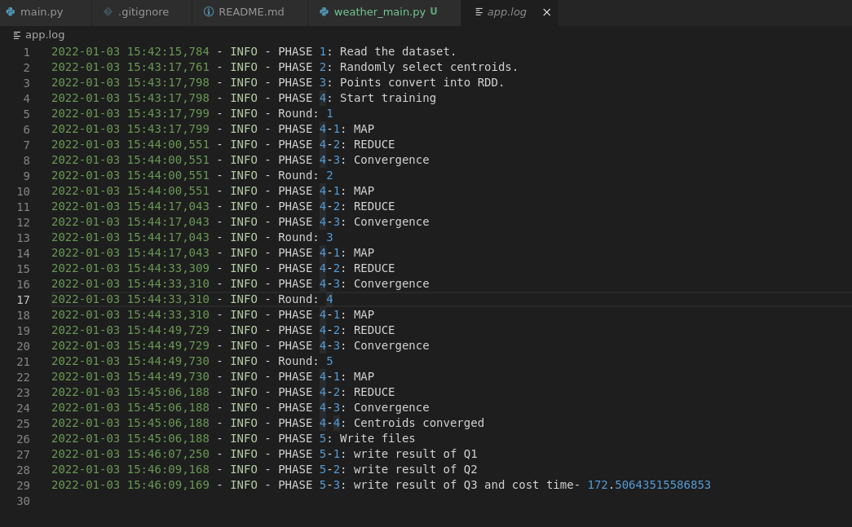
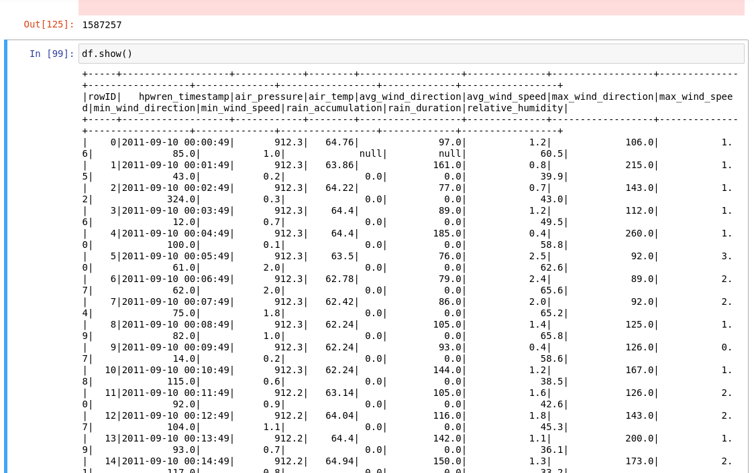
Table: Each Point maps into each cluster
Dataset: Weather Data, online available: https://www.kaggle.com/prakharrathi25/weather-data-clustering-using-k-means/notebook [5]; Data Size: 1587257
Feature Selection: Air_Pressure, Air_Temp, Relative_Humidity

Slide 22
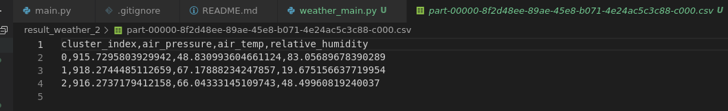
Table: Final Centroids

Slide 23
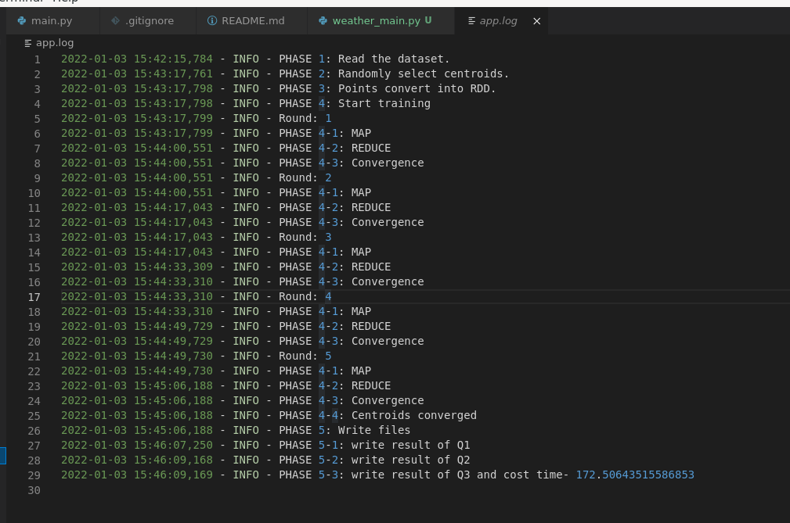
Log: Phase of Implementation

Slide 24
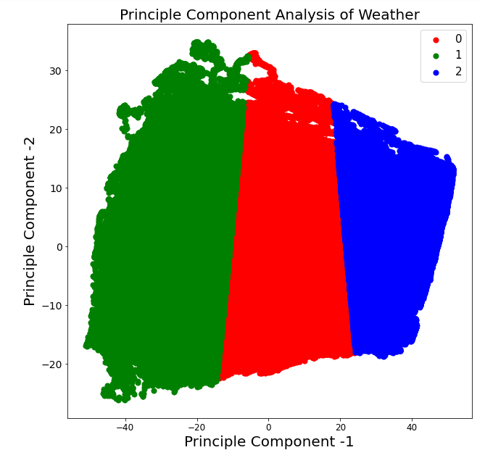
Visualization: Points belong to each cluster
K clustering = 3
Dimension Reduction: Principle Component Analysis (PCA)

Slide 25
Comparison of Speed

Slide 26
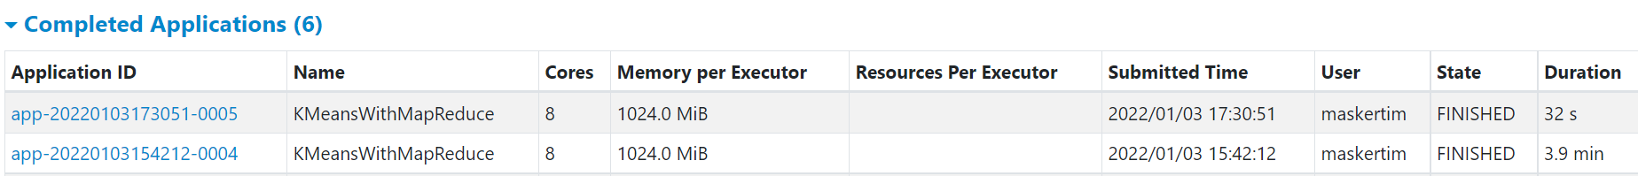
Processing Speed of Cluster
IRIS Dataset
Weather Dataset

Slide 27
Processing Speed
Dataset | Data Size | Mode | Cost Time
IRIS | 151 | Local | ≈7s
IRIS | 151 | Cluster; 2 Workers | ≈32s
Weather | 1587257 | Local | ≈1.3 min
Weather | 1587257 | Cluster; 2 Workers | ≈3.9 min
Possible reason of this comparison:
1. Worker’s hardware is not stronger.
2. Cluster Intrinsic Problem: Communication Delay
3. Data Size is not larger enough

Slide 28
Reference

Slide 29
Reference
[1] K-means: A Complete Introduction, online available: https://towardsdatascience.com/
[2] A Very Brief Introduction to MapReduce, online available: https://hci.stanford.edu/courses/cs448g
[3] davide-coccomini/KMeans-MapReduce, online available: https://github.com/davide-coccomini/KMeans-MapReduce
[4] Iris Flower Dataset, online available: https://www.kaggle.com/arshid/iris-flower-dataset
[5] Weather Data, online available: https://www.kaggle.com/prakharrathi25/weather-data-clustering-using-k-means/notebook

