Slide 1
How does the brain learn what to expect?
What scientists recorded (Schultz and colleagues)
Early trials: the food is a surprise
Dopamine neurons do not signal reward itself. They signal surprise: the reward received minus the reward expected.
After learning: the bell is the surprise
Food skipped: activity dips below normal
Our question
Can one simple RL rule, TD learning, reproduce what the neurons do?
bell
food
Notes:
WHAT TO SAY (plain words)
A famous experiment: a bell rings, and a few seconds later a monkey gets a drop of juice. Scientists recorded dopamine neurons and found three things. First, in early trials the neurons fire when the juice arrives, because it is a surprise. Second, after many trials they fire at the bell instead, and the juice no longer causes a response. Third, if the bell rings and the juice is skipped, the activity dips below normal at the moment the juice was expected.
So dopamine looks like a "surprise" signal: what you got minus what you expected. In reinforcement learning that quantity has a name, the TD error. Our question is whether a very simple RL rule can reproduce all three patterns.
LIKELY QUESTIONS
Q: What is dopamine? A: A chemical messenger in the brain, strongly linked to learning from rewards.
Q: What is a reward prediction error? A: Reward received minus reward expected. Positive = better than expected, zero = as expected, negative = worse than expected.
Q: Where does the real data come from? A: Recordings from single dopamine neurons in monkeys (Schultz and colleagues, 1990s). We did not collect data; we built a simulation and compared its pattern with those findings.

Slide 2
Method: TD(0) on a bell-and-food task
STATE
The time step in the trial. One table entry per step (13 steps)
ACTION
None. The agent only predicts and never chooses
TD ERROR (SURPRISE)
δ = r + γ·V(t) − V(t−1)
what happened minus what was expected
UPDATE
V(t−1) ← V(t−1) + α·δ
move the expectation toward what happened
α = 0.1 · γ = 1 · 300 trials
REWARD
1 when the food arrives (step 8), otherwise 0
ENVIRONMENT
Bell at step 2, food at step 8, repeated for 300 trials
Implementation: Python and NumPy, a table of 13 values and a short update loop. Baseline: the same agent with learning switched off.
Notes:
HOW WE BUILT IT (the answer to "How did you build it?")
1. Environment: a trial is 13 time steps. The bell appears at step 2 and the food (reward = 1) at step 8. We repeat the trial 300 times.
2. State: simply the time step. We keep a table V with one number per step. V(t) is "how much reward do I expect from here on". It starts at 0.
3. Each step we compute the surprise: delta = r + gamma*V(t) - V(t-1), i.e. what actually happened (reward now plus value of where I am) minus what I expected.
4. Then we nudge the expectation: V(t-1) = V(t-1) + alpha*delta. Alpha = 0.1 means we move 10 percent of the way each time.
5. We record delta at the bell step and at the food step on every trial, and plot them.
6. Baseline: the same agent with learning switched off (V stays 0).
LIKELY QUESTIONS
Q: Why is there no action? A: This is a prediction problem (policy evaluation). The animal does nothing that changes the outcome, so the agent only learns values. That is still reinforcement learning, as in the prediction part of Sutton and Barto.
Q: What does the 0 in TD(0) mean? A: A one-step look-ahead: we use only the next state's value to update the current one.
Q: Why gamma = 1? A: The task is episodic and short, so no discounting is needed. With gamma slightly below 1, the bell response would be a little smaller than 1.
Q: Why are states before the bell not updated? A: The bell arrives at an unpredictable moment, so nothing before it can predict it. We keep V = 0 there, which is the standard assumption in this model.
Q: Why a table and not a neural network? A: The state space is tiny, so a table is exact and easy to explain.

Slide 3
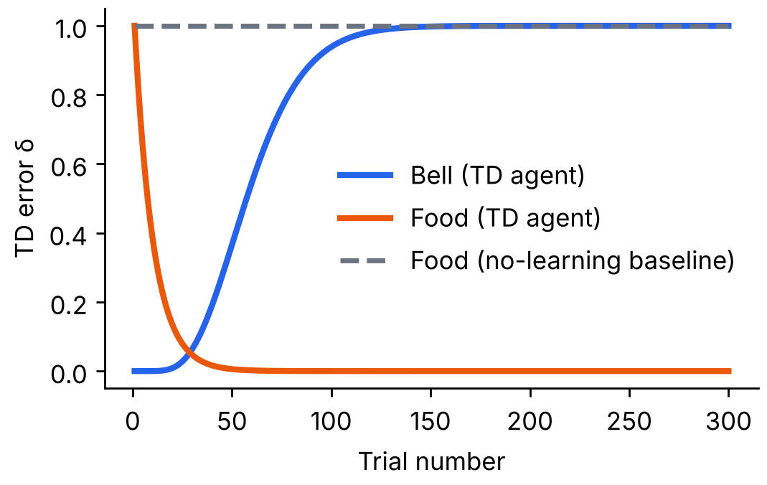
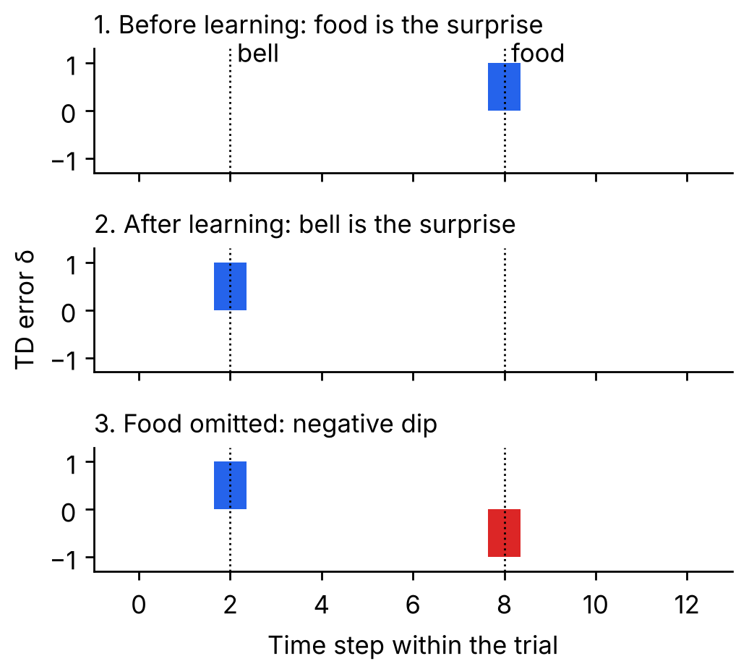
Results: surprise moves to the bell
1.00 → 0.00
δ at the food
0.00 → 1.00
δ at the bell
−1.00
δ when food is omitted
Notes:
WHAT THE RESULTS SHOW
Left plot (learning curve, with baseline): over 300 trials the surprise at the food (orange) falls from 1 to about 0, and the surprise at the bell (blue) rises from 0 to 1. The grey dashed line is the baseline, an agent that never learns: it is surprised by the food on every trial. With alpha = 0.1 the food surprise drops below 0.05 after about 30 trials, and the bell response reaches about 0.94 by trial 100.
Right plot (the three patterns, with learning switched off for the test): (1) before learning the food is the surprise, (2) after learning the bell is the surprise and the food is not, (3) if the food is omitted, delta = -1 at the time the food was expected. These are the same three patterns as in the dopamine recordings.
Conclusion: a simple TD rule, with nothing brain-specific in it, reproduces the signature of dopamine neurons.
LIKELY QUESTIONS
Q: Why does the bell response end at exactly 1? A: Gamma = 1 and the reward is 1, so the bell predicts a total future reward of 1.
Q: Why does the negative dip equal -1? A: The agent expected 1 and got 0, so delta = 0 - 1 = -1.
Q: What is the baseline for? A: To show the effect comes from learning. Without learning, the surprise at the food never goes away.
Q: Is this proof that the brain does TD learning? A: No. It shows TD error is a good explanation of the pattern. The match is qualitative.
Q: What happens to the earlier time steps between bell and food? A: The surprise spreads backward step by step (see the heatmap on the backup slide).

Slide 4




Limitations of the toy model
Perfect clock assumed
Bell and food always fall on the same steps. Real animals estimate time with noise.
Tiny state space
13 states in a lookup table. Real tasks need function approximation for rich inputs.
Qualitative match only
We compared shapes with published findings. We did not fit real recordings.
Dopamine does more
It also relates to attention, motivation and movement. TD error is one explanation, not all of it.
Notes:
LIMITATIONS (say these honestly, they are the marks)
1. Perfect clock: we give the agent one table entry per time step and fix the timing. Real animals do not have a perfect clock, and their timing is noisy.
2. Tiny state space: 13 states. Real problems are large and continuous and need function approximation (neural networks).
3. Qualitative match only: we compared the shapes of our curves with the published dopamine findings. We did not fit real data or measure error against it.
4. Dopamine does more than TD error: it is also linked to attention, motivation and movement, and some dopamine neurons respond to novelty or aversive events. TD error is a strong explanation, not the complete story.
LIKELY QUESTION
Q: How would you improve it? A: Add noisy timing, use function approximation, and fit the model to real recording data.

Slide 5



Ethics and responsible use
Animal research
The findings rest on animal experiments. Credit them, and use simulation to reduce such studies where possible.
The same math that explains how we learn can be used to keep us hooked.
Responsible use means saying clearly what a model can and cannot show.
Engagement design
Unpredictable rewards drive some apps and gambling. Prediction-error insight should not be used to exploit users.
Overclaiming
A good fit to data is not proof of mechanism. Make no clinical claims about addiction or depression from a toy model.
Notes:
ETHICS
1. Animal research: the dopamine findings come from experiments on animals. We cite them properly. Simulation can reduce, but not fully replace, such studies.
2. Engagement design: the idea that unpredictable rewards produce strong responses is used in games, social media feeds and gambling. We should not use prediction-error insights to exploit people.
3. Overclaiming: our model matches the pattern of the data, but that does not prove the brain works this way. We should not make medical claims about addiction or depression from a toy simulation.
Also worth a sentence: in RL in general, a badly specified reward can produce unintended behaviour, which is why reward design is an ethical issue as well as a technical one.

Slide 6
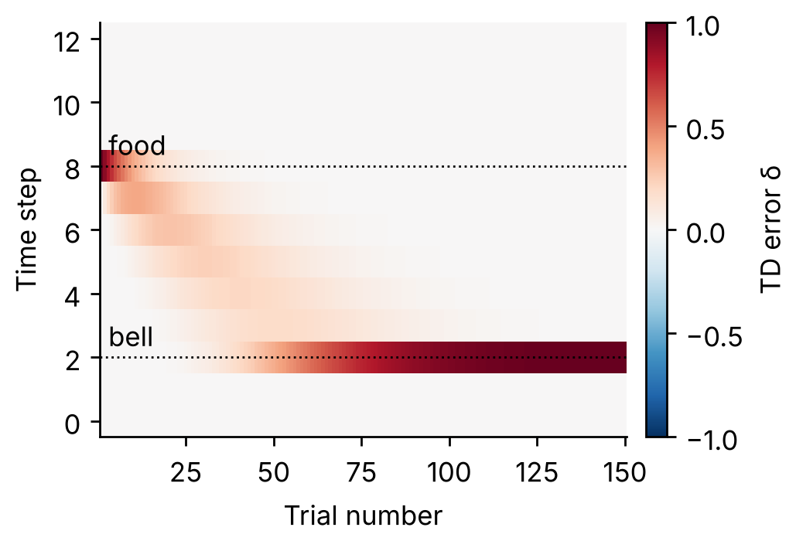
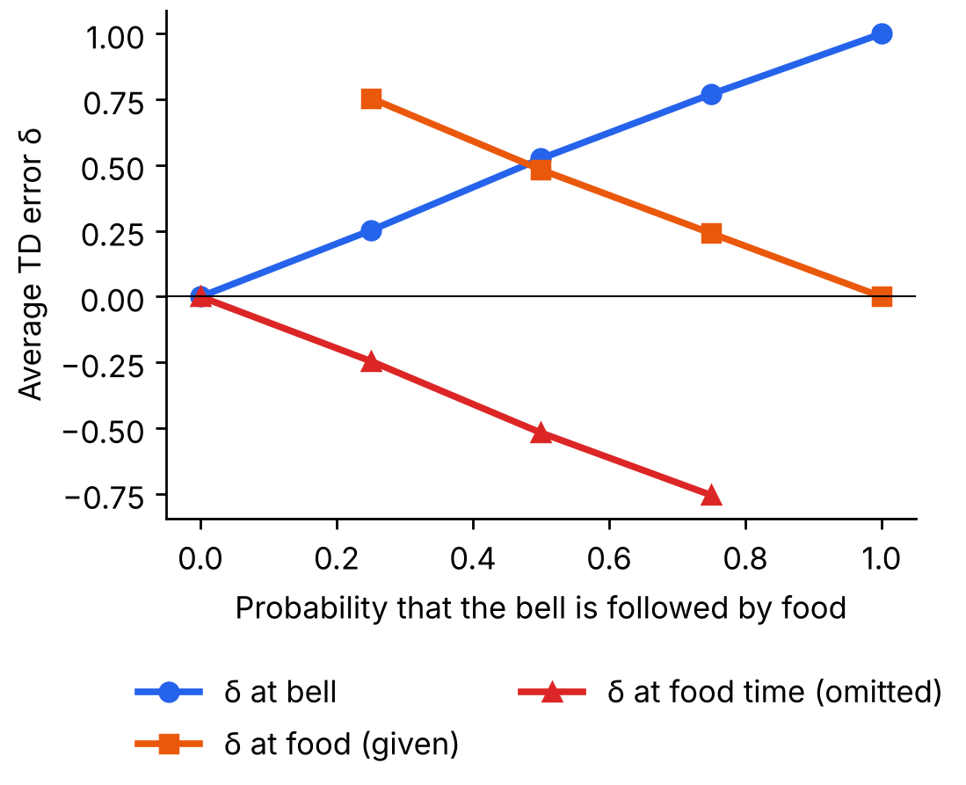
Backup: heatmap and reward probability
Over trials the surprise spreads backward from the food to the bell, one step at a time.
The bell response grows with the chance of food; an omitted food dips more when food was likely.
Notes:
EXTRA 1: HEATMAP
Each column is a trial and each row a time step; red means positive surprise. In early trials the only red is at the food (step 8). Over trials the red spreads backward through the steps between food and bell and finally concentrates at the bell (step 2). This backward spread is the core idea of TD learning: the value of a state is learned from the state that follows it.
EXTRA 2: REWARD PROBABILITY
We trained separate agents where the bell is followed by food with probability 0, 0.25, 0.5, 0.75 or 1. The surprise at the bell grows with the probability (about equal to p). When food is given, the surprise at the food is about 1 - p; when it is omitted the dip is about -p. This matches the idea (Fiorillo, Tobler and Schultz, 2003) that dopamine responses scale with reward probability.

Slide 7
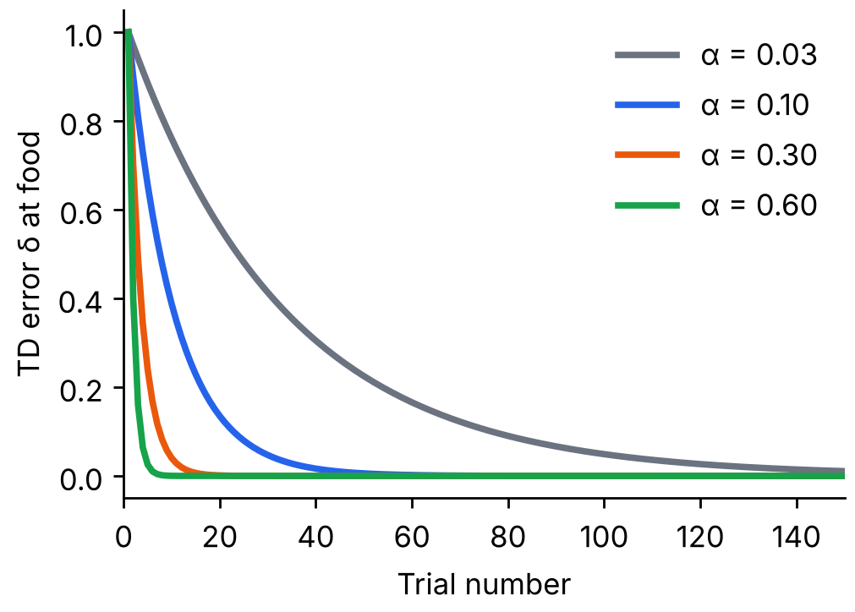
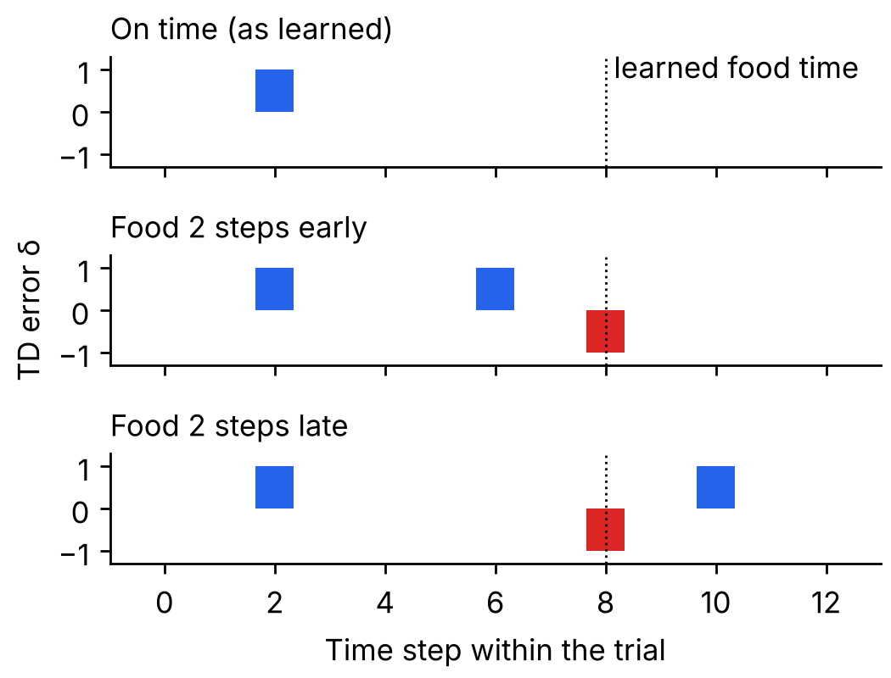
Backup: learning rate and timing
A larger learning rate removes the food surprise sooner: about 100 trials at α = 0.03, about 5 at α = 0.6.
Early food gives a surprise, then a dip at the learned time. Late food gives a dip, then a surprise.
Notes:
EXTRA 3: LEARNING RATE
Alpha controls how far we move toward the new evidence each trial. Trials until the food surprise drops below 0.05: alpha 0.03 about 100, alpha 0.1 about 30, alpha 0.3 about 10, alpha 0.6 about 5. Larger alpha learns faster, but in noisy settings a very large alpha makes the estimate jumpy.
EXTRA 4: TIMING
After learning, we deliver the food 2 steps early or 2 steps late. Early food: positive surprise at the early time, then a negative dip at the time it used to arrive. Late food: a dip at the learned time (food missing), then a positive surprise when it finally arrives. This matches the timing sensitivity reported for dopamine neurons (Hollerman and Schultz, 1998).

