Slide 1

Whatever Happened to the Endangered Species of Texas?
Mason Womble

Slide 2
The database and its purpose
This database consists of the names several species of animals, their taxonomy, how threatened they are, and what factors are threatening them.
This is information and application would be useful for ecologists who are interested in studying the species of Texas, as well as for conservationists who are looking to address these causes.

Slide 3
A shift in focus
The initial proposal honed in on locational data and where these endangered species lived, but that idea proved to be taken.
Now, data and application focused on the main cause as to why they are threatened.

Slide 4
Sources of data
The Texas Parks and Wildlife Department (TPWD) database provided taxonomy and both scientific and common names
The International Union for the Conservation of Nature (IUCN) Red List provided empirical data on threats to the relevant species.

Slide 5

Discrepancies
The IUCN Red List and the TPWD have different rating systems for how threatened a species is.
SPROT is binary, either “threatened” or “endangered”, where as the IUCN uses a broader range.
Since this application focuses on specifically species in Texas, we used the SPROT rating system, which is the subnational protection/listing status

Slide 6
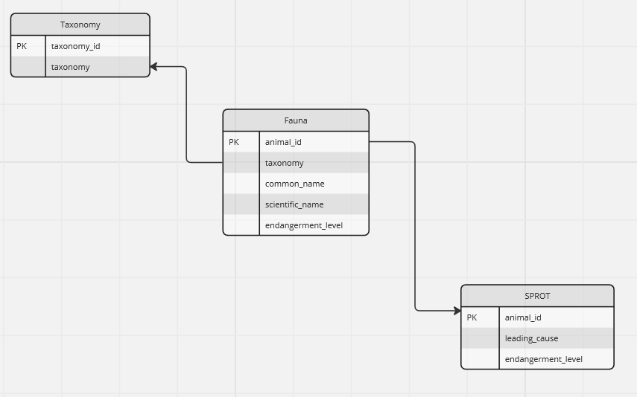

Slide 7

Thank you for listening

