Slide 1
Origin of Crisis
Global savings glut drove down world interest rates
Leverage
Insurance?
Credit default swaps
Agency
Liquidity
Liquidity + Leverage => “Tight Coupling”
Crisis when leverage works in reverse
Housing problems are the spark

Slide 2
Housing
Where did housing and subprime crisis come from?

Slide 3
Credit Default Swap
Derivative used to swap risk
Purchase of insurance against credit risks
E.g., default
Advantage
Exposure to risk that does not require cash outlay
Works fine if defaults are independent
As of April 2008, $62 trillion in outstanding contracts
More “insurance” than outstanding assets insured
In liquidity crisis, asset sales drive out liquidity, reduce value of all assets => no insurance

Slide 4
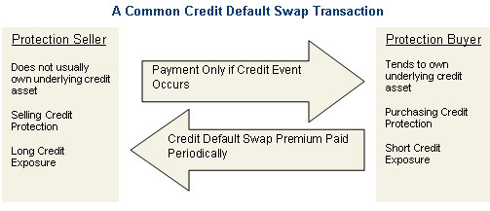
Credit Default Swap

Slide 5
Efficiency versus Flexibility
An efficient system may reduce flexibility
An inefficient system may be more adaptable
Cockroach
Responds to puffs of air, can survive nuclear holocaust
Simple system may survive shocks
Efficient systems may not respond to environmental change
Furu
Long adaptation in Lake Victoria
Perished when Nile perch introduced

Slide 6

Furu and Perch

Slide 7
The Furu
Among the furu were multiple species of insect-eaters and prawn-eaters, mud-biters and algae-scrapers, snail-crushers and snail-shellers, leaf-choppers and zooplankton-eaters, cleaners and scale-scrapers, fish-eaters galore, and a group of 13 species know as pedophages, "child-eaters," dining on the embryos or fry of other furu. Within each group even more narrow specialties emerge. Among the pedophages, for instance, some are rammers, which bash a mouth-brooding female so she opens her mouth and releases her young to be gobbled up

Slide 8
Lesson
Efficient financial system innovated
Created new ways to share risks
Used leverage
Agency induced lots of risk-taking
Financial development has raised fragility
by increasing complexity,
and by forging tighter links between various markets and securities, making them dangerously interdependent.
System was not flexible
Toxic assets
Regulation did not help
Capital requirements led to SIV’s and off-balance sheet
Piling regulations on fragile system does not enhance safety
Chernoybyl
Tightly coupled systems mean one error can cause chain reaction

Slide 9
Short Sale Restrictions
Short sales involves borrowing security
Effectively increases supply
Brings information to market quicker
If fundamental price is below market price, it hastens price adjustment
Short sellers more abundant when price opinions are more divergent
Key point: informed traders more likely to sell short
Key point: short seller must pay dividends to broker
So hard to profit if return is positive on stock

Slide 10
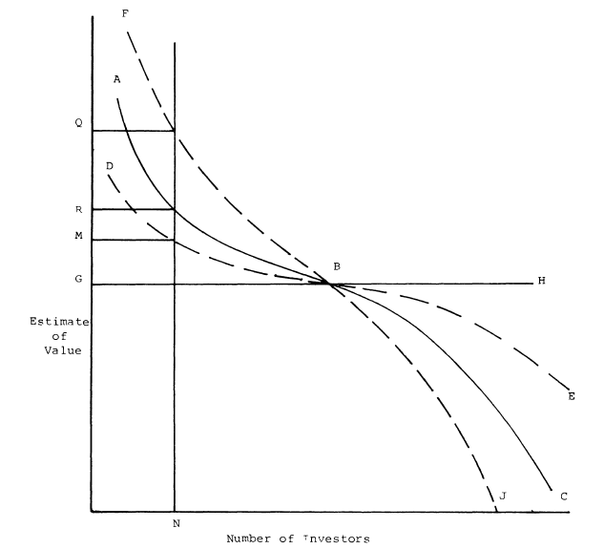
Market Price and Divergent Opinion

Slide 11
Short Sales and Prices
When short sales are prohibited information is absorbed more slowly
Suppose that , that is price is overvalued
Eventually, prices fall to fundamentals
With no short sales this takes longer, t₂ > t₁
During the interim, insiders can loot the firm
=> less for creditors
=> market will be less liquid

Slide 12
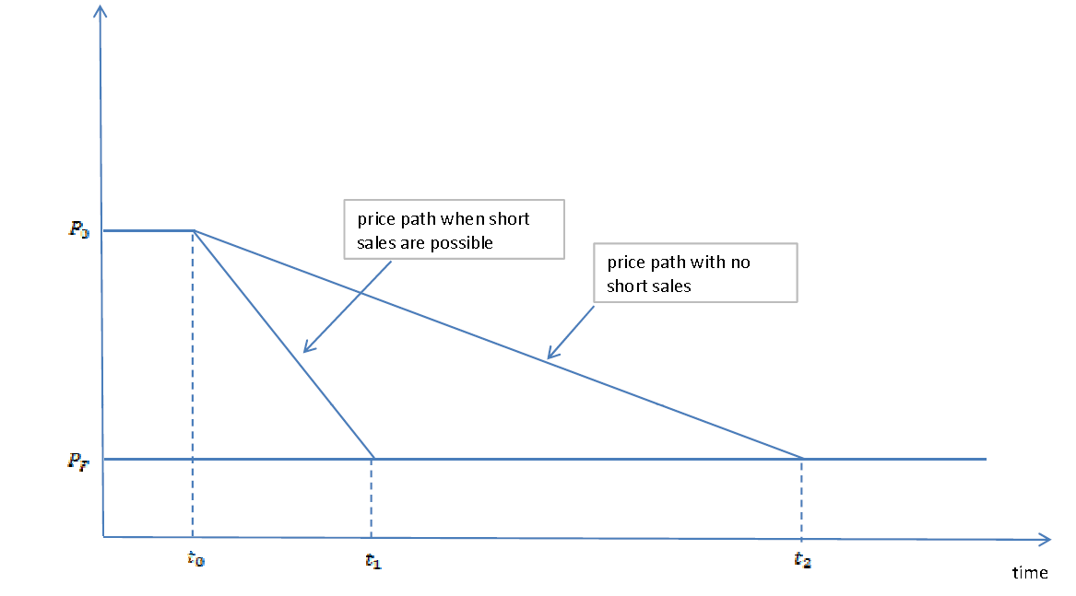
Short Sales and Prices

Slide 13
Synthetic Shorts
Can you get around the ban using options?
Buy a put and sell a call that are in the money
If price falls you benefit on both sides
But there may be restrictions on buying the call option if you don’t hold the stock
Moreover, the ban on shorts means the seller of the put cannot hedge
So the put premium rises and cost of shorting rises

Slide 14
Corporate Bond Yields and Treasury Bonds

Slide 15
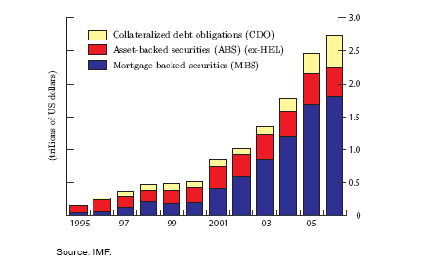
Securitization of Bank Credit Risk

Slide 16
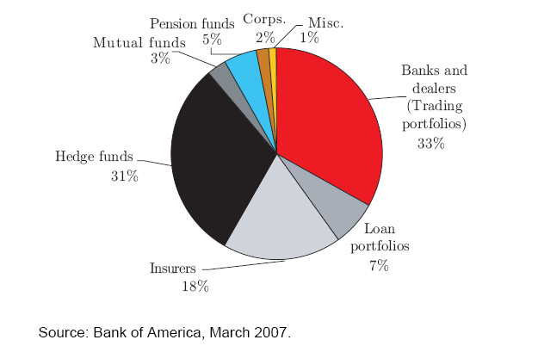
Buyers of CDS Protection

Slide 17
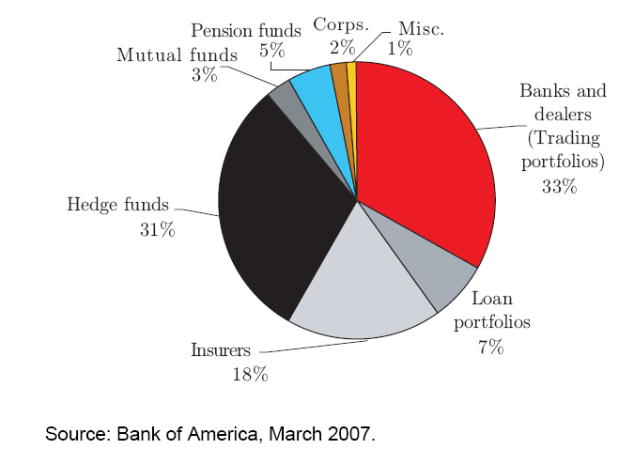
Sellers of CDS Protection

Slide 18
Why?
Benefit
Diversication and a reduction in the costs of raising external capital for loan intermediation
Increase leverage to lend more
Economize on capital
Focus on intermediation
Costs
Lemons premium
Moral hazard cost
Due to inefficient monitoring

Slide 19
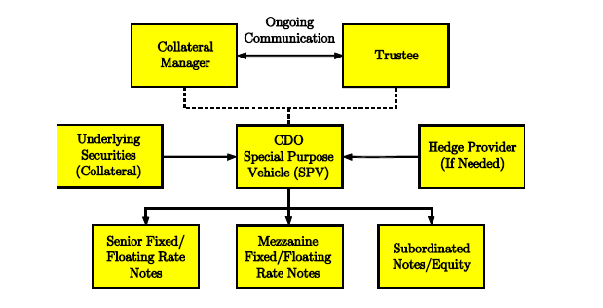
A Typical CDO

Slide 20
CDO’s
Moral Hazard plus lemons => retention of some debt by lender
Explains some of the “trash held” by RSG Bank
This demonstrates to investors a degree of confidence in, or commitment of effort for, low default losses.
Tranches may also satisfy demand for different risk classes
Create high quality debt instruments for sovereign wealth funds
CDO’s reduce entry barriers to finance and thus lower cost of financing
Efficiency effect
But they also raise the fragility of the system as we see
Biggest problem is modeling of default correlation

Slide 21
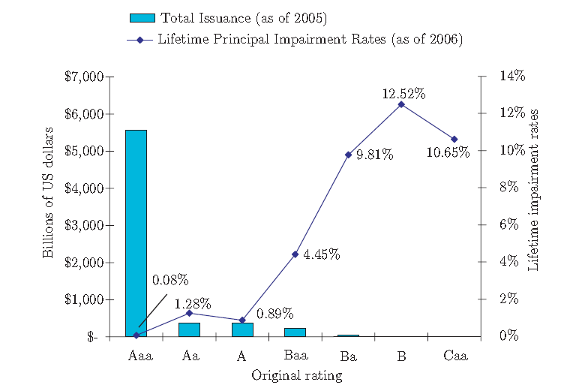
Structured Finance: outstanding issuance and impairment rates by rating

Slide 22
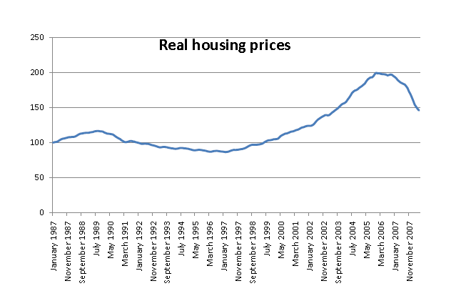
Real Housing Prices

Slide 23
Fundamental Points about Crisis
Why were banks so vulnerable to problems in the mortgage market?
substantial amounts of mortgage-backed securities with exposure to subprime risk were kept on bank balance sheets
Problematic because banks are financed with short-term borrowing that needs to always be rolled over
As the housing market deteriorated, the perceived risk of mortgage-backed securities increased, and it became difficult to roll over short-term loans against these securities.
When banks tried to sell assets the values plummeted, perhaps even below fundamental values
=> funding problems led to fire sales and depressed prices

Slide 24
Leverage and Liquidity
Banks are leveraged and require short-term financing
Not the best place to hold tranches of CDO’s
But agency problems required it
Bad incentives encouraged it
Housing problems led to valuation problems
Led to difficulty in rolling over financing
Leads to general credit crisis

Slide 25
Implications for Bailout
Fire started in housing, but the problem became severe because of leverage
insufficient securitization
If banks had sold more of the cdo’s to unleveraged institutions there would not have been feedback effects
Since asset values fall below fundamental values there is reason to think that a bailout can stabilize prices of these assets
Any solution has to reverse de-leveraging

Slide 26
Why Can’t the Marked Do it?
Why do we need a bailout? Why won’t private investors buy up the cheap assets?
Failure of arbitrage
Suppose you buy and hold today
You profit if you can hold since P^{F} > P_{today}
But price at next margin call may be lower
If leveraged this could be too risky
Hedge funds borrow to invest, investors may pull out if short-term returns tank
Only sufficiently rich investor can hold
In this case, US Government

Slide 27
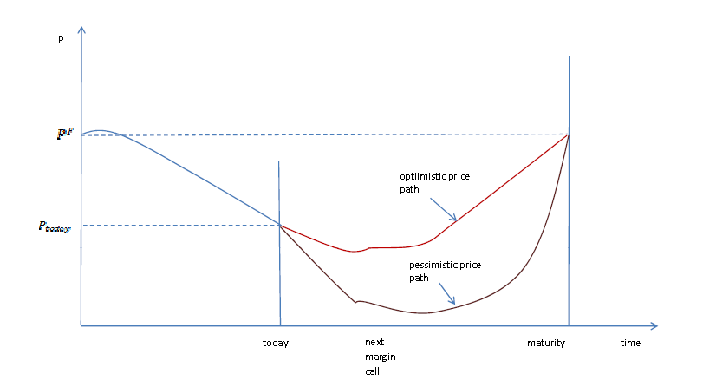
Potential Price Paths

